Slide 1
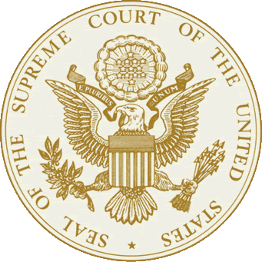
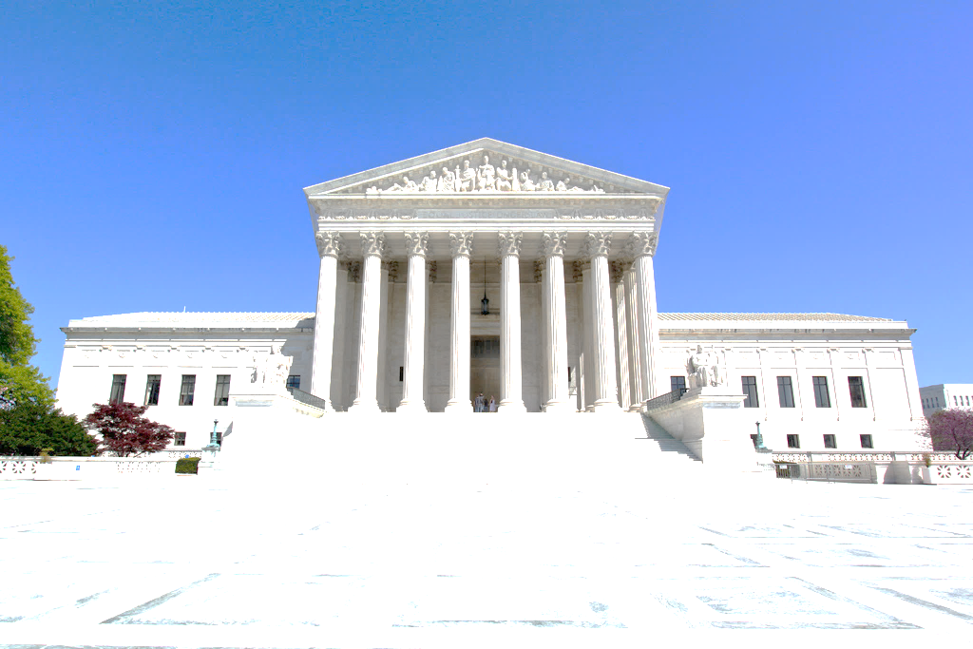
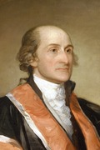
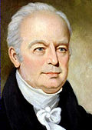
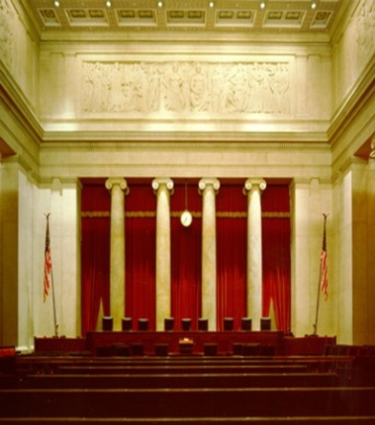
The Federal Judiciary
Objectives:
explain the concept of judicial review;
analyze the development of the federal court system;
describe the structure, jurisdiction and operation of the federal courts;
explain how the federal courts exercise power and what are the checks on that power.

Slide 2
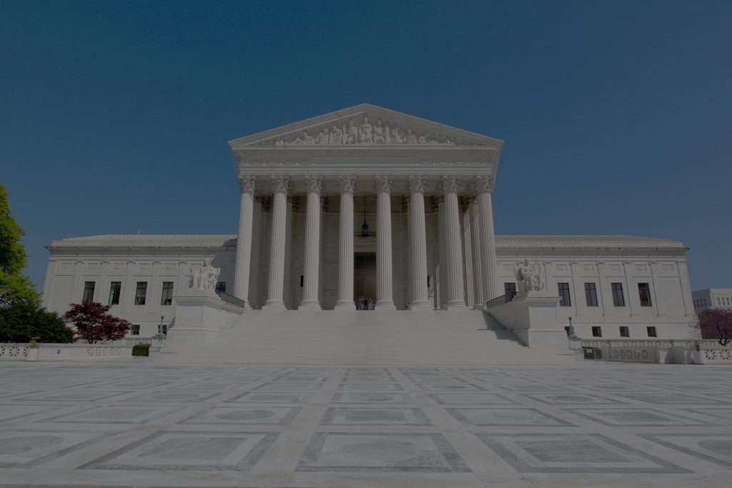
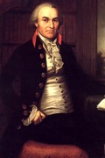
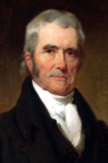
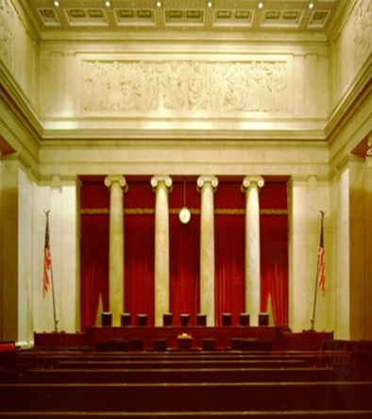
Terms, Terms and More Terms
Dual system of courts: In our court system, we have both federal and state courts
Types of Law:
Statutory Law: deals with written statutes (laws).
Common Law: judges make decisions based on unwritten law (precedents)
Judges rely upon the principle of stare decisis ("let the decision stand")
Criminal Law: concerns violations of laws (murder, etc.)
Civil Law: concerns disputes (torts) between two parties rather than violations against society.
Examples: breach of contract, slander, medical malpractice.

Slide 3
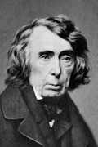
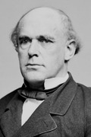
Terms, Terms and More Terms
Judicial Review – power to interpret the constitution
Constitutional Law: A court decides if law/action conflicts with the Constitution
Justiciable Dispute –
Judicial power is passive
Courts cannot reach out and "take" cases; Cases must come to them
There must be an actual case (“controversy”) for a court to make a ruling through legal means.

Slide 4
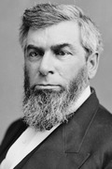
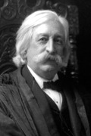
Intro to the Court System
Judicial law-making:
Judges are not impartial referees who only carry out the law
Judges interpret the law, and in so doing in a way make law
It is necessary that they make/interpret law because:
Statutes are often broadly-worded, unclear, or contradictory
The Constitution is broadly-worded, needing interpretation

Slide 5
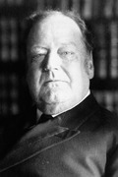
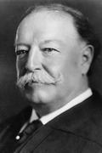
Terms, Terms and More Terms
Criminal Law Participants:
Defendant - the party being charged with a crime
Prosecution – the government—proves guilt of defendants
Grand Jury – decide if enough evidence enough evidence exists to formally accuse person of committing crime
Civil Law Participants:
Plaintiff - the party bringing the charge/complaint
Defendant – person being sued
Criminal & Civil Law Juries:
Petit Jury - the people (normally 12) who often decide the outcome of a case

Slide 6
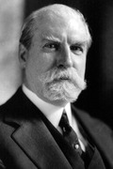
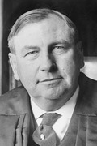
The Nature of the Judicial System
Participants in the Judicial System
Attorneys:
6th Amendment & Gideon v. Wainwright (1963) only guarantees legal counsel to defendant in criminal cases!
Access to quality lawyers is not equal
How Groups can influence courts
Class-Action Suit: lawsuit seeking damages for “all persons similarly situated”
Users of particular products
Fight for civil rights
Use the courts to try to change policies if other branches are too slow!
NAACP used courts in the 1950s & 1960s
Amicus Curiae briefs are used to influence the courts
A brief submitted by a “friend of the court”

Slide 7
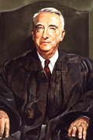
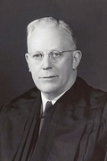
Nature of the Judicial System
Plea Bargain: Defendant pleads guilty to lesser crime—govt. doesn’t prosecute the more serious crime
Prevents case from going to trial which limits # of criminal cases that go to court
80-90% of all criminal cases end in plea bargain
Controversies of Plea Bargains:
Defendant gives up many due process rights (specifically 5th Amendment rights)
Guilty plea stays on your record—can lose many benefits

Slide 8
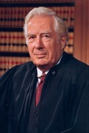
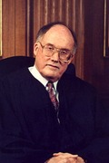
Intro to the Federal Courts
The Judicial Branch comprises all FEDERAL courts.
There are three levels:
Supreme Court
Appellate Courts (Court of Appeals; 12 and D.C.)
Federal District Courts (94)

Slide 9
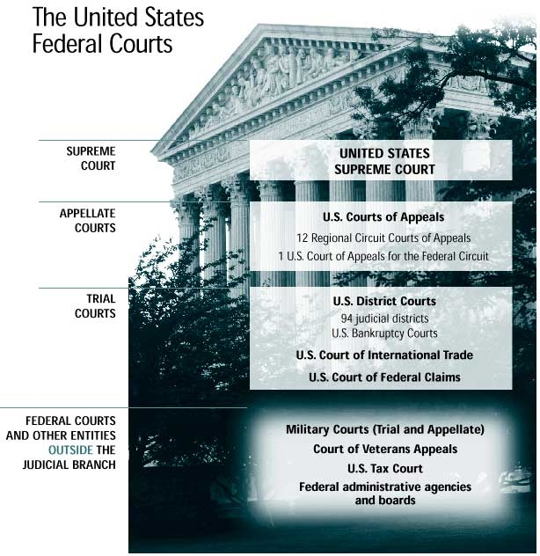
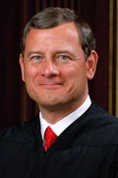

Slide 10
Jurisdictions
Four types:
Exclusive: sole authority of a federal court to try a case
Federal courts may try a case if it involves:
The Constitution, a federal law, or a treaty
Admiralty law (matters on high seas) or maritime law (matters on land but relating to water)
Disputes between two or more states
The U.S. government as a party
Citizens of different states
Ambassadors or diplomats
Concurrent: authority of both a federal and a state court to try a case
Original: authority of a court to first try a case
Appellate: authority of a court to hear a subsequent appeal—review if lower court correctly applied law

Slide 11
Federal Court Structure
Structure of the federal court system
Two types of federal courts
Article I (legislative, or special) courts:
Created to carry out the enumerated powers of Congress
Judges in these hold fixed, not life, terms of office
Examples of these courts:
Claims Court: hears lawsuits against the federal government
Court of Military Appeals
District of Columbia Courts

Slide 12
Federal Court Structure
Article III (constitutional) courts:
Article III of the Constitution deals with the judiciary, and creates a Supreme Court
Congress regulates the structure of the Federal court system (3 levels)
i.e.: power to create "inferior" (lower) courts
Judiciary Act of 1789 – Establishes three levels of courts & set the number of justices on SC at 6 (expanded to 9 in 1869)
These three levels of courts form the main basis of our federal court system.
Judges in these courts hold life terms (Federalist #78)
3 Levels of Constitutional Courts:
District Courts
Appeals Courts
Supreme Court

Slide 13
Federal District Courts
District Courts:
Hold Original Jurisdiction: hear the case first and determine the facts = the trial court
Cases are tried by a judge and jury.
Use grand juries to issue indictments (orders that charge an individual with a crime. Does not mean that one is guilty; it merely means that one will be tried)
A petit (trial) jury decides the outcome of a case
May try civil, criminal, or constitutional cases
Decisions may be appealed to Courts of Appeals

Slide 14
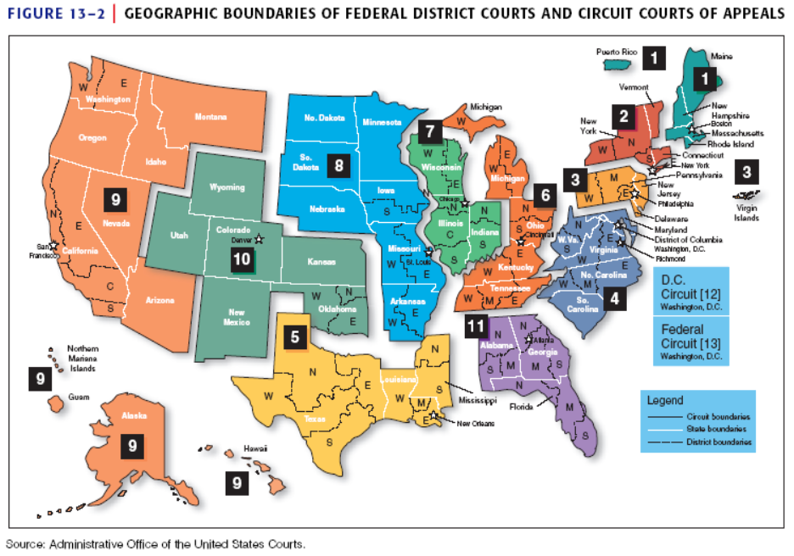

Slide 15
Courts of Appeal
Courts of Appeals (Circuit Courts).
13 of these courts, spread out in 13 districts, or "circuits."
156 judges try > 18,000 cases a year.
Cases tried by a panel of 3 judges
Appellate Jurisdiction: hears appeals from District Courts and regulatory commissions
Decisions may be appealed to the Supreme Court.

Slide 16
The Supreme Court
The Supreme Court
9 justices: 1 Chief Justice, 8 Associate Justices
Rarely Original/MostlyAppellate jurisdiction:
Supreme Court decides which appellate cases it will hear (only court that has this power)
About 10,000 cases appeal – only takes around 80
Most cases come from the federal courts
Most cases are civil cases
Court of last resort
Supreme Court is the final arbiter of the Constitution
Supreme Court decisions establish precedents that are binding on the entire nation

Slide 17
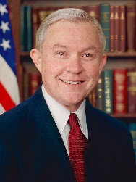
Other Players
Attorney General: Jeff Sessions
Appointed by President w/Senate
consent
Head of Justice Department
Solicitor General:
Appointed by President w/Senate consent.
Represents U.S. government in Supreme Court.
Decides which cases the federal government will appeal to the Supreme Court.
Decides the federal government's position in these cases.
Sometimes called the “10th Justice” of the Supreme Court because of his/her influence there.

Slide 18
Other Players in the Federal Court System
U.S. Attorneys:
At least one for each District Court, 94 in all
Prosecutes federal criminal cases before the District Courts and Courts of Appeals, though most cases are settled by plea-bargaining
Represents U.S. government in civil cases before these same courts
Appointed by the President for 4-year terms (Key patronage positions)
Senatorial courtesy applies in their appointments

Slide 19
Other Players
All Federal Judges:
Appointed by President with “advice and consent” of Senate
Article III states that they shall hold their offices "during good behavior," i.e., for life
Why? – allows judges to be free from political pressures when deciding cases (don’t have to worry about being re-elected)
Advantages of life terms – Experience; Stability; No fear of removal for decisions; Interest groups have little influence
Disadvantages of life terms – Judicial activism; older court; ideology/slow to change
They can be impeached and removed by Congress (very rare -- only a handful of removals in 200 years).
Compensation: Determined by Congress, but compensation cannot be lowered during judges' terms of office.

Slide 20
Selecting Federal Judges
President Nominates federal judges:
Senatorial courtesy: When appointing District Court judges, the President usually consults with the two Senators from the state in which the judges are to be appointed = Senators have the “courtesy” of consulting with the president
Court of Appeals & Supreme Court nominations rarely receive this “courtesy”
Senate Judiciary Committee:
Screens the nominees, and sends a recommendation to Senate floor for approval or rejection.
Has become more of a media circus (we will look at this later)
Politics plays a big role in this step
Senate: Majority vote needed for confirmation
Has refused to act upon or rejected, less than 20% of Supreme Court nominees in the 20th century

Slide 21
Choosing a Judge/Justice
Nominee Factors:
Political Ideology plays an important role when president chooses justice
Party Background - Generally of the same political party as the appointing president
“Litmus Test” – Abortion, Role of Government, etc.
Judicial experience
Diversity
Senate approval/Senatorial Courtesy
Almost all federal judges have
Had legal training
Held positions in government
Served as lawyers for leading law firms
Served as federal district attorney
Served as law school professors

Slide 22
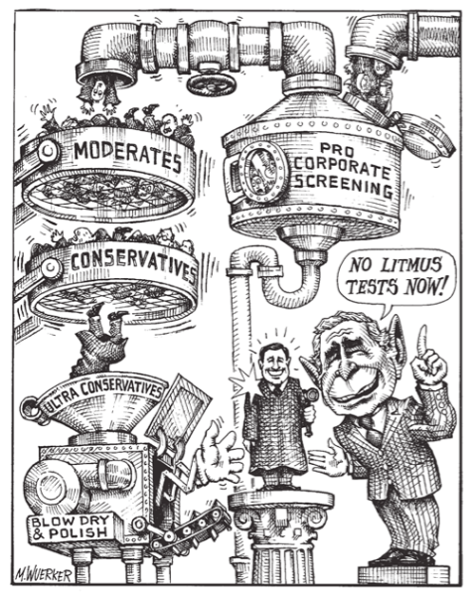
“Litmus” Test
Presidents and their advisors may apply a "litmus test" to a potential nominee
Candidate chosen if their views are liberal or conservative on a single, divisive issue (abortion, gay marriage, privacy, etc.)
IDEOLOGY = Crucial in determining nominee!
Senators often use their own “litmus tests” to determine support

Slide 23
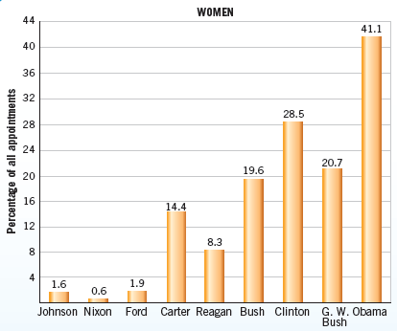
Female Judicial Appointments 1963-2013

Slide 24
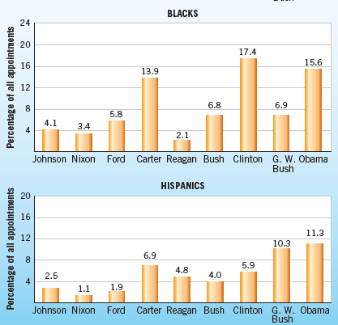
Minority Judicial Appointments 1963-2013

Slide 25
Senate Confirmation Process
Senate Judiciary Committee asks tough questions
Their vote decides if nominee will go to entire chamber
Recent Examples:
Robert Bork (1987) - Rejected
Clarence Thomas (1991)
John Roberts (2005) - our current Chief Justice
Samuel Alito (2005)
Sonia Sotomayor (2009)
Elena Kagan (2010)
Neil Gorsuch (2017)

Slide 26
How Cases reach the United States Supreme Court
Option A.
Original Jurisdiction of the Supreme Court
Option B.
Appellate Jurisdiction of the Supreme Court (Federal Route)
Option C.
Appellate Jurisdiction of the Supreme Court
(State Route)
* Cases involving
foreign diplomats
* Cases involving a state:
- between the US and a state
- between 2 or more states
- between a state and a foreign country
* US Court of Appeal
* Court of Appeals for the Federal Circuit
* Legislative Courts
* Last Resort for State Courts

Slide 27
Supreme Court at Work
Term of the Supreme Court begins on the first Monday in October and generally lasts until June or July of the following year
Accepting Cases
Use the “Rule of Four” to choose cases
Issues a writ of certiorari to call up the case
Writ of Certiorari: A decision by the Supreme Court to hear an appeal from a lower court. Most cases come to the Supreme Court via this means
Very few cases are actually accepted each year
80-100 cases are heard each year

Slide 28
Supreme Court at Work
Hearing the Cases:
Open to the public (limited seating)
Two weeks each month. In April, they adjourn for 2 weeks to consider cases.
When the Court is sitting, public sessions begin promptly at 10 a.m. and continue until 3 p.m., with a one-hour lunch recess starting at noon.
No public sessions are held on Thursdays or Fridays. On Fridays during and preceding argument weeks, the Justices meet to discuss the argued cases and to discuss and vote on petitions for review.
Briefs - Justices receive and review legal briefs before oral arguments
A detailed statement of the facts of the case supporting a particular position by presenting arguments based on relevant facts and citations from previous cases
Look over amicus curiae briefs - “Friend of the Court” briefs
Oral Arguments - Each side only receives 30 minutes to present their case
Justices may interrupt lawyers with any questions that they want to ask

Slide 29
Supreme Court at Work
4. Deciding the Case - after meeting in private…
Majority Opinion: official opinion of the court—explains the view of the justices who agree with decision
Dissenting Opinion: written by justices who oppose the majority
Concurring Opinion: written in support of the majority’s conclusion but stress a different legal basis
Per Curiam Opinion: brief, unsigned opinion
Unanimous Decision: All justices agree
In the event of a 4-4 tie in the Supreme Court, the lower court's decision stands.
Purposes of opinions:
Communicate the Court's reasoning to the public.
Establish precedents for future cases -- importance of stare decisis – let the decision stand
Makes future SC decisions uniform, predictable, and efficient
Drop "hints" that Congress, the states, or the President should take certain actions

Slide 30
Supreme Court at Work
Implementing Court Decisions:
Must rely on others to carry out decisions
Power of Precedent:
Case decisions become standards for later similar cases
Only the Supreme Court can reverse precedents
Ex. Brown v Board of Ed. reversed Plessy v Ferguson

Slide 31
Courts Through History
Early Court History
The Marshall Court (Chief Justice John Marshall 1801–1835) declared the Court to be the supreme arbiter of the Constitution (see Marbury v. Madison), and made a number of important rulings which gave shape and substance to the Constitutional balance of power between the Federal government and the states (McCullough v. Maryland, Gibbons v. Ogden)

Slide 32
Courts Through History
The Taney Court (Chief Justice Roger B. Taney 1836–1864) made a number of important rulings, such as Sheldon v. Sill, which held that while Congress may not limit the subjects the Supreme Court may hear, the Constitution does not so restrain it where lower courts are concerned. However, it is primarily remembered for its ruling in Dred Scott v. Sandford, the case which may have helped precipitate the Civil War.

Slide 33
Courts Through History
In the years following the Civil War, the Chase, Waite, and Fuller courts (1864–1910) interpreted the new civil war amendments to the Constitution, and developed the doctrine of substantive due process
Lochner v. New York: prohibited individuals from working in bakeries for more than ten hours per day or sixty hours per week, ruled unconstitutional.

Slide 34
Courts Through History
Under the White and Taft (former president) courts (1910–1930), the Court held that the 14th Amendment applied some provisions of the Bill of Rights to the states (Gitlow v. New York: freedom of speech applies to state and local governments). They also ruled on cases involving the role of business and government.

Slide 35
Courts Through History
After 1936, the court stopped imposing any restrictions on the state and federal government to regulate the economy.
FDR’s Court Packing Plan
Justice Owen Roberts started to approve of the New Deal programs
He yielded to public opinion to keep the New Deal programs intact
Known as “the switch in time that saved nine”

Slide 36
Courts Through History
The Warren Court – Modern Court Era Begins
The Warren Court (1953–1969) made a number of alternately celebrated and controversial rulings expanding the application of the Constitution to civil liberties, leading a renaissance in substantive due process.
It held that segregation was unconstitutional (Brown v. Board of Education),
That the Constitution protects a general right to privacy (Griswold v. Connecticut)
That schools cannot have official prayer (Engel v. Vitale) or mandatory Bible readings (Abington School District v. Schempp)
Dramatically increased the scope of the doctrine of incorporation (Mapp v. Ohio; Miranda v. Arizona)
Read an equal protection clause into the Fifth Amendment (Bolling v. Sharpe)
Held that the states may not apportion a chamber of their legislatures in the manner in which the United States Senate is apportioned (Reynolds v. Sims)
Held that the Constitution requires active compliance (Gideon v. Wainwright).
Often said to be the “most liberal court ever”

Slide 37
Courts Through History
The Burger Court (1969–1986)
Ruled that abortion was a constitutional right (Roe v. Wade)
Reached muddled and controversial rulings on affirmative action (Regents of the University of California v. Bakke)
And campaign finance regulation (Buckley v. Valeo)
That the death penalty was unconstitutional (Furman v. Georgia) and then later that it was not unconstitutional (Gregg v. Georgia).
More conservative court than Warren

Slide 38
Courts Through History
The Rehnquist Court (1986–2005) had created a majority of conservative jurists, but still was unable to rule conservatively on a few issues. There was a strong focus of ownership rights and a limit on the power of the federal government.
The court set some limits on affirmative action, student free speech, personal litigation, while expanding the power of corporations and increased religion in public schools, as well as school vouchers.
Generally it upheld, but set limits on abortion rights, affirmative action, and other controversial decisions made by previous courts.

Slide 39
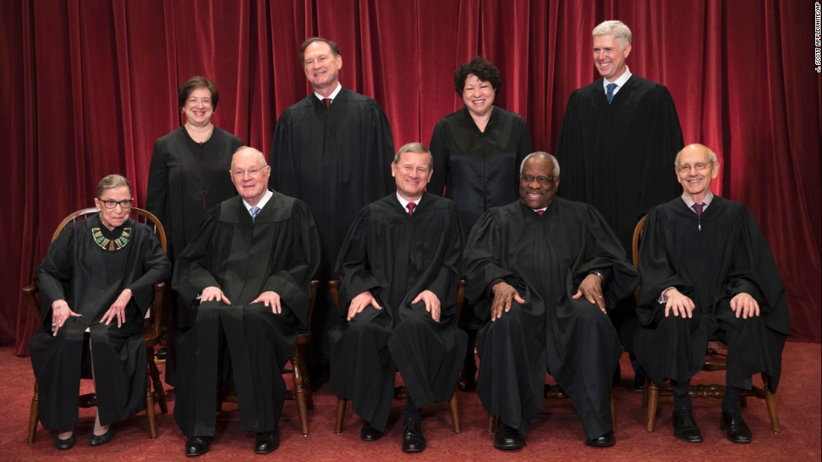
Current Court
The Roberts Court (2005 - )
Chief Justice John Roberts (G. W. Bush)
Justice Anthony M. Kennedy (Reagan)
Justice Clarence Thomas (G. H. W. Bush)
Justice Ruth Bader Ginsburg (Clinton)
Justice Stephen G. Breyer (Clinton)
Justice Samuel Alito (G. W. Bush)
Justice Sonia Sotomayor (Obama)
Justice Elena Kagan (Obama)
Justice Neil Gorsuch (Trump)

Slide 40
Judicial Philosophy
Regarding Policymaking:
Judicial restraint: judges should play a minimal policymaking role - leave policymaking to the legislative branch
Justice Antonin Scalia “The Constitution is not an empty bottle…it is like a statute, and the meaning doesn’t change.”
Judicial activism: judges should sometimes make bold policy decisions—sometimes charting new constitutional ground & overturning laws
Former Justice Charles Evan Hughes: “We are under a Constitution, but the Constitution is what the judges say it is.”
Regarding the Interpretation of the Constitution:
Strict Interpretation: judges should base decisions on a narrow interpretation of the Constitution
Tend to be Conservative Justices
Loose Interpretation: judges should have considerable freedom in interpreting the Constitution
Tend to be Liberal Justices

Slide 41
Checks and Balances
Executive checks:
Courts have no enforcement power; the president/bureaucracy must enforce decisions
In rare cases a president refuses to implement a decision (Worcester v. Georgia (1832) “Trail of Tears”)
Power of judicial appointments (short term check)
Legislative checks:
Congress may alter the structure of the court system (# of courts, # of justices)
Congress can impeach & remove judges
Senate confirms appointments of judges/justices
Rewriting laws that were unconstitutional
Constitutional amendments can overrule court decisions
Rare (need 2/3 of each chamber) & 3/4 of states to agree!
SC declared federal income tax unconstitutional.
The Sixteenth Amendment was added to make it constitutional for Congress to pass an income tax.

Slide 42
Other Checks
Public Opinion
How is the Supreme Court affected?
Appointment/confirmation process—must please president & senators
Rely on other institutions to enforce decisions
New laws/amendments can overrule decisions
Justices can be impeached (rare!!)
Congress can change appellate jurisdiction & # of justices on the court
Most changes in the Court come from changes in personnel (not from Congress)
Over many years, future courts can alter previous precedents
Ex: Roe v. Wade (1973) was altered by Planned Parenthood v Casey (1992)
How is the Supreme Court insulated from politics?
Justices serve life terms
Don’t face reelections
Create its own docket of cases to hear

Slide 43
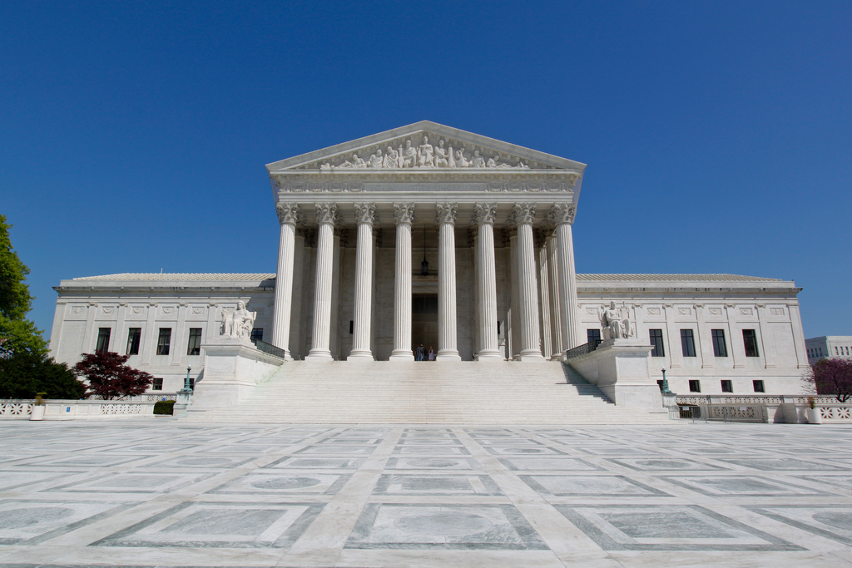
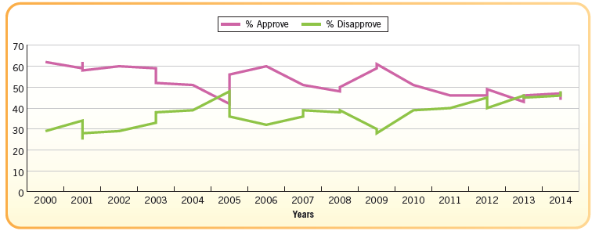
Public Approval of the Supreme Court’s Performance, 2000–2014

