Slide 1
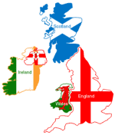
Great Britain- Public Policy and Current Issues
AP Comparative Government

Slide 2
The Government and the Economy
The British economy is historically rooted in liberalism, a philosophy that emphasizes political and economic freedoms for the individual and the market
This liberalized form of economy has gone through many transformations through English history
After World War II and through the 1970’s England practiced a collective consensus philosophy
This was based on social democratic values that support a great deal of government control in the economy
The approach used is called Keynesianism and in this system the government takes action to secure full employment, expand social services, maintain a steady rate of growth, and keep prices stable

Slide 3
The government and the economy
When Margaret Thatcher took over as PM, she instituted the idea of neo-liberalism
This is a revival of the old political and economic philosophy of neo-liberalism
She pushed towards a free market economy and denationalization of industries.
Thatcher and her successor John Major, based their economic policy on Monetarism
This is the idea that there is natural state of unemployment determined by the labor market itself and that state intervention into the economy should be limited to a few steps to foster appropriate rates of growth in the money supply and keep inflation low
These policies were largely based upon the ideas of a laissez-faire economic model

Slide 4
The Government and the Economy
Under Tony Blair (1997-2007), and with the help of Gordon Brown, Britain’s misery index was brought to a new low
The misery index looks at inflation and unemployment rates
They were also able to keep taxes static while increasing welfare programs that improved living standards in England
The global recession of 2008 however derailed the success of Gordon Brown and led to the eventual defeat of the Labour party
Under David Cameron, former PM, the Big Society program was started
This program looked for private companies, charities, and employee-owned groups to have a bigger role in society and in the process of shaping policy
Austerity
Series of reductions in public spending intended to cut welfare and other public institutions in response to the economic crisis
Austerity programs were supposed to end in 2016, but have been extended until 2018

Slide 5
Health Care Issues
Austerity and balancing the budget is illustrated by debates over what to do with the National Health Service
Some say it is too expensive to maintain with an aging population
Others say its benefits outweigh the costs
2012 - Health and Social Care Act
Restructuring of the NHS to reduce costs

Slide 6
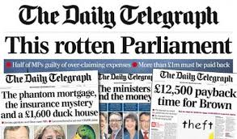
Transparency in Government
In 2009, a great scandal was revealed in Parliament
Members of each party were embezzling funds from Parliament using them to pay for multiple home improvement projects, daily expenses and “second-home allowances”
Reform was called for and then PM Gordon Brown led the movement to increase Parliamentary transparency
British citizens lost much faith in their government because of this scandal
There is transparency within the government though
This is exhibited by the fact that the press had the right to criticize the government for their illegal actions

Slide 7
Relations with the EU
In 1978 Britain entered the Common Market, 21 years after its establishment
The Common Market was the precursor to the EU
The entry of Britain into the CM was brought forth after Thatcher left the government and John Major signed the Maastricht Treaty that created the EU
With entry into the EU, Britain continued to use the British pound
Recent polls show that the percentage of the British public who want to hold on to the British pound has dipped below 50%
In 2013, bowing to pressure from Euroskeptics in his party, Cameron promised a vote on remaining/leaving the EU
The vote was held in 2016 and a majority of voters voted to leave the EU
Led to the resignation of Cameron and to Theresa May as the new PM

Slide 8
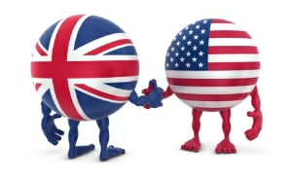
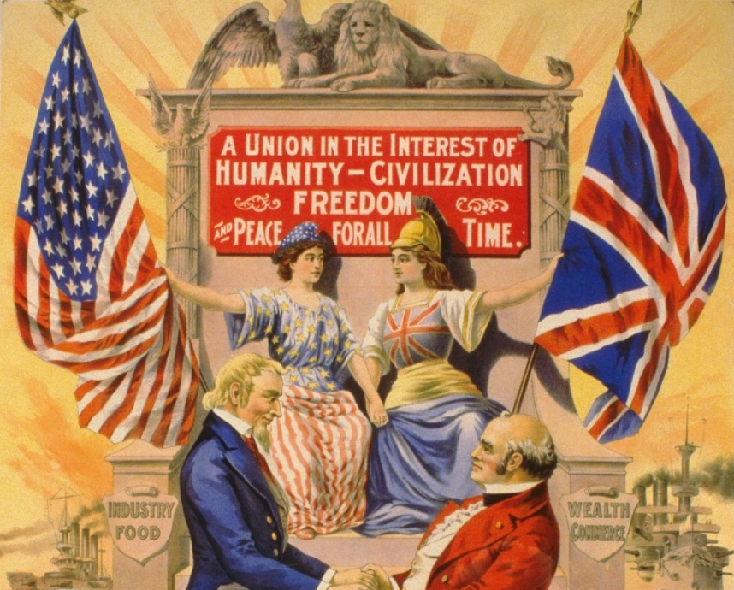
Relationship With the United States
Tony Blair – strongly supported the U.S. invasion of Iraq
Criticized at home and abroad
“Special Relationship”
See each other as crucial allies in building coalitions to deal with international crises

Slide 9
Terrorism and violence
In July 2005, 52 people were killed in London transit bombings (7/7)
In 2006 and 2007 multiple car bombings took place throughout London
In order to combat these terrorist acts MI5 (The British Security Service) has money set aside to stop terrorist activities, a mosque watchdog is in operation, and they are keeping track of suspected terrorists
Under Gordon Brown in 2007, the British government created a program that emphasized non-violence among British Muslims
This program was criticized for its small focus on young Muslim males
About 75% of the energy of the British security services is devoted to stopping terrorism
In 2011, tensions were high across Britain as riots against police violence erupted after the police shot and killed Mark Duggan (an alleged gangster)

Slide 10
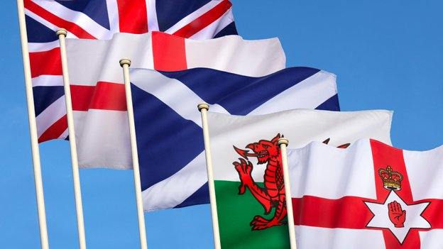
Devolution and Reform
Over the last few decades the British government has started to take part in a process known as devolution
While still being a unitary government, Parliament has started to give Scotland, Wales, and Northern Ireland more independence
This can be seen with Scotland, Northern Ireland and Wales having their own independent parliaments
These parliaments have the power to tax, educate, and participate in economic planning
Scotland even voted in 2013 on a referendum to leave the UK…it failed 55-45%
Devolution has also seen the creation of the office of Mayor of London
The city now has more independence from the central government and its affairs
There have recently been calls from citizens to create a Bill of Rights for citizens, a written constitution, and a new electoral system
A proportional representation was rejected by British voters in 2011

