Slide 1
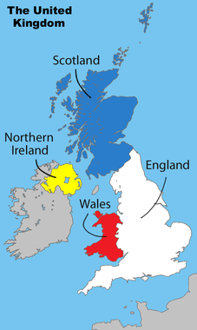
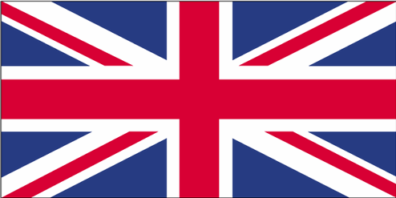
Part 3: Citizens, Society & the State
SPRING 2017

Slide 2
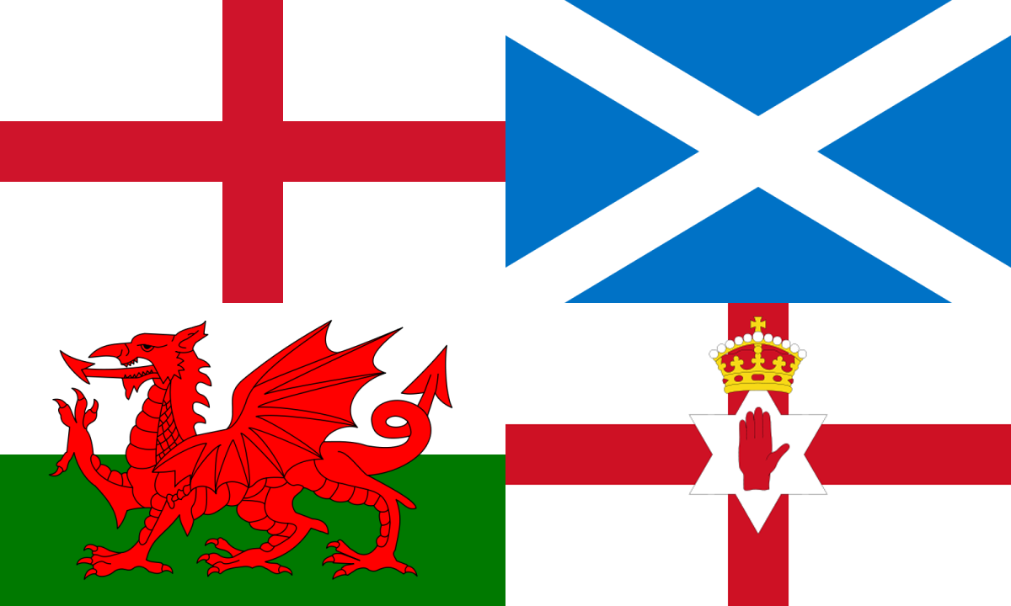
Social Cleavages
For much of British history based on:
Multi-National Identities
English (77%)
This is the largest region of Great Britain and contains the largest population
The British currently have a larger proportion of power throughout the U.K. than do the other entities
Welsh (4.5%)
Wales is west of England and became subject to the English in the 16th century
The Welsh are proud that their language is still being taught in school and still feel some resentment towards England’s rule
They also have their own national flag called the Plaid Cymru
Notes:
Wales
Flag, Welsh Language
Scotland
Strong nat’l identity
National flag, currency, Parliament
Northern Ireland
1949 most of Ireland became a totally independent country and N. Ireland remained under British rule
Protestants/Catholics
Good Friday Agreement: April 1998, Britain agreed to give N. Ireland a regional govt in which all parties would be represented on Proportional Basis

Slide 3
Social Cleavages
Multi-National Identities
Scottish (7.9%)
Scotland joined Britain due to an intermarriage of families in the 17th century
This is despite years of refusing to yield to Britain
Scots still think of themselves as being very different than the British and display their pride with their own national flag and Scottish Parliament
Northern Irish (2.7%)
Religious issues have existed between England and Ireland for centuries
After World War I, Ireland was granted the right of home rule, except for the northeast corner where protestants outnumbered Catholics
The Irish Republican Army (IRA) used guerilla warfare tactics to convince the British to allow Irish independence
In 1949 Ireland was allowed total independence except for the northeast section
Good Friday Agreement: April 1998, Britain agreed to give N. Ireland a regional govt in which all parties would be represented on Proportional Basis
Religion
Catholics (mostly Irish) vs. Protestants (mostly Scottish & English) – primarily before 1998
Notes:
Wales
Flag, Welsh Language
Scotland
Strong nat’l identity
National flag, currency, Parliament
Northern Ireland
1949 most of Ireland became a totally independent country and N. Ireland remained under British rule
Protestants/Catholics
Good Friday Agreement: April 1998, Britain agreed to give N. Ireland a regional govt in which all parties would be represented on Proportional Basis

Slide 4
Social Cleavages
Discussion Question: How has devolution impacted social cleavages: Weakened or strengthened them? How?
UK devolution created:
national Parliament in Scotland (national flag, currency, referendum!)
national Assembly in Wales (Welsh language, flag)
national Assembly in Northern Ireland (Good Friday Agreement in 1998)
Have much more control over regional issues; less likely to separate?

Slide 5
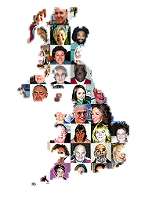
Social Cleavages
More Recently Ethnic Minorities
Only about 7.1% of British pop is of non-European origins:
23% Indian (1.8% of total population)
16% Pakistani (1.3% of total population)
12.2% Afro-Caribbean
10.5% Black African
BUT minority ethnic population grew by 53% between 1991 – 2001
Also, immigrants from Eastern European countries (EU) has increased
About 1 million immigrants since 2004 – 2/3’s Polish
2nd most spoken language in UK – Polish!
Notes:
Immigrants from Eastern Europe:
About 1 million immigrants from 8 central eastern Eur countries that joined the EU in 2004
Poles, who have made up abt 2/3 of the newcomers, are now the largest group of foreign nationals in Britain
Main draw has been better job opportunities

Slide 6
Social Cleavages – Treatment of Minorities
Minorities have experienced some discrimination:
Ethnic minorities disproportionately suffer diminished opportunities
Unequal treatment by police (esp young men)
More than 1/3 of ethnic minority population is younger than 16, nearly ½ is under 25, 4/5 is under 45
Physical harassment by citizens
Marginalization in education, job training, housing & labor
But some have also been very successful
Among men of African, Asian, Chinese & Indian descent, the proportional representation in managerial/professional ranks is actually higher than that for white men
British South Asians (esp Indians) have high rate of entrepreneurship
Notes:
Discrimination
More than 1/3 of ethnic minority population is younger than 16, nearly ½ is under 25, 4/5 is under 45

Slide 7
Social Cleavages
Discussion Question: Based on what you know so far, why do you think Pakistani Muslims have faced more discrimination than other ethnic minorities?
Attacks on 9/11 & 7/7
Largest group of British Muslims come from Pakistan
Muslims have an identity of being a minority distinct from a well-established majority
Many British Muslims are disaffected and unemployed
Lack of integration into British culture
Polls suggest that alienation of minorities, especially Muslims, may be higher in Britain b/c national culture has not absorbed groups into mainstream culture
Muslims may attend classes in full hijab, but many feel treated as 2nd class citizens
Cleavage is coinciding! Ethnicity, Religion, Social Class
Notes:
Pakistani Muslims
Since Osama bin Laden & his companions were found in Pakistan, some scholars think that links of British Muslims to al-Qaeda are stronger
Social Class differences
U.S. many Muslims tend to be well-off, while many British Muslims are disaffected and unemployed
Many Muslims are the children of illiterate workers who slipped in as cheap industrial labor
Lack of Integration
Polls suggest that alienation of minorities, esp Muslims, may be higher in Britain b/c national culture has not absorbed groups into mainstream culture
Muslims may attend classes in full hijab, but many feel treated as 2nd class citizens

Slide 8
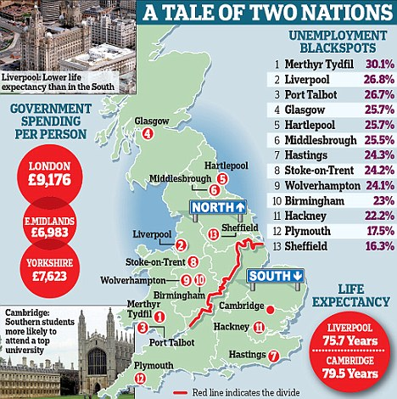
Social Cleavages
Social Class Distinctions
Historically working class vs middle-class
These two classes are not easily divided by income, but are more psychological and subjective
The working class is more focused on keeping the old job, living in the old neighborhood, and keeping close to family and friends
Notes:
Education
Compulsory until age 17 (just raised from 16, will be 18 by 2015), national curriculum
Most important portal to elite classes is through Oxford and Cambridge
Nearly ½ of all Conservative MPs went to Oxbridge, ¼ of Labour MPs
% higher for cabinet positions/PM
More scholarships available for working class BUT Parliament raised min level of tuition to Eng universities from $5,400 to $14, 500 making higher education less accessible to many students

Slide 9
Social Cleavages
Social Class Distinctions
Education (most important portal to elite classes is through Oxford & Cambridge)
Compulsory until age 17 (just raised from 16, will be 18 by 2015), national curriculum
Most MPs went to Oxbridge
More scholarships available for working class BUT Parliament raised min level of tuition to Eng universities from $5,400 to $14, 500 making higher education less accessible to many students
Geographic-Economic
South of England vs north of England, Scotland, and Wales
Wealth and high tech industry centered in South England
Notes:
Education
Compulsory until age 17 (just raised from 16, will be 18 by 2015), national curriculum
Most important portal to elite classes is through Oxford and Cambridge
Nearly ½ of all Conservative MPs went to Oxbridge, ¼ of Labour MPs
% higher for cabinet positions/PM
More scholarships available for working class BUT Parliament raised min level of tuition to Eng universities from $5,400 to $14, 500 making higher education less accessible to many students

Slide 10
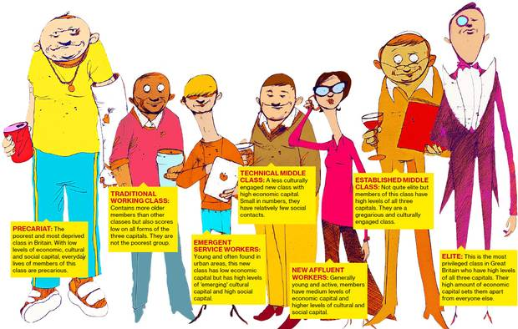
New British Social Classes?
Notes:
Education
Compulsory until age 17 (just raised from 16, will be 18 by 2015), national curriculum
Most important portal to elite classes is through Oxford and Cambridge
Nearly ½ of all Conservative MPs went to Oxbridge, ¼ of Labour MPs
% higher for cabinet positions/PM
More scholarships available for working class BUT Parliament raised min level of tuition to Eng universities from $5,400 to $14, 500 making higher education less accessible to many students

Slide 11
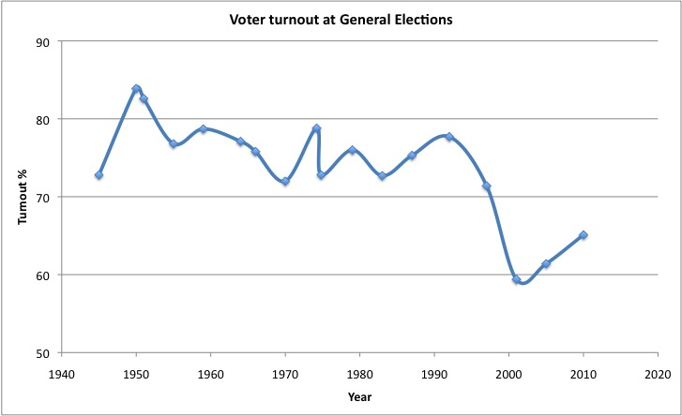
Political Socialization & Participation
Socialization
Family
Schools (civics courses)
Media (BBC)
Participation
Voting – around 70% (down in recent elections)
Voting behavior still tied to social class and region
Social Class: Traditionally the working class has supported the Labour Party and the middle class vote Conservative
Region: Labour – Urban/Industrial areas & Scotland/Wales; Conservatives – Rural and suburbs
Notes:
Interest in politics is low compared to the U.S., while voting rates are higher (U.S. 2012 58%)
Less than 1/5 of population does anything more than vote
Social Movements:
On local level people are more willing to organize around a specific issues, but participation of the active 20% is sporadic
Historic exceptions – women’s suffrage and nuclear disarmament
More Recent Issues: Women’s mvmt on health and children’s issues; environment; anti-poverty events (Live 8), groups protesting globalization and genetically-modified food products, anti-Iraq war

Slide 12
Political Socialization & Participation
Participation
Voting –
Less party loyalty than in past
Interest in politics is low compared to the U.S., while voting rates are higher (U.S. 2012 58%)
Less than 1/5 of population does anything more than vote
Social Movements
Not as strong
On local level people are more willing to organize around a specific issues, but participation of the active 20% is sporadic
Centered on issues (Iraq war, environment, anti-poverty, GMOs, globalization protests, etc)
Notes:
Interest in politics is low compared to the U.S., while voting rates are higher (U.S. 2012 58%)
Less than 1/5 of population does anything more than vote
Social Movements:
On local level people are more willing to organize around a specific issues, but participation of the active 20% is sporadic
Historic exceptions – women’s suffrage and nuclear disarmament
More Recent Issues: Women’s mvmt on health and children’s issues; environment; anti-poverty events (Live 8), groups protesting globalization and genetically-modified food products, anti-Iraq war

Slide 13
Linkage Institutions
Political Parties
UK Parties began to form in the 18th century
Originally parties were just caucuses, or meetings of people with a like mind
The two most major parties in today’s government are the Labour Party and the Conservative Party (also known as a Tory)
Other Parties:
Liberal-Democrats (Formally known as the Whigs)
Many Nationalistic Parties:
This parties include Plaid Cymru (Wales), the Scottish National Party (made dramatic gains in 2015 elections), Sinn Fein (political arm of the IRA), and the Democratic Unionist Party (Protestant clergymen)
British National Party - This party formed in 1982 and has never been represented in Parliament (They are overtly anti-Semitic and anti Muslim)
UK Independence Party - This party focuses on trying to remove the UK from the European Union
Notes:
Interest Groups:
Trade Unions Congress (TUC), Confederation of Business Industries (GSI)
Neo-corporatism: To be able to establish and maintain a neo-corporatist interest group system, a country has to have peak associations that are able to enforce the agreements between business, labour, and the government. Consequently, in Scandinavia, Germany, Austria, and Switzerland, for example, where there are major peak associations that dominate their respective economic sectors, neo-corporatism can best explain major interest group activity.
Neo-corporatist theory also has its critics. Some argue that it is not a distinct interest group system at all but rather just another form of pluralism. This is because it still functions within a pluralist political environment and only major groups are involved in this special relationship with government; all other groups and interests compete in the same way that they would in a pluralist system such as the United States.

Slide 14
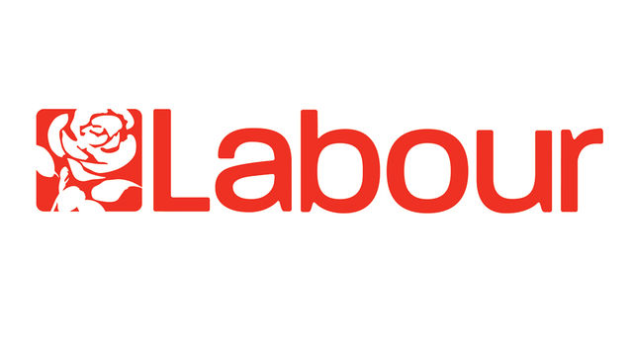
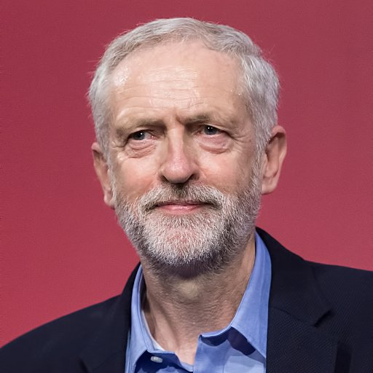
Political Parties
Labour Party
The Labour party most recently had control of Parliament between 1997 and 2010
The party began as an alliance of trade union and socialist groups and worked for the expansion of workers rights
Originally, the Labour Party pushed extremely socialist points of view through Clause 4
Clause 4 asked for the nationalization of the “commanding heights” of British industry
The party has shifted to a more moderate political stance (New Labour)
Jeremy Corbyn – current leader
Notes:
Interest Groups:
Trade Unions Congress (TUC), Confederation of Business Industries (GSI)
Neo-corporatism: To be able to establish and maintain a neo-corporatist interest group system, a country has to have peak associations that are able to enforce the agreements between business, labour, and the government. Consequently, in Scandinavia, Germany, Austria, and Switzerland, for example, where there are major peak associations that dominate their respective economic sectors, neo-corporatism can best explain major interest group activity.
Neo-corporatist theory also has its critics. Some argue that it is not a distinct interest group system at all but rather just another form of pluralism. This is because it still functions within a pluralist political environment and only major groups are involved in this special relationship with government; all other groups and interests compete in the same way that they would in a pluralist system such as the United States.

Slide 15
Political Parties
Conservative Party
The Conservative Party dominated British politics from WWII to 1997
Under Thatcher, the Conservative party pushed for a market economy, large scale privatization, and fewer social welfare programs
This party is characterized by noblesse oblige, and its power is centered in London
The leader of the party must submit to yearly elections in order to be retained as leader
In 1997, the party was weakened by factional arguments
The traditional wing (one-nation Tories) wanted the country ruled by the elites who would rule in the best interests of everyone in the country
They support Britain’s membership in the EU
The Thatcherite wing wants to roll back government controls and move to a full free market
The members of this wing are often referred to as Euroskeptics because they do not agree with EU membership
Theresa May is the current party leader, and has been Prime Minister since 2016
Notes:
Interest Groups:
Trade Unions Congress (TUC), Confederation of Business Industries (GSI)
Neo-corporatism: To be able to establish and maintain a neo-corporatist interest group system, a country has to have peak associations that are able to enforce the agreements between business, labour, and the government. Consequently, in Scandinavia, Germany, Austria, and Switzerland, for example, where there are major peak associations that dominate their respective economic sectors, neo-corporatism can best explain major interest group activity.
Neo-corporatist theory also has its critics. Some argue that it is not a distinct interest group system at all but rather just another form of pluralism. This is because it still functions within a pluralist political environment and only major groups are involved in this special relationship with government; all other groups and interests compete in the same way that they would in a pluralist system such as the United States.

Slide 16
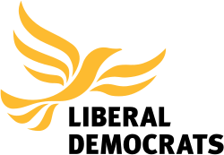
Political Parties
Liberal Democrats
The Liberal Democrats are a merge of the Liberal and Social Democratic parties
This merge took place in 1989
The Liberal Democrats are a victim of the plurality voting system, and despite descent results in popular votes, they continually have very low representation in Parliament
The Liberal Democrats have sought proportional representation to increase their numbers in Parliament
They lost their power in 2015 when the coalition government ended with the election of a majority of Conservatives.
Notes:
Interest Groups:
Trade Unions Congress (TUC), Confederation of Business Industries (GSI)
Neo-corporatism: To be able to establish and maintain a neo-corporatist interest group system, a country has to have peak associations that are able to enforce the agreements between business, labour, and the government. Consequently, in Scandinavia, Germany, Austria, and Switzerland, for example, where there are major peak associations that dominate their respective economic sectors, neo-corporatism can best explain major interest group activity.
Neo-corporatist theory also has its critics. Some argue that it is not a distinct interest group system at all but rather just another form of pluralism. This is because it still functions within a pluralist political environment and only major groups are involved in this special relationship with government; all other groups and interests compete in the same way that they would in a pluralist system such as the United States.

Slide 17
Linkage Institutions
Interest Groups
Interest group pluralism
Most influential interest groups are those tied to class and industry
Confederation of British Industry
The Confederation of Business Industries (CBI) also has influence over the creation of policy
Trades Union Congress
The Trade Unions Congress (TUC) represents a collation of unions and has a great deal of influence of the government
National Farmers Union
British Medical Association
Notes:
Interest Groups:
Trade Unions Congress (TUC), Confederation of Business Industries (GSI)
Neo-corporatism: To be able to establish and maintain a neo-corporatist interest group system, a country has to have peak associations that are able to enforce the agreements between business, labour, and the government. Consequently, in Scandinavia, Germany, Austria, and Switzerland, for example, where there are major peak associations that dominate their respective economic sectors, neo-corporatism can best explain major interest group activity.
Neo-corporatist theory also has its critics. Some argue that it is not a distinct interest group system at all but rather just another form of pluralism. This is because it still functions within a pluralist political environment and only major groups are involved in this special relationship with government; all other groups and interests compete in the same way that they would in a pluralist system such as the United States.

Slide 18
Linkage Institutions
Interest Groups
Neo-corporatism: interest groups (peak associations) take the lead and sometimes dominate the state
To be able to establish and maintain a neo-corporatist interest group system, a country has to have peak associations that are able to enforce the agreements between business, labor, and the government.
Neo-corporatist theory also has its critics.
Some argue that it is not a distinct interest group system at all but rather just another form of pluralism.
This is because it still functions within a pluralist political environment and only major groups are involved in this special relationship with government; all other groups and interests compete in the same way that they would in a pluralist system such as the United States.
Notes:
Interest Groups:
Trade Unions Congress (TUC), Confederation of Business Industries (GSI)
Neo-corporatism: To be able to establish and maintain a neo-corporatist interest group system, a country has to have peak associations that are able to enforce the agreements between business, labour, and the government. Consequently, in Scandinavia, Germany, Austria, and Switzerland, for example, where there are major peak associations that dominate their respective economic sectors, neo-corporatism can best explain major interest group activity.
Neo-corporatist theory also has its critics. Some argue that it is not a distinct interest group system at all but rather just another form of pluralism. This is because it still functions within a pluralist political environment and only major groups are involved in this special relationship with government; all other groups and interests compete in the same way that they would in a pluralist system such as the United States.

Slide 19
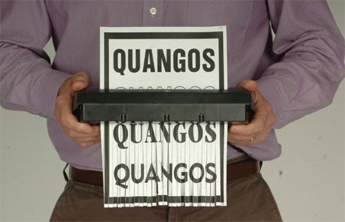
Linkage Institutions
Greatest influence of British interest groups comes through Quangos
Quasi-autonomous nongovernmental organizations
Created by Parliament to put government and private interests together on policymaking board
It is an organization that is funded by taxpayers, but not controlled directly by central government – around 700 exist
Do things like developing safety regulations for factories, creating proposals to improve race relations, and maintaining railway infrastructure
Civil servants, lobbyists and even members of govt serve on quangos
Recent trend toward eliminating and reforming quangos to save $
Notes:
Quangos:
It is an organization that is funded by taxpayers, but not controlled directly by central government – over 700!
Do things like developing safety regulations for factories, creating proposals to improve race relations, and maintaining railway infrastructure
Civil servants, lobbyists and even members of govt serve on quangos

Slide 20
Linkage Institutions
Media:
Radio and television came into existence during the collective consensus era, so it was monopolized by the British Broadcasting Corporation (BBC)
Despite competition from private companies, the government strictly regulates the media and prohibits the selling of advertisements to politicians, parties, or political causes
Notes:
Interest Groups:
Trade Unions Congress (TUC), Confederation of Business Industries (GSI)
Neo-corporatism: To be able to establish and maintain a neo-corporatist interest group system, a country has to have peak associations that are able to enforce the agreements between business, labour, and the government. Consequently, in Scandinavia, Germany, Austria, and Switzerland, for example, where there are major peak associations that dominate their respective economic sectors, neo-corporatism can best explain major interest group activity.
Neo-corporatist theory also has its critics. Some argue that it is not a distinct interest group system at all but rather just another form of pluralism. This is because it still functions within a pluralist political environment and only major groups are involved in this special relationship with government; all other groups and interests compete in the same way that they would in a pluralist system such as the United States.

Slide 21
Political Values
British civic culture is characterized by trust, deference to authority and competence, pragmatism, and harmony
There are high percentages of people who vote, acceptance of authority, tolerance for different points of view, and acceptance of the rules of the game
This is even despite economic crisis and recent rioting
There has been a decrease in support of labor unions
Strikes during the 1970’s helped change the view of Unions and they began to be viewed as bullies
Increased violence regarding Northern Ireland
Religious conflict escalated in the 1970’s with “bloody Sunday” in which 13 Catholics were killed
Religious conflict exists even now
Thatcherism
This was the push by Margaret Thatcher to move towards a free market economy and away from social welfare programs
New Labour
This was the movement headed by Tony Blair to move the Labour party more the center and worked to encourage compromise in government
Protests over the Iraq War
Blair lost his support over his support of the U.S. in the Iraq War. This lead to his resignation
Notes:
Interest Groups:
Trade Unions Congress (TUC), Confederation of Business Industries (GSI)
Neo-corporatism: To be able to establish and maintain a neo-corporatist interest group system, a country has to have peak associations that are able to enforce the agreements between business, labour, and the government. Consequently, in Scandinavia, Germany, Austria, and Switzerland, for example, where there are major peak associations that dominate their respective economic sectors, neo-corporatism can best explain major interest group activity.
Neo-corporatist theory also has its critics. Some argue that it is not a distinct interest group system at all but rather just another form of pluralism. This is because it still functions within a pluralist political environment and only major groups are involved in this special relationship with government; all other groups and interests compete in the same way that they would in a pluralist system such as the United States.

Slide 22
Political Culture/Values
Discussion Question: Given what you know about Britain from your reading (you are reading, right??), research, discussions and notes, create a list of 5 common values in the UK:

Slide 23
British Values (according to Ken Wedding)
Devotion to justice and fair play
Human and civil rights for all
Acceptance of class distinctions and social mobility
Equal representation
Civilian government
Pragmatism and cooperation
Tolerance
Both community and individual responsibility
Honesty and transparency in govt and business
Acceptance of activist govt

