Slide 1
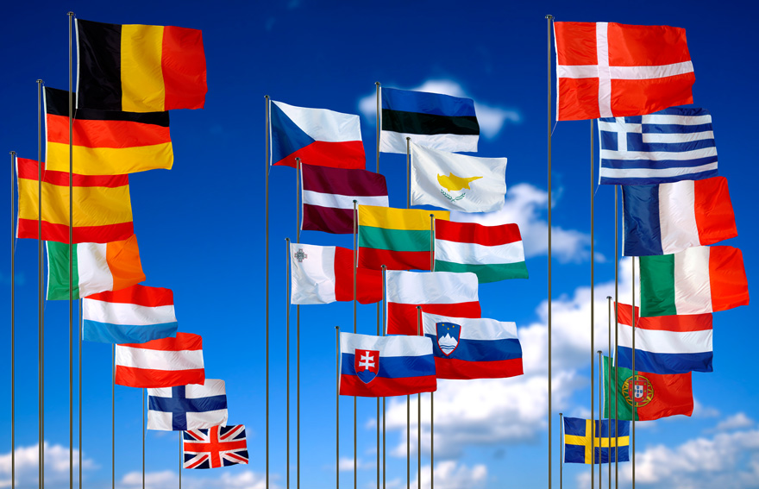
The European Union

Slide 2
What is The European Union?
Shared values: liberty, democracy, respect for human rights and fundamental freedoms, and the rule of law.
The world’s largest economic body.
The world’s most successful model for regional integration and for advancing peace and democracy.
A unique institution as Member States voluntarily cede national sovereignty in many areas to carry out common policies and governance.
It is not a super-state which replaces existing states. Nor is it simply an organization for international cooperation.
28
Member States
Combined population of
EU Member States
500
million
7.5
Percent of world’s
population
Percent of
global GDP
30
60
Percent of combined
worldwide Official
Development Assistance

Slide 3
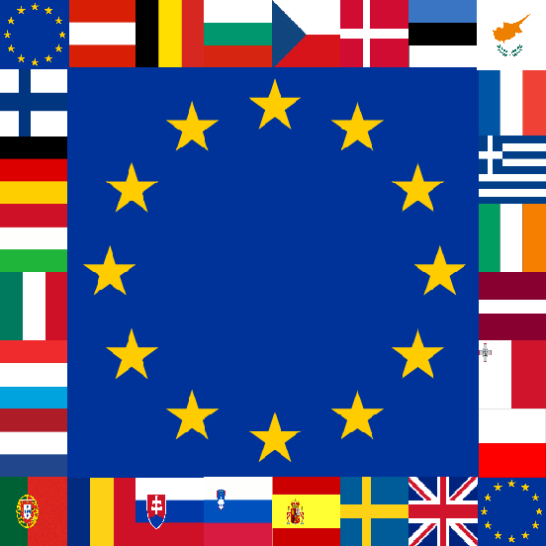
Part 1: A Brief History
“Peace, Prosperity, and Partnership”

Slide 4
Supranationalism
Supranational Organizations: organizations in which nations are not totally sovereign actors
Reflects trend of integration
Process that encourages states to pool their sovereignty in order to gain political, economic, and social clout

Slide 5
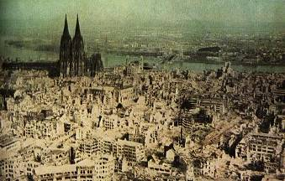
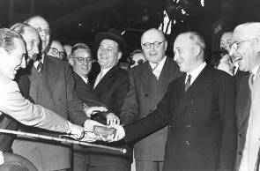
Why Form a European Union?
Began after WWII in an effort to repair nations’ economies in a war-torn Europe
Initial goals were almost completely economic in intent

Slide 6
Evolution of Integration
1949 Council of Europe formed, but had little power
1950 a supranational authority was formed to coordinate coal and steel industries

Slide 7
Evolution of Integration
1957 the EEC (Eur Economic Community) – established by Treaty of Rome
Informally named the “Common Market”
Eliminated all tariffs between European nations and creation of new ones

Slide 8
Evolution of Integration
1965 the EC (European Community) was established
Expanded the organization's functions beyond economics to include a unified approach to peaceful use of atomic energy

Slide 9
Finally, the EU!
1991 the Maastricht Treaty created the modern organization and gave it authority in new areas
Important goal was to coordinate economic policies, particularly through common currency, the Euro

Slide 10
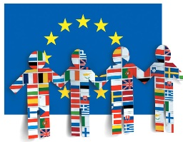
Finally, the EU!
The Treaty Established Three Pillars (spheres of authority)
Trade and economic cooperation
Law enforcement and human rights
Foreign policy and European security

Slide 11
Finally, the EU!
Basis of the EU: The European Union is based on the rule of law and democracy. It is neither a new State replacing existing ones nor is it comparable to other international organizations. Its Member States delegate sovereignty to common institutions representing the interests of the Union as a whole on questions of joint interest. All decisions and procedures are derived from the basic treaties ratified by the Member States

Slide 12
Part 2: Membership

Slide 13
Current Membership
Ongoing expansion is a major characteristic of the European Union – currently 28 members
Began with 6 members in 1957: France, Germany, Italy, Belgium, the Netherlands and Luxembourg
Early 1970s: Denmark, GB and Ireland
1981: Greece
1986: Portugal and Spain
1995: Austria, Finland and Sweden
2004: Cyprus, Czech Republic, Estonia, Hungary, Latvia, Lithuania, Malta, Poland, Slovakia, Slovenia
2007: Bulgaria and Romania
2013: Croatia

Slide 14
Under Consideration for Membership
Macedonia, Turkey*, Montenegro, Serbia, Albania (Iceland dropped its bid in March 2015)
Turkey is controversial (low gdp, history of authoritarian govts, location in mostly Asia, Muslim population)
Notes:
Iceland first applied in 2009, but dropped its bid in 2015, in line with pledges made by its Euroskeptic govt after its election 2 years ago.

Slide 15
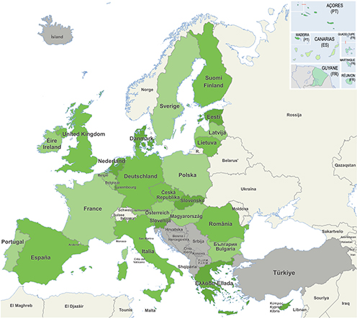
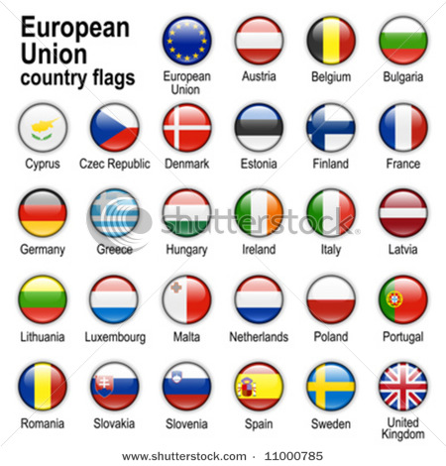

Slide 16
Requirements for Membership
A stable and functioning democratic regime
A market-oriented economy
Willingness to accept all EU laws and regulations
Notes:
Becoming a member of the EU is a complex procedure which does not happen overnight. Once an applicant country meets the conditions for membership, it must implement EU rules and regulations in all areas.
Any country that satisfies the conditions for membership can apply. These conditions are known as the ‘Copenhagen criteria’ and include a free-market economy, a stable democracy and the rule of law, and the acceptance of all EU legislation, including of the euro.
A country wishing to join the EU submits a membership application to the Council, which asks the Commission to assess the applicant’s ability to meet the Copenhagen criteria. If the Commission’s opinion is positive, the Council must then agree upon a negotiating mandate. Negotiations are then formally opened on a subject-by-subject basis.
Due to the huge volume of EU rules and regulations each candidate country must adopt as national law, the negotiations take time to complete. The candidates are supported financially, administratively andtechnically during this pre-accession period.

Slide 17
Part 3: Institutions

Slide 18
5 Main Institutions (1-3 = Iron Triangle)
European Commission
Seeks to uphold interests of the Union as a whole
Council of Ministers
Represents the individual member states
European Parliament
Represents EU’s citizens and is directly elected by them
Notes:
The decision-making process of the EU involves three main institutions:
The European Commission
The European Parliament
The Council of the European Union
This institutional triangle produces the policies and laws that apply throughout the EU.
In principle, it is the Commission that proposes new laws, but it is the Parliament and Council that adopt them. The Commission and the member states then implement them, and the Commission ensures that the laws are properly taken on board.

Slide 19
5 Main Institutions
4. Court of Justice
Upholds the rule of European law
5. Court of Auditors
Checks the financing of the Union’s activities

Slide 20
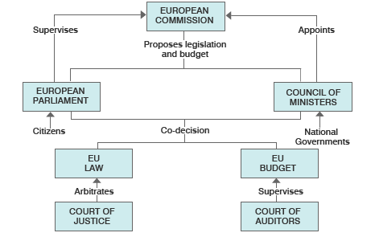

Slide 21
Institutions – The Commission
28 members, one appointed by each state’s govt (approved by EP)
Bureaucracy of several thousand European civil servants
Each commissioner takes responsibility for a particular area of policy
Main responsibility is to initiate and implement new programs
Forms a permanent executive that supervises work of EU (like a cabinet)
Notes:
https://www.youtube.com/watch?v=nWpgO1EPO_Y

Slide 22
Institutions – The Council of Ministers
Composed of head of each member country (PM/Pres, etc) and Pres of EU Commission
Meet regularly at council’s Brussels headquarters
Certain ministers may meet more often about policy issues that directly affect them (ex. Agriculture)
The Commission may initiate legislation, but its proposals don’t become law until they have been passed by Council
Each country is assigned a number of votes in proportion to its share of the population

Slide 23
Institutions – The European Parliament (EP)
Historically has not had a lot of legislative power
736 members directly elected once every 5 years
May propose amendments to legislation
May reject proposals from the Council outright BUT Council may override by unanimous vote
Gained more power with Lisbon Treaty (2007)

Slide 24
Institutions – The European Court of Justice (ECJ)
Supreme court of EU
Has power of judicial review
Meets in Luxembourg
Interprets European law and its decisions may limit national sovereignty
28 judges, each nominated by different member state
Cases are decided by simple majority

Slide 25
Part 4: Key Policies
A Quick Intro…

Slide 26
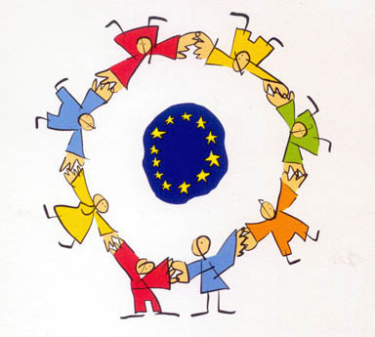
Key Policies – Single Market
Creating and maintaining a single internal market
Removal of tariffs/barriers
Most professional licenses (doctors, hairdressers) accepted in all members states

Slide 27
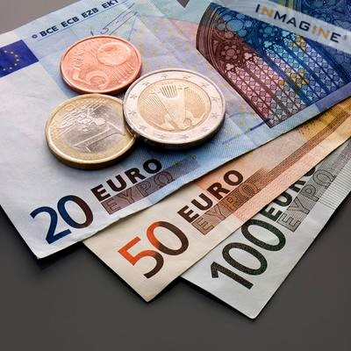
Key Policies – Monetary Policy
Union of monetary policy
Control of money supply
Power to set basic interest rates/fiscal policy is being passed from national banks/govts to European Monetary Union and its central bank
Common currency – Euro (exceptions: UK and Sweden)

Slide 28
Key Policies – Agriculture
Common Agricultural Policy
Almost half of EU’s budget goes to this policy
Goal is to modernize inefficient farms so they can compete
Farm subsidies
Rural development projects

Slide 29
Key Policies – Defense
Common Defense
Crisis management – crises defined as humanitarian, rescue and peacemaking tasks
Goal is to be able to deploy up to 60,000 troops within 60 days that could be sustained for at least one year
Commitment and deployment up to each member state

Slide 30
Key Policies – Justice/Home Affairs
Treaty of Amsterdam – aim was to establish free movement of EU citizens and non-EU nationals throughout Union
Involved setting policy regarding visas, asylum and immigration
Terrorism – EU and US officials have held a series of policy dialogues on border and transportation security

Slide 31
Part 5: Current Issues

Slide 32
Current Issues
Enlargement – rapid growth has brought “enlargement fatigue,” a loss of enthusiasm for further growth
Democratic Deficit: many people fear that the power shift from national to supranational institutions will result in loss of direct control of political decisions by the people (Euroskeptics)
Lack of accountability to average citizen

Slide 33
Current Issues
Constitution – some member states failed to ratify
2007 Lisbon Treaty replaced Constitutional Treaty and made important changes to EU
Cleavages – between big states/smaller states; between industrialized and agricultural states; between wealthy and poor
Sovereign Debt Crisis
UK’s proposed in/out referendum

Slide 34
Current Issues
Refugee Crisis
Currently debating new system of mandatory quotas for sharing refugees
Plan proposed by European Commission
Strongly supported by Germany; Strongly opposed by Hungary
Agreed “in principle” to share 160,000 refugees across at least 22 countries (but not binding)
Notes:
http://www.theguardian.com/world/2015/sep/14/refugee-crisis-eu-governments-set-to-back-new-internment-camps

Slide 35
Current Issues
Refugee Crisis
Proposed outsourcing processing to countries mainly in Africa where “reception centres” or refugee camps would be built
Once the system was functioning, EU members would be “in a position to find asylum applications of these persons inadmissible on safe third country grounds”
See any problems with this????
Notes:
The European commissioner for migration, Dimitris Avramopoulos, admitted that the proposed policy was flawed since target countries in Africa were “not willing” to host EU-sponsored refugee camps on their soil

Slide 36
Additional Videos to Watch
The European Union Explain (CGPGrey)
The European Commission
How the EU Works
Notes:
The European commissioner for migration, Dimitris Avramopoulos, admitted that the proposed policy was flawed since target countries in Africa were “not willing” to host EU-sponsored refugee camps on their soil

