Slide 1
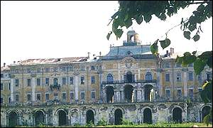
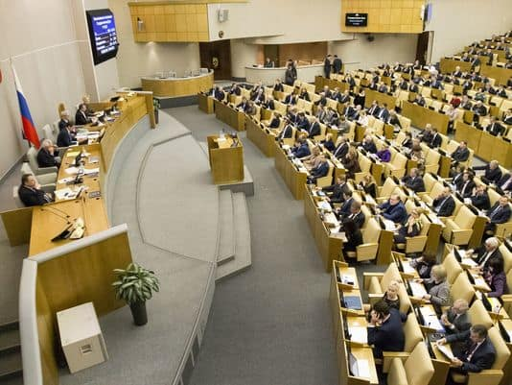
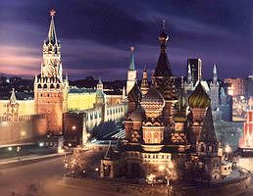
Russia: Public Policy and Current Issues
AP Comparative Government

Slide 2
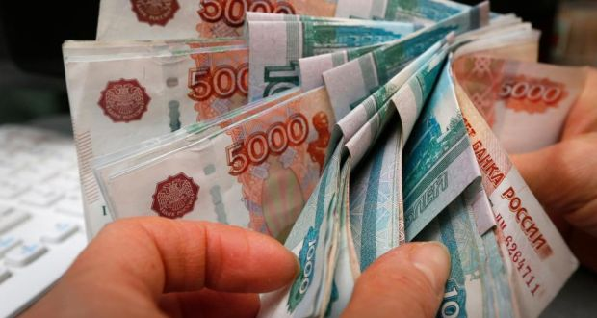
The Economy
In 1991, Mikhail Gorbachev enacted the perestroika reforms
This consisted of market economy programs inserted into the traditional centralized state ownership design of the Soviet Union
These were never fully implemented because of the Soviet Union dissolved
The big question about the economy is how should the economy be handled
Yeltsin’s “shock therapy” was terrible as it created chaotic conditions that were hard for new entrepreneurs to deal with
In 1997, the Russian stock market crashed and unemployment soared

Slide 3
The Economy
In 2004, the economy showed strong indications of recovery, with annually growth of 7 percent
The standard of living has risen, although real incomes improved much more rapidly in neighboring countries
The Russian economy is fueled by huge oil and gas reserves and the corporations that own them
In 2014, the price of oil fell and the ruble lost about half its value
Oil prices stabilized in 2015, but still too low for economic recovery
Inflation has jumped and wages have fallen
There is also still tension between the idea of privatization and state control
Under Putin, there has been a push to reemphasize a state-capitalist model
The government plays a huge role in the economy and has monopolies in oil (Rosneft), natural gas (Gazprom), and weapons/warfare systems (Russian Technologies).
Critics say that government control of these industries hinder competition

Slide 4
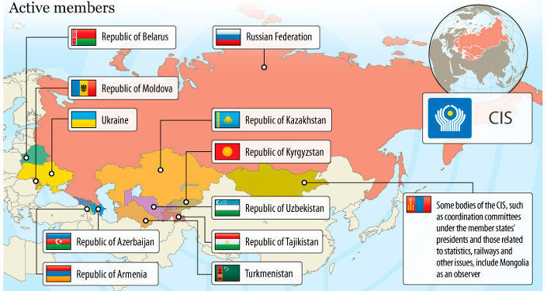
Foreign Policy
The Commonwealth of Independent States unites the fifteen former republics of the Soviet Union with Russia as the leader
There is little formal power over its members, and Russia’s motives are almost always under strict scrutiny by the other countries
Trade agreements bind them together but nationality differences prevents common agreements

Slide 5
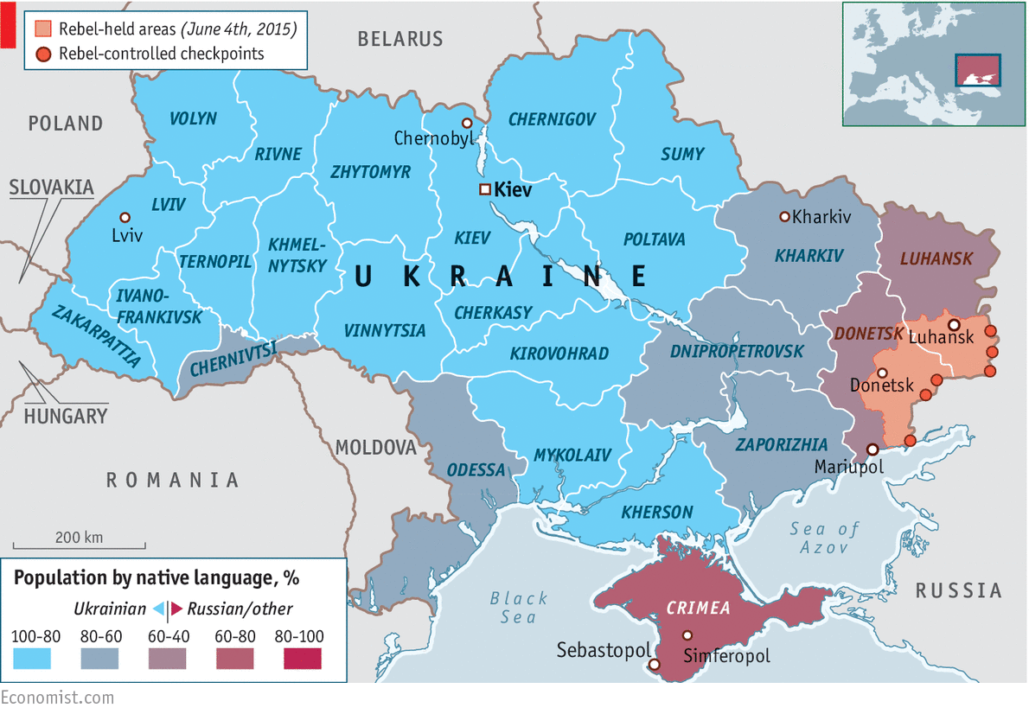
Foreign Policy
Crisis in the Ukraine
Tensions between western leaning Ukrainians and those wanting ties with Russia – mostly along ethnic lines
A Russian backed candidate became President in 2010 (Yanukovich)
He rejected a trade agreement with the EU in 2013 and instead took a $15 billion loan from Russia to move towards a “Eurasian Union” with Russia , Belarus and Kazakhstan
Protests happened, Yanukovich fled to Russia and a coalition government formed
Crimea – a large number of ethnic Russians
Armed men seized government buildings and airports
Fighting between Russian soldiers and Ukraine commenced
Putin signed a treaty formally annexing Crimea
US and EU imposed sanctions
2015 – Russian troops withdrew from Ukraine and there is currently an uneasy peace

Slide 6
Foreign Policy
The biggest issue with Russia is the loss of its superpower status from the Cold War era
This required a change in the way that the two nations dealt with each other
Russia often received aid from the U.S.
In order to aid Russia after the USSR collapsed, the were welcomed into the G-7, which then became known as the G-8
2014 - Back to G-7 after Ukrainian crisis – Members kicked Russia out
Russia is also a member of the U.N. and helped France block a UN Security Council approval of the US/Iraq war
Russia recently became a member of the World Trade Organization
The WTO has massive power in regulating international trade, settling trade disputes, and designing trade policy through meets with tis members

Slide 7
Foreign Policy
Russia exerts political power through the control of natural resources
They control pipelines of natural gas and oil and can reduce supply if other countries do not meet their demands
Russia’s relationship with the United States has also grown more contentious in recent years
Putin saw the invasion of Iraq as an encroachment on Russian national interests
This relationship has been strained because of issues over free elections, human rights abuses, asylum requests, and Russia’s recent incursion into the Ukraine.
Russia has encouraged international challenges to America’s global leadership
Hosted a BRICS summit in Russia
NATO is worried about growing naval expansion

Slide 8
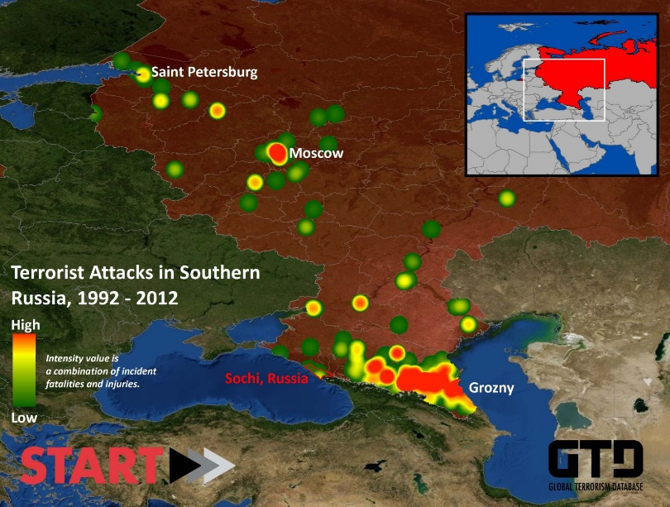
Terrorism
Russia has had to deal with a variety of terroristic issues throughout their country in the post 9/11 world.
There was a terrorist siege at a school in Beslan (2004), a suicide bombing at a subway station in Moscow, and two airplane bombings.
Putin has responded to these terrorist issues by boosting military power and implementing sweeping political reforms. (changing how governors are selected, changing Duma election processes, etc.)

Slide 9
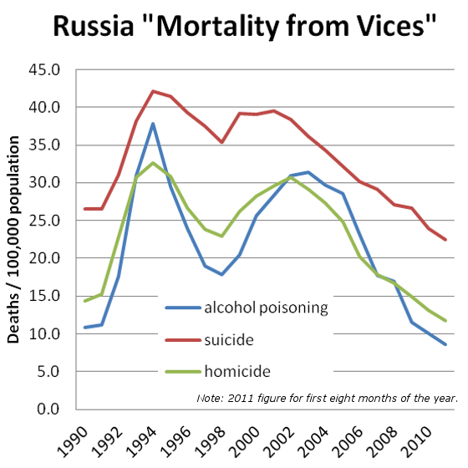
Population Issues
Recently Russia has seen a decrease in their population
UN predicts that population will fall to 116 million by 2050 from 141 million right now
This is largely due to the prominence of abortions and the fact that the economy does not encourage large families
Russia also has health care issues and high death rates because of alcohol use and other disease issues
The life span of Russian men is 59 as compared to 72 for Russian women
To try and expand their population, Russia has spent billions trying to encourage Russians who have moved abroad to come back home

Slide 10
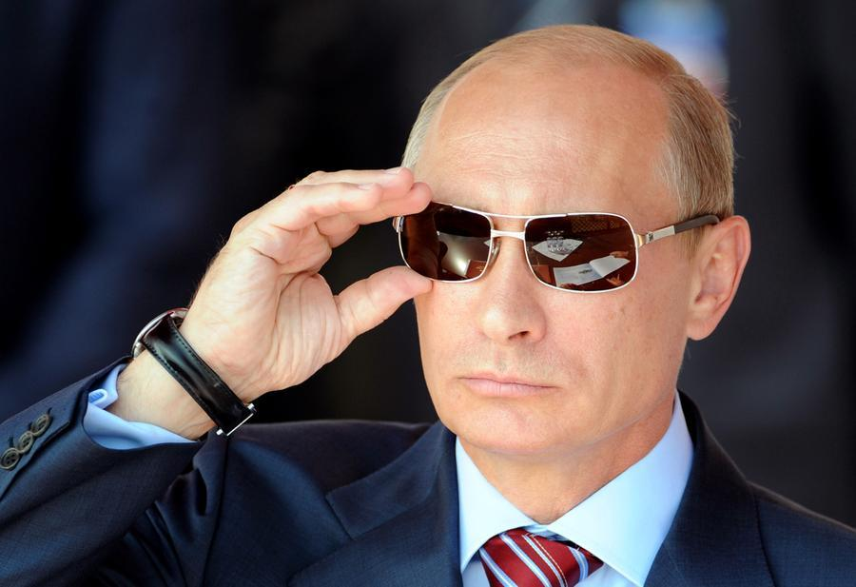
Re-centralization of Power
Under Putin, his party has taken control of a large majority of the seats in the Duma, has taken control over major television stations, as well as major industries throughout the economy.
Even when not in power, Putin was still able to maintain control over what was happening in the government
Is this the end of democracy in Russia or just another alternation between reform and conservatism?
Putin is in power until at least 2018

Slide 11
Development of a Civil Society
Russians do not necessarily share the assumptions of civil society – Life, Liberty, Property
Much more influenced by traditions of statism – have a strong government or die
Throughout their history, survival has depended on a strong, protective government
Question: Is it possible for Russia to truly become democratic and capitalist when it’s people value government protection and equality over freedom, privacy and personal property?

