Slide 1
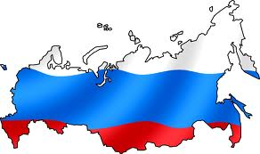
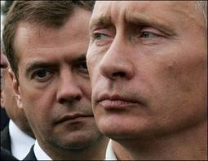
Russia
Part 1: The Making of the Modern State

Slide 2
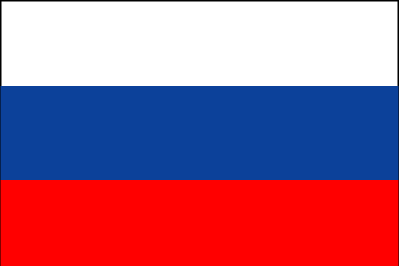
Why do we study Russia?
History of Communism (Soviet Union) & Totalitarianism
Transition to Democracy
Example of Illiberal Democracy
Current trend may be toward authoritarianism under Putin – this makes Russia difficult to categorize.

Slide 3
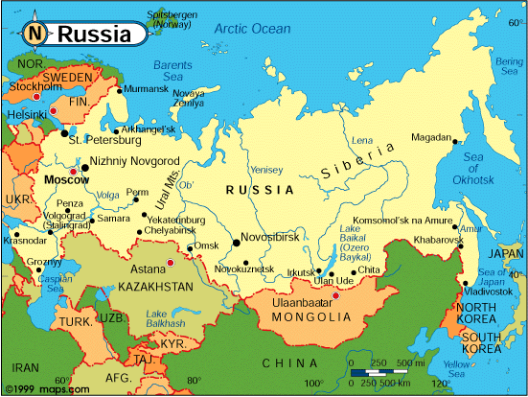
Geography
Officially, the Russian Federation
Largest successor state of the Soviet Union
Largest country in the world (area)
17,098,242 sq mi
Spans 11 time zones
Largest European country in population
140 million -’91-’09 decreasing)
Since 2009 - increasing
73% live in urban areas
Critical location
Between Europe, Islamic World and Asia
Notes:
Population was steadily declining after fall of USSR until 2009, but on the upswing now, although most question whether that trend will continue

Slide 4
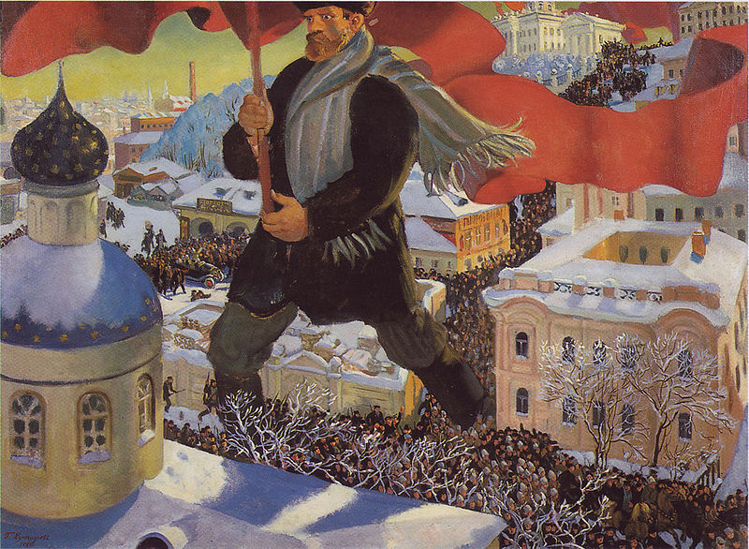
The Bolshevik Revolution
1st country to base political system on Marxism
1917 Bolshevik Revolution
Led by V.I. Lenin
Overthrew tsarist gov’t (tsar comes from “Caesar”)
Marxism-Leninism
Vanguardism
group of revolutionary leaders
Provoked revolution in non-capitalist Russia
Claims to operate in the “true”
Interests of the group/class they
Represent
grows into a “vanguard party”
Democratic centralism –
Mandated a hierarchical party
Structure in which leaders are
Elected from below, but strict
Discipline is required in
Implementing party decisions once made
Notes:
Vanguardism:
Group of revolutionary leaders provoked revolution in (non-capitalist) Russia
Grows into a “vanguard party”
Political party that claims to operate in the “true” interests of the group/class that it represents, even if this understanding doesn’t correspond to the expressed interests of the group itself
Democratic Centralism:
Mandated a hierarchical party structure in which leaders are elected from below, but strict discipline is required in implementing party decisions once they are made

Slide 5
The Bolshevik Revolution
Marx believed it was inevitable that in a capitalistic society, workers would eventually revolt and overthrow the bourgeoise (a socialist revolution) in order to create a classless, stateless, society where government would be unnecessary and “wither away.”
Discussion Question: How did Lenin’s revolution differ from what Marx envisioned?
At the time of the Bolshevik Revolution, Russia was a backward, poorly developed and largely feudal country with a very small industrial working class
Lenin saw the need for a strong leader/group to begin the revolution…and then continue as a strong state
Lenin didn’t believe the working class was capable of achieving socialism without leaders
Lenin became a brutal dictator using coercion to strengthen the state – this set the stage for Stalin
Marx saw the state “withering” away naturally
Leninism is a complete denial of Marxist theory
Notes:
Post-Czarist Russia was a backward poorly developed and largely feudal country where the industrial proletariat was a relatively small minority. To suggest that Russia could undergo a socialist revolution (as Lenin did in 1917) is a complete denial of the Marxist view of history
Lenin persistently rejected the view that the working class was capable of achieving socialism without leaders.
Whereas Marx saw the state as a feature of class society that would be used by a politically-conscious working class to bring about the transfer of power and then be abolished, Lenin saw the state as a permanent and vital part of what he perceived as socialism, and the state had to be strengthened.
The Russian state and its coercive arms became a huge, brutal dictatorship under Lenin, who set the scene for the entry of the dictator, Stalin

Slide 6
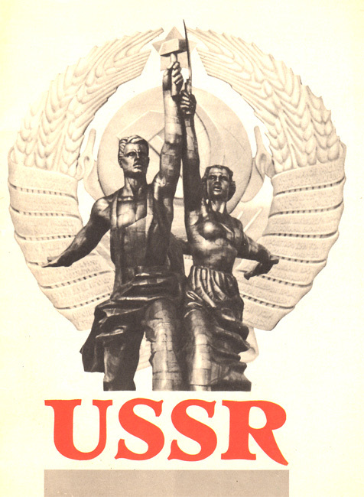
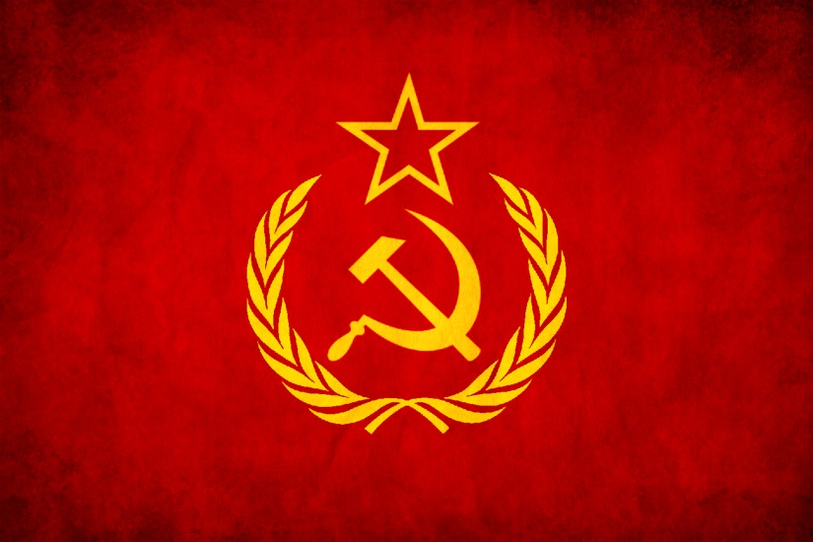
The Bolshevik Revolution
Lenin directed industrialization and agricultural development from a centralized gov’t
1922 Bolsheviks formed the Union of the Soviet Socialist Republics (USSR) (Cheka – security arm)
Authoritarian strains eclipsed democratic elements
No competing ideologies
International isolation
Notes:
Cheka – security arm of the regime was strengthened and restrictions were placed on other political groups
Also a time of international isolation

Slide 7
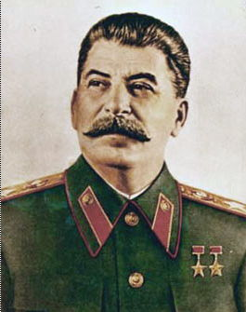
Stalinism (1929-1953)
Placed Communist Party at center of control
Allowed no other political parties to compete
Leaders identified through nomenklatura
Process of party members selecting recruits from lower levels
Central Committee – group of 300 party leaders meet twice a year
Politburo – above the central committee – party elite- lead policy-maker
General Secretary – head of Politburo – dictator of country
Collectivization & Industrialization
Took 90 % of land from peasants and created state run collective farms to prevent emergence of new capitalist class
Private land ownership abolished
Lead to widespread famine and deaths
Favored heavy industry over consumer goods
State planning committee called (Gosplan)
Five Year Plan
Set goals for production of heavy industry (oil, steel, electricity) but neglected consumer goods
Implemented a state planning committee
Notes:
Communist Party:
Central Committee – group of 300 party leaders that met twice a year
Politburo – above the central committee, elite of the party. Lead policymaking organization in Soviet Union
General Secretary – head of the Politburo, assumed full power as dictator of the country
Collectivization:
By 1935, over 90% of agricultural land had been taken from the peasants and made into collective farms
It was rationalized as a means of preventing the emergence of a new capitalist class
Lead to widespread famine and deaths
Industrialization
Favored heavy industries, but neglected consumer goods
State planning committee (Gosplan)

Slide 8
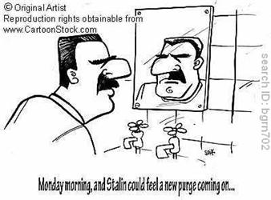
Stalinism (1929-1953)
Totalitarianism and Purges
Media censorship/state control of arts
Party authoritative source of truth
Estimated 5% of population were
executed for “treason” (8-13 million)
Attempts at De-Stalinization
Nikita Khrushchev led process of reforms (1953-1964)
Rejected terror as political control
Loosened censorship
Restructured collective farms
Leonid Brezhnev reversed reforms (1964-1982)
Political repression became predictable (harassment, arrest, and exile)
Notes:
Brezhnev partially reversed Khrushchev’s reforms. Controls tightened in cultural sphere; Individuals who expressed dissenting views were harassed, arrested, or exiled.
Unlike in Stalinist period, political repression was predictable

Slide 9
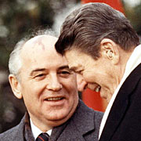
Gorbachev (1985-1991)
Mikhail Gorbachev – reformer who wanted to adapt communist system to new conditions, not usher in its demise
3 Main Goals:
Glasnost – political “Openness”
Allowed more open discussion of issues
Opened door for revolt by some republics
Democratization
Creation of Congress of People’s Deputies
President selected by Congress
Perestroika – Economic Reform
Transfer of economic powers from govt to private hands and market economy
Also - “New Thinking” in foreign policy – military buildup was halted
Notes:
Also, “New Thinking” in foreign policy – military buildup was halted

Slide 10
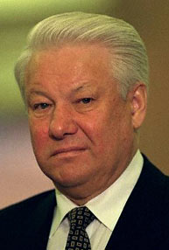
The Russian Federation: 1991 - Present
Aug 1991, “conservatives” (opposed to reform) led a coup d’etat to remove Gorbachev
Failed! Stopped by protesters led by a more radical reformer, Boris Yeltsin (the elected president of the Russian Republic of the USSR) https://www.youtube.com/watch?v=R1Uw_k3MnLM
Gorbachev restored to power but by Dec 1991, many republics declared their independence
End of USSR!!
Now Russian Federation
14 separate independent republics
Yeltsin emerged as president of largest and most powerful republic, Russian Federation

Slide 11
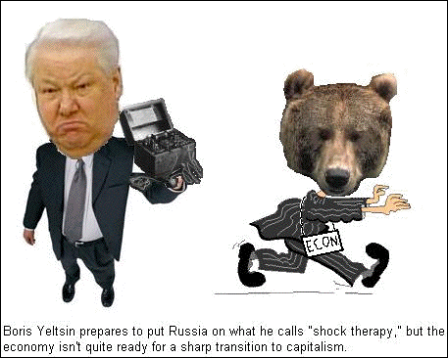
The Russian Federation: 1991 - Present
Yeltsin’s Goal
Create a western-style democracy
Constitution of 1993 – 3 branches (Pres, PM, Duma, Constitutional Court)
Shock Therapy – rapid, radical, market reform (Spontaneous privatization had already happened late 1980’s – early 1990’s)
Loosened or lifted price and wage controls
Privatization Vouchers ($10 to
Each Russian to invest in company)
Insider Privatization –
majority of Shares owned by firm’s employees
Rise of Oligarchs & corruption
Supported Yeltsin
Wealthy owners of natural resources and media
Caused high inflation, (1354%)
lowered GDP – agriculture/industry declined
Capital flight - $ invested outside of RF
Money laundering
Mafia
Notes:
Constitution of 1993:
3 branch govt
Pres, PM, lower legislative house (Duma), Constitutional Court
Shock Therapy:
Spontaneous Privatization (late 1980s - early 1990s): managers or bureaucrats made firms private without a legal basis
Privatization Vouchers, worth about $10, (November 1992) given to each Russian to invest in companies
Insider Privatization: majority of shares owned by firm’s employees
Effects of Shock Therapy:
High inflation (1354% in 1992) in 1990s
GDP declined: Agricultural and industrial production declined
Capital flight: money invested outside of country
Money laundering
Mafia
Rise of Oligarchs – elite, wealthy owners of natural resources and media that supported Yeltsin’s 2nd term and Putin’s 1st – very powerful

Slide 12
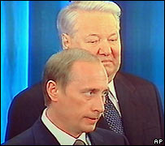
The Russian Federation: 1991-Present
Yeltsin’s frequent illnesses, alcoholism, and erratic behavior eventually led to his resignation in the months before the 2000 election
Prime Minister Vladimir Putin became acting president
2000 Election: Putin won presidency… resounding victory
Served 2 terms (4 years each) – honored constitutional limit and stepped down, BUT
2008 Election: Dimitri Medvedev became President (One term only) while Putin became PM
Most people believe Putin still controlled policymaking power
2012 Election: Putin won and started 6 year term (number of years changed)…more to come…
Putin turned 64 October 7, 2016
Notes:
In 1999, Yeltsin appointed Putin as PM
When Yeltsin resigned as Pres in Dec 1999, Putin became acting President
March 2000 Election – Putin won resounding victory
Putin will be 63 on Oct 7, 2015

