Slide 1
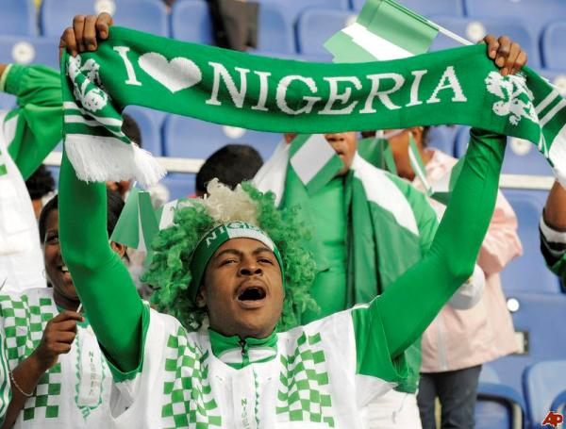
Nigeria: Policy Issues
AP Comparative Government

Slide 2
Public Policy
Nigeria’s years as a military state have resulted in a top-down approach to policy making
The president and his cabinet ministers create legislation through a patron-client system and have created a loyalty pyramid with support moving up the chain
These pyramids are backed by guns, which makes protest dangerous

Slide 3
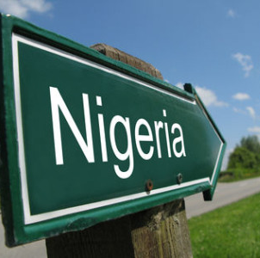
Economic Issues
Most of Nigeria’s population lives in poverty and the elite squander the money
Currently the Country is deeply in debt
2001 – Govt. asked the Supreme Court to allow for the collection of oil revenues to pool them into a federal account.
The South protested because they saw it as a way for the North to take profits away
Also, almost no one believed the profits would benefit anyone but corrupt officials.
Like Iran, Nigeria is a rentier state
Their economy is mainly supported by the money that they receive from the sale of oil
Those who benefit do so through rent-seeking behavior, they are able to make money and earn important positions because of personal and political connections
Much of the economy is supported by an informal economy
Notes:
EFCC – page 505

Slide 4
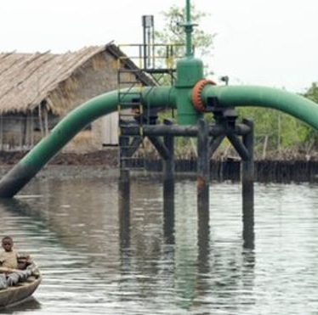
Economic Issues
As a member of OPEC, Nigeria can make political and economic demands because of their oil supplies
They have the ability to step up production when middle-eastern countries have cut off their supplies, giving Nigeria a good bargaining chip
This overreliance on oil can have major impacts on the Nigerian economy
When the oil market goes down, the entire economy is negatively affected
Heavy debt because the profits from good years are squandered and aren’t there when needed

Slide 5
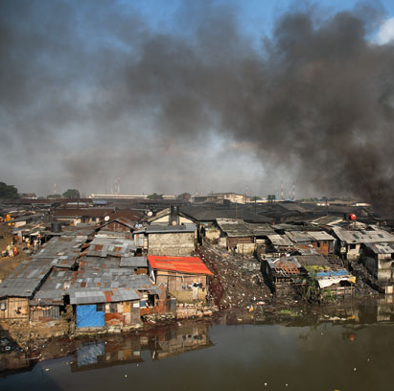
Economic Issues
The Nigerian National Petroleum Corp. has one of the worst transparency record in the world
It’s been called a “slush fund for the government.”
A reform bill has been in the works for 15 years
Never passed
Niger Delta protests make the region unstable
Siphoning of oil, violence, etc.
Many companies refuse to help produce the oil

Slide 6
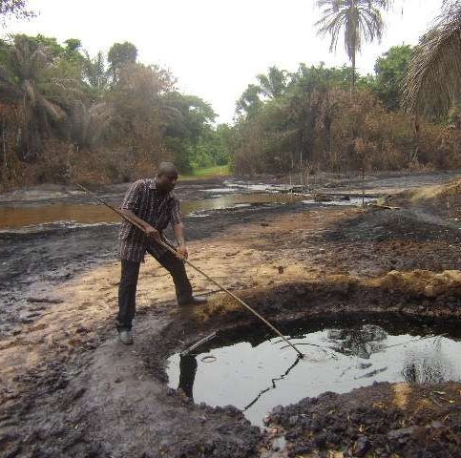
Economic Issues
President Jonathan
Tried to contain the rebels, but violence continues
Oil spills have also decimated the environment on the Niger Delta
A UN report estimated it would take 30 years and $41 billion to rid the mangroves of a thick carpet of crude oil

Slide 7
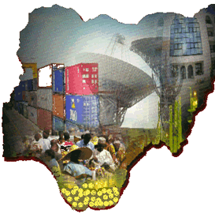
Economic Issues
During the 1980’s oil crisis, President Babangida developed an economic structural adjustment program with the help of the World Bank and the IMF
This program was designed to diversify Nigeria’s economy, reduce government spending and privatize para-statals (the latter has still not completely happened)
Recent reforms
Professionally managed sovereign wealth fund
Replaced the slush-fund that the government used to give away more than $10 billion in the run-up to the 2011 elections.
More Nigerians have bank accounts (mobile banking)
Main goal is to funnel oil revenues into an efficient financial system to provide capital for roads, power stations, and private enterprise.

Slide 8
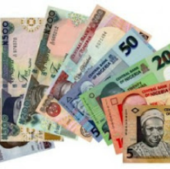
Economic Issues
Under President Obasanjo, the Nigerian banking system greatly improved
Many weak banks were forced to close in 2005 due to a lack of capital
This has sheltered it from much of the damage caused by the Global recession of 2008
There are issues however with international tourism, the production of electricity and power grid management
Despite all the issues, Nigeria’s GDP is fast approaching that of South Africa.
It may become Africa’s largest economy in a decade

Slide 9
Supranational Organizations
Two major organizations that Nigeria is a member of:
OPEC
ECOWAS
A union of fifteen West African countries who have agreed to create a free trade zone and explore further economic integration
Transportation infrastructure, common market (like EU), making budgets more transparent and responsible

Slide 10
Federal Character
Federalism is something supported by Nigerians, as it promotes the sharing of power
It is the goal of Nigeria to seek a “federal character” for the nation that recognizes people of all ethnicities, religions, and regions and takes their needs into account
This is also seen in the requirement that a presidential candidate receive at least 25% of the vote in 2/3 of states in order to win the Presidency
So far, this has not led to more unity or nationalism, but only more division

Slide 11
Federal Character
There have been issues with the size of government as positions are often created just to ensure equal representation within the bureaucracy
These bureaucrats then see themselves as beholden to ethnic and regional interests.
The 36 states also see themselves in competition for political and economic benefits
Federalism has greater support in the South than in the North
The South believes that the central government should devolve some power to the state and local levels
Such as – control over resources
However, because the North generally doesn’t have as many resources to share – they benefit from govt. sponsored redistribution of resources

Slide 12
Democratization
Many changes have occurred in Nigeria that have allowed for the implementation of democratic principles
Some public enterprises have been privatized
Limiting the role of government
Some social welfare programs have been enacted
Some stolen money has been returned
Financial reserves have grown
Public wages have increased to try and stop bribery

Slide 13
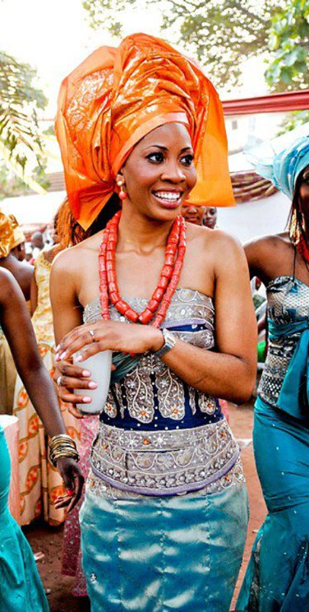
Democratization
These are other reasons why democratization may be taking place:
Some checks and balances between government branches have appeared
Legislature refused to change the Constitution to allow Obasanjo to run for a third term in 2007
Some independent decisions in the courts
President Obasanjo’s attempt to keep his VP, Abubakar off the ballot in 2007 was stopped by the courts
The use of some judicial review
Revival of civil society
After 2007 election, many groups pushed for reform and were successful to a degree

Slide 14
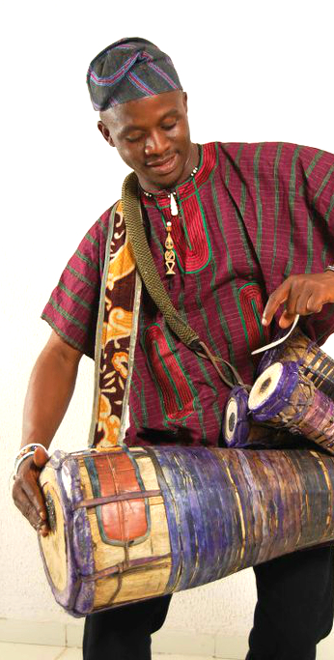
Democratization
Other reasons why democratization may be taking place:
Independent media
During 2007 election, the media sent out correspondents across 36 states to bring back reports of stuffed ballot boxes, voter intimidation and fraudulent results
Internet and cell phones allow poll observers, voters, and political parties to freely communicate
Difficult to hide election fraud
Media watched the 2011 & 2015 elections closely and reported irregularities
Peaceful succession of power
2007 – First peaceful transfer of power between two civilians
2010 – Goodluck Jonathan took over as President after Yar’ Adua’s death without any controversy
2015 – Jonathan conceded election to Buhari and he took power with little resistance
Improving Freedom House scores
Nigeria is now listed as partly free on this scale or a 4.5 on the Freedom House scale (1-7)
The score has improved over the years
1976 – Nigeria was “not free”

Slide 15
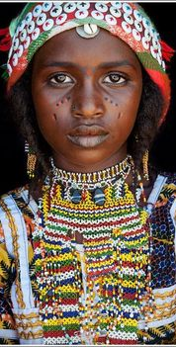
Democratization
So is Nigeria stabilizing as a nation?
Nigeria’s economic and political problems are so intertwined:
Economic problems are rooted in patron-clientelism, which leads to corruption, which makes other economic problems harder to solve.
Political problems can be traced to patron-clientelism by encouraging ethnic discord
One of the key characteristics of a true democracy is regular competitive elections where voters have true choices
It’s easy to criticize Nigerian elections:
1993 – annulled results; 1999 & 2003 – put a former military general back in power with ballot box stuffing/theft; 1999/2003/2007 – candidates were assassinated and ordinary people killed just trying to vote
2011 & 2015 – hailed as massive improvement (but military leaders still running)
Perhaps the best question to ask: “Was this election better than the last one?”
If so, maybe democracy is truly developing

