Slide 1
NIGERIA
“I am not Nigerian because I was born in Nigeria but because Nigeria was born in me.”
--Saminu Kanti
Part 3: Citizens, Society & the State

Slide 2
Democratization Problems
Necessary condition for democratization: citizens need to have time to pay attention and participate in the political process
Problem for Nigeria:
60% live in poverty
Large gap between rich and poor (Gini = .48) – Like Mexico
Economy shows fewer signs of growth – bleak outlook to close the gap
Health issues – AIDS epidemic (1 in 11 AIDS carriers are Nigerian)
Gov’t has general made AIDS a secondary priority, leaving much of the challenge to a small group of underfunded NGOs
Gov’t has provided medications through a small number of clinics, but they reach only a few thousand in a country where several million people are estimated to be HIV positive
Literacy – Overall 59.6% (69.2% for men, 49.7% for women)
Higher than many other nations in Africa, but below the world average of 89.9% for men, 82.2% for women
Notes:
AIDS:
Gov’t has general made AIDS a secondary priority, leaving much of the challenge to a small group of underfunded NGOs
the gov’t has provided medications through a small number of clinics, but they reach only a few thousand in a country where several million people are estimated to be HIV positive
Literacy
Higher than many other nations in Africa, but below the world average of 87% for men, 77% for women

Slide 3
Comparative Literacy Rates
Country | Males | Females
China | 98.2% | 94.5%
Iran | 91.2% | 82.5%
Mexico | 96.2% | 94.2%
Nigeria | 69.2% | 49.7%
Russia | 99.7% | 99.6%
UK | 99% | 99%
China & Russia’s high literacy rates reflect the emphasis that communist leaders put on literacy, as well as equality between the sexes.
Compare them to Nigeria and Iran
In Nigeria, each woman bears an average of 4.9 children in her lifetime, which means that educational opportunities are often cut short at a young age to have children and stay at home to raise them.
Notes:
AIDS:
Gov’t has general made AIDS a secondary priority, leaving much of the challenge to a small group of underfunded NGOs
the gov’t has provided medications through a small number of clinics, but they reach only a few thousand in a country where several million people are estimated to be HIV positive
Literacy
Higher than many other nations in Africa, but below the world average of 87% for men, 77% for women

Slide 4
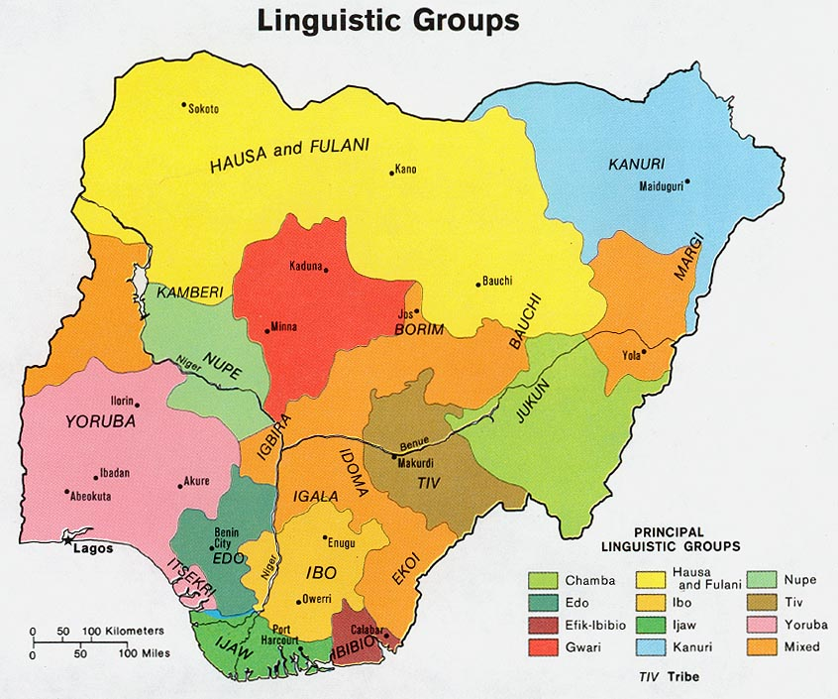
Cleavages
One of the most fragmented societies in the world
Similar to Russia – Both have contended with ethnic conflicts (Russia – Chechnya; Nigeria – Biafra)
In both countries these have undermined legitimacy
Ethnicity – 250 to 400 distinct ethnic groups (different languages, religion)
3 Major Ethnic Groups:
Hausa-Fulani, Igbo, and Yoruba tribes are largest, but can’t speak each other’s languages and have no contact generally
Hausa-Fulani – 29%: Muslim groups which dominate the northern half of country
Yoruba – 21%: split btw Muslim, Christian, and indigenous religions; dominate SW third of country (including Lagos)
Igbo (Ibo) – 18%: mostly Christian; live in SE oil-producing region
Notes:
Hausa-Fulani, Igbo, and Yoruba tribes are largest, but can’t speak each other’s languages and have no contact generally

Slide 5
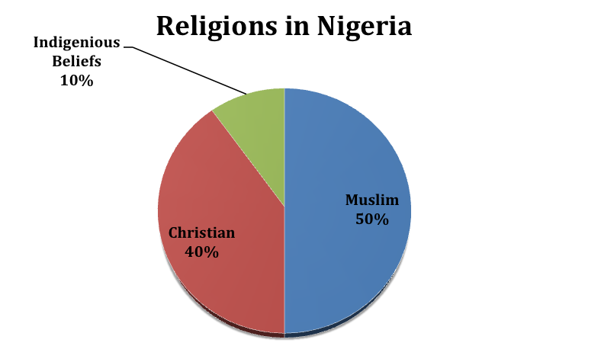
Cleavages
China & Soviet Union – ethnic tensions managed by unifying ideology (Communism); No such ideology in Nigeria so competing religions have exacerbated ethnic tensions
Religion – 50% Muslim, 40% Christian, 10% various native religions
Disputes rooted in preferential treatment British gave to Christians and the role of sharia in Nigerian law

Slide 6
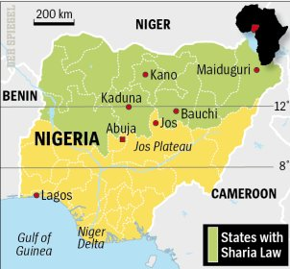
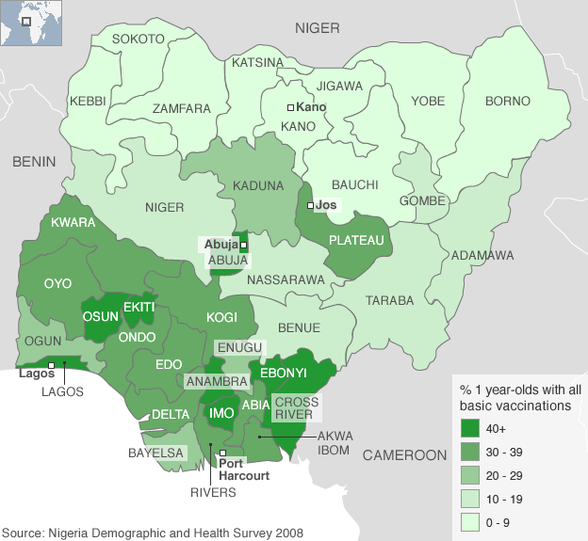
Cleavages
Region – Country was divided into Three Federated Regions in 1955
Regions follow ethnic and religious divisions and are the basis for setting election/legislative procedures/political party affiliations
Region – North v. South
North:
Predominantly Muslim
Less educated
Poorer
Less industrialized
Poorer healthcare
South:
Predominantly Christian
More educated
Wealthier (oil reserves)

Slide 7
Cleavages
Urban/rural differences – political organizations, interest groups, media only operate in cities
Social class – Educated elite are those with ties to the state, who often use the treasury to benefit themselves
Wealth of elites stems from control of state and resources of the country
Have maintained power by appealing to ethnic and religious identities
Many educated elite, however, would like to see Nigeria transformed into a modern nation based on democratic principles
Notes:
Social Class:
Wealth of elites stems from control of state and resources of the country
Have maintained power by appealing to ethnic and religious identities

Slide 8
Civil Society
Open and Free
Mostly centered around ethnic identity and religion
Centripetal forces = encouraging Nigerian unity
Centrifugal forces = fragmentation along ethnic and religious lines
Elite – private clubs and professional organizations
Trade Unions – protect rights of workers
National Union of Petroleum and Gas Workers (NUPENG)
Soldiers and veterans belong to military support groups
NGO’s
These groups have related to the government mainly through corporatism and clientelism
Could form base of viable democracy

Slide 9
Political Culture
Patron-clientelism (prebendalism) – just like Mexico and China
Exchanging political and economic favors
Leads to corruption
State Control – Throughout history, the state has always tried to control almost all aspects of life. However, it has not completely succeeded (formal/informal ethnic and religious associations, professional/labor groups, and other NGOs have long shaped society)
Modernity vs. Tradition – Values established in the pre-colonial era conflict with those established in the colonial era
Creates problems between need to get in touch with roots (based on ethnicity) but need to work together for the good of the whole nation
Religious Conflict – Islam vs. Christianity

Slide 10
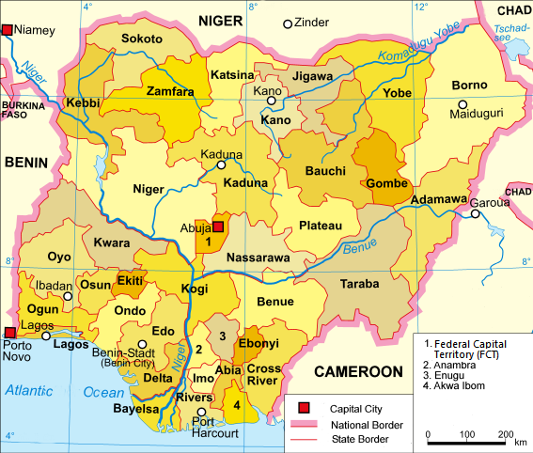
Political Culture
Geographic Influences – Six zones
Northwest – Hausa-Fulani (Muslim)
Northeast – Kanuri & others (Muslim)
Middle Belt – Smaller ethnic groups (mix of Muslim & Christian)
Southwest – Yoruba (40% Muslim; 40% Christian; 20% Native)
Southeast – Igbo (Roman Catholic and Protestant)
Southern – Niger Delta area; small minority groups

Slide 11
Participation - Elections
Independent National Electoral Commission (INEC)
Created to help legitimize Nigerian election process
Parties
Viewed as corrupt during 2007 election
New reforms helped make 2011 election free and fair (first in Nigerian history)
Same day registration
Local result verification
Cleaning up voting rolls
A village in Kaduna state reported 50,000 votes in 2007; found to contain only 4,000 voters

Slide 12
Participation - Elections
Citizen voting behavior is hard to track because of very few national elections that have been held
Also party loyalty is an imperfect measure of voter attitudes because of their basis on specific leaders
2011: More than 3% of votes declared invalid; approx. 54% turnout
Jonathan (south) 53%; Buhari (North) 32%
Goodluck Jonathan did not win one of the 12 northernmost states out of 36
Buhari did not win more than 25% in Southernmost states
2015: 2.8% of votes declared invalid; turnout less than 44%
Difficulty voting in some areas – Boko Haram

Slide 13
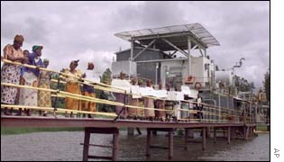
Protests & Demonstrations
Since the return of democracy in 1999, a number of ethnic-based & religious movements have mobilized to pressure the federal gov’t to address grievances
Target international oil companies in Niger Delta
July 2002 – unarmed Ijaw women occupied ChevronTexaco’s Nigerian operations
Ended when officials agreed to provide jobs for women’s sons & set up credit plan to help village women start businesses
Under Obasanjo, many protests were violently suppressed
Notes:
Under Obasanjo, many protests were violently suppressed

Slide 14
Protests & Demonstrations
Protests grew in 2006
Groups organized to attack foreign based oil companies
Armed rebel gangs blew up pipelines, disabled pumping states, and kidnapped foreign oil workers
Production sites shut down and some foreign companies have left
Amnesty signed in 2009 – unease remains
After election of 2011, protests erupted in North b/c Jonathan, a Christian from the South, retained the presidency
Many people believed the informal rule of rotating presidents from north and south had been violated
Notes:
Nigeria is the world’s 8th largest oil exporter, so these events affected int’l energy markets, contributing to higher prices and tighter supplies
Some companies left b/c of instability
2009 amnesty signed, which calmed things down

Slide 15
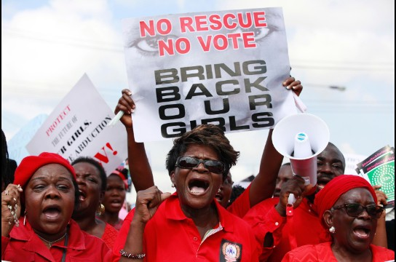
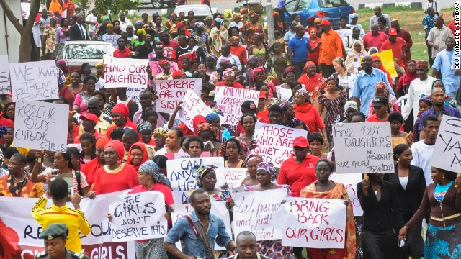
Protests & Demonstrations
2014: Multiple demonstrations/protests broke out calling on the Nigerian government to rescue schoolgirls kidnapped by the Islamist militant group Boko Haram
In April, more than 200 girls were abducted from their boarding school in northeastern Nigeria
More on Boko Haram
2015 – Nigeria, Niger, & Chad displaced Boko Haram from most of its territory
Violence continues
Notes:
April 30 – Million Woman March

