Slide 1
NIGERIA
“The trouble with Nigeria is simply and squarely a failure of leadership. There is nothing basically wrong with the Nigerian character. There is nothing wrong with the Nigerian land or climate or water or air or anything else.”
--Chinua Achebe
Part 2: Institutions

Slide 2
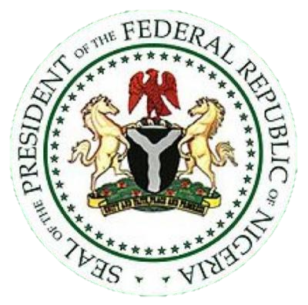
The Basics
Democracy (fragile)
Federal*
Territory divided into 36 federal states + federal capital territory, Abuja
*Currently neither checks or balances operate, and state and local governments are totally dependent on the central government
774 local governments
Presidential System
Bicameral Legislature
Modern Politics = Republics
First Republic – 1963-66
Second Republic – 1979-83
Third Republic – 1993
Fourth Republic – 1999-Present

Slide 3
The Executive Branch History
1979 – Presidential System established
1983 – Palace Coup (by Buhari) established military dictatorship with subsequent coups; all promised “transition to democracy”
Buhari; Babangida; Abacha
1999 – First Presidential election under new Constitution; civilian rule returned, but presidents elected in 1999, 2003 and 2015 were military generals
1999-2007 – Obasanjo
2007-2010 – Yar’ Adua (died)
2010-2015 – Goodluck Jonathan
2015-? – Muhammadu Buhari (ran in 2003, 2007, & 2011)
First PEACEFUL power transfer from one party to another
Elections of 1999, 2003, and 2007 – rife with fraud and violence
Elections of 2011 & 2015 were better, however, no clear trend toward democratization is in place
Notes:
Patrimonliasm – system of patronage in which the president is at the top
When Buhari takes office on 29 May 2015 as scheduled it will mark the first time in Nigeria's history that an incumbent elected President will peacefully transfer power to an elected leader of the opposition.

Slide 4
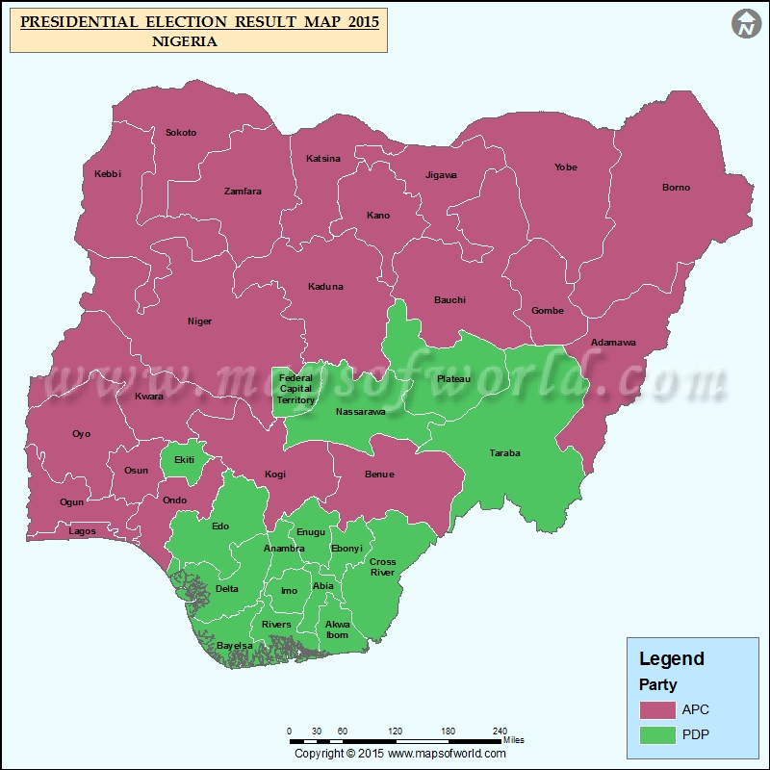
The Executive
Executive – President and Cabinet
Directly elected, 4 yr term, 2 term limit
2-round/majority model
Candidate must win majority of votes cast AND at least 25% of votes cast in 2/3 of Nigeria’s states
If no candidate wins a majority in the first round, second round pits top two popular vote winners
Notes:
Patrimonliasm – system of patronage in which the president is at the top
When Buhari takes office on 29 May 2015 as scheduled it will mark the first time in Nigeria's history that an incumbent elected President will peacefully transfer power to an elected leader of the opposition.

Slide 5
The Executive
Discussion Question: Why do you think Nigeria has the requirement of winning at least 25% of votes cast in 2/3 of Nigeria’s states to move to the 2nd round?
1999 Constitutional requirement
So a purely regional candidate cannot win the presidency
An attempt to help unify the people/country

Slide 6
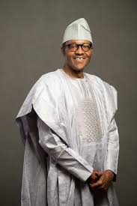
The Executive
May appoint officials to all parts of national government without approval of legislature
Leads to patrimonialism: system of patronage in which the president is at the top
Dispenses jobs and resources as rewards to supporters
Receives all gov’t oil revenues and distributes some to the states as directed by law
Commands armed forces
Can veto laws passed by legislature

Slide 7
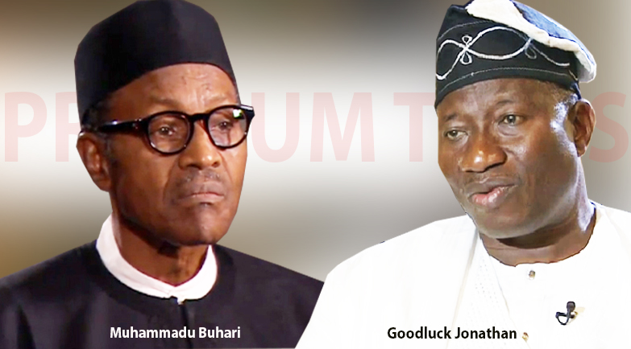
The Executive
Former President: Goodluck Jonathan
Current President: Muhammadu Buhari
72 year old Muslim, former military dictator!
Promised to curb corruption, including theft of public funds by elites and poor government practices and supervision.
Notes:
When Buhari takes office on 29 May 2015 as scheduled it will mark the first time in Nigeria's history that an incumbent elected President will peacefully transfer power to an elected leader of the opposition.

Slide 8
The Bureaucracy
Bureaucracy – assumed to be bloated, corrupt, and inefficient
Bribery is common
Jobs in bureaucracy are awarded through prebendalism
Parastatals – privately owned, but headed by government appointees (part of the patron-client network)
Provide public utilities or major industries – water, electricity, steel, defense, petroleum, etc.
Generally inefficiently run and corrupt
Nigerian Electric Power Administration (NEPA) – called “Never Expect Power Again” by Nigerians
Changed name to Power Holding Company (PHC) – called “Please Hold Candle” by Nigerians
Recently some privatization of power distribution companies
State corporatism – parastatals serve to give the appearance of public/private cooperation, while really giving the state control
Notes:
Jobs in bureaucracy are awarded through prebendalism
Parastatals:
Nigerian Electric Power Administration (NEPA) – called “Never Expect Power Again” by Nigerians
Changed name to Power Holding Company (PHC) – called “Please Hold Candle” by Nigerians

Slide 9
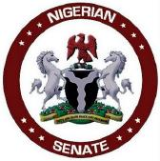
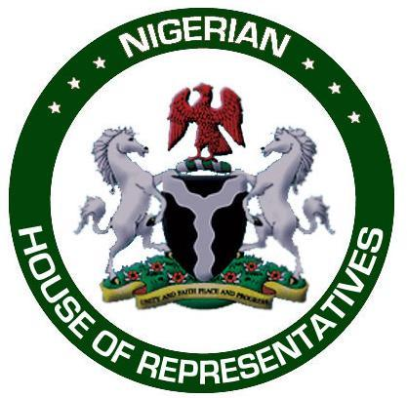
The Legislature
Legislature – parliamentary until 1979, now bicameral National Assembly
Senators and Representatives serve 4 year terms, elected the week before the president
Senate
109 Senators (directly elected)-3 per state, 1 from Abuja
Very diverse given the different regions that are equally represented
House of Representatives
360 members; SMD; Plurality vote
One of the lowest rates of female representation in legislature in the world (7 Senators; 20 Representatives – 2015 Elections)
Very little power, but occasionally acts as a check on president (like when Obasanjo wanted a 3rd term)
Have had corruption scandals
2000 – Senate President removed for kickbacks
2011 – Speaker of House investigated for misappropriation of $140mil.
Notes:
National Assembly did not ratify President Obasanjo’s plan to alter the Constitution to allow him to run for a 3rd term in 2007

Slide 10
The Judiciary
Federal and state courts with an appeals process up to the Supreme Court
Strong and autonomous after independence, but since ravaged by military rule
Most judges today are not well versed in law, easily manipulated by the government
Theoretically in charge of judicial review, not practically
Law is complicated by the sharia which operates in 12 northern states, controversially
Structure is complicated by sharia courts that exist side by side with courts based on British model
Establishment of tribunals to hear accusations of voting fraud in 2007 election
Indication of taking rule of law seriously
Had power to remove officials from positions
More independent and stronger?
Procedures put in place were followed and some cases referred to Supreme Court

Slide 11
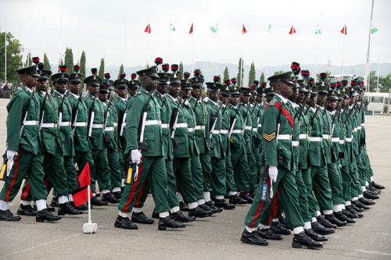
The Military
Guess what? It’s strong!
Military made distinctions between “military in government” and “military in barracks” after early coups
“Military in government” presidents (like Babangida) had to restrain influence of traditional military
Appointed senior military to cabinet positions to make them part of his patronage network
“Military in barracks” leaders have often been critical of military control of political power
Leads to internal discord & military leaders have to keep eye on each other
The best place for young Nigerians to improve their lives, demonstrate their talents (tends to contain Nigeria’s best and brightest)
Controversial, but it is the one national institution with the capability to restore order
Notes:
Best and brightest join the military
Members from all parts of Nigeria

Slide 12
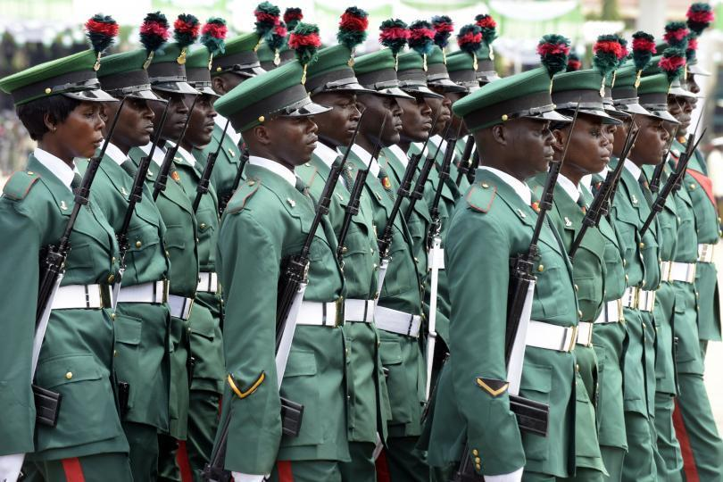
The Military
Suffered setbacks in 2014 & 2015
Boko Haram couldn’t be contained
Some soldiers refused orders or fled
Sept. 2015 – Campaign against them with other countries
Victory claimed by military
Bombing continues – Boko Haram proclaimed goal of creating new caliphate
President Buhari promises to quell corruption in the army, since embezzlement by generals contributed to the lack of resources to defeat Boko Haram
Notes:
Best and brightest join the military
Members from all parts of Nigeria

Slide 13
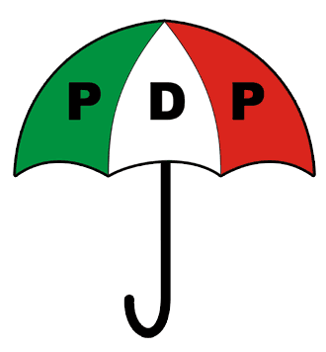
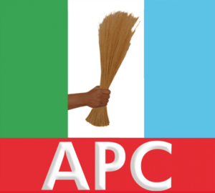
Linkage Institutions - Political Parties
Regionally & ethnically based
Fragmented Multi-Party System
Reinforced and deepened ethnic and religious cleavages
Parties appear and disappear based on leaders
Recent Parties:
People’s Democratic Party (PDP)
Most long-lasting: Obasanjo, Goodluck Jonathan
Coalition of northern and Yoruba politicians, current & former military leaders, and smaller ethnic groups in middle of country
All Progressives Congress – 2013 three opposition parties merged to challenge PDP in 2015
Buhari’s party
Notes:
People’s Democratic Party (PDP) – Obasanjo and Yar’Adua’s party of power, “won” in most parts of the country with Southern and Northern candidates
All Nigeria People’s Party (ANPP) – General Muhammad Buhari’s party
Action Congress (AC) – merger of many parties, led by Atiku Abubakar (who was disqualified from running in 2007, then reinstated by the Supreme Court days before the election)

Slide 14
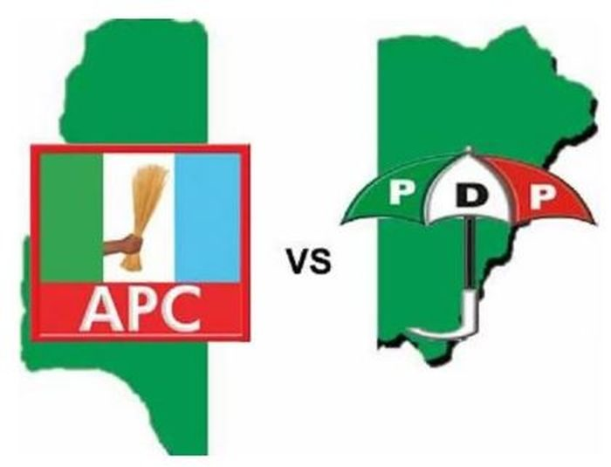
Political Parties
These parties are becoming less regional, and increasingly run a “ticket” with candidates of different regions, campaigning across all of Nigeria
Why?
Because of 1999 Constitutional requirement
The PDP originated in the Muslim North, but deliberately ran Obasanjo, a Christian Yoruba from the South in 1999 and 2003 – became dominant party
However because of fraud and violence – less legitimacy for govt.
2011 – PDP ran Jonathan (Southern Christian) – criticized for not running a Muslim from North
2015 – APC made inroads into the South, ensuring election of Buhari

Slide 15
Interest Groups
Have and continue to play an important role in Nigerian politics
Some based on religion:
Christian Association of Nigeria; Several Muslim organizations
Some based on professions of educated elite:
Legal professions, physicians, educators
Labor Unions
Were independent and powerful before military oppression of 1980’s
Have regained power in recent years
Nigeria Labor Congress – organized successful general strike in 2007 against elimination of gas subsidies

Slide 16
Linkage Institutions - Media
Well developed, independent press
Reflects ethnic interests/issues
TV/ Newspapers more common in urban areas
Parastatals operate over 100 stations
Privately owned TV stations/cable/satellite services
Most outspoken newspapers in South
Radio reaches all of Nigeria – all 36 states have their own (broadcast in local language) – compete with private broadcasters
Cellphone service has overtaken landline
95 million cell phones/700,000 wired phones
2009 – 44 million internet users but only 1200 internet hosts
Notes:
State radio – broadcasts in local language

