Slide 1
NIGERIA
“Nigeria is not a nation. It is a mere geographical expression.”
--Chief Obafemi Awolow
Part 1: The Making of the Modern State

Slide 2
Just for Fun…
http://www.theonion.com/video/in-the-know-situation-in-nigeria-seems-pretty-comp,14171/

Slide 3
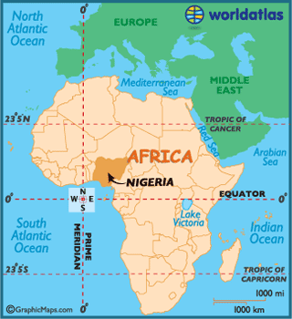
Why Study Nigeria?
LDC trying to democratize
History of colonialism, military rule, parliamentary democracy & presidential democracy
Ethnic/Religious/Regional Cleavages
Largest population in Africa (140 million)
Federalism
Resource curse (oil)
Countries with an abundance of non-renewable natural resources, tend to have less economic growth, less democracy, and worse development outcomes.
Patron-Client Relations (Prebendalism)

Slide 4
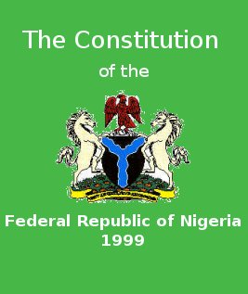
Sovereignty, Authority, and Power
Constitutionalism – eluding Nigeria so far
Acceptance of a constitution as a guiding set of principles
First constitution in 1914
8 more since
Latest – 1999 – heavily amended
Military and civilian leaders alike have never felt the need to obey constitutions, and often write new ones upon taking power
Notes:
Constitutionalism: acceptance of a constitution as a guiding set of principles.

Slide 5
Sovereignty, Authority, and Power
Legitimacy
Newly independent (1960)
Highly fragmented along ethnic, regional, religious lines
History of ethnic/religious conflict, economic exploitation by the elite, and use of military force
The sole stable national institution is the military
Leads to legitimacy of military’s right to rule
Most leaders have been generals
Extremely low legitimacy of government, overall
Massive corruption, distrust of government
1998 – General Abacha died unexpectedly – celebrations in the streets
Citizens don’t believe elections are done in a fair and honest way

Slide 6
Sovereignty, Authority, and Power
Legitimacy
Important source of legitimacy in the north – Sharia
Especially since 1999
Became public law after 1999
Hisbah, a police force, enforces Islamic morality in the streets
Govt. crackdown on Hisbah in 2008 – national ban on religious and ethnic militias
Application of sharia returning to a compromise between faith and modern realities of life in Nigeria
Sharia is evident in new education programs for girls
Hybrid Islamic education along with math and reading
State officials also using sharia rules on cleanliness to encourage recycling

Slide 7
Corruption Perception Index - 2014
Country | CPI Score | Rank (178 Countries)
China | 36 | 100
Iran | 27 | 136
Mexico | 35 | 103
Nigeria | 27 | 136
Russia | 27 | 136
UK | 78 | 14
2006 – Nigeria ranked 142 out of 146
Why?
Patron-clientelism (prebendalism) in Nigeria, China, Mexico
China, Mexico, Nigeria, Russia, and China – corruption is a part of the political culture

Slide 8
Pre-Colonial Era (800-1860)
Trade Connections – The Niger River and Atlantic Ocean allowed contact with other nations.
Early Influence of Islam – Trade in the North put early Hausa and other groups in contact with Islam, which gradually replaced traditional customs and religions
Kinship-based Politics – Among southern people, political org. didn’t go beyond the village level which were made up of extended families
Complex Political Identities – Contrast between state and local gov’t was far from clear cut
Democratic Impulses – Rulers were expected to seek advice and govern in interest of the people
Leaders were seen as representatives of the people
They could be removed from their positions
Notes:
Authoritarian rule – British established chiefs to rule on their behalf
Interventionist state – no “free market”… chiefs expected to rule to meet economic goals set by the British
Individualism – self-interest of capitalism was mixed with state-domination of the economy
Intensification of ethnic politics – Hausa-Fulani, Igbo, Yoruba competed for “rewards” from British

Slide 9
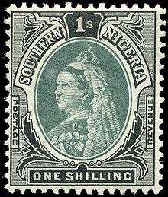
Influence of British Rule (1860-1960)
Deepened ethnic and regional divisions
Authoritarian rule – British established chiefs to rule on their behalf
Interventionist state – no “free market”… chiefs expected to rule to meet economic goals set by the British
Individualism – self-interest of capitalism was mixed with state-domination of the economy
Intensification of ethnic politics – Hausa-Fulani, Igbo, Yoruba competed for “rewards” from British
Indirect rule in the north (Muslim leaders)
Direct rule in south
Christianity
Islam already in North from Arab traders
Western-style education
Mostly in south (Christian missionaries)
Independence – 1960
Since then…the ”National Question”
Should we even be a country?
Notes:
Authoritarian rule – British established chiefs to rule on their behalf
Interventionist state – no “free market”… chiefs expected to rule to meet economic goals set by the British
Individualism – self-interest of capitalism was mixed with state-domination of the economy
Intensification of ethnic politics – Hausa-Fulani, Igbo, Yoruba competed for “rewards” from British

Slide 10
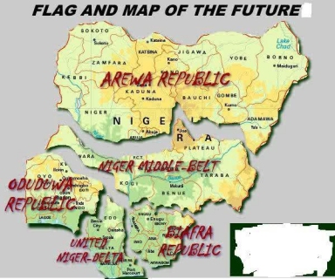
?

Slide 11
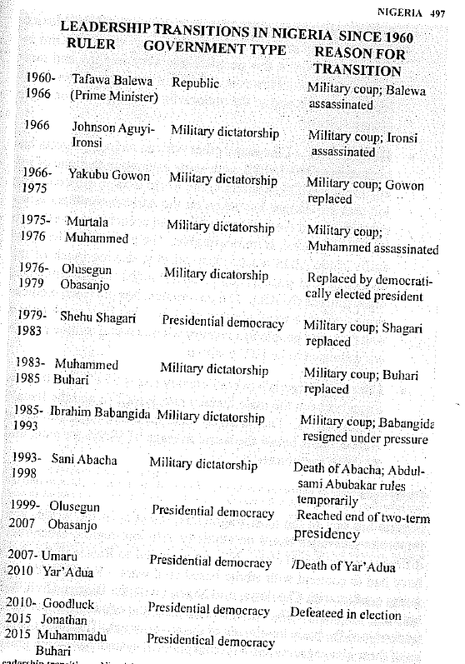
Since Independence
British trained natives to join bureaucracy before 1960
Taught them western political values – freedom, justice and equality of opportunity
Seeds of decolonization planted
1960-1979 – British parliamentary style democracy
Why didn’t it work?
Ethnic divisions made it difficult to identify a majority party or allow a PM to have necessary authority

Slide 12
Since Independence
1967-70 Biafran Civil War
First military ruler, Ironsi, justified his authority by announcing his intention to end violence and stop political corruption
Killed in a coup by a 2nd general
Coup sparked the Igbo to fight for independence for their land – called Biafra
Country did remain together, but only under military rule
1979 – Presidential System
Popularly elected President, separate legislature, & independent judiciary (however not consistent checks on pres. power)
Both systems experienced frequent interruptions/periods of Military Rule –frequent coups
7 coup d'états between 1966 – 1993

Slide 13
Since Independence
Other Trends
Intensification of ethnic conflict – Hausa-Fulani formed a majority coalition with Igbo, angering the Yoruba
Personalized rule and corruption
Govt revenue goes to Nigerian elite through patron-client system/prebendalism
Two military presidents: Babangida and Abacha maintained large foreign bank accounts with regular deposits diverted from Nigerian state (oil $)
Example: 2/3’s of the profits from oil sales during the first Gulf War ended up in the hands of Nigerian elites
Loyalty Pyramids - Senior govt officials are supported by a broader base of loyal junior officials
State control of resources means that those in the pyramid get the spoils, and they alone have access to wealth and influence
Federalism – attempt to pacify ethnic tension, though military leaders did not allow much local power
Economic dependence on oil – enriches those in power, who ignore other sectors of the economy
Notes:
Corruption:
Two military presidents: Babangida and Abacha maintained large foreign bank accounts with regular deposits diverted from Nigerian state (oil $)
Loyalty Pyramids
Senior govt officials are supported by a broader base of loyal junior officials
State control of resources means that those in the pyramid get the spoils, and they alone have access to wealth and influence

Slide 14
Economic Development
Rentier State based on oil revenue (like Iran)
Debt because of over-reliance on oil and corruption
1980s Nigeria was forced to turn to international organizations for help in managing its huge national debt
World Bank/International Monetary Fund helped develop economic structural adjustment program
Restructure and diversify Nigerian economy to decrease dependence on oil
Notes:
Rentier state, like Iran

