Slide 1





Role of Media
Poli Sci – Unit 1

Slide 2
Role of Media
Mass Media
  Includes all forms and aspects of communication to the general public
  Considered the “fourth branch of government” given the importance and influence on the electorate, policy-making, politics, and the government
  Five types:
    Newspapers
    Radio
    Magazines
    Television
    Internet

Slide 3
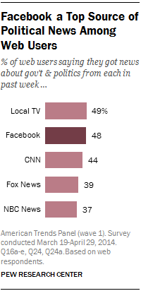
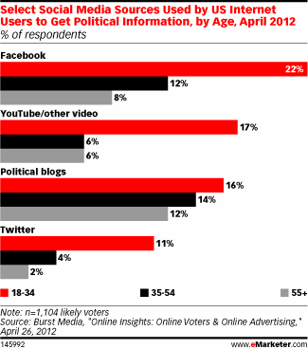
Role of Media

Slide 4
Role of Media
Gatekeeper
  Influencing or determining which issues receive attention or degree of attention
  Stories they report on tell us what to care about as a country
    Agenda setting
Scorekeeper
  Tracking candidates or issues showing their importance or significance over time
    Ex. Polls on who’s leading in elections; what issues Americans care about, etc.
Watchdog
  Investigating and exposing candidates and institutions
    Ex. Watergate, Benghazi investigation, Iran-Contra, etc.

Slide 5
Role of Media
Selective attention: many focus in on media sources they already agree with
Selective exposure: screening out those messages that do not conform to their own biases
Selective perception: many perceive news in the way they want to view it – they see what they want and filter out the rest
Could this lead to people seeing media as biased?
How do we know what is real and what is biased?

Slide 6
Role of Media
MEDIA ACTIVITY
  What is media bias?
  What is “fake news”?
  Have you ever believed in fake news? When? Why?
  What happens if we can’t tell real news from fake news?
  Where do you go to read the news? [If students state social media, where specifically? Whom do they follow? If students state TV, which programs?] Why do you go there? What other options do you have?

Slide 7
Role of Media
http://umich.edu/~newsbias/index.html
Mediaocracy - http://www.pbseduelectioncentral.com/we-the-voters (Decoding Bias Handout)
Articles from all sides - https://www.allsides.com/
Trending news - http://newsmap.jp/
Confirmation Bias, etc. - https://www.facinghistory.org/resource-library/facing-ferguson-news-literacy-digital-age/confirmation-and-other-biases
Slanted Sentences - https://learning.blogs.nytimes.com/2003/03/20/slanted-sentences/
Media Smarts – Bias Activities (pdf)
Media and Amer. Dem. – slanted words/sentences (pdf)

Slide 8
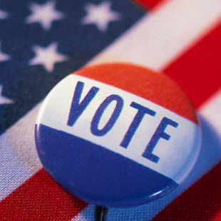

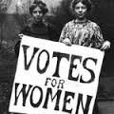
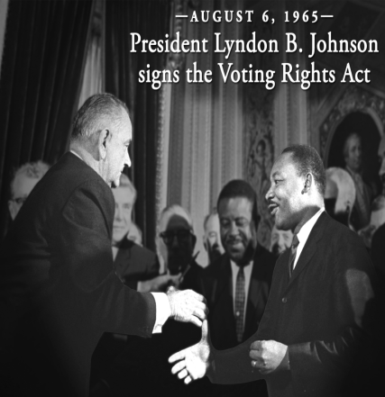
Political
Participation

Slide 9
Expansion of Suffrage
Suffrage = The right to vote
Electorate means the “potential voting population”
1810 - religious qualifications were eliminated
1840 - property requirements eliminated
1870 - 15th Amendment – the right to vote cannot be denied based on race, color, or previous condition of servitude.
  However, did they really get the right to vote?
1920 - 19th Amendment - allowed women to vote

Slide 10
Expansion of Suffrage
1924 – Native Americans allowed to vote
1961 - 23rd amendment – Washington, D.C. residents allowed to vote in federal elections
1964 - 24th Amendment - eliminated poll taxes
1965 - Voting Rights Act
1971 - 26th Amendment - allowed everyone over 18 to vote

Slide 11
Voting Requirements
Set by each state
U.S. Citizen – Nothing in the Constitution says that a non-citizen can’t vote (most states require citizenship)
  Non-citizens cannot vote in federal elections – 1996 law
  A couple of states allow non-citizens to vote in local elections
Residency – You must live in the state to vote there
Age – Limit can’t be higher than 18
Registration – you must be registered in a state to vote
  Most states cut off registration 30 days before an election

Slide 12
Voting through History
Ted Ed:
  https://www.youtube.com/watch?t=40&v=P9VdyPbbzlI
So You Think You Can Vote? –
  https://vimeo.com/185519440

Slide 13
Registration
Registration- a procedure of voter id to prevent fraudulent voting
All states except ND and WI require registration
  Oregon recently passed a law mandating that the state automatically registers a voter when they get state identification. You must send in a letter asking to remove you from the voter list. IL HAS THIS NOW
“Motor-Voter” Law since 1995
  Allows people to register to vote at government agencies.

Slide 14
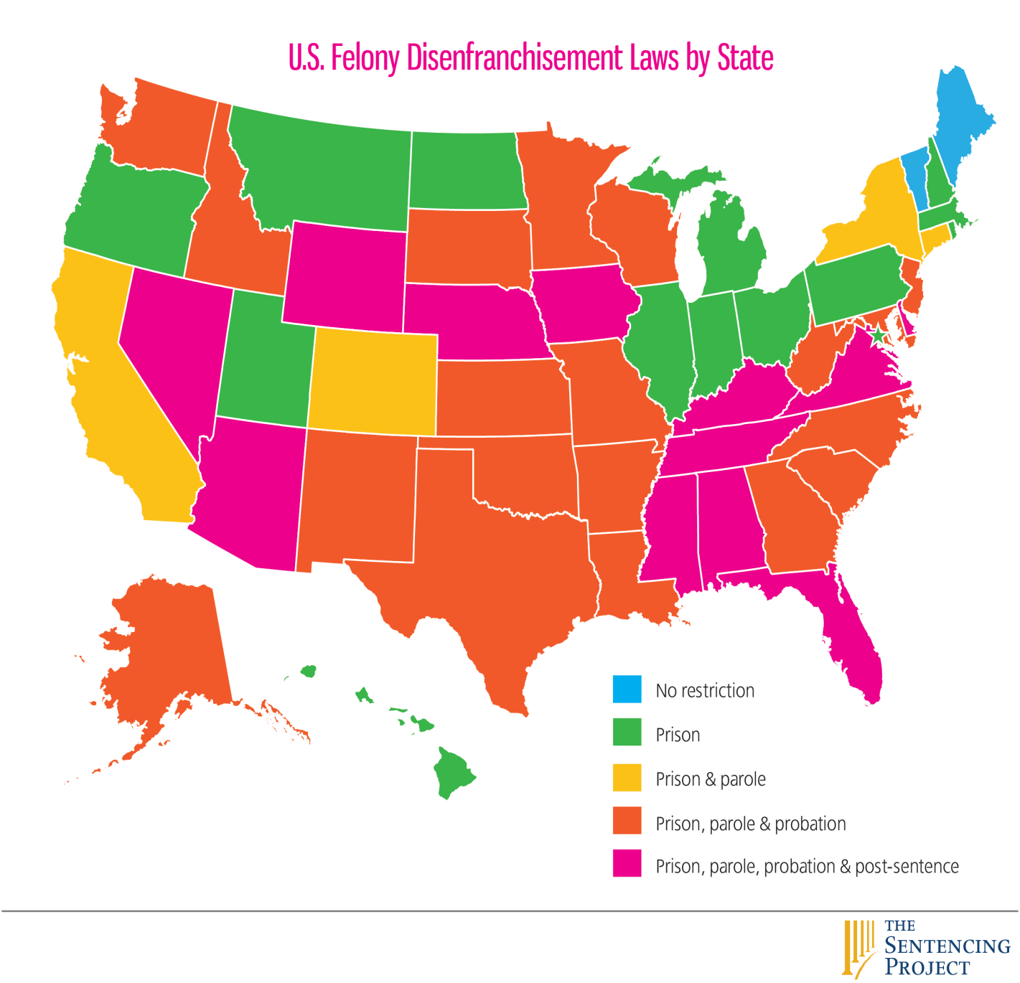
Who is denied the right to vote?
No state allows anyone living in a mental institution to vote.
Around ¼ of the states denies voting to felons.
A few states do not allow anyone who is dishonorably discharged from the military to vote
  Considered a felony in some states

Slide 15
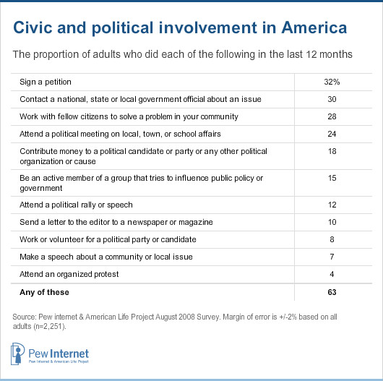
Political Participation
There are many ways to participate in politics:

Slide 16
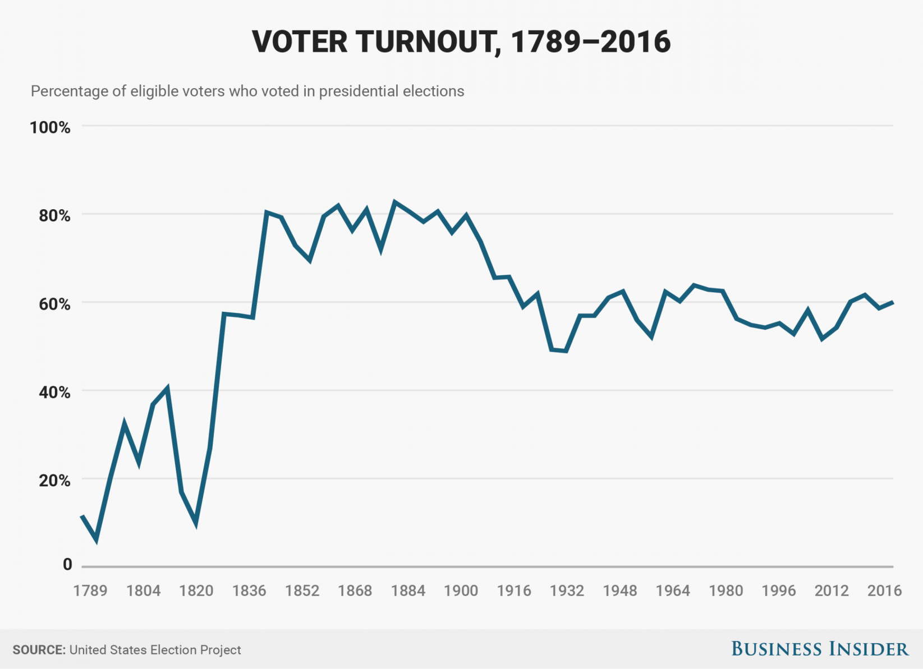
Political Participation
Voting is the most common way to participate

Slide 17
Political Participation
Voting is the most common way to participate

Slide 18
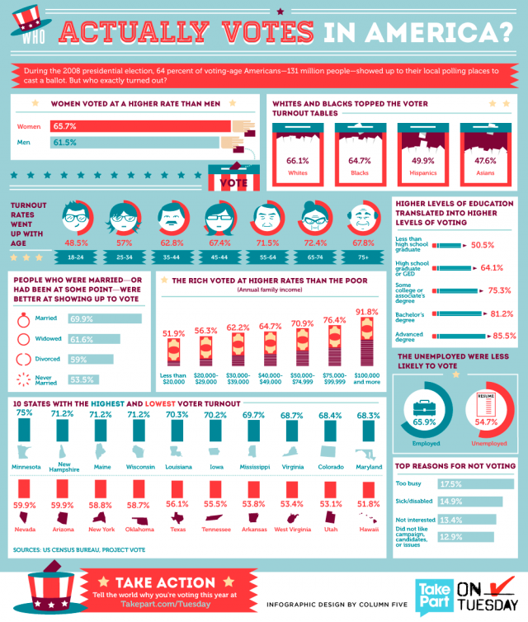

Slide 19
2016 Voter Turnout by State

Slide 20
Which age group is more likely to turn out to vote?

Slide 22
Is Latino Voting Increasing or Decreasing?

Slide 24
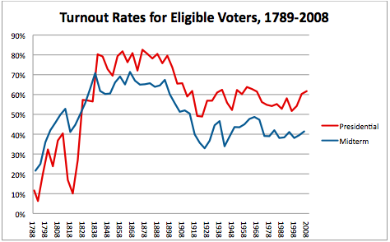
Political Participation
Voter turnout significantly decreases in off-year/midterm elections, congressional elections held in years when there is no presidential election

Slide 25
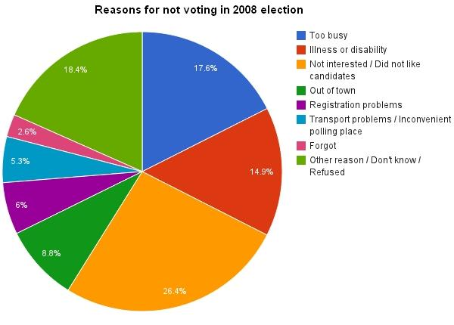
Why don’t more people vote?

Slide 26
Comparing Voters & Non-Voters
Voters | Non-Voters
Higher income, education, occupation level Well established in a community, home owners or urbanites Strong party identification – contact with party Live where laws and customs promote voting Older than 35, married, established in life Female | Lower income, education level, unskilled jobs More often rural residents, rather than urban or suburbanites Less contact with party organizers Live where less enthusiastic law enforcement Younger, transient, becoming established Male

Slide 27
Voting Analysis
2016 Voting Analysis Activity

