Slide 1
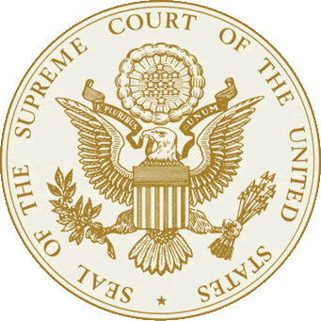
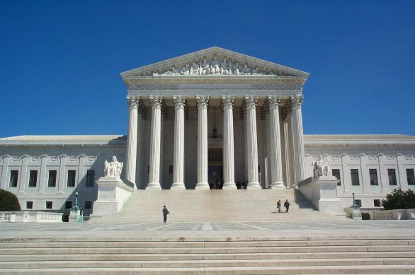
The Judicial Branch: the federal courts

Slide 2
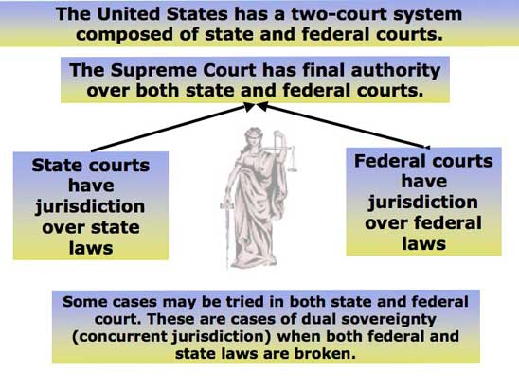
Dual Court System
There are really two court systems in the United States
  National judiciary that extends over all 50 States
  Court systems found in each State (most cases are heard here)
We are going to be focusing mainly on one part of the national judiciary, the Supreme Court

Slide 3
Constitutional Courts (regular courts)
Types of Federal Courts
  Examples
    District Courts (94 of them)
    Court of International Trade
    Courts of Appeal (12 of them)
    U.S. Supreme Court (only 1)
  Most Federal Cases are heard in one of these courts

Slide 4
Special Courts
(Legislative courts)
Types of Special Courts
  Examples
    Appeals for the Armed Forces
    Veterans Appeals
    Claims Court
    Tax Court
    Court for Washington DC.

Slide 5
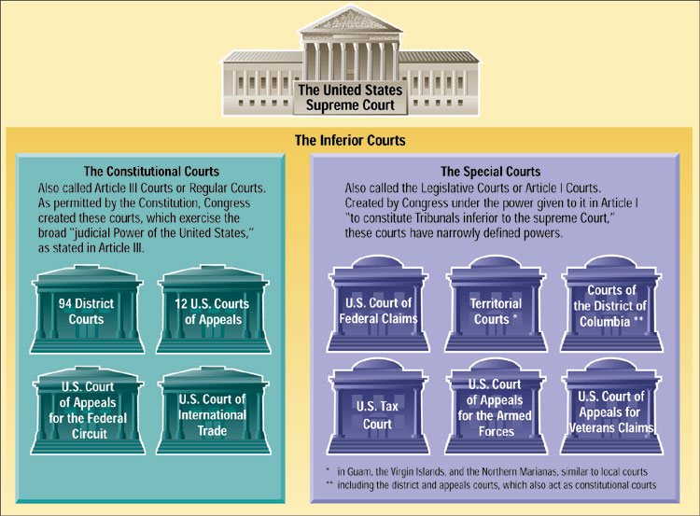

Slide 6
Plaintiff v. Defendant
The one who brings a case/lawsuit is the Plaintiff.
The one being charged/sued in a case is the Defendant.

Slide 7
How do we decide where cases go?
    State or Federal?

Slide 8
Jurisdiction
Definition: The right to hear a case

Slide 9
Exclusive Jurisdiction
Cases that can only heard in federal court
Would include cases involving
  The USA or its officials
  Ambassadors
  Disputes between states
  Disputes between citizens of separate states
  US citizens suing foreign citizens or foreign countries
  Citizens of the same state suing about property in another state.

Slide 10
Concurrent Jurisdiction
A case that may be tried in either the state or federal court system.
Disputes between parties of different states involving $50,000 or more are usually tried in Federal District Court!

Slide 11
Original Jurisdiction
Where a case originally was heard
Local Courts (part of state system), Federal District Courts, and the Supreme Courts (state and U.S.) are all courts of original jurisdiction!

Slide 12
Appellate Jurisdiction
Case taken on appeal from a lower court to a higher court
The Federal and State Courts of Appeal and the Supreme Courts all have appellate jurisdiction!
Can uphold, modify, or overrule a decision

Slide 13
11th Amendment
Citizens of one state, may not sue the government of a state in which they do not reside.
The federal government may not hear a case like this according to this amendment.

Slide 14
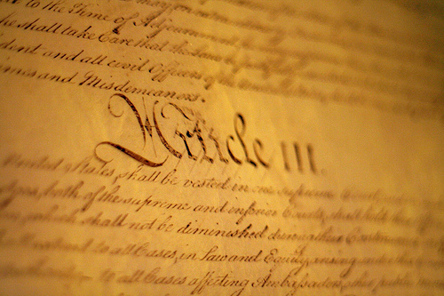
Where in the Constitution is the Supreme Court?
Article III of the Constitution sets up the Supreme Court
The Supreme Court was designed be as powerful as Congress or the President (checks and balances!).
The Supreme Court is the FINAL authority on law in the United States.

Slide 15
Judicial Review
(1 of the six principles)
The Supreme Court has the final say on what the Constitution actually means.
This ability to interpret the Constitution, and declare laws constitutional or unconstitutional, is known as judicial review.
This power of judicial review is NOT written in the Constitution. It was established in the 1803 case Marbury v. Madison.

Slide 16
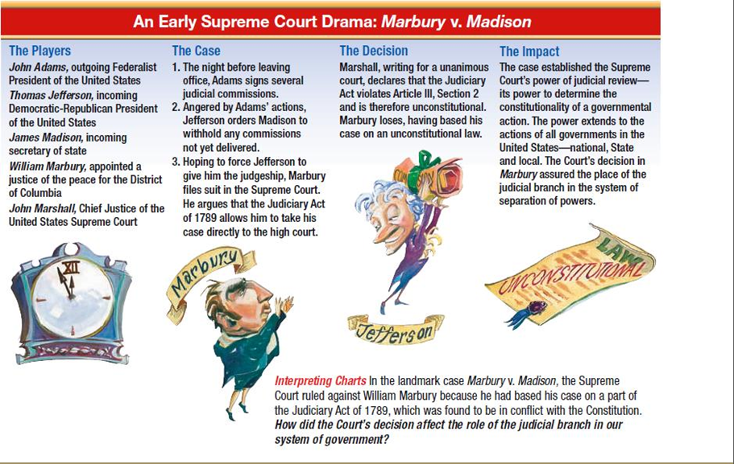

Slide 17
So, who makes up the supreme court?
The Supreme Court is made up of nine judges, who are called by the title “Justice”
  The number of Justices is not specified in the Constitution.
    One Chief Justice
    Eight Associate Justices
These Justices are appointed by the President.
These appointments must be approved by the Senate.
Justices serve a life term.

Slide 18
Pay and Retirement
Chief Justice of the USA $258,100/year
Associate Judges $246,800/year
Retire with full pay after 15 years at age 65 or after 10 years at age 70.
Justices may lose their position for reasons like death, impeachment, resignation, or retirement

Slide 19
Who are the justices??
Neil Gorsuch – Newest Justice – Trump appointee.
Elena Kagan – Pres. Obama’s second appointee (first time 3 women on SC)
Sonia Sotomayor – First Latina SC Justice
Samuel Alito – Pres. Bush appointee
Stephen Breyer – First time up for appointment, he lost to RBG
Ruth Bader Ginsburg – Liberals favorite. She was a good friend with former Justice Scalia (very conservative). Oldest justice currently
Clarence Thomas – 2013: Spoke during arguments for the first time in 7 years
Anthony Kennedy – Swing vote in critical cases. 2nd oldest.
CJ = John Roberts – won 25 cases at the SC before becoming CJ
Antonin Scalia (deceased) – Loved opera and was good friends with Ginsburg
  His seat was vacant for almost a year. Pres. Obama nominated Merrick Garland, but the Senate refused to confirm him.
  Neil Gorsuch took his seat last month.

Slide 20
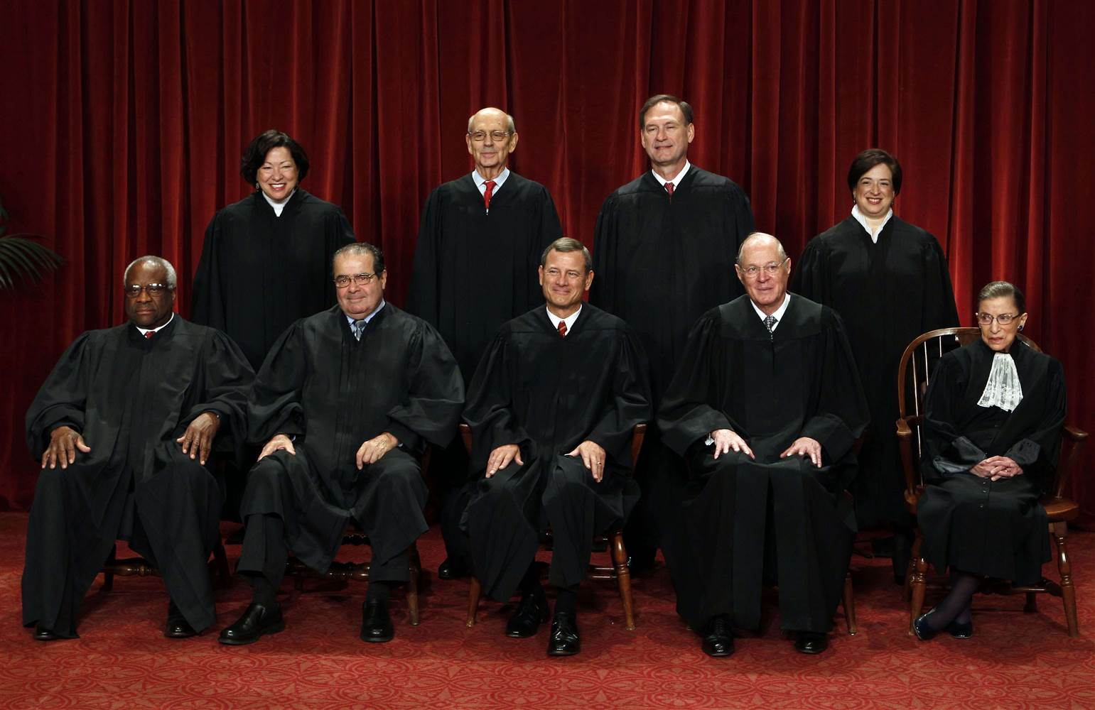

Slide 21
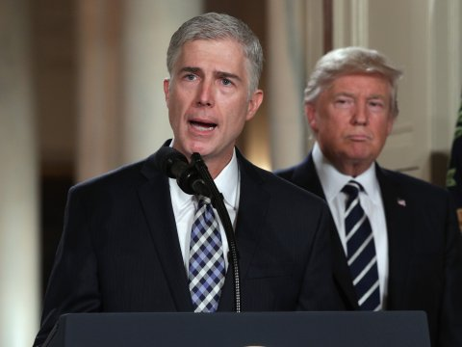
Neil Gorsuch

Slide 22
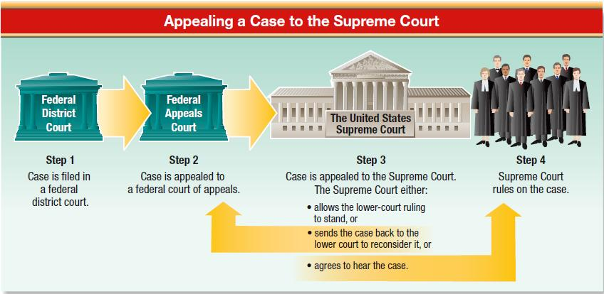
How do court cases reach the supreme court?
Most court cases reach the Supreme Court through what is called writ of certiorari.
  This writ is an order by the Supreme Court for a lower court to send up the records on a given case for review. (Appellate Jurisdiction)
  The Supreme Court decides what cases it will hear.

Slide 23
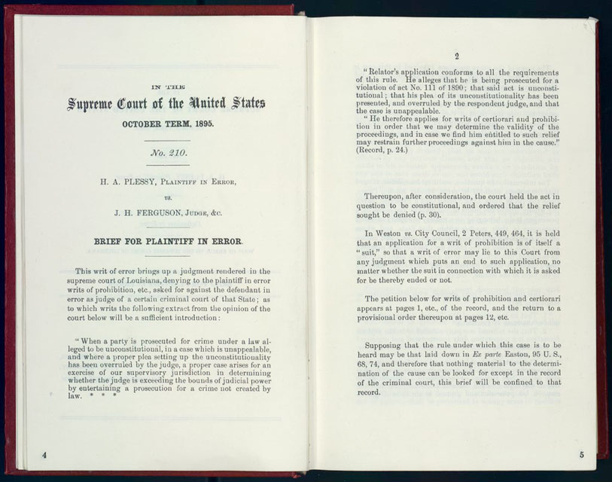
How does the Supreme court operate?
Step One: Briefs
  No, we’re not talking about the Justices’ choice in underwear.
  Briefs are documents written by lawyers for each side of the case and filed with the court before arguments begin.
  They state one side’s argument.

Slide 24
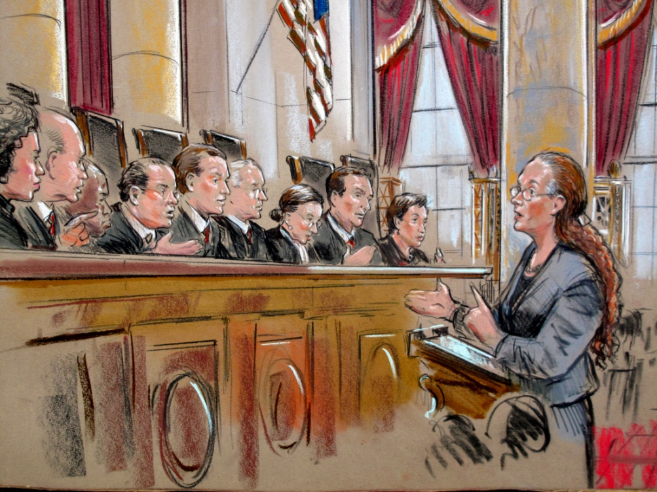
Step Two: Oral Arguments
  Lawyers for both sides argue their case to the Justices. Their presentations are limited to 30 minutes.
  These arguments happen in two week cycles from October to early May.

Slide 25
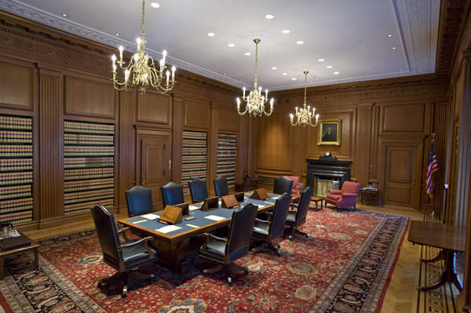
Step Three: Conference
  Conferences start off by the Chief Justice stating how he feels about a case.
  Following this, each Associate Justice summarizes their viewpoints. This is done in order of seniority.
  After each Justice has spoken, they take a “poll” and then debate the case.

Slide 26
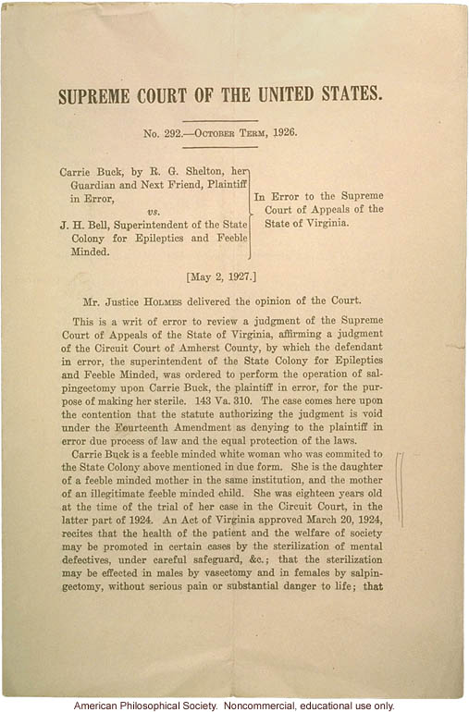
Step Four: Making Decisions
  About a 1/3 of the decisions are unanimous. However, many Supreme Court decisions are split, due to the fact that the easy cases rarely make it up to the Supreme Court.

Slide 27
Three types of SCotUS Decisions
  When the Supreme Court makes their decisions, they are split into three types, and are written out:
    Majority opinion: this is the decision that the most Justices sided with
    Concurring opinion: this is for Justices for agree with the majority opinion, but for a different reason than stated.
    Dissenting opinion: this is the decision written by the Justices who do not agree with the majority opinion.

Slide 28
Judicial Philosophies of Judges
2 Types:
1.) Judicial Activism
  The court should play a more active role in creating national policies and answering questions of conflict in society
2.) Judicial Restraint
  The court should operate strictly within the limits of the Constitution and only answer questions if a clear violation of the Constitution is present. Policy making should be left up to the executive and legislative branches.

Slide 29
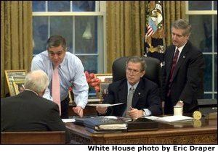
U.S. Supreme Court Confirmation Process
Stage 1
Presidential Nomination
White House staff reviews candidates and submits a short list to the president
FBI background investigation
Candidates submit financial disclosure forms
ABA grades candidates
Interest groups weigh in on candidates
President selects nominee

Slide 30
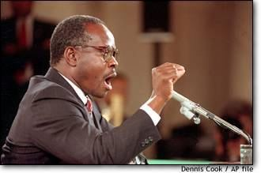
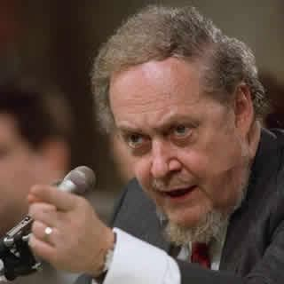

U.S. Supreme Court Confirmation Process
Stage 2
Senate Judiciary Committee Hearings
Senate Judiciary members and their staffs review candidate’s background (may conduct own investigation)
Interest groups may conduct campaigns for or against nominee (including TV ads)
Intense media attention to Senate hearings
Senate Judiciary Committee questions candidate on judicial philosophy, stands on key issues, etc.
Judiciary Committee votes up or down on nominee and sends recommendation to full Senate

Slide 31
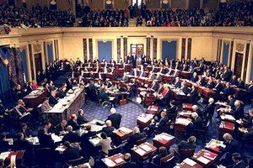
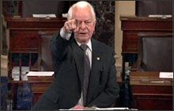
U.S. Supreme Court Confirmation Process
Stage 3
Full Senate Vote
Floor debate on nominee
Confirmation vote by full Senate
  Only needs 51 votes

Slide 32
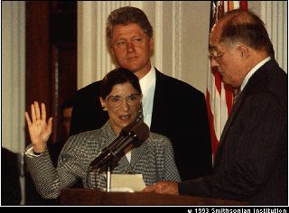
U.S. Supreme Court
Confirmation Process
Stage 4
Oath of Office
If confirmed by the Senate, nominee sworn in, usually by Chief Justice
Once on the Court, justices often make decisions on the bench very different from what the nominating President had anticipated
independent
judiciary

