Slide 1
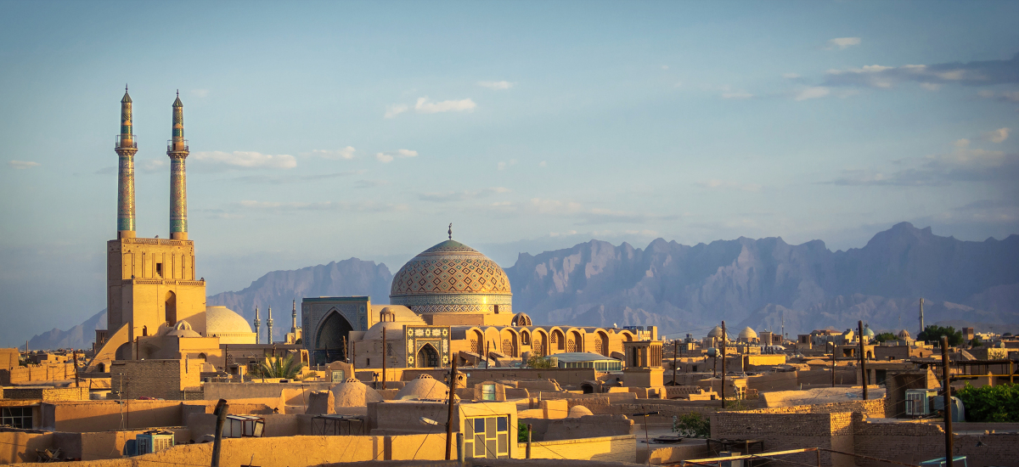
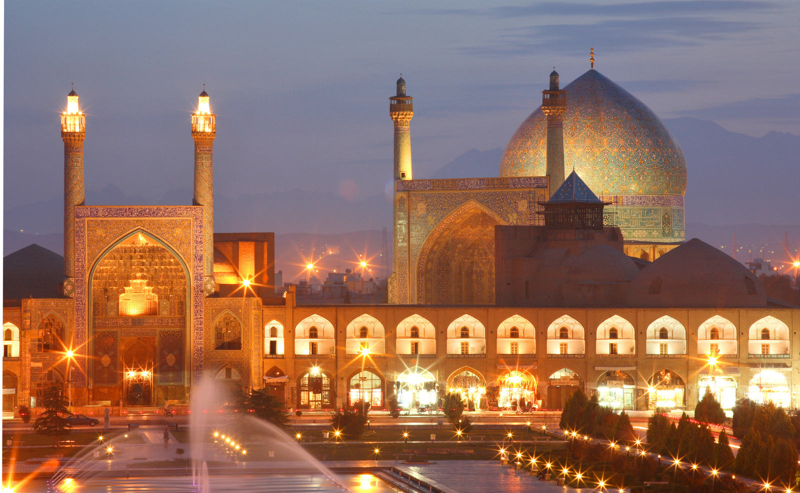
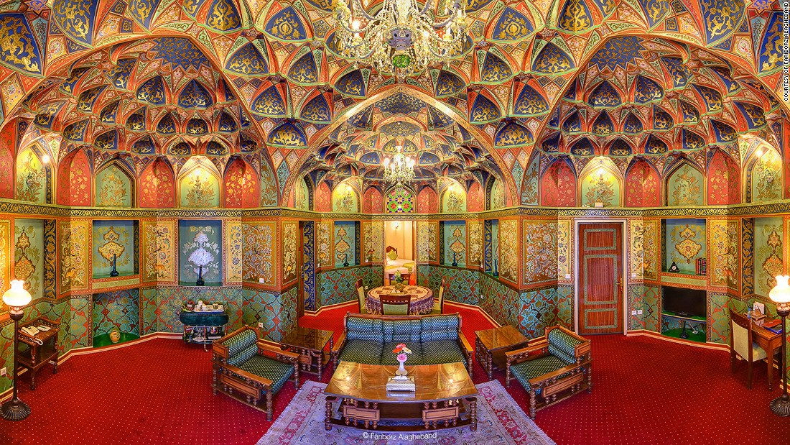
Iran: Public Policy
AP Comparative Government

Slide 2
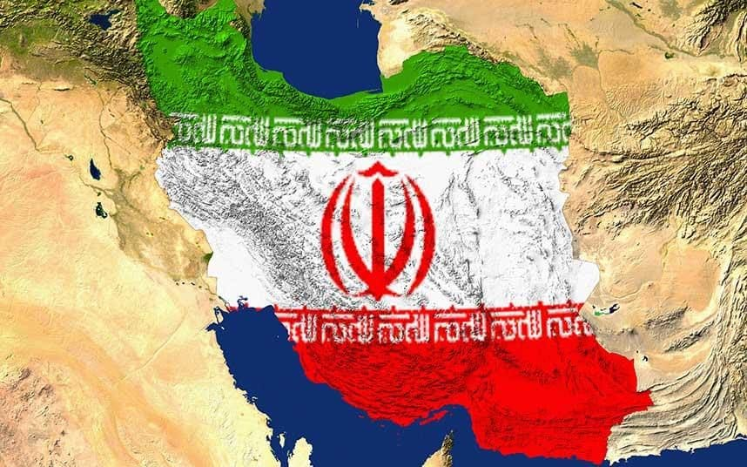
Policy Making Factions
The most powerful policymaking institutions in Iran are the Majles and the Guardian Council
The Expediency Council referees between the two institutions
There are a variety of factions that exist and argue about the creation of policy

Slide 3
Policy Making Factions
Conservative v reformist:
These conflicts often revolve around the conflict between theocracy and democracy
Conservatives uphold the principles of the regime and base their beliefs on strict sharia
Conservatives warn that modernization from western countries may threaten the tenets of Shiism that provide the moral basis for society
Reformists believe that the political system needs significant reform
They often disagree on what these reforms should be
They are less wary of western influence and don’t feel that government leaders need to be clerics

Slide 4
Policy Making Factions
Statists v Free-marketers:
This rift is not bound to the conservative/reformist cleavage
The statists believe the government should take an active role in controlling the economy (i.e. redistributing land and wealth, eliminating unemployment, financing social welfare programs, and placing price ceilings on consumer goods)
While not communists, they do enjoy the same philosophy as a Soviet 5 year plan
Free-marketers want to remove price controls, lower business taxes, encourage private enterprise and balance the budget
They enjoy the idea of a U.S. style economy, but placed within the constructs of sharia
These disputes have often led to gridlock in the Majles
Rouhani has included a broad number of factions in his cabinet

Slide 5
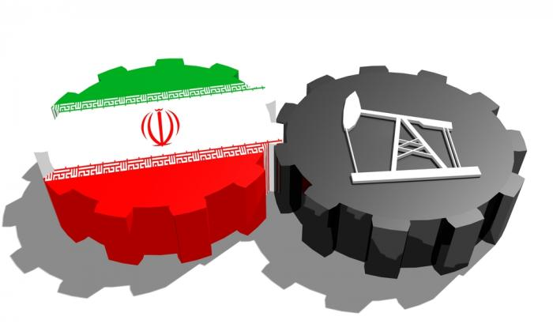
Economic Issues
In 2002, a bill was drafted in the Majles that would have permitted foreigners to own up to 100% of a company in Iran (Up from 48%)
The reformist bill was struck down in the conservatively controlled Guardian Council
Oil has created positives and negatives for Iran
Iran is a rentier state that sells indigenous raw materials to the outside world
The sale of oil has provided Iran with a huge source of income
The instability of the price of oil has greatly hurt the country

Slide 6
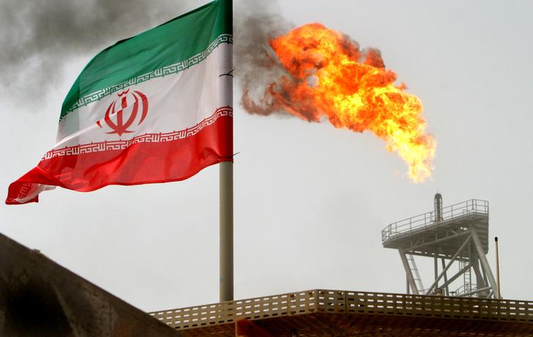
Economic Issues
Ayatollah Khomeini once stated that “economics is for donkeys”
This was supposed to affirm the importance of religious over secular leaders
While this is still the case, even the conservatives do not deny the importance of economics in modern times
Under Ahmadinejad, public subsidies went up, but massive oil mismanagement hurt the economy
Oil prices were so low that refiners refused to produce more oil
This pushed Iran to import 40% of its oil
The dramatic drop in oil prices in 2008 greatly hurt the nation
In 2010, subsides were largely stopped
This caused oil prices to jump 75% and diesel prices went up by more than 2000%
Other utilities also greatly increased in price
In order to help the poor, the government has given cash payments to low income families
2013 - $100 billion spent on subsidies to the public

Slide 7
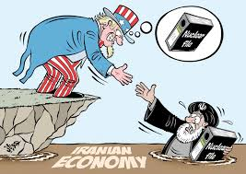
Economic Issues
2015 – Arms agreement with West – many hoped with the lifting of sanctions, the economy would get better, but there are still many problems
Oil exports dwindled to half of former levels
GDP fell; currency rates plunged; unemployment rose sharply
Rouhani’s success depends on ability to fix economy

Slide 8
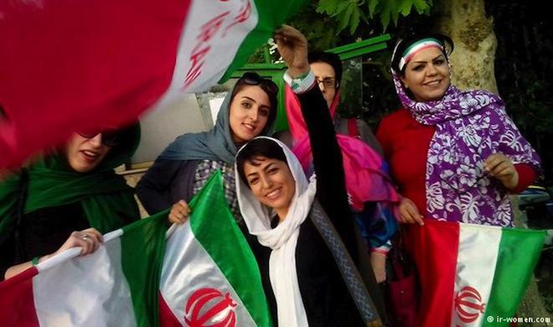
Population Policy
The country has recently tried to bring down the overall birth rate
This is in contrast to previous years that pushed for families to have larger families
The birth rate has begun to drop as women’s education rights have increased and birth control has been sanctioned
Becoming a middle-aged country
1.6-1.9 children per woman – in line with European rates

Slide 9
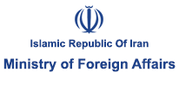
Foreign Affairs
The international profile of Iran grew considerably under Mahmoud Ahmadinejad
He was quite controversial and made many statements about the Holocaust being a myth
Ahmadinejad largely took very defensive stances in the western media, threatening to attack anyone who got in the way of Iranian development
Rouhani has expressed concern over Iran’s “brain drain” (exit of scholars to the West) and is willing to negotiate with the West
Iran tried to join the WTO in 1996
The application was rejected because of the difficulty for foreign investment and because of U.S. opposition
Iran does have fair amount of influence because of their involvement in OPEC
OPEC controls the price of oil exported from its member states

Slide 10
Nuclear Energy
Over the last decade, the United States and Iran have been involved in contentious talks regarding Iran’s nuclear program
Iran contends that the program is only used to generate nuclear power for the country
This stance was put into doubt after to heavy water facilities in Arak were disclosed
These facilities allow for the development of uranium that can be used in nuclear weapons
Over the last few years the U.S. has implemented massive sanctions against Iran in attempt to force a change in behavior regarding nuclear generation
The Iranian economy has suffered greatly because of these sanctions

Slide 11
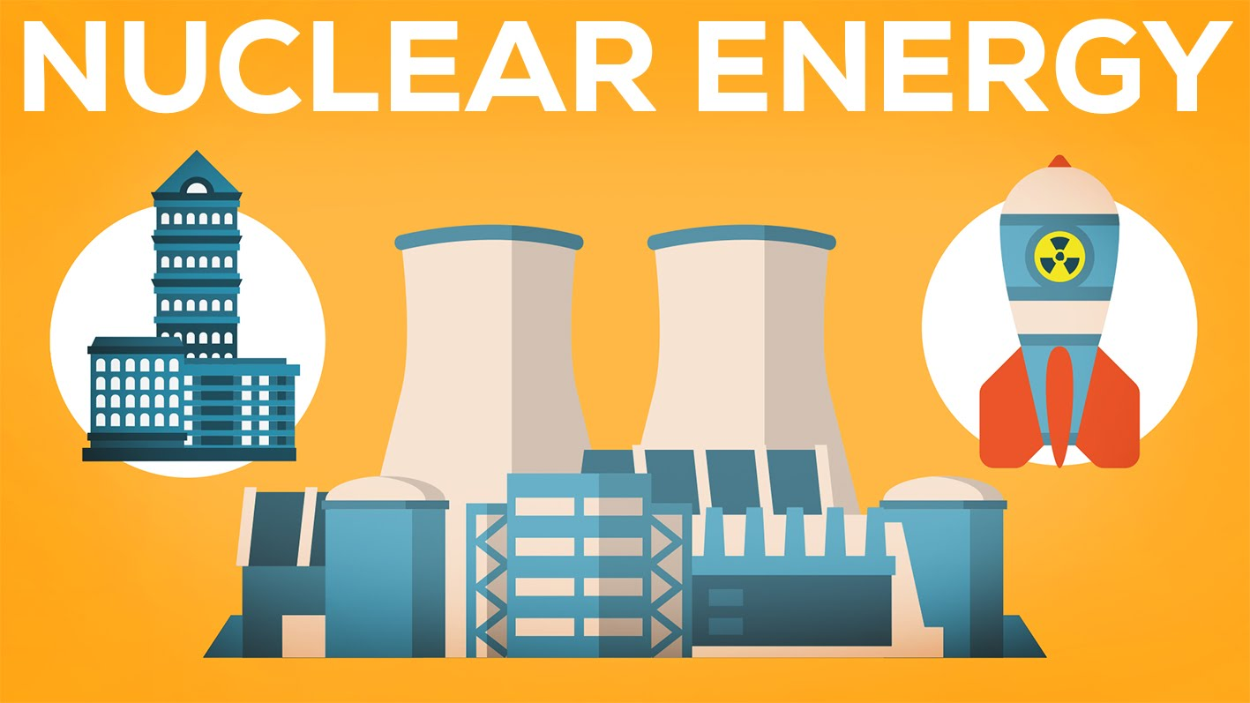
Nuclear Energy
2015 Nuclear agreement with Iran
U.S. and five other world powers agreed to future of Iran’s program
Limits on nuclear program - Iran agreed to turn one controversial site into a research facility and rebuild another so that production of weapons grade plutonium would be impossible
Continuation of enrichment but levels of enrichment were limited
Extension of the “breakout time” – extends amount of time it would take Iran to make a bomb
Sanctions may return – If Iran doesn’t comply, UN Security Council can reinstate sanctions
Comprehensive inspections – inspectors from IAEA have continual access to Iranian facilities, especially if any suspicious activity occurs
Terms of agreement expires in 10-15 years

