Slide 1
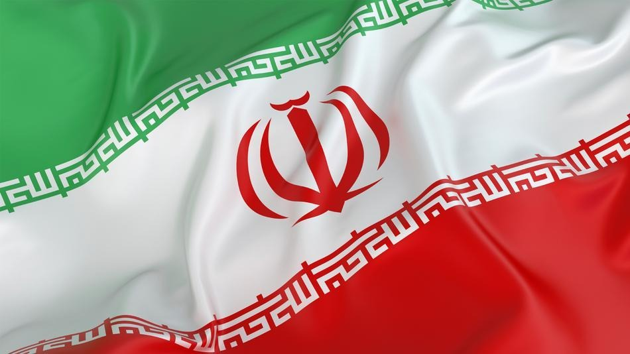
IRAN
“This is the voice of Iran, the voice of the true Iran, the voice of the Islamic Revolution.”
--Iran National Radio February 11, 1979
Part 1: The Making of the Modern State
Notes:
Quote:
This announcement came on Iran’s national radio the first evening after the coup d'état that deposed Muhammad Reza Shah, who had followed his father in ruling Iran with an iron first for more than a half a century
The announcement struck fear into hearts of many westerners who today see the 1979 Revolution as the beginning of a great conflict between the West and Islamic civilizations
Flag:
3 equal horizontal bands of green (top), white, and red
National emblem (a stylized representation of the word Allah in the shape of a tulip, a symbol of martyrdom) in red is centered in the white band;
ALLAH AKBAR (God is Great) in white Arabic script is repeated 11 times along the bottom edge of the green band and 11 times along the top edge of the red band

Slide 2
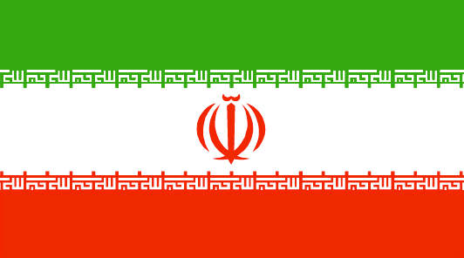
Iranian Flag and National Anthem
Iranian Flag:
Green = Islam/Persia
White = Freedom/Purity
Red = Sacrifice/Martyrs
The center symbol is a calligraphic Arabic word design in the Flag center that could either be read as Allah (GOD) and or Laelaha Ellallah (there is no God but one almighty God). The five parts symbolize the five pillars of Islam. The sword represents the strength of Iran and the “tashdid” on top doubles that power.
Symbolism = A tulip growing from the blood of martyrs.
The border on the red and green middle section is a stylized Arabic script of “Allahu Akbar” meaning “God is greater than to be described.”
National Anthem:
https://www.youtube.com/watch?v=pGp3OED4gtU

Slide 3
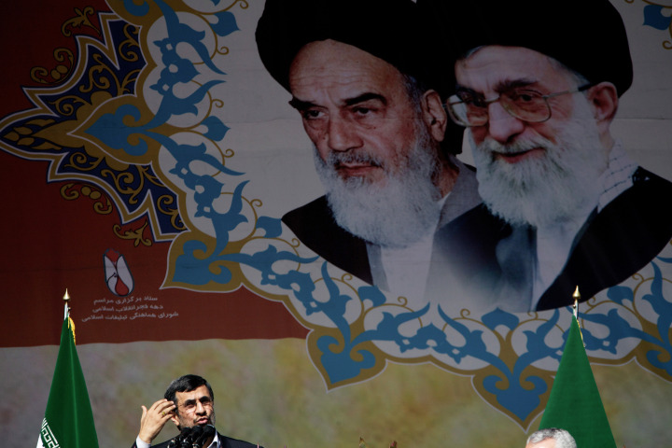
Why Study Iran?
World’s only theocratic republic
Theocracy with democratic elements
Unique among Middle Eastern countries
Tradition versus modernization

Slide 4
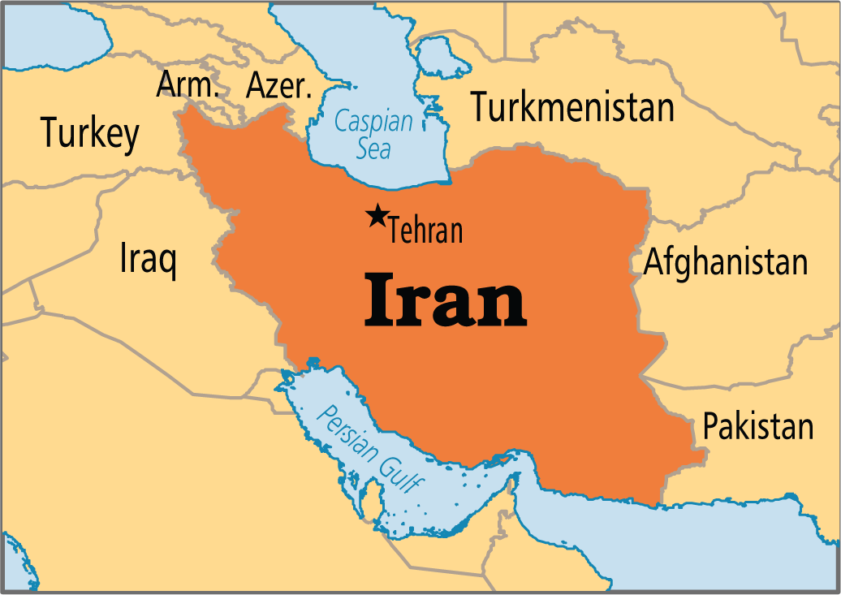
Geography
Crossroads between:
Central Asia and Asia Minor
Indian subcontinent and the Middle East
Arabian Peninsula and the Caucasus Mountains
Historically vulnerable to invaders
3x the size of France
Much of territory inhospitable to agriculture
2nd largest oil producer in the Middle East and 4th largest in the world
Urbanized and party industrialized
68% live in urban centers
70% labor force is employed in industry and services
Notes:
Geography:
Historically vulnerable to invaders: Indo-Europeans, Islamic Arab tribes and Turkic invasions
Slightly larger than Alaska
Much larger than immediate neighbors
68% live in urban centers
70% labor force is employed in industry and services

Slide 5
Population
67% of population on 27% of land
Mostly in the NW and cities of Tehran, Qom, Isfahan, Shiraz, & Ahwaz
Persian country, NOT Arab
Strong sense of nationalism – Identify as Persian before Muslim
89% Shi’a Muslim
58% speak Farsi (Persian)
Recent years, successful literacy campaign
Over 90% of population can now communicate in Persian, the national language
Notes:
Population:
mostly in Caspian provinces, the northwest, and in cities of Tehran, Qom, Isfahan, Shiraz, Ahwaz
Recent years, successful literacy campaign
Over 90% of population can now communicate in Persian, the national language

Slide 6
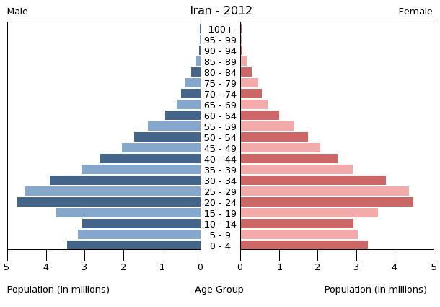
Population
Iran has a large young population
24% of all Iranians are under 15 and 27 is median age (was 23!)
Notes:
Population:
Youngest population of the AP6
Early after Revolution, government encouraged births (to produce soldiers to for the war against Iraq), then it is encouraged birth control - even had a state-owned condom factory! (b/c economy could not support rapidly growing population)– Now reversed policy and is encouraging large families
The government is made up of mostly the older generation
83% of adults are literate, life expectancy is over 70
Middle income country with per capita income above that of Mexico, Brazil, and South Africa

Slide 7
Population and Statistics
Youngest population of the AP6
After 1979 Revolution, government encouraged births to produce soldiers for the war against Iraq
Then, it encouraged birth control
Even had a state-owned condom factory! (b/c economy could not support rapidly growing population)
The government is made up of mostly the older generation
83% of adults are literate, life expectancy is over 70
Middle income country with per capita income above that of Mexico, Brazil, and South Africa
Notes:
Population:
Youngest population of the AP6
Early after Revolution, government encouraged births (to produce soldiers to for the war against Iraq), then it is encouraged birth control - even had a state-owned condom factory! (b/c economy could not support rapidly growing population)– Now reversed policy and is encouraging large families
The government is made up of mostly the older generation
83% of adults are literate, life expectancy is over 70
Middle income country with per capita income above that of Mexico, Brazil, and South Africa

Slide 8
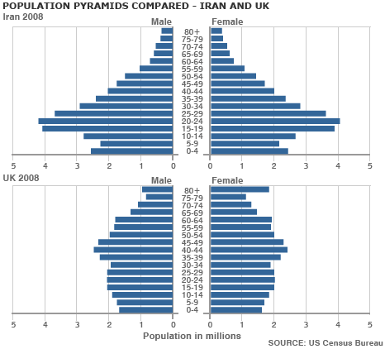

Slide 9
Population
Discussion Question: What future problems might be Iran need to address based on this population pyramid? Why is Iran now promoting population growth?

Slide 10
Sunni v. Shiite
Sunnis | Shiites
Majority of population in most Muslim countries | Majority in Iran, Iraq, Bahrain, possibly Lebanon
“Followers of tradition” | “Partisans of Ali (son-in-law)”
Most prominent members of community should select new leader, 4 caliphs (and heirs), based on piety, wisdom, morality, leadership ability, competence; ruled continuously until breakup of Ottoman Empire at end of WWI | Leadership should be based on bloodlines to Muhammad…all the way to Twelfth (Hidden) Imam who went into hiding; his return will herald end of the world
Any religious educated person can rule | Senior clerical scholars (ayatollahs) should interpret Shari’a until Twelfth Imam returns
Overwhelming majority in world | Less than 10% of Muslims worldwide -See themselves as “party of oppressed”
Notes:
Shi’ism
“Partisans of Ali” (Shi’at Ali)
Believe that rulers could descend only through Muhammad’s heirs, such as Muhammad’s cousin, son-in-law, Ali, whom they believed Muhammad had chose as successor
Imams disappeared in 874
Hidden imam will return at the end of time and restore a just order
Thus, all secular authority is illegitimate
Clergy stands in for hidden imam
Constitute less than 10% of Muslims worldwide (see themselves as “party of oppressed” standing up to wealthy & powerful – as did Muhammad)
Concentrated in Iran, southern Iraq, Azerbaijan, and southern Lebanon

Slide 11
History – Safavids & Qajars
Safavids (1501-1722) conquered Iran in 16th century
Forcibly converted their subjects to Shi’ism
Sunni population remained on periphery
Rulers claimed to be descendants of 12 Imams
Imam: a Muslim leader of the line of Ali held by Shiites to be the divinely appointed, sinless, infallible successors of Muhammad
Tolerated religious minorities
Christians, Jews, Zoroastrians
Qajars (1794-1925)
A Turkish tribe takes power after invasion and civil war
Did not claim hereditary links to 12 Imams
Move capital to Tehran
Declared Shi’ism to be state religion; clerical leaders’ interpreters
Economic troubles during time of imperialism
Iran was never colonized, but imperialist nations (GB, Russia) gained concessions
Notes:
Safavids:
Sunni population remained on periphery
Imam: a Muslim leader of the line of Ali held by Shiites to be the divinely appointed, sinless, infallible successors of Muhammad
Religious Minorities: Christians, Jews, Zoroastrians
“People of the Book” because they are mentioned in Qur’an
*Iran was never colonized, but imperialist nations (GB, Russia) gained concessions
Qajars: (Kahzure)
Did not claim hereditary links to 12 Imams
Shi’I clerical leaders could claim to be the main interpreters of Islam

Slide 12
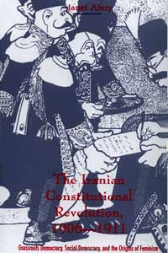
History – Introduction of Democracy
Constitutional Revolution (1905-1909)
Merchants and local industrialists demanded constitution
Shah (king) agreed
Constitution of 1906
Direct elections
Separation of powers
Laws made by elected legislature (Majles)
Very strong – controlled cabinet members
Popular sovereignty
Bill of Rights
Retained Shiism as official religion
Created Guardian Council of clerics
Veto power
Notes:
Constitutional Revolution:
Merchants and local industrialists demanded constitution
Shah (king) agreed

Slide 13
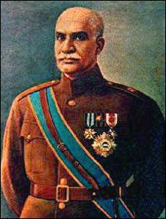
History – The Pahlavi Dynasty (1925-1979)
1921 - Reza Shah carried out coup d’etat
Military officer
Abolished Qajar dynasty
4 years later named himself “shah-in-shah” (king of kings)
Ruled with iron fist; Majles lost its power
Created centralized bureaucratic state by modernizing economy and secularizing political life of the country (built first national railroads, first modern factories, and took land from rural elites)
Women did not have to wear veil
Men had to shave their beards
Closed religious schools
Replaced with free, state-run institutions that stressed science and other modern topics
Changed name from Persia to Iran; allied with Nazis
Forced to abdicate in 1941 because of his pro-German sympathies
Notes:
Reza Shah
Military officer seized power in 1921
Abolished Qajar dynasty and declared himself king (shah) in 1926 of Pahlavi dynasty
Created centralized bureaucratic state by modernizing economy and secularizing political life of the country (built first national railroads, first modern factories, and took land from rural elites)
Women did not have to wear veil
Men had to shave their beards
Closed religious schools
Replaced with free, state-run institutions that stressed science and other modern topics
Forced to abdicate in 1941 because of his pro-German sympathies
Allied forces recognized his son, Muhammad Reza Pahlavi as new monarch
Muhammad Reza Shah:
Centralized power (e.g., Interior Ministry appointed provincial governors, town mayors, district superintendents and village headmen)
Built up military – 5th largest in world by 1979
Formed SAVAK: arrested, tortured, killed dissidents at home and abroad
Secularized legal system (supplanted shari’a)
Close ally with United States (puppet)
Improved infrastructure

Slide 14
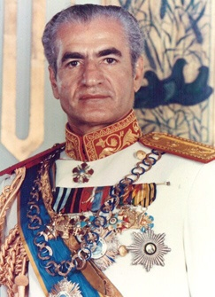
History – The Pahlavi Dynasty (1925-1979)
Reza’s son, Muhammad Reza Shah took power in 1941
Formed SAVAK: secret police
Arrested, tortured, killed dissidents at home and abroad
Authoritarian regime
Centralized power (e.g., Interior Ministry appointed provincial governors, town mayors, district superintendents and village headmen)
Built up military – 5th largest in world by 1979
Secularized legal system (supplanted shari’a)
Close ally with United States (puppet)
Improved infrastructure
Rise of the National Front (opposition)
Led by Muhammad Mosaddeq
Drew support from middle class
Emphasized Iranian nationalism
Notes:
Reza Shah
Military officer seized power in 1921
Abolished Qajar dynasty and declared himself king (shah) in 1926 of Pahlavi dynasty
Created centralized bureaucratic state by modernizing economy and secularizing political life of the country (built first national railroads, first modern factories, and took land from rural elites)
Women did not have to wear veil
Men had to shave their beards
Closed religious schools
Replaced with free, state-run institutions that stressed science and other modern topics
Forced to abdicate in 1941 because of his pro-German sympathies
Allied forces recognized his son, Muhammad Reza Pahlavi as new monarch
Muhammad Reza Shah:
Centralized power (e.g., Interior Ministry appointed provincial governors, town mayors, district superintendents and village headmen)
Built up military – 5th largest in world by 1979
Formed SAVAK: arrested, tortured, killed dissidents at home and abroad
Secularized legal system (supplanted shari’a)
Close ally with United States (puppet)
Improved infrastructure

Slide 15
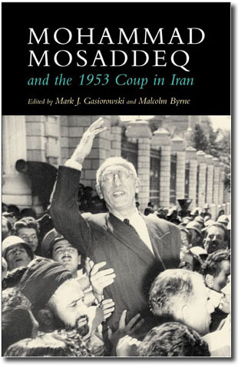
History – The 1953 Coup
Mosaddeq advocated nationalizing the British owned-company that monopolized Iran’s oil business
British establish the Anglo-Iranian Oil Company (later = BP)
Supported by Tudeh – Communisty Party
Also wanted to take armed forces out from under shah’s control
Elected Prime Minister in 1951
Power grew & forced shah to flee country in 1953
British and U.S. orchestrated overthrow of Mosaddeq & restored shah to power…Why?
Notes:
British establish the Anglo-Iranian Oil Company (later becomes BP)

Slide 16
History – Muhammad Reza Shah
Westernization/Secularization of Iranian culture
White Revolution (1963):
Focused on land reform
Gov’t bought land from large absentee owners and sold it to small farmers at affordable prices
Purpose was to encourage farmers to become entrepreneurs with irrigation canals, dams, and tractors
Secularized Iran further by extending voting rights to women, restricting polygamy, and allowing women to work outside the home
Called “white” to counter “red” influences
Notes:
White Revolution:
started in 1963
Called “white” to counter “red” influences
Focused on land reform
Gov’t bought land from large absentee owners and sold it to small farmers at affordable prices
Purpose was to encourage entrepreneurs with irrigation canals, dams, and tractors
Secularized Iran further by extending voting rights to women, restricting polygamy, and allowing women to work outside the home
Rentier State
Derives much of its revenue on a regular basis from payments by foreign concerns in the form of “rent”
Rentier economy is heavily supported by state expenditure, while the state continuously receives “rent” from abroad
Oil revenues allowed Iran to modernize quickly
Import-substitution placed emphasis on capital-intensive industries and led to neglect of small-scale production and agriculture

Slide 17
History – Muhammad Reza Shah
Rentier state - Derives much of its revenue on a regular basis from payments by foreign countries in the form of “rent”
Rentier economy is heavily supported by state expenditure, while the state continuously receives “rent” from abroad
Iran received an increasing amount of income by exporting its oil
Income so great that by 1970s govt no longer relied on internal taxes for support
Paid most of its expenses through oil income
Import-substitution placed emphasis on capital-intensive industries and led to neglect of small-scale production and agriculture
Industrialization
Rapidly industrialized from oil revenue
Centralization
State controlled – banks, tv/radio, Natl. Iranian Oil Co.; local gov’t came under control; Majles became a “rubber stamp”
Notes:
White Revolution:
started in 1963
Called “white” to counter “red” influences
Focused on land reform
Gov’t bought land from large absentee owners and sold it to small farmers at affordable prices
Purpose was to encourage entrepreneurs with irrigation canals, dams, and tractors
Secularized Iran further by extending voting rights to women, restricting polygamy, and allowing women to work outside the home
Rentier State
Derives much of its revenue on a regular basis from payments by foreign concerns in the form of “rent”
Rentier economy is heavily supported by state expenditure, while the state continuously receives “rent” from abroad
Oil revenues allowed Iran to modernize quickly
Import-substitution placed emphasis on capital-intensive industries and led to neglect of small-scale production and agriculture

Slide 18
History – Muhammad Reza Shah
Discussion Question: Can a government that doesn't depend upon its constituents for income (rentier state) really be representative or legitimate?
Notes:
Rentier State
Derives much of its revenue on a regular basis from payments by foreign concerns in the form of “rent”
Rentier economy is heavily supported by state expenditure, while the state continuously receives “rent” from abroad
Oil revenues allowed Iran to modernize quickly
Import-substitution placed emphasis on capital-intensive industries and led to neglect of small-scale production and agriculture

Slide 19
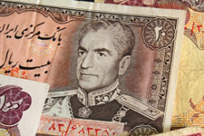
History – Muhammad Reza Shah
The Shah’s Downfall:
Became more distant from people over the years
Became very wealthy
Bolstered personal wealth by establishing tax-exempt Pahlavi Foundation, a patronage system that controlled large companies that fed the pocketbooks of the shah and his supporters
Ignored civil liberties
Stifled newspapers, political parties, and professional associations
1975 – Shah announced the formation of the Resurgence Party and declared Iran to be a one-party state with himself has the head
Alienated clergy, intelligentsia, and urbanites
Overstepped bounds of political culture:
Perceived as being totalitarian
Secularized too fast
Offended nationalists and clergy with ties to west (particularly U.S.)
Notes:
Shah’s Downfall:
Bolstered personal wealth by establishing tax-exempt Pahlavi Foundation, a patronage system that controlled large companies that fed the pocketbooks of the shah and his supporters
1975 Shah announced the formation of the Resurgence Party and declared Iran to be a one-party state with himself has the head

Slide 20
Comparative Iranian Regimes
Rulers | Characteristics | Influences on Modern Political System
Safavids (1501-1722) | Converted Iranians to Shiism Tolerated “People of the Book” Ruled from Isfahan Relied on local rulers Rulers claimed to be descendants of the 12 Imams | Almost 90% of Iranians today are Shiite Tradition of isolation Authoritarianism, NOT totalitarianism Foundations for Theocracy
Qajars (1794-1925) | Turkish invaders Ruled from Tehran Retained Shiism, but lost hereditary claims to 12 Imams Dominated by other countries Loved luxury; fell into debt | Loosened Shiite influence Tradition of trade/contact with others Authoritarianism, NOT totalitarianism Foundations for secularism, separation btwn religious and political leaders Failures of regime led to the creation of a repressive government
Pahlavis (1925-1979) | Overthrew representative govt Centralized power in shah Increasing oil income: rentier state Contact with West Secularization Corruption | Reinforced authoritarian rule; led to resistance to totalitarianism Modern corruption issues in govt, economy Increased secularization led to re-establishment of a theocracy

Slide 21
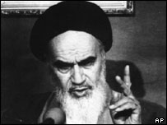
History – 1979 Revolution
Triggers:
Oil prices decreased by 10% and consumer prices increased 20%
Revolution of rising expectations
U.S. put pressure on shah to loosen restraints on opposition
Encouraged others to voice frustrations
Organized and led by clerics, but broadly supported by many sectors
Revolutionary coalition:
Urban poor (especially recent rural-urban immigrants)
Moderate middle classes, concerned with political freedoms
Leftists
Bazaar merchants: ability to bring economy to standstill
Clergy: moral focal point, and hierarchical internal structure, communication networks, capable orators
Charismatic leader – Ayatollah Ruhollah Khomeini
In exile in Paris, but speeches were influential
Shah fled country in Feb 1979
Notes:
Revolutionary coalition:
urban poor (especially recent rural-urban immigrants)
Moderate middle classes, concerned with political freedoms
Leftists
Bazaar merchants: ability to bring economy to standstill
Clergy: moral focal point, and hierarchical internal structure, communication networks, capable orators

Slide 22
Founding of the Islamic Republic - 1979
April 1979 national referendum was held – voted out monarchy established Islamic Republic
Established a new constitution
Drawn up by Assembly of Religious Experts (73 man assembly of clerics directly elected by people)
Gave broad authority to Khomeini and clergy, although PM Mehdi Bazargan strongly objected
Presented to people in midst of U.S. hostage crisis – high hostility toward Americans – 99% of electorate endorsed (only 75% voted)
Ayatollah Khomeini (Supreme Leader)
Islamic fundamentalism
Emphasized literal interpretation of Islamic texts
Social conservatism
Political traditionalism
Jurist’s guardianship (valeyat-e-faqih):
Gave senior clergy (Grand ayatollahs) all-encompassing authority over the whole community—not just widows, minors, and mentally disabled
Only senior clerics could interpret Shari’a Law
Notes:
Islamic Fundamentalism/Islamism:
Emphasized literal interpretation of Islamic texts
Social conservatism
Political traditionalism
Valeyat-efaqih (fah-key)
Islamic Republic Constitution
Drawn up by Assembly of Religious Experts (73 man assembly of clerics directly elected by people)
Gave broad authority to Khomeini and clergy, although PM Mehdi Bazargan strongly objected
Presented to people in midst of U.S. hostage crisis – high hostility toward Americans – 99% of electorate endorsed

Slide 23
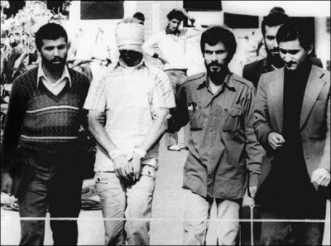
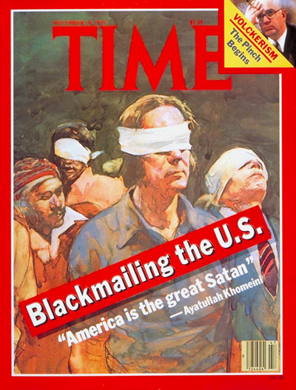
Iran Hostage Crisis
American embassy hostages held for 444 days from 1979-1981
Believed that purpose could be to undercut PM Bazargan
Official prime minister of provisional government at the time of the Revolution
Islamic in name but democratic in content
Wanted to call Iran Democratic Islamic Republic
Resigned when he realized that Khomeini would not order the release of the hostages
Notes:
Bazargan
Official prime minister of provisional government at the time of the Revolution
Islamic in name but democratic in content
Wanted to call Iran Democratic Islamic Republic
Resigned when he realized that Khomeini would not order the release of the hostages

Slide 24
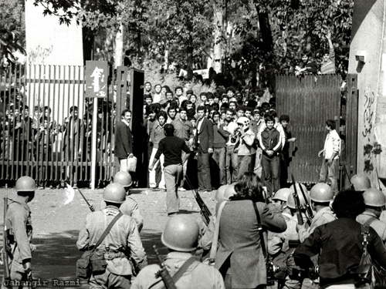
Cultural Revolution
Launched by Shia leaders after revolution
Aimed to purify the country from the shah’s regime, secular values, and western influences
Purged universities of liberals
Suppressed all opposition
Similar to??

Slide 25
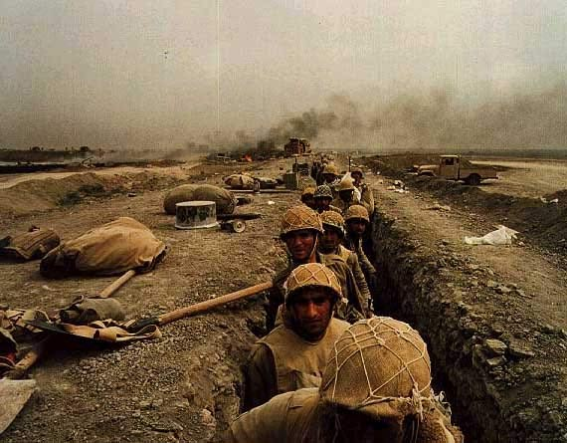
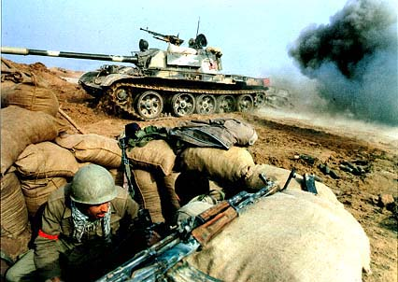
Iran-Iraq War (1980-88)
Started when Iraq invaded Iran by land and air
U.S. backed Saddam Hussein and Iraq – provided weapons
People rallied around the govt in response
Ended in 1988 with a UN-brokered cease-fire

Slide 26
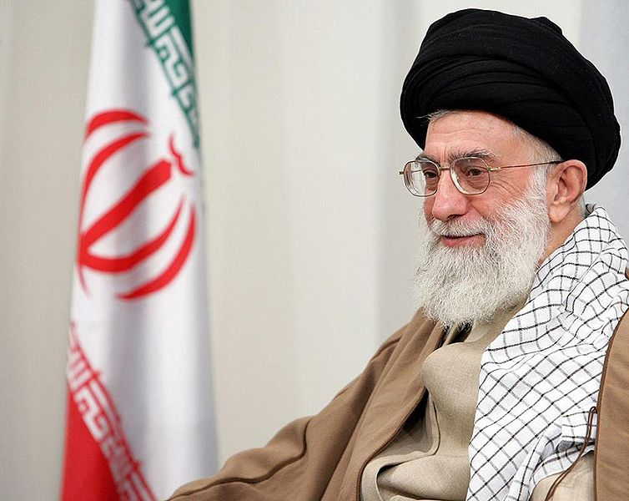
Post-Khomeini (1989-Present)
Khomeini died in 1989
The Constitution specifically put Khomeini in the position for life, and stated that after his death, his authority would pass to a leadership council of two or three senior clerics
This did not occur when Khomeini died b/c his followers did not trust the clerics
Ayatollah Ali Khamenei (1989-Present)
Change in constitution
A Cleric of middle rank
Does not have same charisma or academic credentials
Keeps spirit of revolution alive, anti-American, and maintain theocracy
President - Hashemi Rafsanjani (1989-1997)
Moderate
Concerned with reforming slumping economy due to theological commitments and war with Iraq
Very few reforms
Notes:
The Constitution specifically put Khomeini in the position for life, and state that after his death, his authority would pass to a leadership council of two or three senior clerics.
This did not occur when Khomeini died bc his followers did not trust the clerics.
They changed the Constitution and selected as Supreme Leader Ali Khamenei, a cleric of the middle rank
Ayatollah Ali Khamenei (1989-Present) does not have same charisma or academic credentials
Keep spirit of revolution alive, anti-American, and maintain theocracy

Slide 27
Post-Khomeini (1989-Present)
President Mohammad Khatami (1997-2005)
Reformist and surprise winner
Vote from women, university students, and young adults throughout country, even those in armed forces
Originally seen as major setback for conservative clergy
Campaigned on theme of creating “civil society” and improving sick economy
Reforms:
Easier to organize political groups
Less censorship of press
Some open protests permitted
Relaxed enforcements of social interactions between sexes
Allowed inspections of nuclear facilities
Tried to improve relations with US and other Western countries
Reformist Khatami was left isolated by conservative resurgence
Most reforms overturned by Guardian Council
Hard line conservatives disqualified moderates from 2004 parliamentary elections
Notes:
Khatami:
Unknown liberal cleric
Landslide, surprise victory
Vote from women, university students, and young adults throughout country, even those in armed forces
Originally seen as major setback for conservative clergy
Campaigned on theme of creating “civil society” and improving sick economy
Stressed importance of an open society that would protect individual liberties, freedom of expression, women’s rights, political pluralism and rule of law
Campaigns stressed need for “dialogue between civilizations
Reforms:
Easier to organize political groups
Less censorship of press
Over 200 independent newspapers and magazines with a wide array of viewpoints were established
Some open protests permitted
Tried to improve relations with US and other Western countries
Relaxed enforcements of social interactions between sexes
Allowed inspections of nuclear facilities
Most reforms overturned by Guardian Council

Slide 28
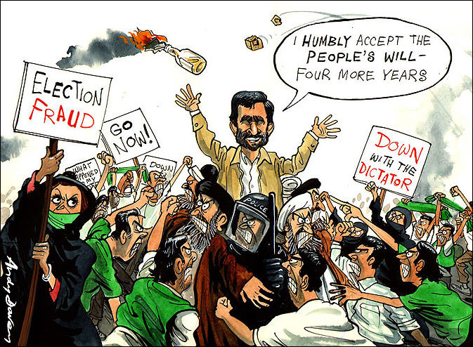
President Ahmadinejad (2005-2013)
President Mahmoud Ahmadinejad (2005-2013)
Tehran's ultra-conservative mayor
Won a run-off vote in presidential elections in June 2005, defeating his rival, the former president Akbar Hashemi Rafsanjani
First non-cleric president in 24 years
Notes:
Ahmadinejad:

Slide 29
2009 Presidential Election
Huge push for reformist candidate Mousavi to beat Ahmadinejad
Close race – 85% Turnout
Allegations of fraud were strong – Mousavi urged his supporters to the streets
The Iranian government itself has acknowledged that in 50 areas, more votes were counted than there are eligible voters
The government has acknowledged that 3 million ballots were stuffed
Khamenei agreed to an investigation
Iran's supreme leader, Ayatollah Khamenei, declared the vote legitimate
Huge protests/Government Crackdown
Dozens of moderate clerics and reformist political leaders in Tehran and around Iran arrested
Mousavi himself was "being closely monitored by police"
Ayatollah Khameni has restated his position that the election results were fair
Significant violence at universities around the country, as well as hundreds of arrests and reports of tear gas in the dorms
Notes:
Mousavi (moo-sah-VEE)
Uploaded on Jun 14, 2009
UPDATE: In the weeks since I have made this video, the evidence of electoral fraud has gone from anecdotal to irrefutable. The Iranian government itself has acknowledged that in 50 areas, more votes were counted than there are eligible voters. The government has acknowledged that 3 million ballots were stuffed, and lots of evidence indicates that it was in fact much more. The commenters saying otherwise in this video either don't have a handle on the situation or believe in broad conspiracies encompassing the entire western world. UPDATE: Iran's supreme leader, Ayatollah Khamenei, has declared the vote legitimate.
UPDATE: The twitter link has been shut down. Gchat and yahoo chat have also been shut down in Iran. I'm still getting good updates from http://www.twitter.com/persiankiwi and http://www.twitter.com/tehranbureau Also worth following: http://www.twitter.com/y_shar and http://www.twitter.com/iran09 UPDATE: Dozens of moderate clerics and reformist political leaders in Tehran and around Iran have been arrested. Mousavi himself is apparently not under house arrest, although he is "being closely monitored by police," which sure SEEMS like house arrest. Ayatollah Khameni has restated his position that the election results were fair. UPDATE: There seems to be significant violence going on at universities around the country, as well as hundreds of arrests and reports of tear gas in the dorms.

Slide 30
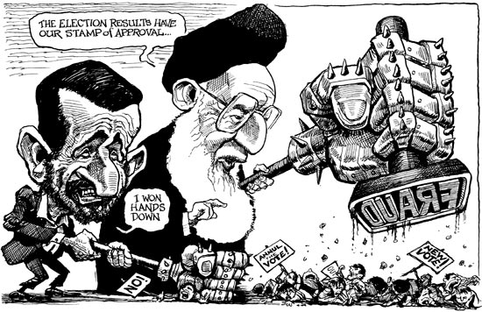
Notes:
Ahmadinejad:

Slide 31
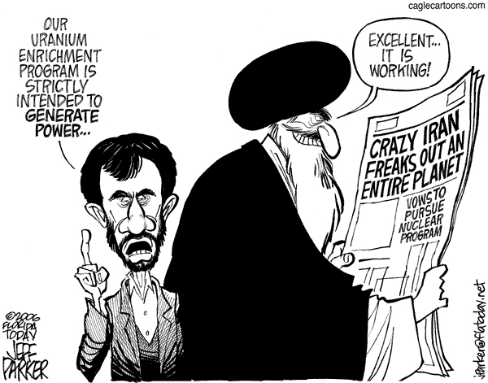
President Ahmadinejad (2005-2013)
Council of Guardians rejected candidacies of popular reformers
Further restrict public freedom
Several major reformist newspapers closed
Journalists and civil society activists arrested
Jailed internet users who spread information “aimed at disturbing the public mind”
Morality police and vigilantes to enforce Islamic dress codes & prevent public mingling of men and women
Increased reports of arrest, torture, and executions
Sharia more strictly enforced
Called for destruction of Israel
Questioned reality of Holocaust
Increased nuclear fuel research
Notes:
Ahmadinejad:

Slide 32
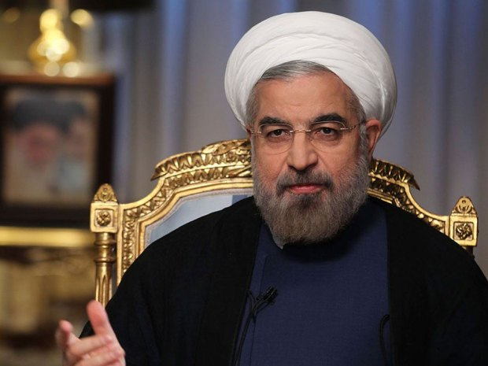
Current
President Rouhani (Elected 2013)
Moderate cleric
How did he win?
Guardian Council disqualified two prominent candidates
Former President – Rafsanjani
Ahmadinejad’s choice – Esfandiar Rahim Mashaei
High turnout – 72%
Rouhani – 50.7%
What does this mean?
Powerful mandate to improve international relations
Negotiate nuclear settlement
Helped Supreme Leader:
Restored legitimacy lost after 2009 election
Returned a cleric to the presidency
Ahmadinejad often clashed with the religious order and traditionalists
Notes:
But if the election was a victory for reform and middle class voters, it also served the conservative goals of the supreme leader, restoring at least a patina of legitimacy to the theocratic state, providing a safety valve for a public distressed by years of economic malaise and isolation, and returning a cleric to the presidency. Mr. Ahmadinejad was the third noncleric to hold the presidency, and often clashed with the religious order and its traditionalist allies.
Update using Ethel Wood – pg. 445-446

Slide 33
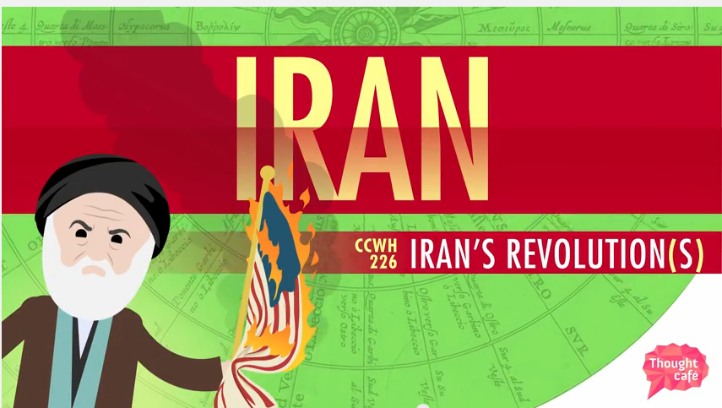
Review: Crash Course

