Slide 1
Democracy & Free Enterprise
Chapter 1.3
Political Science – Ms. Shay

Slide 2
Five Basic Concepts
Of Democracy

Slide 3
Worth of the Individual
Each person is important and has dignity no matter what his station in life.
At time the welfare of one individual is subordinated to the interests of the many.

Slide 4
Equality of All Persons
All men are created equal
Equality of opportunity
Equality before the law
NOT equality of condition.

Slide 5
Majority Rule, Minority Rights
A majority of people will be right more often than they will be wrong
Will of the people rather than dictate of the ruling few
A search for satisfactory solutions is experimental and we will sometimes get it wrong
Must always recognize rights of minority

Slide 6
Necessity of Compromise
We blend and adjust competing views and interests
This concept is based on the worth of each individual
Many issues can be solved in several ways

Slide 7
Individual Freedom
Freedom is not absolute but restrictions should be in least.
“The right to swing my fist, ends where the other man’s nose begins.”
~ Justice Oliver Wendell Holmes
“The rights of every man are diminished when the rights of one man are threatened.”
~John F. Kennedy
A balance of liberty and authority.

Slide 8
A Commitment To Freedom for the Individual
This is both evident in the government and in the economy

Slide 9
What is Free-Enterprise?
An economic system characterized by four fundamental factors
Private ownership
Individual initiative
Profit
Competition

Slide 10
Free-Enterprise
Also Known as:
Private enterprise
Capitalism
Free-market economy
Market based economy

Slide 11
What is the Market?
YOU

Slide 12
Three Questions to be Answered in any Economy
What items are to be produced?
How much should be produced?
What will that product cost?
You, the market, make those decisions, not the government!!!!!!

Slide 13
How does the market decide?
The Law of Supply and Demand
When supply is high, prices drop
When supply is low, prices rise

Slide 14
How does the Government participate in the economy?
To protect the public
2. Preserve private enterprise

Slide 15
Government Regulation of the Economy
Anti-trust laws
Pure food and drug laws
Anti-pollution standards
Building codes
Zoning ordinances
$400 billion bailout package

Slide 16
Government Promotion of Economy
Grants Money for:
Transportation systems, scientific research, food crops
Builds roads
Public schools
Postal service
National currency
Weather alerts
Fire and police

Slide 17
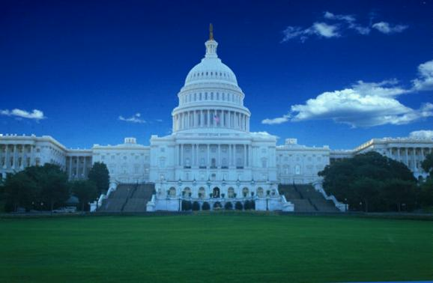
“The legitimate object of government is to do for a community of people, whatever they need to have done, but can not do, at all, or can not, so well do, for themselves – in their separate, and individual capacities.”
Abraham Lincoln, July 1, 1854

Slide 18
Assignment
Choose one of the following prompts and write a one page response.
Which one of the 5 basic concepts of democracy do you believe is the most important to the survival of our nation and how successful has the US been in accomplishing that goal?
How much government participation is acceptable in the US economy to be able to adhere to these basic concepts of democracy?

