Slide 1
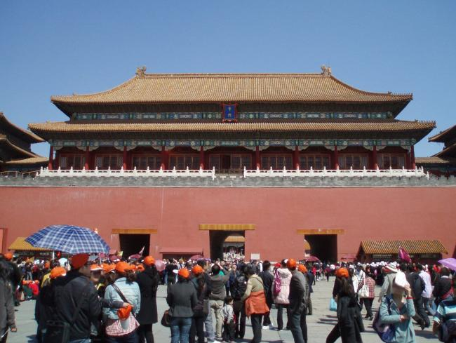
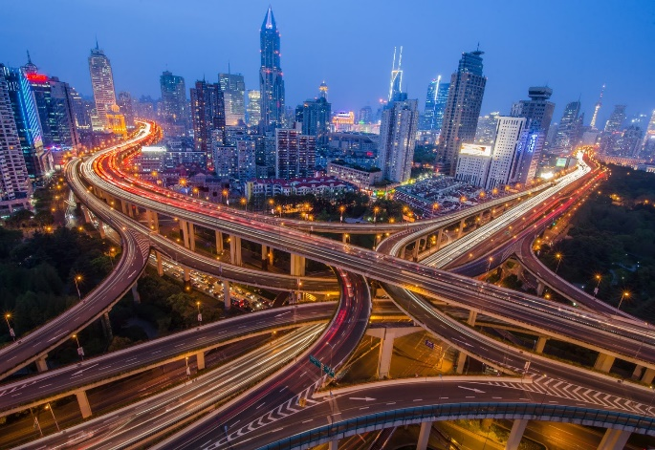
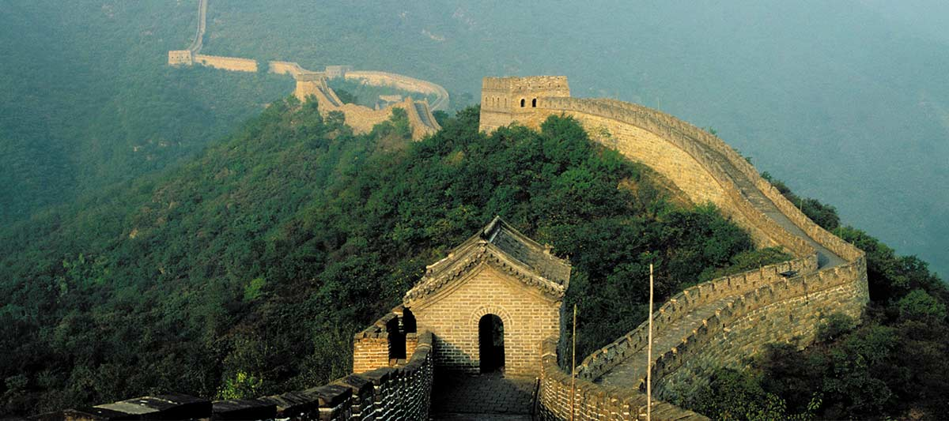
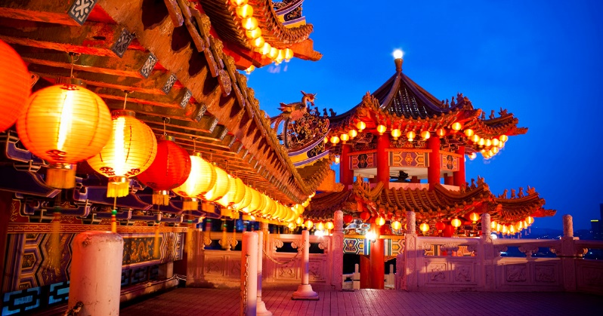
Policy Issues
AP Comparative government

Slide 2
Democracy
Those who are in power now in China have done little to stray from the path that Deng set for them
The Chinese government is based upon economic reform, while continuing to show resistance to political reform
Reform by Leaders such as Zhu Rongji (Former Premier), Jiang Zemin (Former General Secretary and President), and Hu Jintao (leader of the CCP since 2003) can be seen in these ways:
Some input from the National People’s Congress is accepted by the Politburo
More emphasis is placed on laws and legal procedures
Village elections are now semi-competitive, with choices of candidates and some freedom from the party’s control

Slide 3
Human Rights
Tiananmen Square incident
China under pressure from international Human Rights Orgs
Government has so far refused to liberalize the political process
2010 – Nobel Peace Prize awarded to Liu Xiaobo
Jailed Chinese activist and vocal critic of the government
China censored news of the award
China maintained that Liu was a criminal and placed his wife under house arrest
Asked other countries to boycott Nobel ceremonies – 15 countries did

Slide 4
Rule of Law
The principle of rule of law, almost always associated with liberal democracies, is based on the belief that rulers should not have absolute power over their subjects
From the Communist point of view, law is a way for the bourgeoisie to suppress the proletariat
This is why Communist nations rarely subscribe to the idea of rule of law
Mao sought to destroy the legal codes of dynastic rule and establish a more egalitarian China
Since 1978 the rule of law has become more prevalent, because of the greater need for regulation of the economy as it grows more and more capitalistic and to attract foreign companies

Slide 5
Rule of Law
Procuratorates, or officials who investigate and prosecute official crimes, were recreated from early China and used to deal with the increasing corruption in Chinese business
China is more constrained by the concept of rule of law today, but this has not changed the harsh criminal system of China
The Death penalty is often enforced for smuggling, rape, theft, bribery, trafficking of women and children, and official corruption
Has fallen sharply from 12,000 in 2002 to 3,000 in 2012.
The Minister of Health has cited a decline in executed prisoners as a reason for the shortage of organs available for transplant
2014 – Central Committee plenum focused on the rule of law as part of anti-corruption campaign
Declared December 4 – National Constitution Day and officials have to swear oath of allegiance to the Constitution

Slide 6
Civil Rights and Liberties
Many believed that Hu Jintao would promote more individual freedoms
He was mentored by members of the liberal faction of the party
He took the lead in reversing the cover-up of the SARS outbreak and pledged greater accountability and transparency
However, he continued to suppress dissent
He called for “ideological education” at universities
Xi Jinping has continued to crack-down on promoters of western ideas
In March 2015 – two members of a group promoting the rule of law were arrested
During 2015 – several hundred civil rights lawyers were detained

Slide 7
Population Policy
Mao believed that population policies were imperialist tools and thought that they should not be implemented
At that time China had 850 million people in its population
After Mao’s death, it was realized that population growth was preventing further growth of GDP
A two child family was then promoted, and abortions and birth control were provided to help prevent further births
Deng Xiaoping instituted a one child policy - 1979
This policy provided incentives and penalties to assure that couples produced only one child
Late marriages were encouraged, and free contraceptives, abortions, and sterilizations were provided to families that followed the policy
Steep fines were instituted for those who had a second child
These policies are enforced both in urban settings and rural settings
1984 – Policy relaxed in rural areas because of the need for family labor. Reinstated in 2002 when the gov’t discovered that many rural births were going unreported

Slide 8
Population Policy
The one child policy did lead to high degree of female infanticide because of traditional values surrounding males
Infanticide has dropped due to the use of selective abortions (after knowing gender)
There is now a disproportionate number of males to females, and many males find it hard to marry because of this
It considered to be dishonorable to not find a wife and has caused many societal issues throughout China
China’s population is also rapidly aging because of the lack of new births
Cultural tradition – sons take care of aging parents
Problem – Aging population without enough sons to take care of the aging
2015 – Gov’t instituted many exemptions to the policy
Partners that are both single children may have two children
Minorities may have two children
Late 2015 – CCP announced “Two-child” policy to replace “one child” policy in 2016

Slide 9
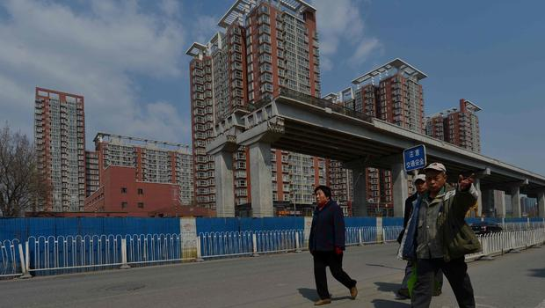
Population Movement
2012 – CCP leaders identified urbanization as a top priority
Goal is to integrate and move about 900 million rural residents into city living by 2025
Gov’t is increasing spending on roads, hospitals, schools, community centers, etc. in response to this goal

Slide 10
Economic Policy
From 1948 to 1978, China followed a communist political economic model: a command economy directed by a central government based on democratic centralism
This policy system was known as the “iron rice bowl” or cradle-to the grave health care, work, and retirement security
The state set production quotas and distributed basic goods to consumers
Deng Xiaoping began a series of economic reforms that pushed for a socialist market economy after the failure of the “iron rice bowl” reforms movement
These reforms were centered on a gradual infusion of capitalism, while still retaining state control

Slide 11
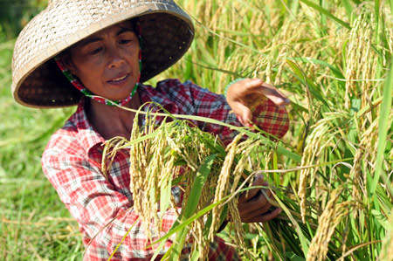
Agricultural Policy
The people’s communes: Early history in the PRC required almost all peasants to be organized into collective farms of approximately 250 families each
During the Great Leap forward, large farms were merged into what were known as “people’s communes”
These communes were often poorly managed and peasants didn’t see the need to work hard because of the massive amount of people subsisting on the farmland.
The communes were the weakest parts of Mao’s government
Household responsibility system
In the early 80’s, Deng got rid of the communes and instituted the household responsibility system (still in effect)
Individual families take full charge of the production and marketing of crops
After they pay their taxes, they are free to do with their goods as they please

Slide 12
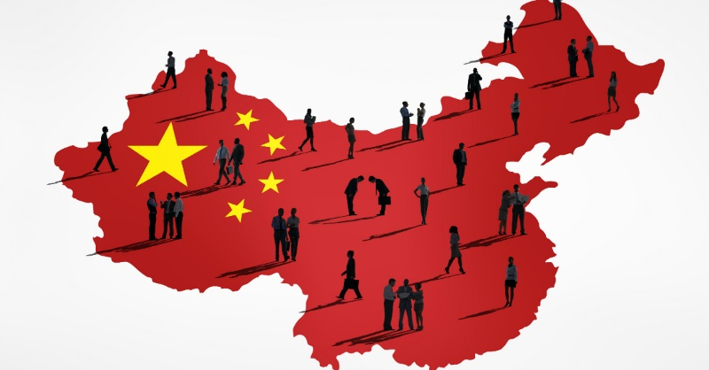
Business Policies
Private business:
In 1988, the National People’s Congress created a new category of property control known as “private business.”
Private businesses include co-ops, service organizations, and rural industries that largely operate as capitalist enterprises
This system is state-controlled and private businesses exist in a system that is often refereed to as “bamboo capitalism”
While government controlled businesses have largely failed due to inefficiency, they still provide strict control of the products produced in private industry
The fastest growing sector of the Chinese economy is rooted in township and village enterprises
The success of these enterprises have slowed the immigration of citizens from rural villages to cities for a period of time
Under Jiang Zemin, many TVEs were dismantled/privatized/restructured
They are becoming less important to the overall economy

Slide 13
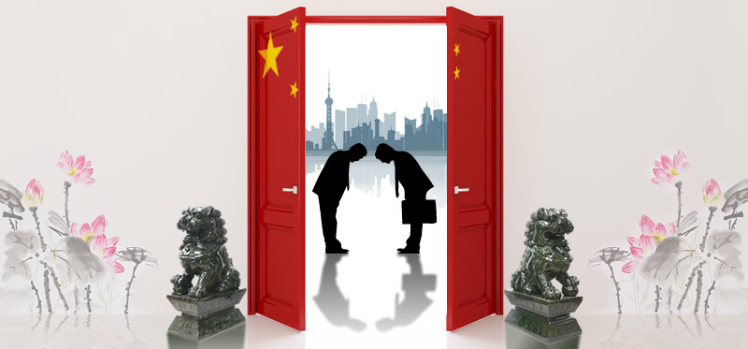
Economic Problems
Unemployment and inequality:
Under Maoism, gender equality was important and everyone was guaranteed a job
Under marketization, unemployment has skyrocketed
It is hoped that with the huge growth of the Chinese economy, that the unemployment issue will be taken care of by the market
There is a floating population in China, as people move from place to place looking for work
It is believed that if the poor do not soon benefit from the booming economy, Chinese growth is not sustainable
Inefficiency of the state sector:
Privatization and marketization have reshaped the Chinese economy
While the Chinese still have large portions of state owned production, it is horribly inefficient and has too many workers
These industries are largely dependent on state subsidies

Slide 14
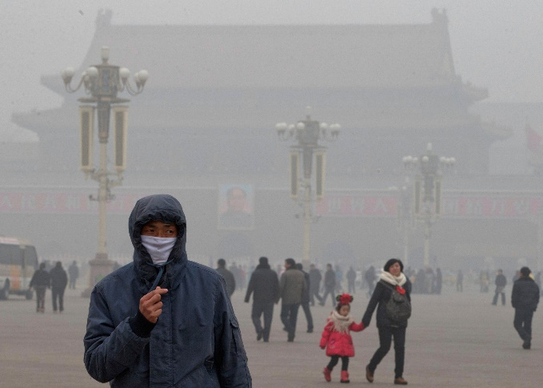
Economic Problems
Pollution:
Air and water pollution are serious problems in China
Beijing and Shanghai have some of the most polluted air in the world and it is so bad that it has at times caused acid rain to fall on neighboring countries
It is believed that China became the leading producer of greenhouse gases in 2008
While policies have been put in place in regards to pollution control, the bureaucracy has very little power to enforce those policies
Product Safety:
In 2007, Chinese factories were caught exporting poisonous pharmaceutical ingredients, bogus pet food, faulty tires, and unhealthy shellfish.
These types of issues are at the heart of the struggle between state control and free market policies.
The reduction in government power has led to companies being able to get away with more in the production of goods.

Slide 15
Economic Outlook
2008 – Many forecasters thought the global economic crisis would hit China hard
However, in 2010, its economy grew by 10%
By 2014, GDP growth had eased to 7.4%
March of 2015 – PM Li Keqiang called for growth of about 7%
Called slower growth the “new normal”
China still hasn’t developed a consumer economy where personal spending fuels development
Other critics say that China hasn’t created an innovation economy
China has become 2nd largest economy – passing Japan
On pace to overtake the United States by 2025 or 2030

Slide 16
Foreign Policy
China has made great strides in joining the world community in regards to their economy and their trade connections
They however have fought against improving human rights issues and continue to threaten to invade Taiwan
China also has tensions with Japan because of previous Japanese invasions
Under Mao, great amounts of foreign aid were given to radical states including Korea and Vietnam
They also used to have strong ties to the USSR, but that ended after Mao believed that the USSR had turned their back on true communism

Slide 17
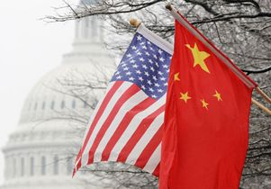
Foreign Policy
US/Chinese relations:
Until the 1970s the US and China had very little interaction
This largely centered on the US containment policy and China’s anti-capitalist attitudes
It was under Deng Xiaopoing’s leadership when China really began to work with the U.S.
Problems in Chinese trade today deal with illegal exports and currency manipulation issues
Because of their great trade power and because they own so much U.S. debt, China is starting to be looked at as a major trade and political power in the world

Slide 18
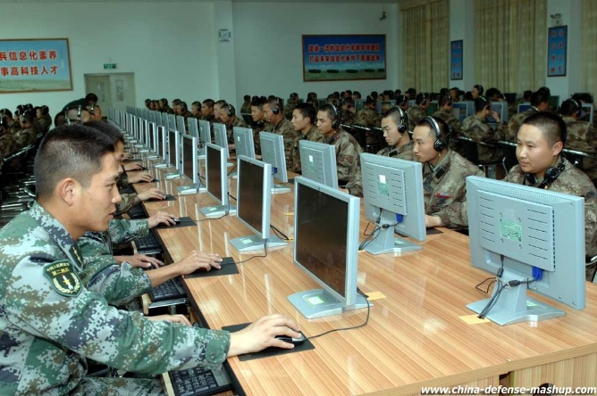
Foreign Policy
Internet Hacking
Western governments and companies have accused Chinese hackers of disruption
2013 – Mandiant report
Evidence of Chinese hacking group based in Shanghai near a unit of the PLA
Chinese government condemns the report

Slide 19
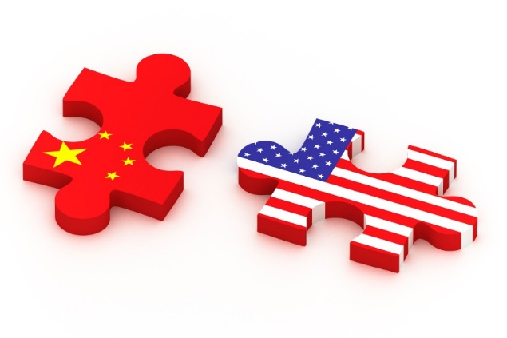
Foreign Policy
Over the last twenty-five years, China has focused on four Special Economic Zones
These regions of China provide special tax rates and other incentives to do business in those regions
The four economic zones eventually spread throughout the majority of China
China is now a member of the WTO and has “most favored nation status” for trading with the U.S.
Britain also ceded control of Hong Kong back to China because of their improved world status

Slide 20
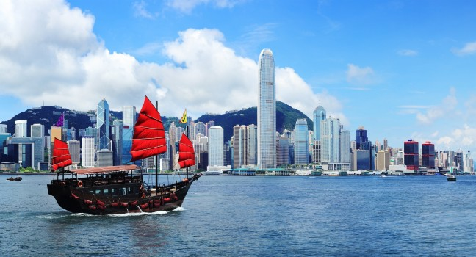
Hong Kong
In 1997 Hong Kong was ceded back to the control of mainland China
China practices a “one country, two systems” policy
Hong Kong is subject to Chinese rule, but is allowed to maintain its capitalist system, legal system, and way of life.
Hong Kong is able to enjoy the same civil liberties they possessed as when under British Rule
2014 – Umbrella Revolution – protesters wanted greater input into elections than Beijing allowed
Beijing announced plan for 2017 election of chief executive of HK by direct election, but nomination would be up to 1200 member committee
Pro-democracy lawmakers defeated the election packet in 2015 saying it was meaningless
Nothing was changed – Beijing will choose HK’s chief executive
HK has been threatened with the designation of Shanghai as a global financial and shipping center by 2020

Slide 21
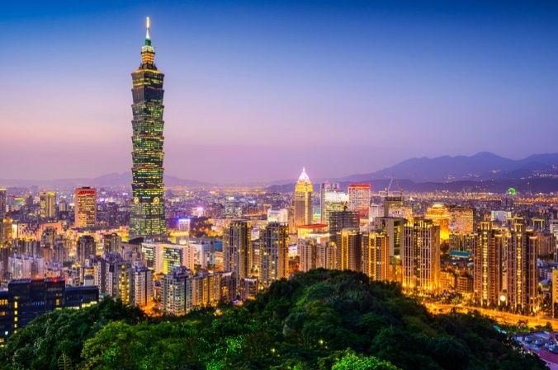
Taiwan
Taiwan has asserted is claim to independence and in the 1960’s they were recognized as the sole legitimate representative of China
In the 1970’s mainland China was able to supplant Taiwan in the UN
Continuing conflict exists as to whether or not Taiwan is independent and China asserts that they have authority over the nation
Taiwan is split on how they should be recognized
2008 – Negotiations commenced to restore “three links” (transportation, commerce, and communications)
Flights began in 2008 between the two
2010 – China cut-off military exchanges with America in response to US approval of $6.4 billion arms sale to Taiwan
2013 – China offered 31 new measures to better integrate Taiwan economically

