Slide 1
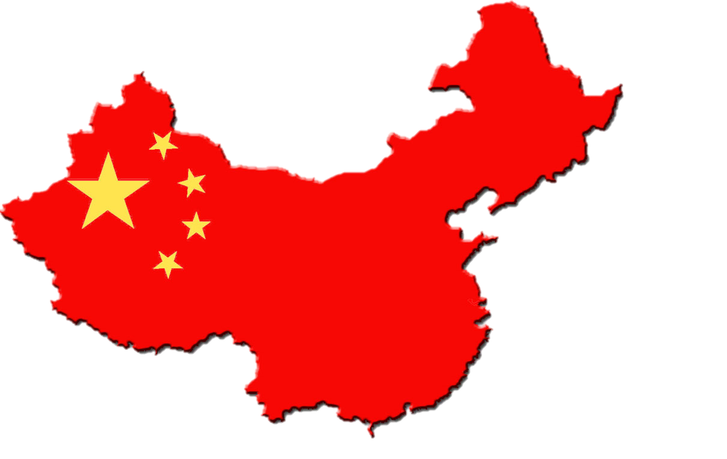
CHINA
“Let China sleep. For when China wakes, it will shake the world.”
--Napoleon
Part 1: The Making of the Modern State

Slide 2
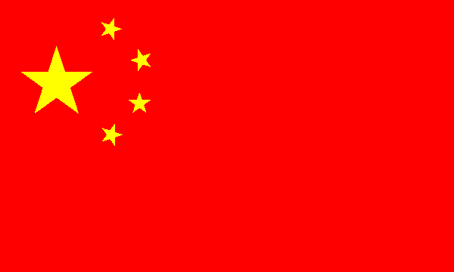
Why do we study China?
Unique history greatly shapes political culture
One of the few remaining communist nations
North Korea, Cuba, Vietnam, Laos
Successful move towards capitalism BUT remains highly authoritarian
Questions to ponder…
Will democratization follow economic reform success?
Will human rights violations keep China from global partnerships?
What type of change (if any) will Xi Jinping bring?
Notes:
Other Communist Nations:
North Korea, Cuba, Vietnam, Laos
China’s Flag
Red = revolution
Yellow Stars to stand out brightly against the red ground
Larger star = CPC
Four smaller stars = Chinese people.
Great unity of the Chinese people under the leadership of the CPC.

Slide 3
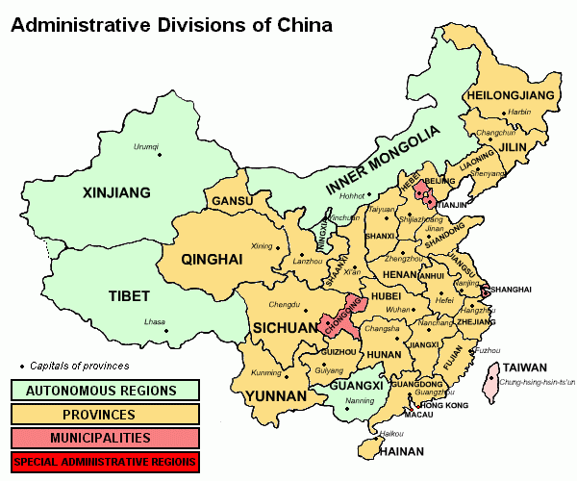
Geography Basics
Officially, the People’s Republic of China (PRC)
4th largest country
9,596,961 sq mi
Less than 15% of land good for agriculture
Roughly equal to U.S. in area, BUT China’s population is more than 4x greater
Major Cities:
Shanghai 16.575 million
BEIJING (capital) 12.214m
Chongqing 9.401m
Shenzhen 9.005m
Guangzhou 8.884m
More populated in the East
Notes:
Population
Roughly equal to U.S. in area, BUT China’s population is more than 4x greater
Major Cities: Shanghai 16.575 million; BEIJING (capital) 12.214 million; Chongqing 9.401 million; Shenzhen 9.005 million; Guangzhou 8.884 million
More populated in the East
*Taiwan
Location of the exiled government (Republic of China) beginning in the late 1940s China considers Taiwan a province, Taiwan considers itself independent
International recognition is mixed - The United States has deliberately avoided the issue of defining China’s borders
Autonomous Region:
A territorial unit that is equivalent to a province and contains a large concentration of ethnic minorities
Ex: Tibet
Have some autonomy in the cultural sphere but in most policy matters are strictly subordinate to the central govt
Special Administrative Regions
Hong Kong & Macau (muh-cow) are ruled indirectly by China
Hong Kong was claimed by the British in the mid-1800s, and then transferred the People’s Republic of China (PRC) in 1997
Enjoy a high degree of autonomy in all matters except foreign affairs and defense for the next 50 years

Slide 5
Geography Basics
Largest population in the world
1.3 billion
23 provinces*
Taiwan
Location of the exiled government (Republic of China) beginning in the late 1940s. China considers Taiwan a province, Taiwan considers itself independent
International recognition is mixed - The United States has deliberately avoided the issue of defining China’s borders
5 autonomous regions
A territorial unit that is equivalent to a province and contains a large concentration of ethnic minorities (Ex: Tibet)
Have some autonomy in the cultural sphere but in most policy matters are strictly subordinate to the central gov’t
4 centrally administered cities – Beijing, Shanghai, Tianjin, Chongqing
2 Special Administrative Regions (SAR)
Hong Kong & Macau are ruled indirectly by China
Hong Kong was claimed by the British in the mid-1800s, and then transferred the People’s Republic of China (PRC) in 1997
Enjoy a high degree of autonomy in all matters except foreign affairs and defense for the next 50 years
Notes:
Population
Roughly equal to U.S. in area, BUT China’s population is more than 4x greater
Major Cities: Shanghai 16.575 million; BEIJING (capital) 12.214 million; Chongqing 9.401 million; Shenzhen 9.005 million; Guangzhou 8.884 million
More populated in the East
*Taiwan
Location of the exiled government (Republic of China) beginning in the late 1940s China considers Taiwan a province, Taiwan considers itself independent
International recognition is mixed - The United States has deliberately avoided the issue of defining China’s borders
Autonomous Region:
A territorial unit that is equivalent to a province and contains a large concentration of ethnic minorities
Ex: Tibet
Have some autonomy in the cultural sphere but in most policy matters are strictly subordinate to the central govt
Special Administrative Regions
Hong Kong & Macau (muh-cow) are ruled indirectly by China
Hong Kong was claimed by the British in the mid-1800s, and then transferred the People’s Republic of China (PRC) in 1997
Enjoy a high degree of autonomy in all matters except foreign affairs and defense for the next 50 years

Slide 6
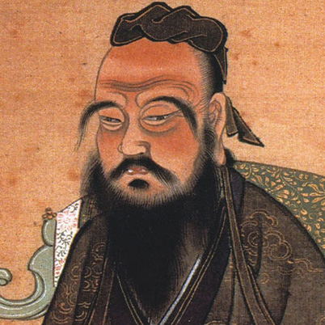
Critical Junctures: Confucius
Imperial China (2000 years) & Confucianism
Harmony, order, and peace
Five duties of universal obligation or basic human relations
Obedience to Authority, Hierarchy, Meritocracy
Civil service was created
Had to pass exams based on Confucian ethics
Dynastic rule reinforced key themes in Chinese government
State institutions: authoritarian
Commerce and private enterprise frowned upon (small middle class)
Civil society was “dormant”
Quest for national unity
Ethnocentrism
The belief in the inherent superiority of one's own ethnic group or culture

Slide 7
Critical Junctures: Confucius
Discussion Question: What elements of Confucianism do you think can be found in modern Chinese political culture?
Obedience to authority – acceptance of authoritarian rule
Hierarchy – structure of the CCP

Slide 8
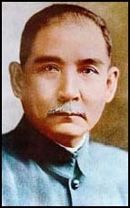
Critical Junctures: The Republic of China
1839 -1949: Century of Humiliation
Economic stagnation/poverty
Increased pressure from the outside/imperialism
Loses Hong Kong to GB after Opium Wars (in 1841) – Returned to China in 1997
Creates a feeling of xenophobia among Chinese
Also creates hatred of the West
Dynastic rule ends
Nationalism rises!
Revolution! (1911-12) Establishes Republic of China
Sun Yat-sen became President
Sun Yat-sen was American educated
Believed in nationalism, democracy, & social welfare
Could not hold power
Warlords rule
Regional warlords challenged the govt – time of political chaos
Sun Yat-sen
Father of the Republic Father of the Revolution
Notes:
Century of Humiliation
Loses Hong Kong to GB after Opium Wars (in 1841) – Returned to China in 1997
Revolution
Sun Yat-sen was American educated
Regional warlords challenged the govt – time of political chaos

Slide 9
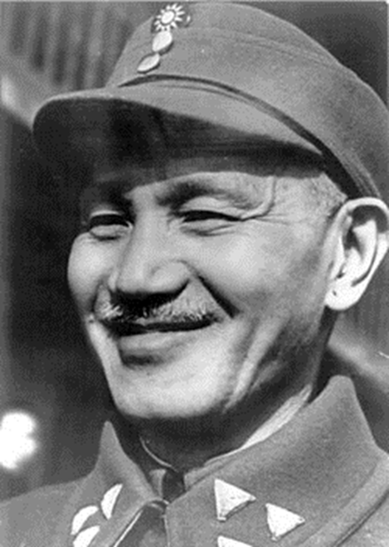
Critical Junctures: The Republic of China
China is about 80% rural at this time
1911 – 1949 Two political forces vie for power:
The Nationalist Party (KMT)
Led by Sun Yat-Sen
Focused on resisting foreign influence
Favored modernization and reform
Eventually led by Chiang Kai-Shek
Chiang takes power in 1928
Mao/followers become enemies of the state
Chinese Communist Party (CCP, founded 1921)
Led by Mao Zedong
By 1928, the CCP was forced West out of the cities and into the countryside
Chiang Kai-Shek
Leader of Nationalist Party
Notes:
China is about 80% rural at this time
Struggle for power
Chiang and Mao wrestle for power
Chiang takes power in 1928 & Mao/followers become enemies of the state

Slide 10
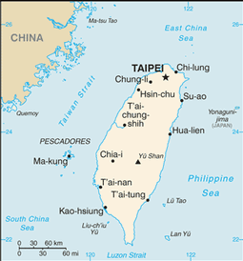
Critical Junctures: The People’s Republic of China
1934-1935: The Long March
Mao & supporters flee from Nationalist forces
Chiang chased Mao into countryside to try to destroy him, but had the opposite effect. Mao gained more support (Mao becomes a hero to peasant class)
Very important bc lays the foundation for Mao and the CCP.
Relationships developed between families at this time will continue to be important in terms of the Communist Party leadership (example of guanxi- informal politics)
1941-1945: World War II
Communists more successful against Japan
1949: The People’s Liberation Army marches into Beijing unopposed, establishing the People’s Republic of China (PRC)
The Nationalists fled to Taiwan, where they established the Republic of China (ROC) (international community does not recognize PRC until 1970s!)
Notes:
The Long March:
Chiang chased Mao into countryside to try to destroy him, but had the opposite effect. Mao gained more support.
Very important bc lays the foundation for Mao and the CCP.
Relationships developed between families at this time will continue to be important in terms of the Communist Party leadership (example of guanxi- informal politics)

Slide 11
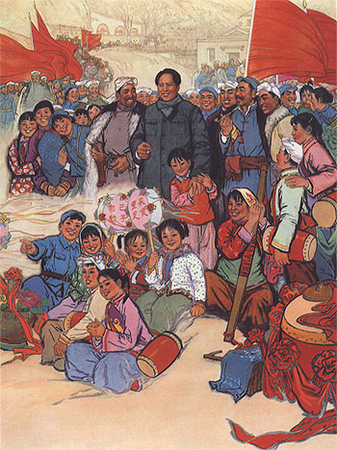
Critical Junctures: Maoism
Maoism – form of communism that believed in the strength of the peasant
Key Values:
Collectivism: Loyalty to party and state rather than family or village
Struggle and Activism: For the people (sacrifice) rather than maintain harmony by accepting status quo
Egalitarianism
Rather than hierarchy with women and peasant at the bottom (CCP’s existence contradicts this)
Wanted to create more equal roles for men and women
Mao was committed to women’s equality b/c “women hold up half of the heaven”
Self-Reliance: People in charge of their destiny; isolate from abroad
Mass Line: leaders would communicate their will/direction to people, but people would communicate their wisdom to leaders
Notes:
Key Values of Maoism:
Collectivism: loyalty to party and state rather than family or village
Struggle and Activism: for the people (sacrifice) rather than maintain harmony by accepting status quo
Egalitarianism and populism rather than hierarchy with women and peasant at the bottom (CCP’s existence contradicts this)
Wanted to create more equal roles for men and women
Mao was committed to women’s equality b/c “women hold up half of the heaven”
Self-Reliance: people in charge of their destiny; isolate from abroad

Slide 12
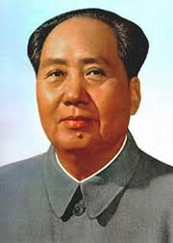
Critical Junctures: Maoism
The Soviet Model (1949-1957): The USSR poured money and expertise into the PRC
Land Reform
Redistributed property from rich to poor and increased productivity in countryside
Civil Reform
Free people from Opium addiction
Enhanced women’s legal rights
Five-Year Plans
Nationalized industry
Collectivized agriculture
Private property eliminated
Notes:
The USSR poured money and expertise into the PRC
With this help Mao and the Chinese Communist Party work on land reform, civil reform, 5 year plans

Slide 13
Critical Junctures: Maoism
Discussion Question: Compare how the Communist Party came to power in China with how it came to power in Russia – how was it different?
China: Communists won popular support by defeating Japan in WWII and then defeating the Nationalists in a civil war. Then they established a communist state, the PRC, which replaced the republic of 1911
Russia: Bolsheviks led a communist revolution & overthrew the czar
How was Maoism similar to Marxist-Leninism in the Soviet Union? Different?
Similar: Democratic Centralism (Communist Party best directs needs of the masses); collectivization; nationalized industry
Different: Mao valued strength of peasant, instituted mass line

Slide 14
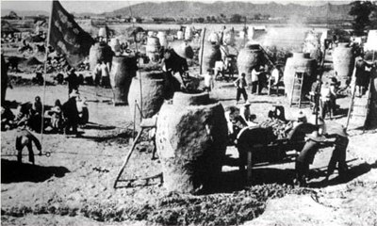
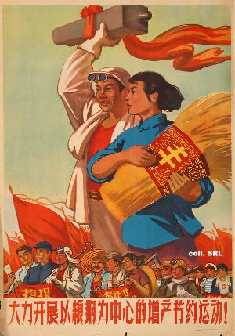
Critical Junctures: Maoism
The Great Leap Forward (1958-1966)
Wanted to free China from Soviet domination
Mao believed that the path the USSR had taken didn’t work for China
All-around development – equal emphasis on industry AND agriculture
Utopian effort to transform China into a radical egalitarian society
Reorganizes China into communes that would serve all basic social and economic functions
Backyard furnaces
People trying to make steel in countryside
All wood was used to fuel the furnaces
People melted down any metal they had
Notes:
Great Leap Forward:
All-around development – equal emphasis on industry AND agriculture
Backyard furnaces – people trying to make steel in countryside
Mass Mobilization (turn #s into asset)
Red vs. Expert - emphasis on party workers – not bureaucrats running govt. Cadres – party workers at lowest levels were expected to demonstrate party devotion by encouraging people to work hard
Decentralization – people can do it!
Estimates of death from famine as a result of this program and other factors range between 18 mil. and 45 million

Slide 15
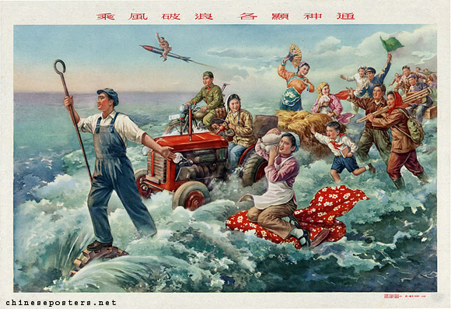
Critical Junctures: Maoism
The Great Leap Forward (1958-1966)
Mass Mobilization (turn #s into asset)
Red vs. Expert
Emphasis on party workers – not bureaucrats running govt. Cadres – party workers at lowest levels were expected to demonstrate party devotion by encouraging people to work hard
Decentralization
People can do it!
Failure – Famine
Estimates of death from famine as a result of this program and other factors range between 18 mil. and 45 mil.
Notes:
Great Leap Forward:
All-around development – equal emphasis on industry AND agriculture
Backyard furnaces – people trying to make steel in countryside
Mass Mobilization (turn #s into asset)
Red vs. Expert - emphasis on party workers – not bureaucrats running govt. Cadres – party workers at lowest levels were expected to demonstrate party devotion by encouraging people to work hard
Decentralization – people can do it!
Estimates of death from famine as a result of this program and other factors range between 18 mil. and 45 million

Slide 16
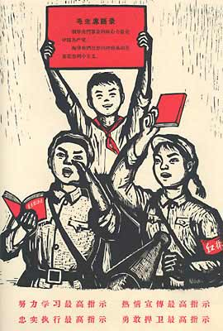
Critical Junctures: Maoism
The Cultural Revolution (1966-1976)
Mao’s ideological crusade designed to jolt China back toward his vision of communism
Main objective – political purification through struggle against “class enemies”
Between 1960 and 1966, Mao allowed two of his faithful – Liu Shaoqi and Deng Xiaoping – to implement market-oriented policies to revive economy
But Mao was still unhappy with China’s progress toward true egalitarianism
Mao and his backers accuse members of the party of taking “the capitalist road”
Goal – remove all vestiges of “old” China and its inequality
Scholars sent to fields to work
Universities/libraries destroyed
Emphasis on elementary education only
Student radicals (Red Guard) lead a purging of “class enemies”
Notes:
http://www.youtube.com/watch?v=M5Os4xdm5lI (brief Chinese History)
The Cultural Revolution:
Mao’s ideological crusade designed to jolt China back toward his vision of communism
Main objective – political purification through struggle against “class enemies”
Between 1960 and 1966, Mao allowed two of his faithful – Liu Shaoqi and Deng Xiaoping – to implement market-oriented policies to revive economy
But Mao was still unhappy with China’s progress toward true egalitarianism
Mao and his backers accuse members of the party of taking “the capitalist road”

Slide 17
Signs from the Cultural Revolution
“Destroy the Old World, Build a New World”

Slide 18
Signs from the Cultural Revolution
“Let new socialistic culture conquer every stage”
Features Jiang Qing, who led the Cultural Revolution Group of the Politburo

Slide 19
Signs from the Cultural Revolution
“We will crash the dog heads of those who oppose Chairman Mao!”

Slide 20
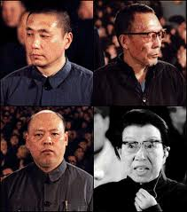
Critical Junctures: Maoism
1976: Mao dies leaving followers divided into factions
Each faction has ties back to Long March – importance of informal politics
Radicals – led by Mao’s wife
One of the “Gang of Four” who supported radical goals of cultural revolution
Military - had been led by Lin Biao, Mao’s designated successor, but he died in a mysterious plane crash in 1971
Rumors of an attempted coup around same time
Moderates – moderates (led by Zhou Enlai) who emphasized economic modernization and some contact with other countries
Moderates win and arrest Gang of Four
Crash Course World History – China’s Revolutions
Notes:
Each faction has ties back to Long March – importance of informal politics

Slide 21
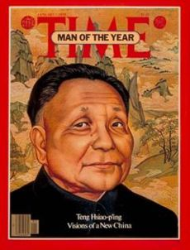
DENG XIAOPING
“It doesn’t matter whether a cat is white or black, as long as it catches mice.”
-Deng Xiaoping
Economic Reform

Slide 22
Critical Junctures: Deng Xiaoping
Discussion Question: Deng Xiaoping has a famous quote…
“It doesn’t matter whether a cat is white or black, as long as it catches mice.”
What does this mean?
It doesn’t matter if a policy is socialist or capitalist if it helped the economy.

Slide 23
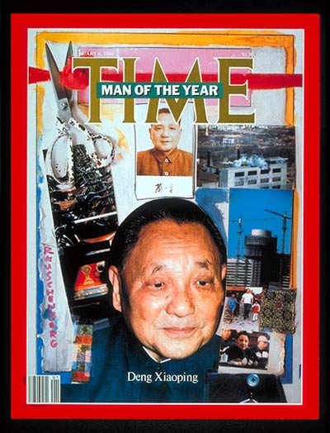
Critical Junctures: Deng Xiaoping
1979: Deng Xiaoping takes control of the Communist Party
Was “purged” twice by Mao (reinstated and purged) and brought back by moderate leaders
Four Modernizations
Industry, Agriculture, Science & Military
Open Door Trade policy
Trade with everyone, including capitalist nations like the U.S. to boost China’s economy
Reforms in Education
Higher academic standards, expansion of higher education and research (reversal of Cultural Rev)
Restored legal system/bureaucracy of Old China
Notes:
Deng Xiaoping
Was “purged” twice by Mao (reinstated and purged) and brought back by moderate leaders
Open Door Policy – Trade with everyone, including capitalist nations like the U.S. to boost China’s economy
Reforms in Education – Higher academic standards, expansion of higher education and research (reversal of Cultural Rev)

Slide 24
Critical Junctures: Deng Xiaoping
Socialist Market Economy
Household Responsibility System
Replaced communes
Village owns farmland, but it is contracted out by the local govt to individual families
After paying taxes/contract fees to govt, families may consume/sell what they produce
More Economic Liberalization
Special Economic Zones (SEZs)
Regions in which foreign investors were given preferential tax rates and other incentives
Township and Village Enterprises (TVEs)
Market-oriented public enterprises under the purview of local governments (iron, steel, cement, chemical fertilizer, hydroelectric power, and farm tools)
Thrived from 1978 to 1996
Ownership rights” stayed with the collective, while “use rights” were delegated to managers
Notes:
Deng Xiaoping
Household Responsibility System: (early 1980s) Village owns farmland, but it is contracted out by the local govt to individual families
SEZ: TVE: market-oriented public enterprises under the purview of local governments (iron, steel, cement, chemical fertilizer, hydroelectric power, and farm tools) thrived from 1978 to 1996 ; ownership rights” stayed with the collective, while “use rights” were delegated to managers

Slide 25
Critical Junctures: Deng Xiaoping
Economic Success:
Fastest-growing major economy in the world for more than two decades
GDP per capita grew at avg. rate of a little over 9% per year from 1990-2009
Economic Problems:
No more “iron rice bowl” – cradle to grave benefits
Under Mao, guarantee of lifetime employment, income and basic cradle-to-grave benefits to most urban and rural workers
Workplace also provided housing, health care, day care, and other services
Unemployment
Inequality
Notes:
1990-2009 – U.S. GDP grew at 1.5% per year
Iron Rice Bowl
Under Mao, guarantee of lifetime employment, income and basic cradle-to-grave benefits to most urban and rural workers
Workplace also provided housing, health care, day care, and other services
Floating Population
Peasants migrate to urban areas to find work
Approx 150 million people
Migrant workers are mostly employed in low-paying jobs, but fill an important niche in China’s changing labor market, esp in construction
Hukou – late 1950s, system that registers each citizen as entitled to work and to live in a specific urban or rural location
But this contributed to increasing inequality btw rural and urban bc limited farmers ability to go to cities
Authorities allowed recent migration b/c their labor was crucial to economic expansion BUT they have no rights in urban areas (education, for children health care, can be evicted by govt)

Slide 26
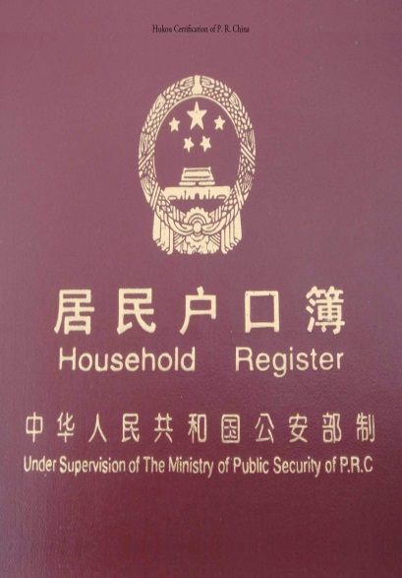
Critical Junctures: Deng Xiaoping
Economic Problems:
Floating Population – urban migration & issues with hukou (household registration)
Peasants migrate to urban areas to find work
Approx. 150-250 million people
Migrant workers are mostly employed in low-paying jobs, but fill an important niche in China’s changing labor market, esp. in construction
Hukou – late 1950s, system that registers each citizen as entitled to work and to live in a specific urban or rural location
But this contributed to increasing inequality btwn rural and urban because it limited farmers ability to go to cities
Authorities allowed recent migration b/c their labor was crucial to economic expansion BUT they have no rights in urban areas (education, for children health care, can be evicted by gov’t)
Notes:
1990-2009 – U.S. GDP grew at 1.5% per year
Iron Rice Bowl
Under Mao, guarantee of lifetime employment, income and basic cradle-to-grave benefits to most urban and rural workers
Workplace also provided housing, health care, day care, and other services
Floating Population
Peasants migrate to urban areas to find work
Approx 150 million people
Migrant workers are mostly employed in low-paying jobs, but fill an important niche in China’s changing labor market, esp in construction
Hukou – late 1950s, system that registers each citizen as entitled to work and to live in a specific urban or rural location
But this contributed to increasing inequality btw rural and urban bc limited farmers ability to go to cities
Authorities allowed recent migration b/c their labor was crucial to economic expansion BUT they have no rights in urban areas (education, for children health care, can be evicted by govt)

Slide 27
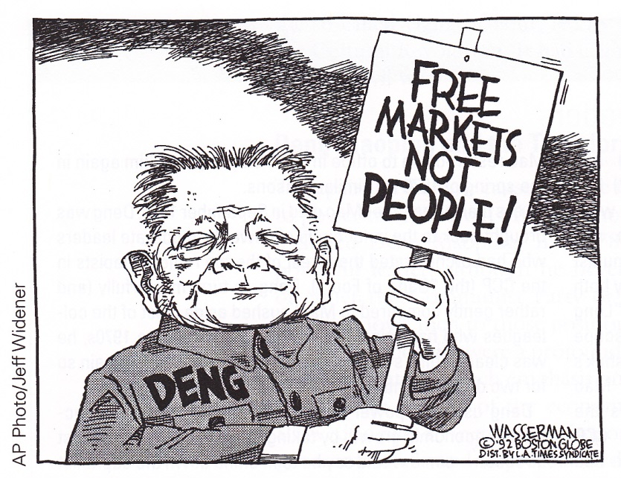
Critical Junctures: Deng Xiaoping
China embraced market reforms, gradually moving away from a command economy, but did NOT embrace political or democratic reform
1989: Tiananmen Square protests
Large scale demonstrations, esp. among students and intellectuals for more political freedoms
Used army to crack down on protests
Death toll has not been revealed

Slide 28
Critical Junctures: Deng Xiaoping
Discussion Question: Classify the following as ideas under Mao Zedong (MZ) or Deng Xiaoping (DX) or Both (B):
Allowed foreign investment
Iron Rice Bowl
Communes
Open Door trade policy
Education limited to elementary school
No private property allowed
Household Responsibility System
Egalitarianism pursued
Market socialism
Believed Communist Party leadership should not be challenged

Slide 29
Critical Junctures: Deng Xiaoping
Discussion Question: Classify the following as ideas under Mao Zedong (MZ) or Deng Xiaoping (DX) or Both (B):
Allowed foreign investment (DX)
Iron Rice Bowl (MZ)
Communes (MZ)
Open Door trade policy (DX)
Education limited to elementary school (MZ)
No private property allowed (MZ)
Household Responsibility System (DX)
Egalitarianism pursued (MZ)
Market socialism (DX)
Believed Communist Party leadership should not be challenged (B)

Slide 30
Critical Junctures: Technocrats
After Deng dies, rise of technocrats
Career-minded bureaucrats who administer public policy according to technical rather than a political rationale
Professional competence & political loyalty
Jiang Zemin (1993-2003)
Hu Jintao (2003-2013)
Xi Jinping (2013 - ?)
Has given high priority to promoting “people-centered” urbanization
Urban registration will be extended to 100 million migrants currently living in cities, while another 100 million will be moved to urban areas btw 2014 and 2020
Gov’t will invest in housing, schools, hospitals, & public transportation
All had university training in engineering
All were “groomed” by top leaders to move up in ranks
Notes:
Xi Jinping:
Has given high priority to promoting “people-centered” urbanization –
Urban registration will be extended to 100 million migrants currently living in cities, while another 100 million will be moved to urban areas btw 2014 and 2020.
Gov’t will invest in housing, schools, hospitals, & public transportation

