Slide 1
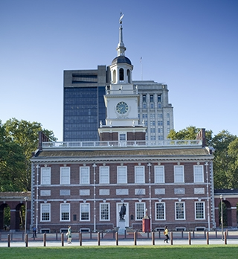
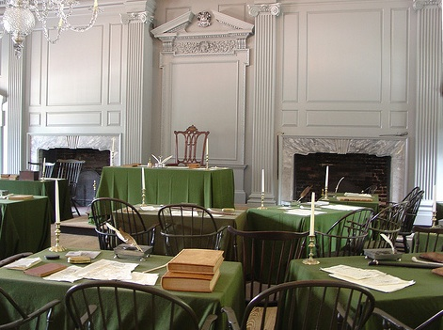
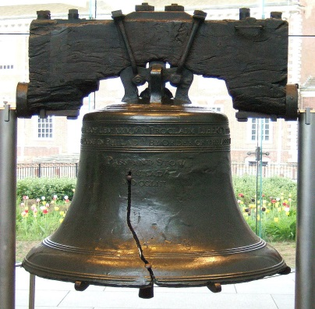
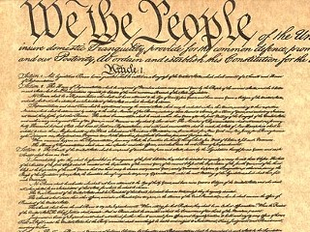
The Constitution
Objectives:
Explain how evolving debates about liberty led from the Revolutionary War to the Constitutional Convention.
Discuss the major proposals and compromises in making the Constitution
Summarize the differences between the Federalists and Anti-Federalists
Discuss continuing debates about democracy and the Constitution.

Slide 2
The Declaration of Independence~July 4, 1776
Statement of Beliefs – a political revolution based on liberty, with no mention of economic condition.
a new attitude in colonial mindset
All men are created equal
Three natural rights that come from God – not from man or monarch
Life
Liberty
Pursuit of happiness

Slide 3
Articles of Confederation
First form of government – weak in several ways:
Congress had no power to collect taxes
Congress had no power to regulate trade
No president to enforce law
No judicial branch to interpret law
One vote per state regardless of size
Needed unanimous consent to amend
9/13 majority to pass laws
Congress could not draft soldiers

Slide 4
Shays’ Rebellion January 1787
Protest led by Daniel Shays
Ex-Revolutionary soldiers, now farmers, forcibly prevented the courts in Massachusetts from convening
Feared they would have their property confiscated for non-payment of debt and taxes
Governor could not suppress with his own state militia because he didn’t have one and federal government couldn’t afford to send troops
Private funds for a private army dispersed the crowd.
Impact – Deep fears of anarchy in the states

Slide 5
Reaction to Shays’ Rebellion
Jefferson
Washington
“ A little rebellion now and then is a good thing. The tree of liberty must be refreshed from time to time with the blood of patriots and tyrants”
“For God’s sake, if they have real
Grievances, then redress them,
If not, employ the full force of
Government against them at once!”

Slide 6
Constitutional Convention Philadelphia ~ 1787
Goal was to revise the Articles but Madison proposed they be abolished!
No delegate from any state had permission from governor to abolish
No state model was sufficient
PA was most democratic but unicameral and thus too tyrannical.
MA was less democratic in requiring ownership of property and Christianity to be eligible to vote.

Slide 7
Framers (Founding Fathers)
55 men – young but “experienced”
8 signed the Declaration of Independence
7 Governors
34 lawyers
Not necessarily “intelligent” but “practical”
1/3 were veterans of the American Revolution
30 attended regularly
RI refused to attend
James Madison – “Father of Constitution”

Slide 8
How do we devise a government strong enough to preserve order, but not so strong as to threaten liberty?

Slide 9
Factions Among Delegates
Centralization vs Decentralization
Federalism vs States’ Rights
A range of beliefs from near monarchism to definite decentralized republicanism

Slide 10
Agreements at Convention
Scrap the articles and give more power to the national government
Establish a republican government
Establish a constitutional government
Prevent a single interest from dominating
Suffrage for property owners only
Protect property rights

Slide 11
Conflicts at Convention
Congressional Representation
Powers of the Executive and Judicial Branches
Slavery
Regulation of Commerce

Slide 12
Large States vs Small States
The Virginia Plan: Large States
National legislature with representation based on population
Single executive chosen by legislature
Judges chosen by legislature
The New Jersey Plan: Small States
National Legislature:
State legislatures choose one rep for their state
Each state gets 1 vote
Plural executive chosen by legislature
Judges appointed to life by executive
All acts of Congress would be the supreme law of the land

Slide 13
Great Compromise (Connecticut Compromise)
Solved the conflict of Congressional representation!
Proposed by Roger Sherman of CT
Bicameral legislature
one chamber based on population (House)
One chamber based on equal representation per state (Senate)

Slide 14
Selection of President Compromise

Slide 15
Slavery Compromise

Slide 16
Trade Compromise

Slide 17
Interstate Commerce Clause
National Government can regulate commerce among states, territories, and native American reservations (interstate trade)
May not regulate trade within states (intrastate trade)
May not tax international exports
State governments cannot tax imports

Slide 18
Federalist 51 James Madison
“If men were angels, no government would be necessary. If angels were to govern men, neither external nor internal controls on government would be necessary.”
“In framing a government which is to be administered by men over men, the great difficulty lies in this: you must first enable the government to control the governed; and in the next place oblige it to control itself.”

Slide 19
Madisonian Model
“a double security arises to the rights of the people, the different governments will control each other, at the same time that each will be controlled by itself”
Separation of Powers – three branches were to be independent of each other
Checks and Balances – three branches are able to prevent one another from becoming too powerful
Federalism – power over people is divided between federal and state gov’ts

Slide 20
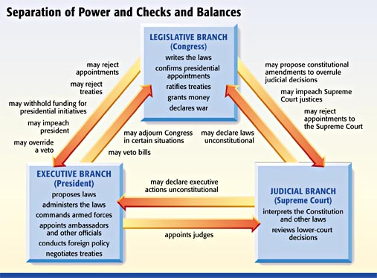

Slide 22
Types of Powers
Implied – powers not specifically delegated in the Constitution
Necessary and Proper Clause (Art. I Sec. 8) “to make all laws necessary and proper for carrying into execution the foregoing powers
Denied – powers that are specifically NOT allowed to either federal or state gov’ts
Habeas corpus: an order to produce an arrested person before a judge (cannot be suspended)
Bills of attainder: laws that declare a person guilty of a crime without a trial
ExPost Facto Laws: laws that make an act criminal even though the act was legal when committed

Slide 23
Preamble to Constitution
Brief introduction to document
Highlights purposes of government
Shows intentions of founding fathers

Slide 24
Seven Articles
Legislative Branch
Executive Branch
Judicial Branch
Relations Among States
Amendment Process
National Supremacy
Ratification

Slide 25
Amendments
Bill of Rights – 1st ten amendments to the Constitution that limits government action
Assembled by Madison with 200 suggestions
Only applicable to the national government until the 14th amendment

Slide 26
Federalist 84
A bill of rights…are not only unnecessary in the proposed constitution, but would even be dangerous. They would contain various exceptions to powers which are not granted; and on this very account, would afford a colorable pretext to claim more than were granted.”
“For why declare that things shall not be done which there is no power to do? Why for instance, should it be said, that the liberty of the press shall not be restrained, when no power is given by which restrictions may be imposed?”

Slide 27
Patrick Henry’s Anti-Federalist argument
Without a Bill of Rights, you will exhibit the most absurd thing to mankind that ever the world saw ­ a government …that has abandoned all its powers…the powers of taxation, the sword, and the purse. You have disposed of them to Congress, without a Bill of Rights ­ without check, limitation, or control... You have a Bill of Rights to defend against a state government, which is bereaved of all its power, and yet you have none against Congress, thought in full and exclusive possession of all power!?”

Slide 28
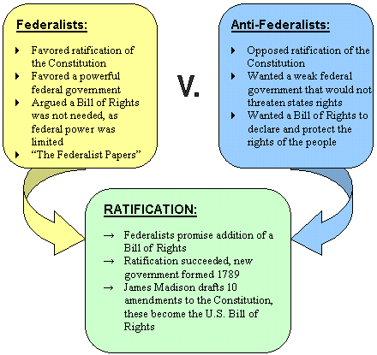

Slide 29
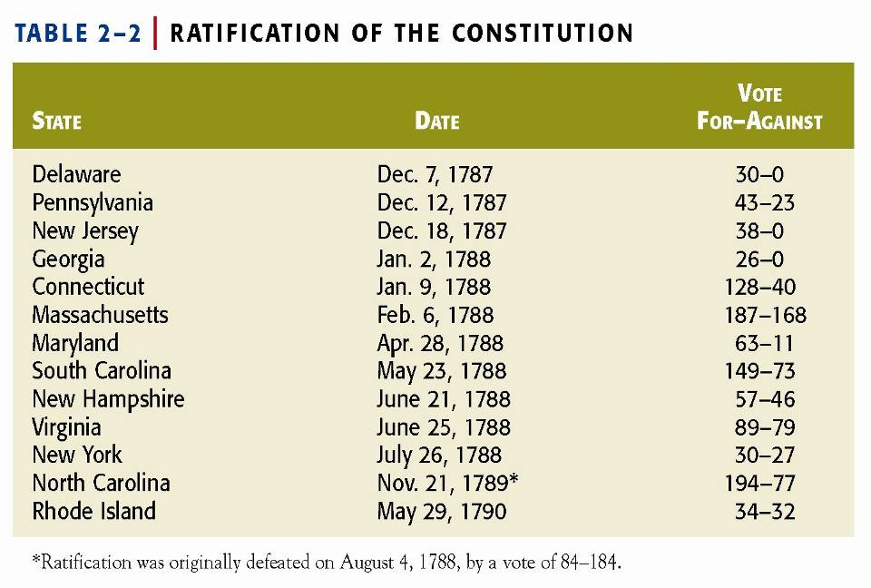

Slide 30
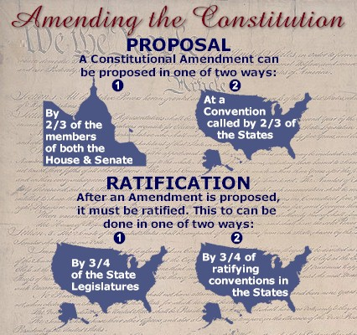

Slide 31
Why is there a process and why is it difficult?
Constitution should not be changed for “light and transient causes.”
Every government must be able to cope with new and unforeseen problems
Written intentionally vague to address matters of principle, rather than detail
If process is rigorous, ample time is needed to consider the merits of such a change

Slide 32
Informal Methods of Change
Congressional legislation
Presidential action/executive order
Judicial Review
Interpretation, custom and usage

Slide 33
Equality
Slavery ignored – Roger Sherman said the Convention was not the time nor place to discuss issues of morality
If slavery was abolished in the Constitution, we may not have one at all
Avoided issue until 1808 when slave trade ended

Slide 34
Women
Abigail Adams reminded her husband, “Don’t forget the ladies.”
Not specifically mentioned but included by reference to citizens, persons, and people.
Nothing in Constitution ever denied women the right to vote, but custom interpretation, and usage blocked it.

Slide 35
Continued Controversies
Too weak or too powerful?
Balanced Budget Amendment
Line Item Veto
Authority of Federal Courts
Term Limits on Congress
Presidential Authority

