Slide 1
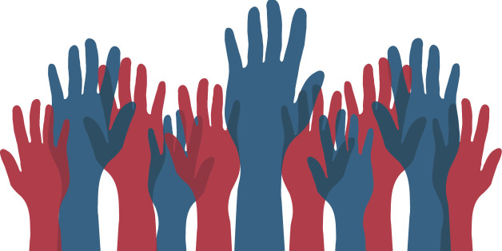
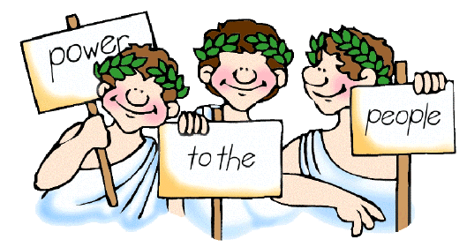
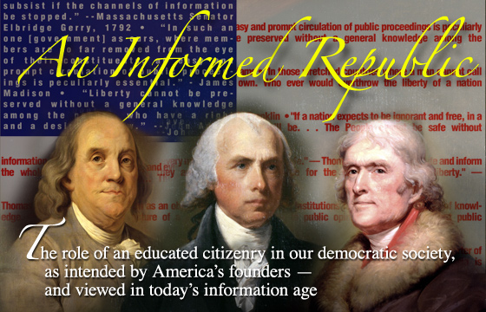
The Study of American Government
Objectives:
Explain how politics drives democracy
Discuss five views of how political power is distributed in America
Explain who governs in America and to what ends.

Slide 2
What is politics?
Politics – the activity by which an issue is agitated or settled.
We negotiate, argue, discuss, persuade, apply force – all in an effort to agitate or settle an issue
Issues – Conflicts that are real or apparent between the interests, ideas, or beliefs of different citizens

Slide 3
How should the government collect money and how should it be spent? 1786
James Madison – “the federal gov’t needs to have the power of taxation and collectors of revenue, but overall powers should be few and defined and its taxing power would be used sparingly.”
Patrick Henry – “if the federal government has the power to tax there will be an immense increase spent by an ever-growing gov’t”

Slide 4
How should the government collect money and how should it be spent?
Budget Proposal 2016
Revenue $3.5 Trillion
Expenditures $4 Trillion
Deficit $500 Billion
Debt $19 Trillion
Spend less, borrow more, raise taxes – but on who? Reallocate funds?

Slide 5
Other Issues
What are other issues in American Politics today?

Slide 6
Politics
Think about:
Why do politicians kiss babies when campaigning for office?
Why does Congress try to fix some issues while putting others on hold?
Why did BP spend millions of dollars airing commercials and ads showing how they were helping clean the Gulf of Mexico?

Slide 7
Government & Politics
Political scientists ask how and why
Who governs—and to what ends?
How do political issues get on the public agenda?
How do the politics of issues change over time?
What political obstacles and opportunities will arise?
What is the role of public opinion, interest groups, the media, the courts and political parties?

Slide 8
Government & Politics
Politics is the process/activity
Politicians move the process from the people to the government
Government is the institution in which decisions are made that resolve conflicts or allocate benefits and privileges
Public Policy: exercising government power in order to alleviate problems facing all of society

Slide 9
Why is Government Necessary?
Power – the ability of one person to get another person to agree
Authority - the right to exercise power
Formal authority – right to exercise power is vested in a government official
Legitimacy – acceptance of authority by population because of a law or constitution

Slide 10
Purpose of Government
Thomas Hobbes:
“Every man is against every man…and the life of man is solitary, poor, nasty, brutish, and short.”
Govt. should:
enforce laws
defend citizens
punish criminals
Exchange some citizen rights to have law and order
John Locke:
“Life, liberty, and the enjoyment of personal property”
Govt. should:
guarantee peoples’ natural rights
not place restrictions on people without THEIR consent
Power to the People!

Slide 11
Forms of Government
Authoritarian: a government whereby the ruler(s) have absolute control
people have no choice to choose their leader(s)
usually totalitarian - a government that controls all aspects of a nation’s political and social life
Aristocracy: “rule of the best” - the most prominent citizens rule
Democracy: political authority is vested in the people
From the Greek words demos (“the people”) & kratos (“authority”)

Slide 12
Two types of democracy Rule of the many
Direct Democracy
Participatory democracy
Decisions made by people directly rather than by elected representatives
Began in Greece
Works best in small populations
Representative Democracy
Leaders are elected by popular vote to represent the interests of the people and make decisions for them
Used by most nations that are democratic today

Slide 13
Defining American Democracy ~Joseph Schumpeter~
The democratic method is that institutional arrangement for arriving at political decisions in which individuals acquire the power to decide by means of a competitive struggle for the people’s vote.
AKA Representative Democracy

Slide 14
Dangers of Direct Democracy
The founders believed in government based on the consent of the people
However, they were highly distrustful of anything that might look like “mob rule”
Can you think of an example?
Therefore, they devised institutions to filter the popular will through elected elites

Slide 15
Federalist #10 by James Madison
“A common passion or interest will, in almost every case, be felt by a majority of the whole… and there is nothing to check the inducements to sacrifice the weaker party or an obnoxious individual. Hence it is that such democracies have ever been spectacles of turbulence and contention, and have ever been found incompatible with personal security or the rights of property; and have in general been as short in their lives as they have been violent in their deaths.”

Slide 16
Theoretical Components of Democracy
Equality in voting—the principle of “one person, one vote” is basic to democracy.
Effective participation—political participation must be representative.
Enlightened understanding—free press and free speech are essential to civic understanding.
Citizen control of the agenda—citizens should have the collective right to control the government’s policy agenda.
Inclusion—citizenship must be open to all within a nation

Slide 17
Concepts of Democracy
Worth of the Individual – basis of all citizen participation
Equality of all persons – equality of opportunity and equality before the law
Majority Rule, Minority Rights – protection of the minority opinion
Necessity of Compromise – experimentation until we get it right
Individual Freedom – The right to swing my fist ends where the other man’s nose begins

Slide 18
Principles of Our Government
Popular Sovereignty – rule by the people
Limited Government – some things the government cannot do (Bill of Rights & Federalism)
Separation of Powers – to prevent any one branch from becoming too powerful
Checks and Balances - accountability
Rule of Law – the government must also follow the laws
Judicial Review – Supreme Court has the power to judge constitutionality of all laws

Slide 19
Who Has the Power?
To make decisions?
To determine the issues?
To lead?
To control debate?
To inspire and persuade?

Slide 20
Theory #1 – Class View or Marxist Theory
Wealthy capitalists and other economic elites determine most policies
Began with Marx’s idea that the business owners (upper class/bourgeoisie) dominate until workers (99%/proletariat) start a revolution (Bernie Sanders anyone?)
Let’s just call it the power of the rich (leaders of multinational corporations)

Slide 21
Theory #2 – Power Elite View
A group of business, military, labor union, and elected officials control most decisions (most are outside the government)
Argues that American democracy is dominated by a few top leaders – wealthy or privately powerful
George Soros and the Koch Brothers
Military industrial complex

Slide 22
Theory #3 – Bureaucratic View
Appointed bureaucrats ultimately run everything – they don’t just implement policy, they make it
Their competence is essential to the management of complex affairs
Executive Department Hired Employees
Independent Agency Hired Employees
White House Staff
Joint Chiefs of Staff

Slide 23
Theory #4 – Pluralist View
Representatives of a large number of interest groups are in charge
Political resources are broadly shared and therefore competition among all affected interests shapes public policy
Political players include: cities, states, school boards, legislatures, executives, judges, bureaucrats – none of which dominate
Many groups hold power – bargaining and compromise determine policy

Slide 24
Theory #5 –Creedal Passion View
Each of the first 4 are correct
However, most important policy decisions are influenced by the morally impassioned elites
Motivated to bring policies in line with democratic ideals
Patrick Henry – “Give me liberty or give me death”
Jacksonian Democracy 1820’s Common Man
Civil Rights Leaders of 1960s
Anti Vietnam War protestors

Slide 25
Who Governs and to What Ends?
Big business? Unions? Politicians? People? Special interests? Wall Street? Military? Crack-Pot Liberals? Media? White Males?
Does it matter?
Isn’t family, love, work, play, health more important?
Who has the greatest power?

Slide 26
The Political Agenda
Consists of issues that people believe require governmental action
Shared political values – what is caused by individual decisions and what is caused by societal forces
Weight of custom and tradition – people are okay with the government doing what it usually does.
Importance of events/circumstantial – terrorist attacks, war, recession
Terms of debate – how do candidates discuss the issues?

Slide 27
How is Policy Made?
By the Influence of the following groups
Organized Groups
BLM, Unions
Riots or behind the scences
Interest Groups
NRA, Greenpeace
Government Institutions
Courts, bureaucracy, Senate
Roe v Wade, Great Society, confirmation hearings
Media
Reporting on issues or creating the debate?
States
State law becomes federal polciy

Slide 28
How Issues are Handled on the Political Agenda
Intense interest group conflict
One group prevails unchallenged
Ideological appeal to broad national constituencies
Quiet bargaining in congressional offices

Slide 29
Cost and Benefit
Cost – any burden, monetary or non monetary that some people must bear if a policy is adopted
Who pays? Who ought to pay?
Benefit – any satisfaction monetary or non monetary that people believe they will enjoy if the policy is adopted
Perceived or real
Who benefits? Who ought to benefit?

Slide 30
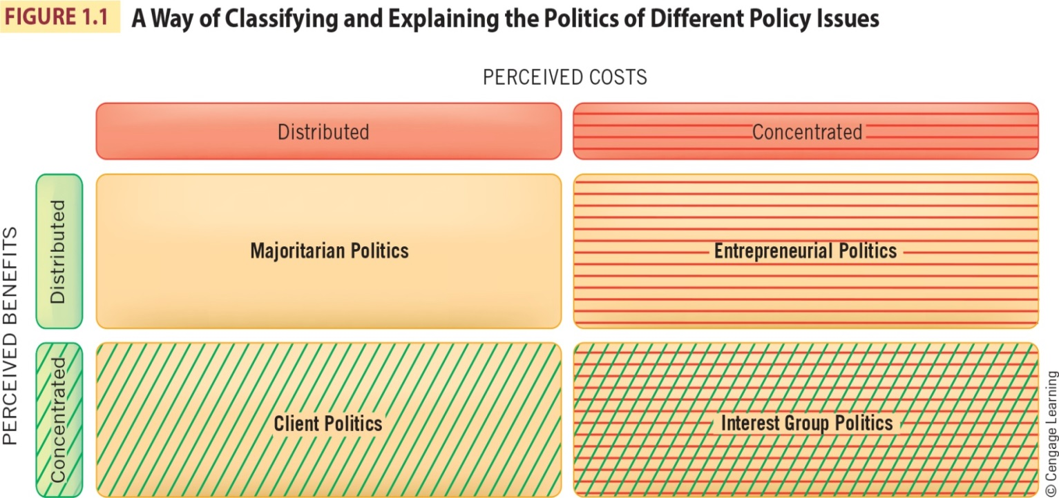
Four Types of Politics

