Slide 1
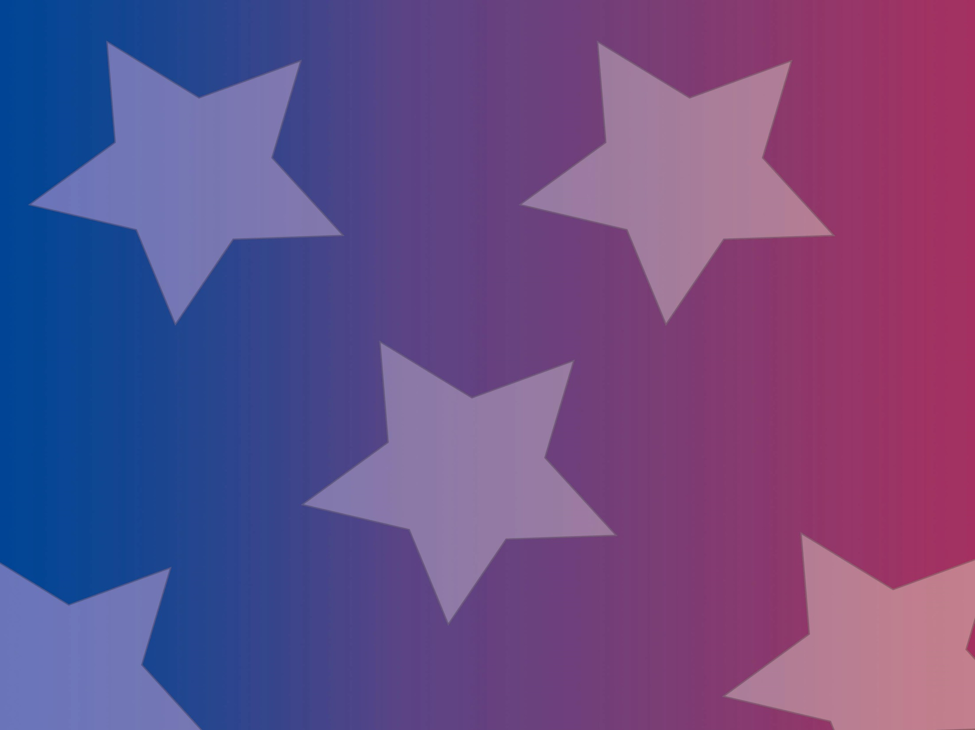
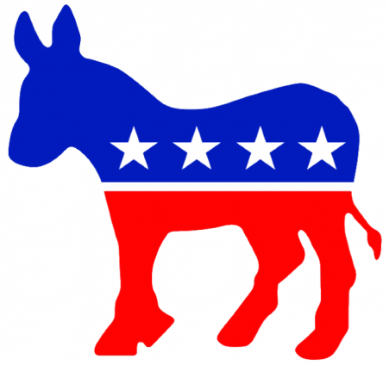
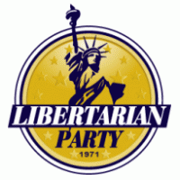
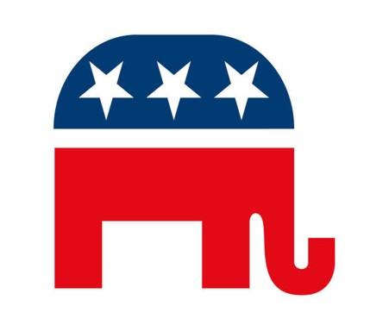
Political Parties
Objectives:
Describe the roles, functions and organizations of American political parties
Explain how they differ from other democracies
Describe the evolution of the party system.
Notes:
Political Party - An organization that seeks political power by electing people to office so that its positions and philosophy become public policy.

Slide 2
Political Parties
Political Party - a group that seeks to elect candidates to public office by supplying them with a label (party identification), by which they are known to the electorate
Parties are:
Necessary
perform vital functions
Complicated
full of internal conflict
disorganized and decentralized
rigid but capable of being taken over by reformers.
Notes:
Political Party - An organization that seeks political power by electing people to office so that its positions and philosophy become public policy.

Slide 3
4 Functions of Parties
Organization: - Candidate Recruitment
Parties need to find viable candidates for a whole range of elected positions at the federal and state level
Obstacles to recruitment include:
Time
Privacy
Finances
Prospects
State and local parties run many recruitment efforts, however, more and more power has been given to the national party leaders.
Notes:
Political Party - An organization that seeks political power by electing people to office so that its positions and philosophy become public policy.

Slide 4
4 Functions of Parties
2. Nominating Candidates Through Primaries
Closed primary – only registered party members may vote for the party’s nominee
This tends to lead to a stronger party system
Open primary – all voters (regardless of party membership) may vote for a party’s nominee
Moderate candidates may tend to win these, however, there is no empirical evidence to support this assertion
IL has an open primary
Still can only vote in one party’s primary, not both
Notes:
Political Party - An organization that seeks political power by electing people to office so that its positions and philosophy become public policy.

Slide 5
4 Functions of Parties
Nominating Conventions
Candidates for president are officially nominated
Conventions are held after primaries are held in all 50 states ( happened in July 2016 )
In these primaries, delegates are chosen to represent one candidate based on the vote in each state
Each party has different rules for delegate selection
Democrats = Proportional allocation
Republicans = Proportional and winner-take-all
Each state has a different number of delegates based on party rules for each party
Democrats and Republicans also have delegates that are “unpledged” and may vote however they wish.
Democrats = super-delegates (party leaders/elected officials)
Republicans = “un-bound” delegates
Notes:
Political Party - An organization that seeks political power by electing people to office so that its positions and philosophy become public policy.

Slide 6
4 Functions of Parties
Nominating Conventions (cont.):
The delegate system was implemented to reduce the power of party bosses to choose the nominee
Unintended consequences:
Empowering party activists
Candidates choose the delegates that will represent them
To reassert themselves, party leaders have worked to put themselves back in the process in 3 ways:
Democrats have super-delegates
Invisible primary - Process by which candidates try to attract the support of key party leaders (endorsements) before the elections begin
Raising money – more money = more likely chance of winning.
Notes:
Political Party - An organization that seeks political power by electing people to office so that its positions and philosophy become public policy.

Slide 7
4 Functions of Parties
3. Winning Elections
Labels to help voters decide
Get out the Vote campaigns
Mobilize and register voters to vote for your candidates
Supporter lists
Providing polling data
Campaign staff
Money
Donations from the party to a specific candidate sends a signal that this person is worthy of other donors to give money
Notes:
Political Party - An organization that seeks political power by electing people to office so that its positions and philosophy become public policy.

Slide 8
4 Functions of Parties
4. Operating the Government
Appointments to Judicial and executive branches
Providing organized “loyal” opposition to government
Make sure, if not in power, that party is ready for next election
Leaders
Issues
Policies
Notes:
Political Party - An organization that seeks political power by electing people to office so that its positions and philosophy become public policy.

Slide 9
Party Systems
European parties are disciplined gatekeepers, to which voters are very loyal, though this has been declining recently
Candidates for elective office usually nominated by party leaders
Campaigns are run by the party
Elected officials expected to vote and act together with members of his/her party
In a parliamentary system, the legislative and executive branches are one, so one party controls it all. In the U.S., the President is elected separately from the legislature, so two parties can be in power at once
The federal system decentralizes power in U.S.
Parties are closely regulated by state and federal laws, which weaken them
Candidates are now chosen through primaries, not by party leaders
Notes:
Political Party - An organization that seeks political power by electing people to office so that its positions and philosophy become public policy.

Slide 10
History of Parties in the U.S.
The Founding/Post G. Washington
Federalists (Hamilton) vs Democratic-Republicans (Jefferson)
Issues:
Size and power of national government
State’s rights
Voters:
Federalist: New England, Wealthy, Merchants
Republican: South, Artisans, Farmers
Adams (Federalist) wins over Jefferson (Republicans)
1804 - Jefferson Inaugural Address:
“We are all Republicans, we are all Federalists”
U.S. became pretty much one party (Republicans) after Jefferson (Madison, Monroe)
Notes:
Political Party - An organization that seeks political power by electing people to office so that its positions and philosophy become public policy.

Slide 11
History of Parties in the U.S.
Jacksonian Era:
Birth of Modern Democratic Party
1824 - Republican Party splits
Andrew Jackson leaves party to form his own
Republicans change name to National Republicans
Jackson helps form the Democratic Party
This is the same Democratic Party we have today
1828 - Jackson wins
National Republicans rename themselves Whigs
During the Jacksonian era political participation became a mass phenomenon
Eliminated caucus-based nominations
Members of Congress nominated Pres. candidates
Moved to Party conventions to nominate
Voter Bases:
Dems – Rural/South
Whigs – North/Urban centers
Notes:
Political Party - An organization that seeks political power by electing people to office so that its positions and philosophy become public policy.

Slide 12
History of Parties in the U.S.
Civil War/Sectionalism
Birth of the Republican Party
1856 - modern Republican Party forms
Remnant of Whig party split, anti-slavery Democrats, and the Free Soil Party
First and only time that a third party transitioned into a major party in the U.S.
From 1860 through 1932
Republicans control White House and to a lesser extent Congress
Exceptions:
Grover Cleveland (1885-1889; 1883-1897)
Woodrow Wilson (1913-1921)
There were splits within the Republican Party based on reformers who opposed patronage
Mugwumps and Progressives
Voter bases:
Republicans: North/Urban
Democrats: South
Notes:
Political Party - An organization that seeks political power by electing people to office so that its positions and philosophy become public policy.

Slide 13
History of Parties in the U.S.
Era of Reform
This is part of the Republican dominance (early 1900s), but many changes in the parties and elections happened
Republicans – coalition of big business and working class
Democrats – rural interests
Progressives pushed measures to curtail parties’ power and influence
Primary elections for candidates
To try and get rid of political machines and bosses
Voter requirements to reduce fraud
Adoption of the standard ballot (Australian)
Civil service reform to get rid of patronage
Results:
The worst forms of political corruption were reduced
All political parties were weakened
Parties became less able to hold officeholders accountable or to coordinate across the branches of government
Notes:
Political Party - An organization that seeks political power by electing people to office so that its positions and philosophy become public policy.

Slide 14
History of Parties in the U.S.
New Deal Era (1932-1964)
Democratic dominance
Grand coalition of
Urban dwellers
Labor Unions
Catholics
Jews
The Poor
Southerners
African Americans
Farmers
Notes:
Political Party - An organization that seeks political power by electing people to office so that its positions and philosophy become public policy.

Slide 15
History of Parties in the U.S
Polarization and Resurgence
Mid to late 20th century
Elections had come to be more about candidates than parties
More independent voters
Lot of split-ticket voting
With the civil rights legislation in the 1960s, parties began to take certain stands on racial issues
Shortly after, each party started to take stands on many other social issues (abortion, taxes, women’s rights, etc.)
This made ideology the main glue that holds the parties together, instead of the patronage of the past
This allowed for the era of polarization on issues between the parties to be ushered in
Notes:
Political Party - An organization that seeks political power by electing people to office so that its positions and philosophy become public policy.

Slide 16
Party Realignments
Critical or realignment periods
Periods when a major, lasting shift occurs in the popular coalition supporting one or both parties
Occurs when a very important issue cuts across party divisions
Two kinds of realignments:
A major party is defeated so badly that it disappears and a new party emerges (Federalists and Whigs)
Two existing parties continue but voters shift their loyalty from one to another (1896 and 1932)
Notes:
Political Party - An organization that seeks political power by electing people to office so that its positions and philosophy become public policy.

Slide 17
Five Realigning Periods
1800 – Jeffersonian Republicans defeat Federalists
1828 – Jacksonian Democrats come to power
1860 – Republicans replace Whigs as second party
1896 – Republicans defeated Democrat William Jennings Bryan
Economic issues shifted loyalties to East/West, city/farm split
1932 – FDR is elected and Democratic resurgence
Economic depression triggered new coalition for Democrats
Notes:
Political Party - An organization that seeks political power by electing people to office so that its positions and philosophy become public policy.

Slide 18
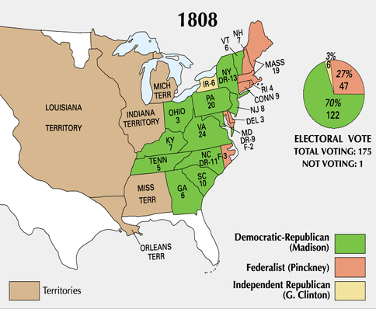
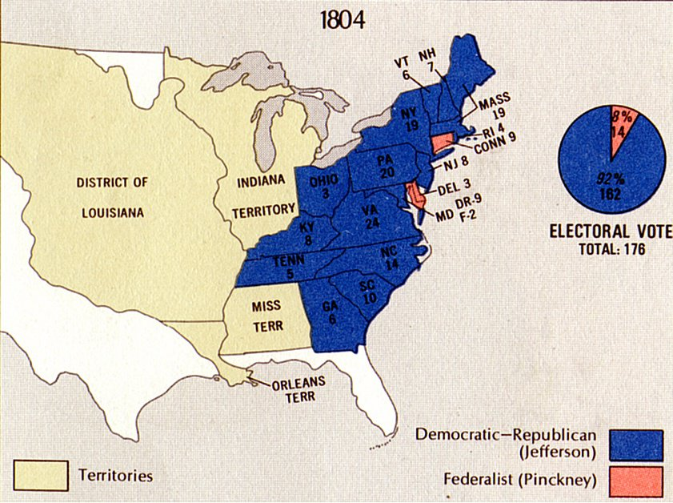
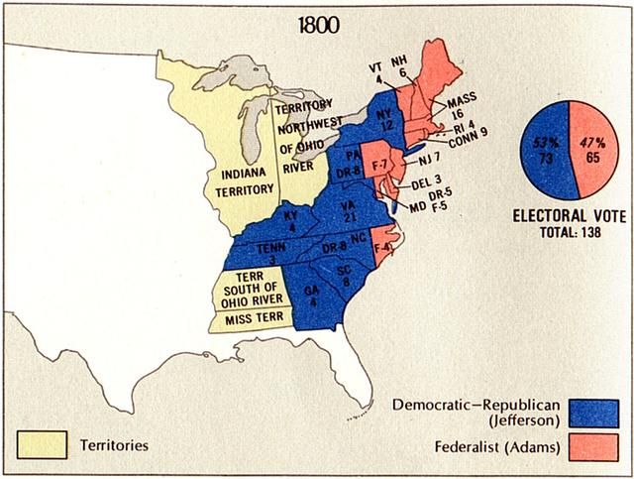
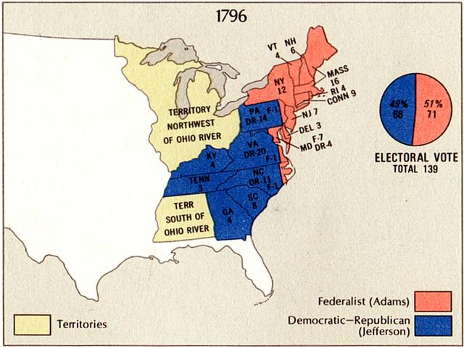
Jeffersonian Republicans
Notes:
Political Party - An organization that seeks political power by electing people to office so that its positions and philosophy become public policy.

Slide 19
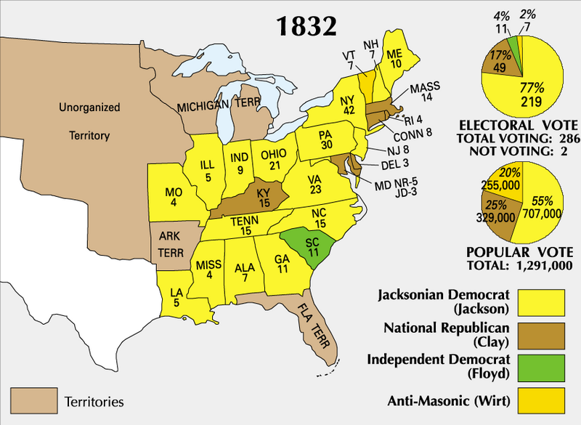
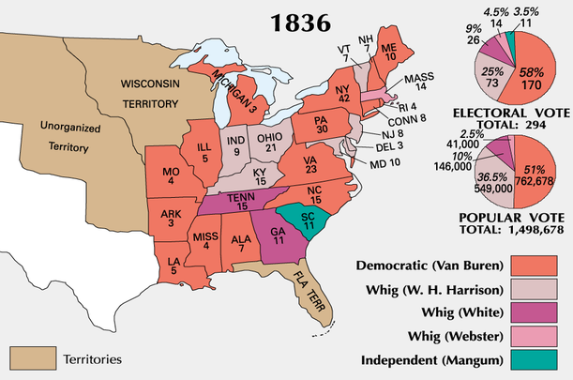
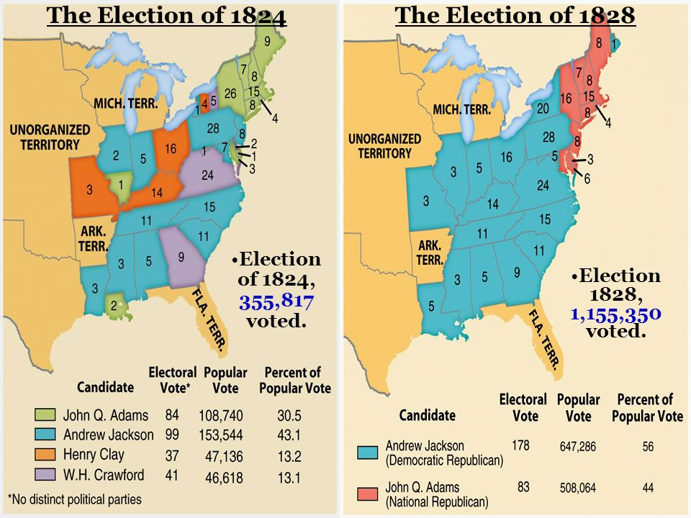
Jacksonian Era
Notes:
Political Party - An organization that seeks political power by electing people to office so that its positions and philosophy become public policy.

Slide 20
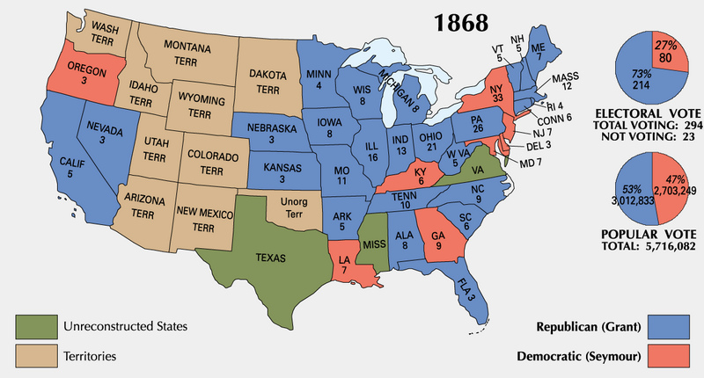
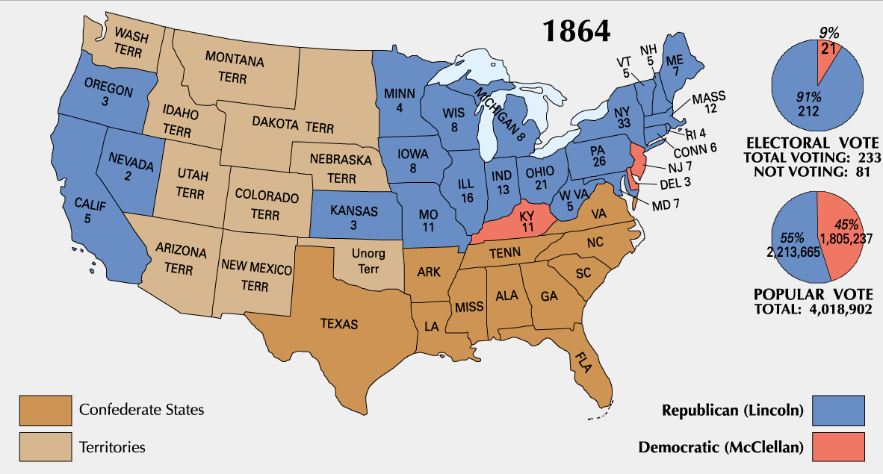
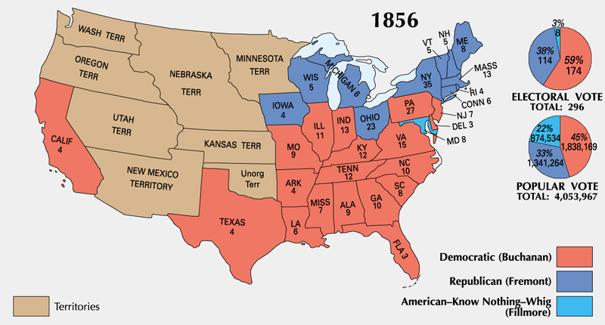
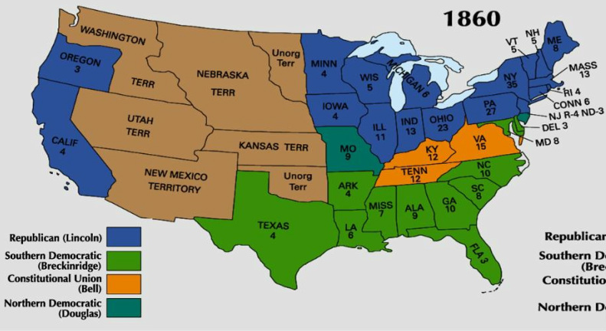
Republican Party Emerges
Notes:
Political Party - An organization that seeks political power by electing people to office so that its positions and philosophy become public policy.

Slide 21
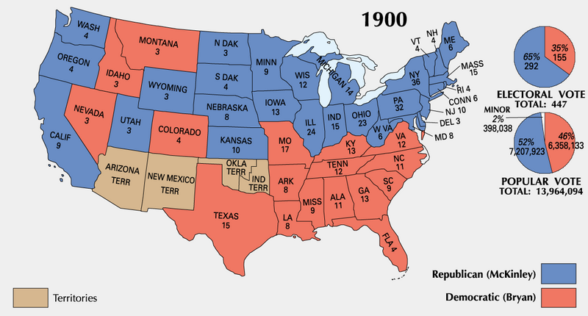
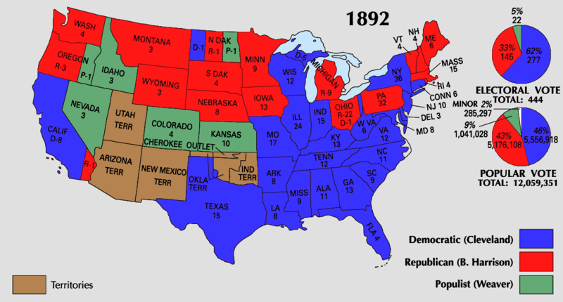
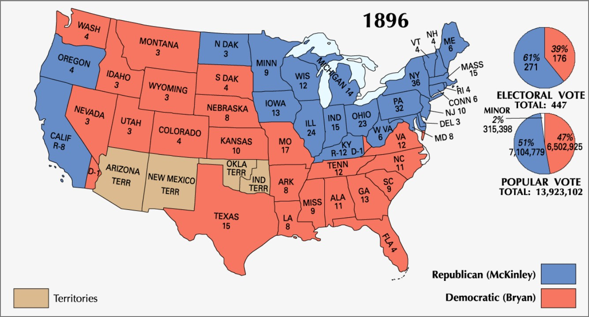
1896 Election (Before/After)
Notes:
Political Party - An organization that seeks political power by electing people to office so that its positions and philosophy become public policy.

Slide 22
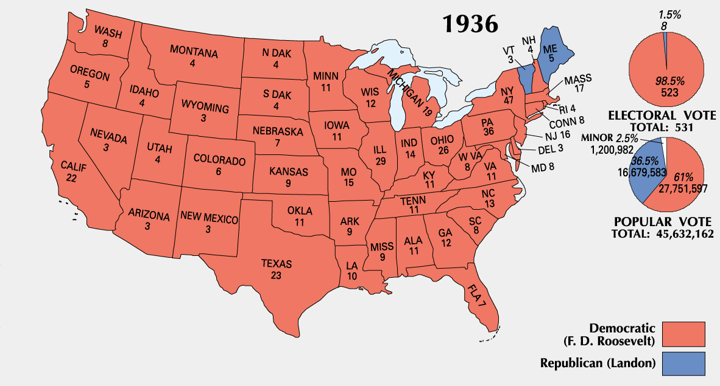
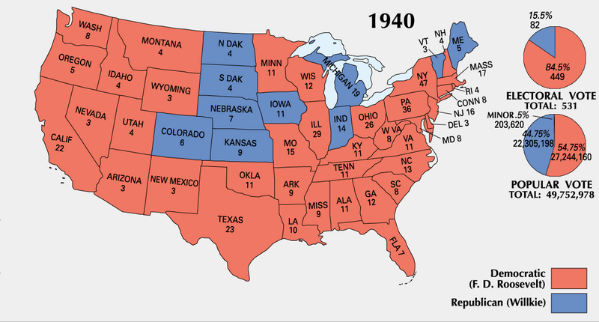
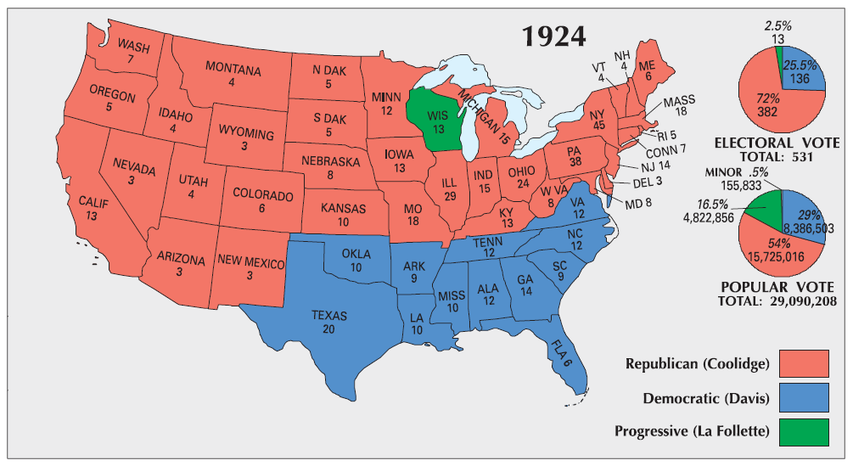
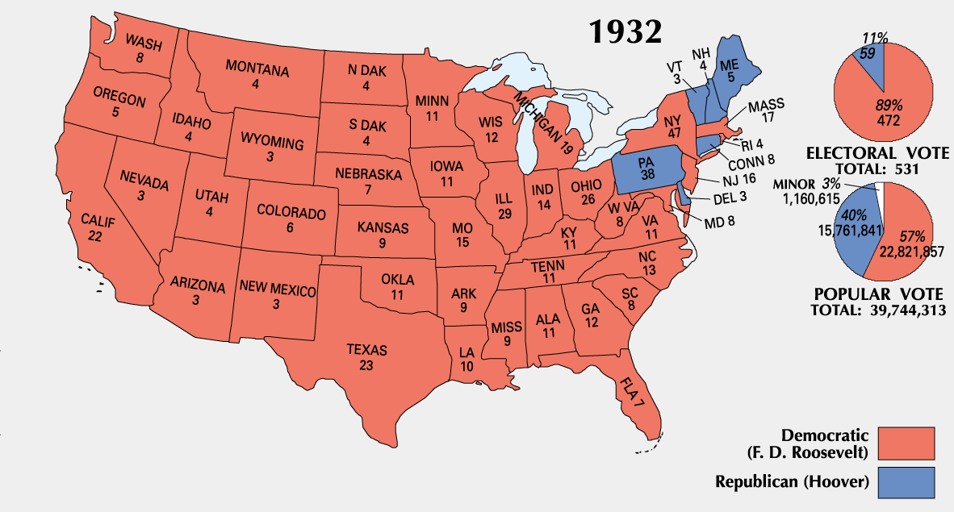
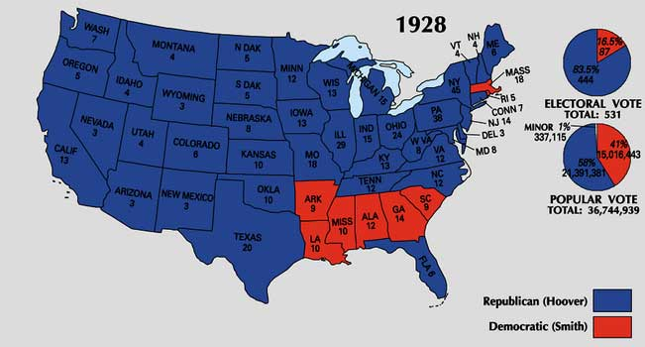
1932 Election (Before/After)
Notes:
Political Party - An organization that seeks political power by electing people to office so that its positions and philosophy become public policy.

Slide 23
Realignments: Still Relevant?
While the historical realignments are helpful in explaining the growth of parties, many scholars question the usefulness of using the theory to describe modern elections
While parties in the past tended to change drastically, most change today occurs gradually.
Notes:
Political Party - An organization that seeks political power by electing people to office so that its positions and philosophy become public policy.

Slide 24
Dealignment?
Dealignment
Process whereby a large portion of the electorate abandons its previous partisan affiliation without developing a new one to replace it
It is contrasted with realignment
Are we experiencing dealignment?
People have abandoned both parties to become Independents
However, most Independents are really partisans in their voting behavior and attitudes
Dealignment has led to ticket splitting in recent times
Notes:
Political Party - An organization that seeks political power by electing people to office so that its positions and philosophy become public policy.

Slide 25
Dealignment?
Other factors that have weakened the parties and contributed to dealignment
Candidate-centered campaigns (especially after FECA)
Public disenchantment with parties and politics during the 60's
Growth of interest groups – have taken on some party functions
Development of mass media – candidates rely on media rather than party organization to get message across
Growth of political independents
Trend to “vote the man, not the party” and rise of ticket splitting (voting for candidates from both political parties)
Notes:
Political Party - An organization that seeks political power by electing people to office so that its positions and philosophy become public policy.

Slide 26
Organization of Parties
National Organization:
Every four years – National Convention
Meeting of party delegates to nominate Pres. Candidate and set direction of the party (platform)
Between conventions, affairs managed by national committee
Delegates who run the day to day affairs of the party
National chair – day to day manager of the party elected by the national committee Reince Priebus and
Debbie Wasserman-Schultz
Congressional Campaign Committees
Party committee in Congress that provides funds and direction for members and wanna-be members
Overall, the main role of the national party organization is to fundraise and represent the party in the media between conventions
Notes:
Political Party - An organization that seeks political power by electing people to office so that its positions and philosophy become public policy.

Slide 27
Organization of Parties
State and Local Parties: (Very different from what they used to be)
Political machines
Party organizations that recruited members through money, jobs, etc.
Very hierarchical in structure
Weakened by the Progressive Era election reforms
Hatch Act (1939) – illegal for federal employees to serve in political campaigns as officers, fundraising, endorsing, etc. They could only vote and donate money
New-style machine → fueled by campaign contributions
More donors are giving money to state parties to boost chances of winning elections locally
Notes:
Political Party - An organization that seeks political power by electing people to office so that its positions and philosophy become public policy.

Slide 28
Partisanship
Partisan identification – a voter’s long-term, stable attachment to a political party
Same as partisanship
Think back to political socialization
Underlying stability with changes in response to major events (economy, terrorism, etc.)
Polling indicates that partisans tend to “trust” the government more when their party is power.
During Clinton’s presidency, both the crime rate and budget deficit had fallen sharply, but when they asked Republican voters, they said that crime and the budget had increased.
Parties shape how ordinary Americans interpret the political world
Notes:
Political Party - An organization that seeks political power by electing people to office so that its positions and philosophy become public policy.

Slide 29
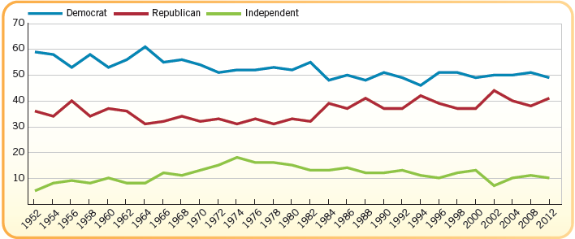
Voter’s Partisanship, 1952-2012
This chart includes “leaners” as party of each party’s id (i.e. someone who says they are independent but tend to vote Republican)
Partisanship indicates loyalty for candidates (around 90%)
Notes:
Political Party - An organization that seeks political power by electing people to office so that its positions and philosophy become public policy.

Slide 30
Two Party System
A two party system - two dominant parties compete in national elections
It is unique; by some estimates fewer than 30 countries have it
Most countries have multi-party systems
Reasons for the Two Party System in the U.S.
Electoral College – winner takes all
Single member districts – one man one vote
Distribution of Public Opinion
Plurality system stacks the deck against third parties
Money from interest groups
Media Coverage
Exclusion from TV debates
Notes:
Political Party - An organization that seeks political power by electing people to office so that its positions and philosophy become public policy.

Slide 31
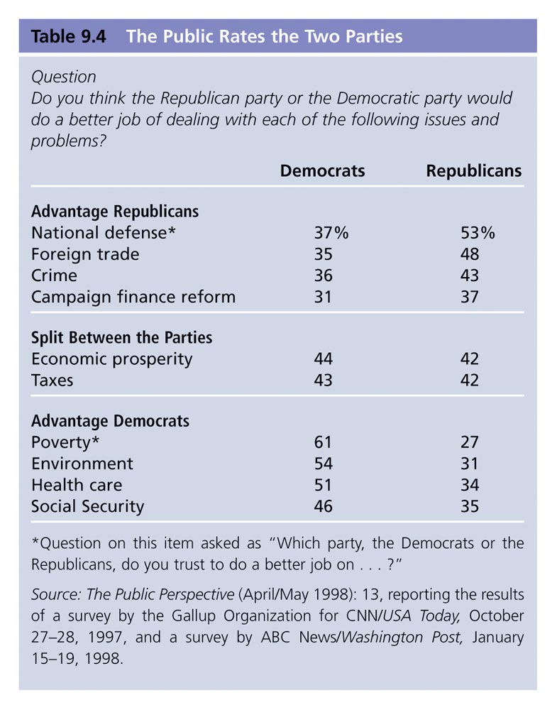
Differences in Public Opinion
Most Americans see a difference between what each party stands for, so there’s a “home” for however you stand on any issue
Each party has a broad coalition
Notes:
Political Party - An organization that seeks political power by electing people to office so that its positions and philosophy become public policy.

Slide 32
Minor Parties
Our electoral system may prevent minor parties from winning, but not from forming
There are four major types of minor parties
Ideological parties: comprehensive view of American society and government that is radically different from both parties; most enduring type
Libertarian Party, Green Party, Communist Party
One-issue parties: address one concern, avoid others
Free Soil Party, Know-Nothing Party, Prohibition Party
Economic protest parties: regional, protest economic conditions (disappear if conditions chg)
Greenback Party, Populist Party
Factional parties: form split in a major party, usually over the party’s presidential nominee
“Bull Moose” Party, “Dixiecrat” Party, Reform Party
Notes:
Political Party - An organization that seeks political power by electing people to office so that its positions and philosophy become public policy.

Slide 33
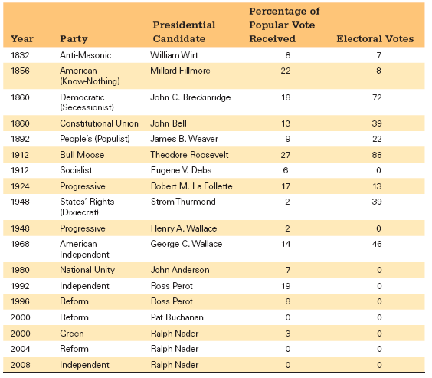
Minor Parties in the U.S.
Notes:
Political Party - An organization that seeks political power by electing people to office so that its positions and philosophy become public policy.

Slide 34
Impact of Minor Parties
Why aren’t there more? Most party members are able to influence their own party before becoming so disaffected that they leave
Throughout history - minor parties have little chance of winning, but they can mess things up for the major parties by taking votes (Ross Perot, Ralph Nader)
Major parties may adopt minor party ideas into their own party
Factional parties tend to have the most impact
Mugwumps made the Republicans more responsive to civil service reform
Progressive Parties caused the parties to take up business and electoral regulation
Tea Party has been successful in influencing Republican Party policies and candidates
Notes:
Political Party - An organization that seeks political power by electing people to office so that its positions and philosophy become public policy.

Slide 35
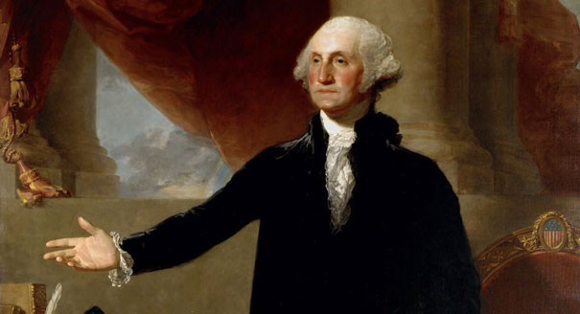
Washington’s Warning
“However [political parties] may now and then answer popular ends, they are likely in the course of time and things, to become potent engines, by which cunning, ambitious, and unprincipled men will be enabled to subvert the power of the people and to usurp for themselves the reins of government, destroying afterwards the very engines which have lifted them to unjust dominion.” ~ Farewell Address, September, 1796
Notes:
Political Party - An organization that seeks political power by electing people to office so that its positions and philosophy become public policy.

Slide 36
Notes:
Political Party - An organization that seeks political power by electing people to office so that its positions and philosophy become public policy.

