Slide 1
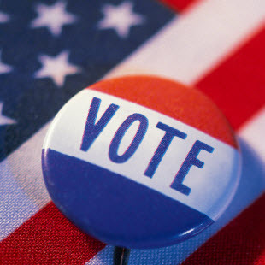
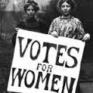
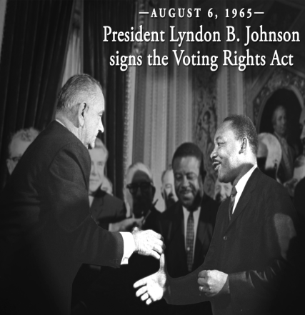
Ch. 8 - Political Participation
Objectives:
Describe how American voter turnout compares to other modern democracies in the world.
Explain the expansion of suffrage in the U.S.
Identify factors that predict who participates in politics.

Slide 2
Who can vote?
1 – US citizens
2 – resident of the state you’re voting in
3 – you must be at least 18
4 – you must register!!! ( in IL )
**Literacy Tests are prohibited
**Poll Taxes are prohibited

Slide 3
The Changing Electorate
Electorate means the “potential voting population”
Early 1800s – almost all white males could vote
1870 - 15th Amendment - extends the right to vote to African American men – “the right to vote cannot be denied based on race color or previous condition of servitude.
SCOTUS ruled that it really didn’t give anyone a “right” to vote, so Jim Crow….
Grandfather clauses – a clause that allows people who can’t meet registration requirements the right to vote if they or their ancestors had the right to vote pre-1867 (1915 – Unconstitutional)

Slide 4
The Changing Electorate
1920 - 19th Amendment – women’s suffrage
1924 – Native Americans allowed to vote
1961 - 23rd amendment – DC residents allowed to vote in federal elections – given 3 electoral votes
1964 - 24th Amendment - eliminated poll taxes
Voting rights act of 1965 also enforced this
Greater numbers of minorities voting
1971 - 26th Amendment – 18 y/o suffrage

Slide 5
Voter Turnout
Two ways to calculate voting turnout:
Voting-Age Population (VAP)
All U.S. residents age 18 or older
2012 national voter turnout rate = 53.6%
Voting-Eligible Population (VEP)
Excludes U.S. residents not legally permitted to cast a ballot
2012 national voter turnout rate = 58.2%

Slide 6
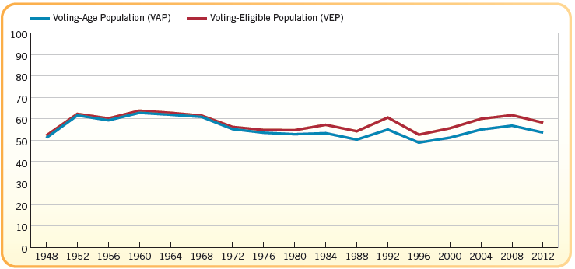

Slide 7
Theories of Low Voter Turnout
Theory one - real decline
This may be due to voter registration difficulties
Just a continuation of the drop since the early 1960s

Slide 8
Non-Voting: Real Decline
Registered voters
Varies by age
About one-half of nonvoters are registered
Burden of registration on voter
Motor-voter law
1995: allow people to register to vote when applying for driver’s license – not all states do this – IL does
Get Out the vote (GOTV) drives

Slide 9
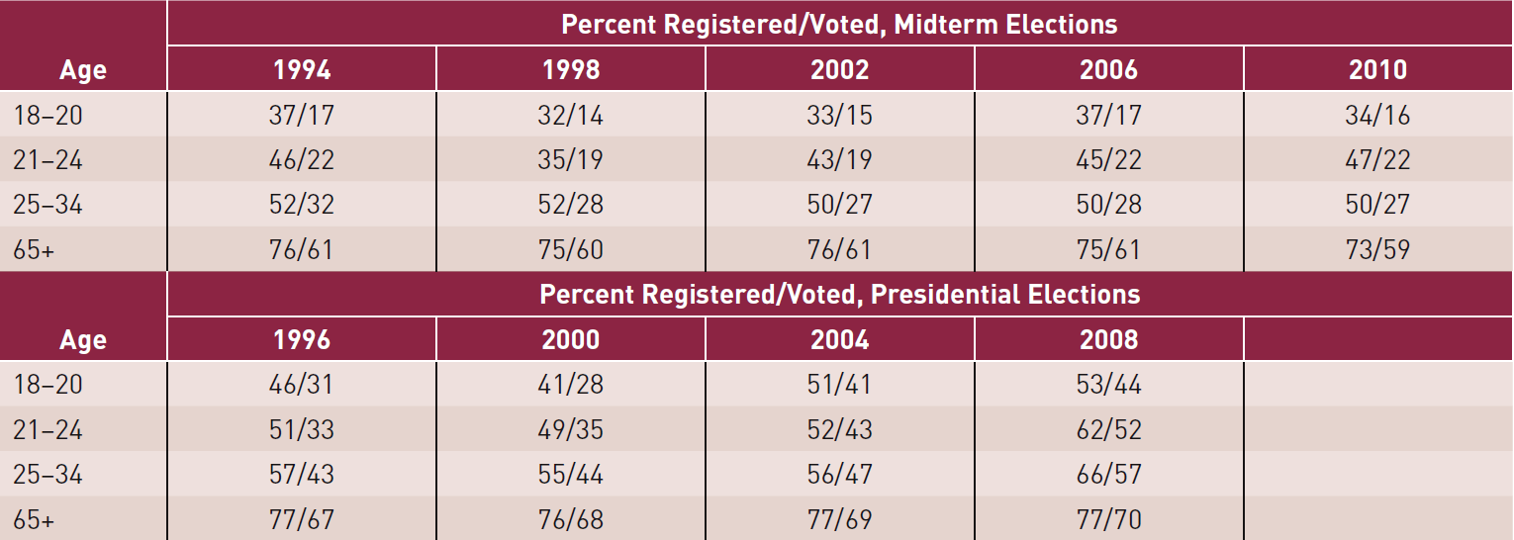
Voter registration and turnout

Slide 10
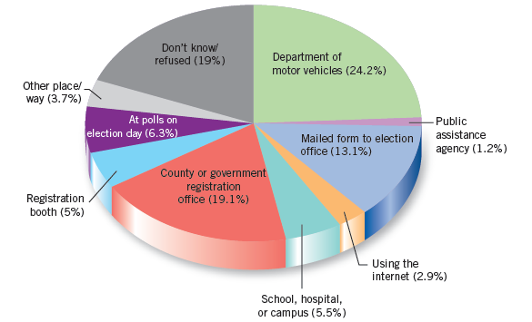
Method of Voter Registration, 2012

Slide 11
Theories of Low-Voter Turnout
Theory two: An apparent decline in voting:
Political parties once printed the ballots
Ballots were cast in public
Parties controlled the counting
Voter eligibility was easily bypassed
Political machines controlled everything
The Australian ballot was adopted in 1910 (it’s a standard ballot for everyone printed by the government)

Slide 12
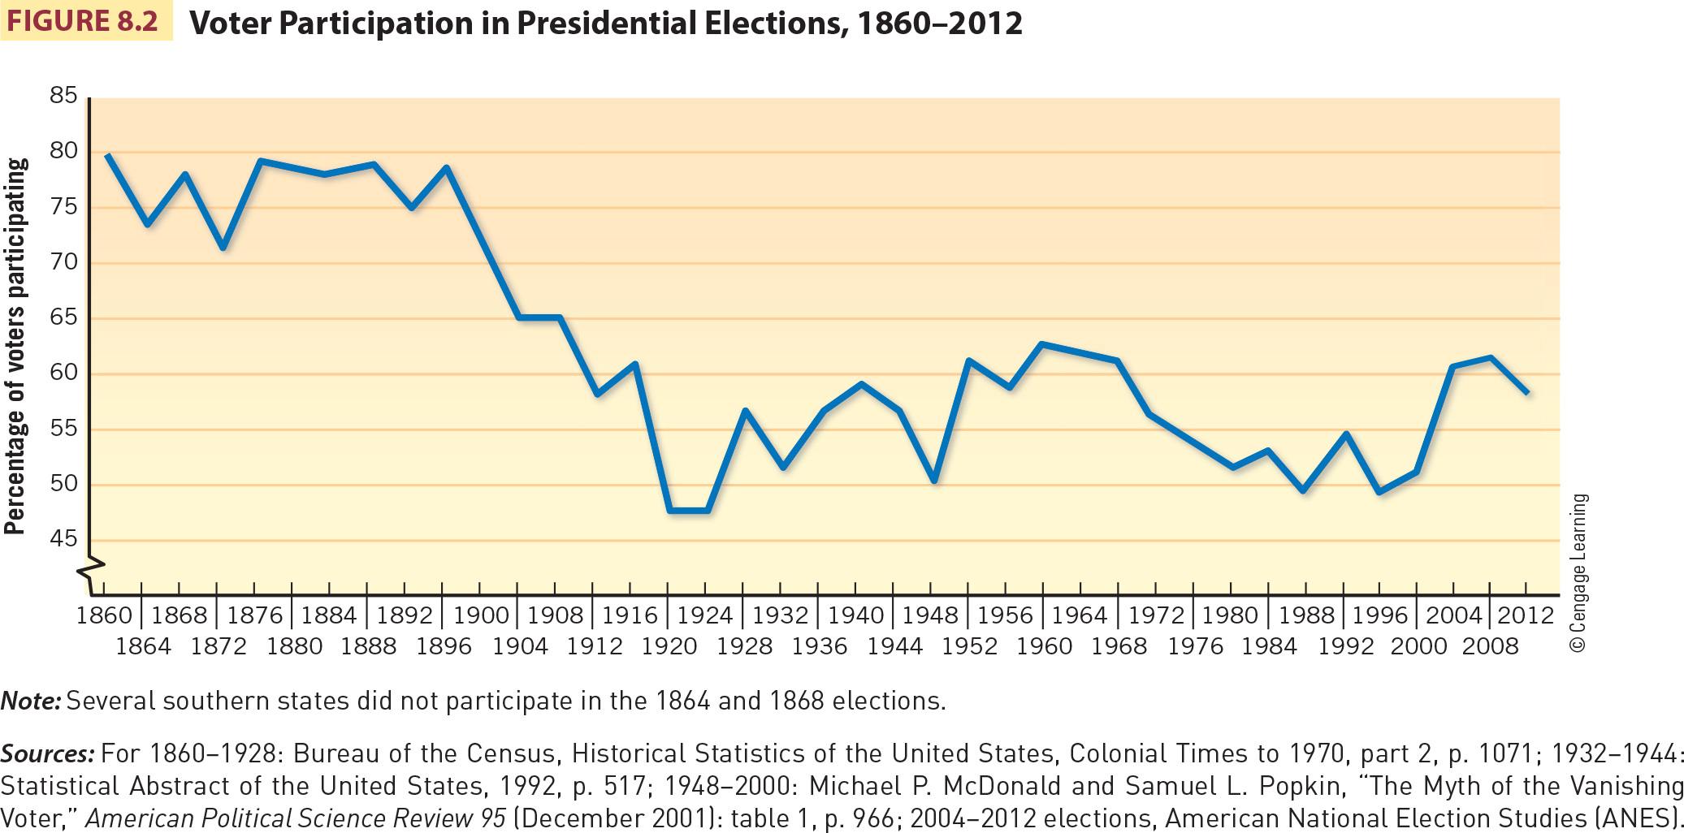
Voter participation 1860-2012

Slide 13
Non-Voters: Why?
Registered nonvoters gave three major reasons why they did not vote:
Too busy or had scheduling conflicts
Family chores or obligations
Believed their vote would not make a difference
Low efficacy
Apathy
However, when you look at the registration data, you see that we have low turnouts because, unlike Europe, voters have to make an effort to register to vote
This is changing: OR, CA, WV, VT have laws that automatically put you on the voting rolls unless you opt out. Normally if you go in for a driver’s license, etc. you are registered automatically.
28 other states are considering this as well in 2016

Slide 14
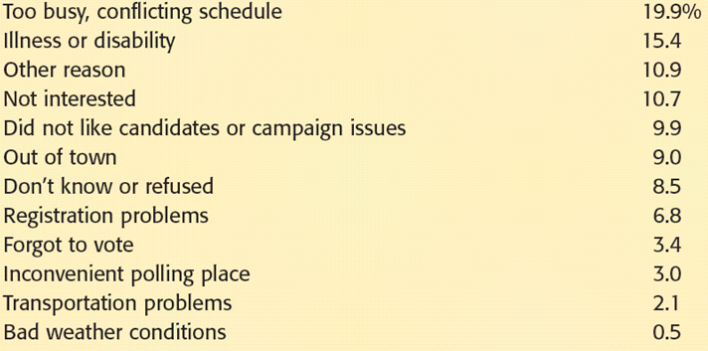
Why don’t people vote?

Slide 15
Participation Overview
People who participate:
Inactive – rarely vote; don’t get involved; don’t talk about politics
Voting specialists – vote, but that’s it; tend to be older with little income/schooling
Campaigners – vote and get involved in campaigns; strong party ID
Communalists – don’t like conflict of parties; form groups to petition about probs. locally
Parochial participants – don’t vote or campaign, but contact govt. officials when needed
Activists – highly educated, high incomes, involved deeply in politics

Slide 16
Who Participates?
Participation: Causes and Meaning
Cannot make broad generalizations about causes or meaning of participation
While fewer Americans may be voting, more Americans are participating
Education plays a big role
More educated = more likely to participate
Church goers vote more
Men and women vote at similar rates
However, women are starting to vote in higher numbers than men
Whites participate more than African-Americans and Latinos
But minorities are the fasting growing portion of the electorate
Older people vote more than younger
Non-voters tend to be poor, minorities and uneducated but an increasing number of college students and white collar workers don’t vote

Slide 17
Voter Turnout in Presidential Elections, by Schooling, Employment, and Race, 2000–2012
Notes:
Figure 8.3
Source: Adapted from U.S. Bureau of the Census, Current Population Reports, June and November 2008.

Slide 18
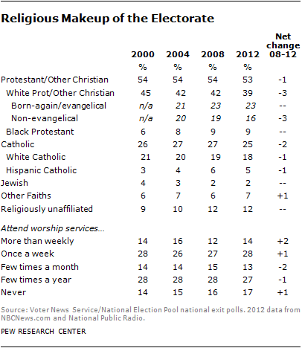

Slide 19
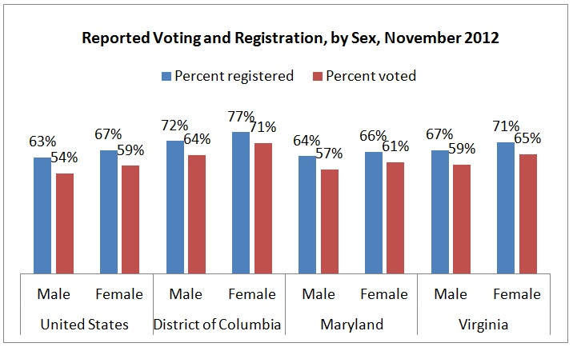

Slide 20
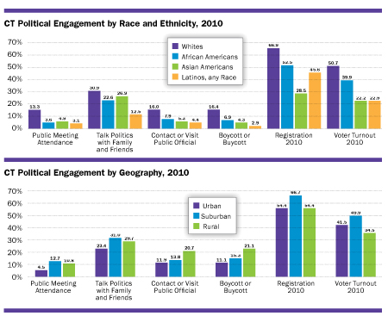

Slide 21
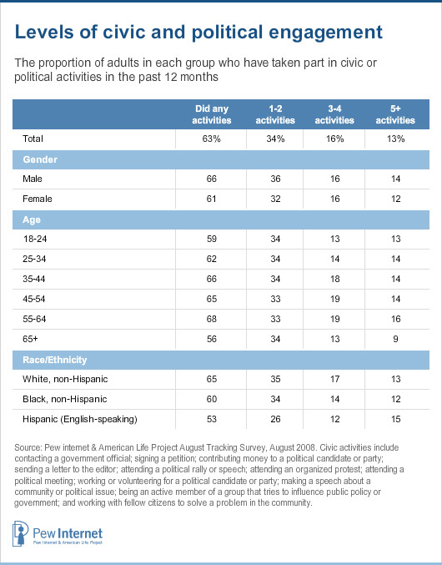

Slide 22
Political Participation
Remember, Americans may not vote as much but they are involved in other activities
Protests, petitions, giving money, campaigning, talking about politics, etc.
Studies show no connection between distrust of politicians and not voting
Registration barriers continue to be lowered to boost voter turnout
There are over 500,000 elected positions in America

Slide 23
Political Participation Here and Abroad
Percent of People Who… | U.S. | Rank among 20 Democracies | Outranked by…
Tried to persuade others to vote for a candidate | 44% | 2nd | Canada
Supported party by attending meeting, putting up poster | 30% | 2nd | Canada
Donated money to political group | 21% | 1st | none
Were contacted by party or candidate | 47% | 3rd | Canada, Ireland
Notes:
Table 8.4
Source: Professor Martin Wattenberg, University of California, Irvine, using data from the Comparative Study of Electoral Systems.

Slide 24
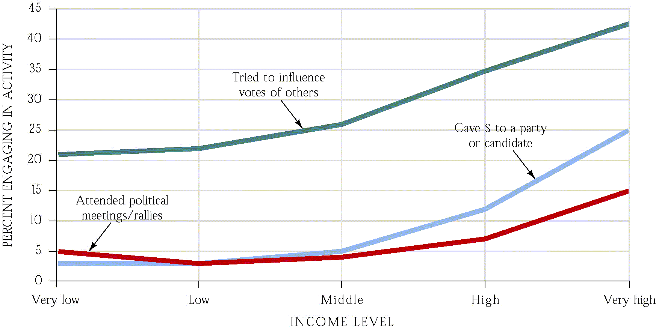
Participation by class

Slide 25
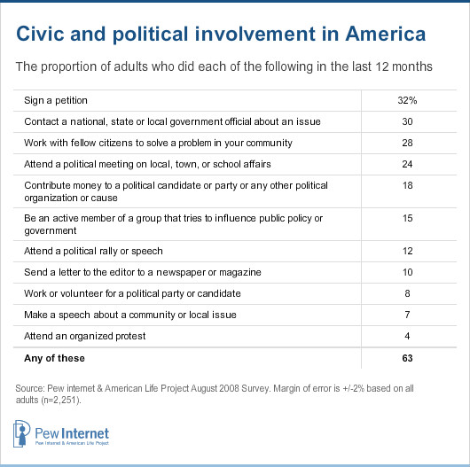

Slide 26
Final Thoughts…
Funny thing is, we may not vote as much as Europeans, but we participate much more in things such as joining civic associations, supporting social movements, writing congressmen, and fighting city hall
Low turnout rate may actually indicate that we are reasonably satisfied with the governmental system, and if everyone voted it might be a sign of discontent????
Bottom line – efficacy and interest really determine who will and won’t vote – SO VOTE

