Slide 1
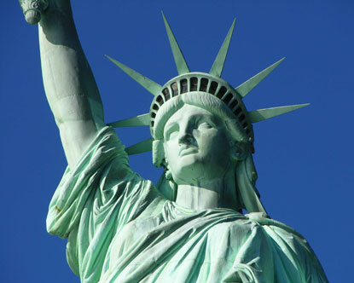
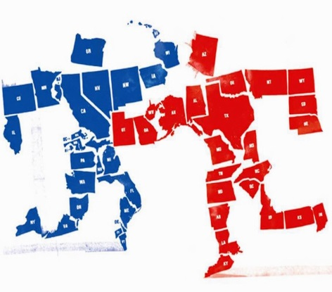
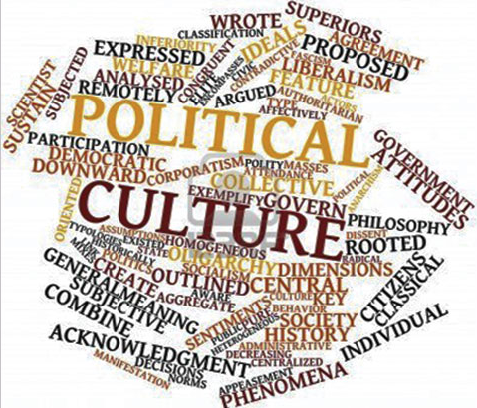
Political Culture
Objective:
Explain the concept of political culture and its key components
Discuss how the U.S. differs from other countries in its political culture
Identify the key sources of political culture in the U.S.
Evaluate how conflicts in American political culture affect public confidence in gov and tolerance of different political views.

Slide 2
Alexis de Tocqueville – Democracy in America
“The position of the Americans is therefore quite exceptional, and it may be believed that no democratic people will ever be placed in a similar one. Their strictly Puritanical origin, their exclusively commercial habits, even the country they inhabit, which seems to divert their minds from the pursuit of science, literature, and the arts, the proximity of Europe, which allows them to neglect these pursuits without relapsing into barbarism, a thousand special causes, of which I have only been able to point out the most important, have singularly concurred to fix the mind of the American upon purely practical objects. His passions, his wants, his education, and everything about him seem to unite in drawing the native of the United States earthward; his religion alone bids him turn, from time to time, a transient and distracted glance to heaven. Let us cease, then, to view all democratic nations under the example of the American people”

Slide 3
We are unique!
Alexis de Tocqueville saw many reasons why democracy took hold in the US
No feudal aristocracy-low taxes-few legal restraints
Westward expansion-vast territory provided opportunities
Nation of small independent farmers
Our moral and intellectual characteristics

Slide 4
What is American Political Culture?
Political Culture: A distinctive and patterned way of thinking about how political and economic life ought to be carried out
For example, Americans generally believe more strongly in political equality than in economic equality

Slide 5
American political values
Liberty – rights
Private property rights
Equality – equal vote; equal chance to participate and succeed; equality with political opportunities
Equal Opportunity, not Equal Results
Democracy – government is accountable to the people
Civic duty – take community affairs seriously and become involved when possible
Individual responsibility – individuals responsible for their own actions and well-being
"Rugged individualism"

Slide 6
Sources of American Political Culture
American Revolution was essentially over liberty—asserting rights
Widespread (not universal) participation permitted by Constitution
Absence of an established national religion made religious diversity inevitable
Family instills how we think about world and politics
Not a high degree of class consciousness - Most people consider themselves “middle class”
“Rags to riches” mentality
Protestant Work Ethic (Pilgrims):
Work Hard
Save Money
Obey the Law
Do good works

Slide 7
Questions to explore
Three questions concerning the American political system:
How do we know that the American people share these beliefs?
How can we explain the existence in our society of behavior that is obviously in conflict with these beliefs?
Why has there been so much political conflict in our history?

Slide 8
Economic beliefs
Americans support free enterprise, but support some limits on marketplace freedom
Americans believe in equality of opportunity but not equality of result
Americans have a widely shared commitment to economic individualism
“Bailouts” = politically unpopular

Slide 9
Political beliefs
Americans tend to assert their rights
Emphasize individualism, competition, equality, following rules, treating others fairly but impersonally
Stronger sense of civic duty
Stronger sense of civic competence
Confidence in public institutions
High confidence in private institutions
Patriotism
Some other countries put more emphasis on harmony and equality

Slide 10
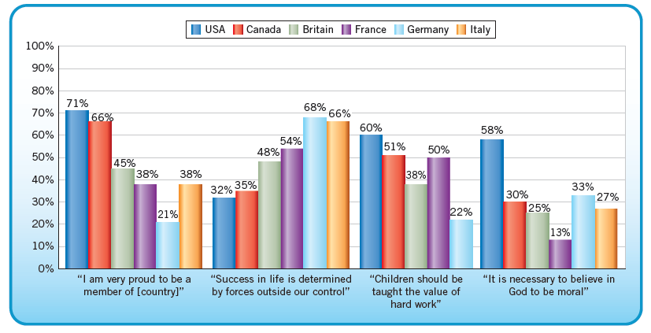
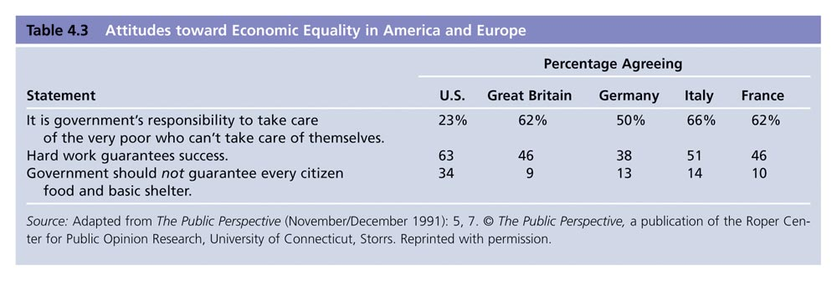
Modern democracies w/ different political cultures
Most modern democracies have vastly difference political cultures--why?
Demographic differences (religion, ethnicity, population, etc.)
Historical development of individual countries plays a large role in the development of class consciousness
Differing ideas of the proper role of government

Slide 11
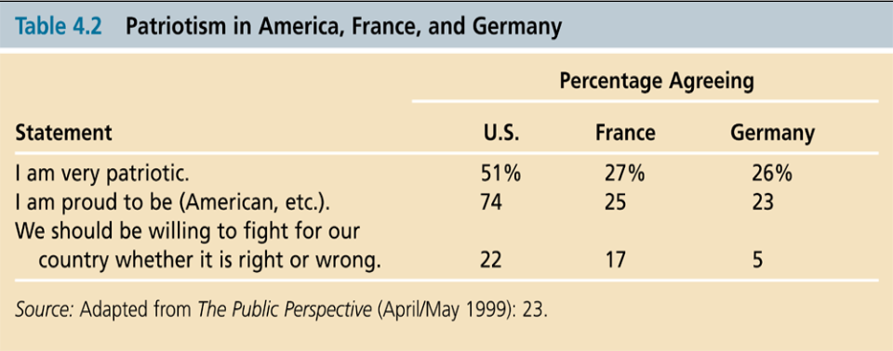
Civic duty and civic competence
Civic duty: a belief that one has an obligation to participate in civic and political affairs
Civic competence: a belief that one can affect government policies

Slide 12
Political efficacy
Political efficacy:
Capacity to understand and influence politics
Faith & trust in govt.
If a person’s political efficacy is high, then they believe they have power over the decisions of their government.
If a person’s personal efficacy is low, then they believe they have little power over the decisions of their government.
Internal efficacy: confidence in one’s ability to understand, thus participate in politics
Relatively unchanged since 1950s
External efficacy: belief that govt. will respond to citizens
Dropped steadily since late 1960s
Govt. too big, too unresponsive??

Slide 13
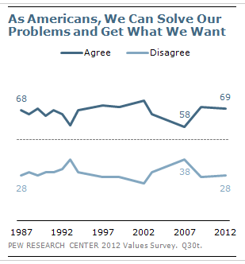
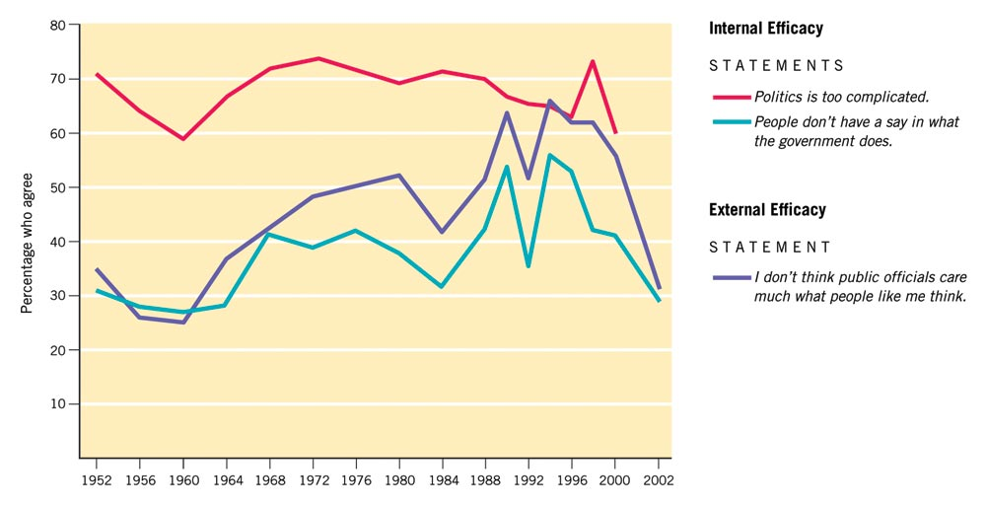
Changes in the Sense of Political Efficacy, 1952-2000

Slide 14
The civic role of religion
Americans are more religious than most citizens in European democracies
Institution of Religion similar to Govt. Institutions
Hierarchical, Bureaucracy
The USA has been a beacon for religious liberty = Pilgrims!
First Amendment
Both liberals and conservatives have used ‘the pulpit’ to promote political change
Civil rights movement was led by black religious leaders
In the 1980s and 1990s, conservative Christians became a strong political force in all levels of politics

Slide 15
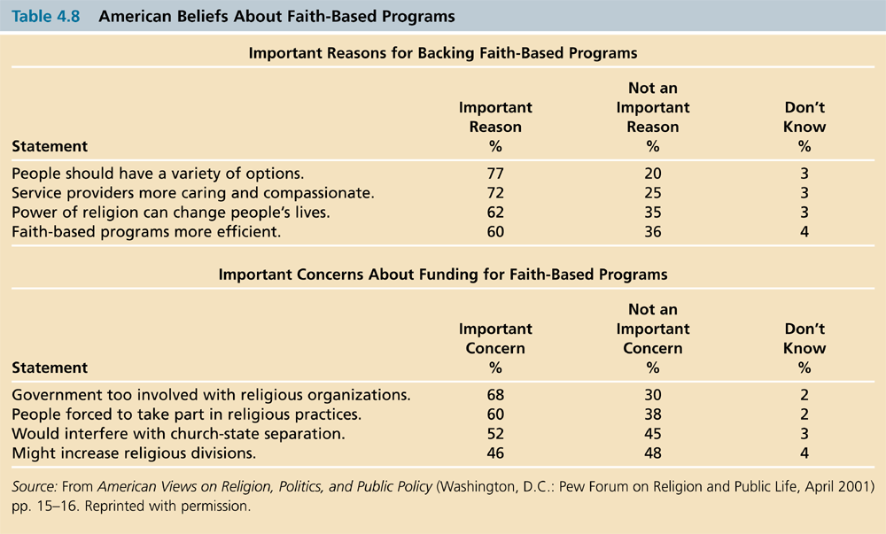

Slide 16
Why is there conflict?
Self-interest and social circumstances
Class Consciousness: belief that you are a member of an economic group whose interests are opposed to people in other groups.
Top 1% vs. the 99%
Broad values may not apply to specific controversial subjects
Beliefs contradict each other and are not consistently applied

Slide 17
The Culture War
The cultural clash in America is a battle over values
The culture war differs from political disputes
The culture conflict is animated by deep differences in people’s beliefs about morality
Two cultural camps:
Orthodox: morality is as, or more, important than self-expression; morality derives from fixed rules from God
Progressive: personal freedom is as, or more, important than tradition; rules change based on circumstances of modern life and individual preferences

Slide 18
Mistrust of government
There is evidence that mistrust for government officials has increased since the late 1950s/1960s
Causes: Watergate, the Vietnam War, Iranian Hostage Crisis, Iran-Contra and Clinton Impeachment
Public confidence is likely to ebb and flow with circumstances
Trust remains in the system of government, however

Slide 19
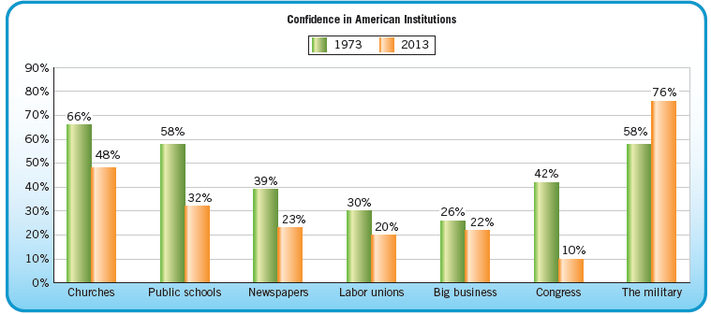
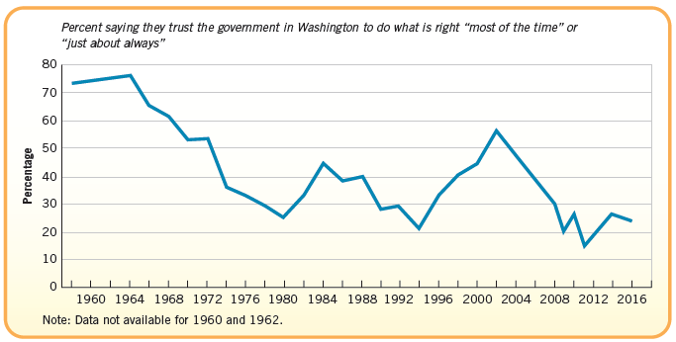
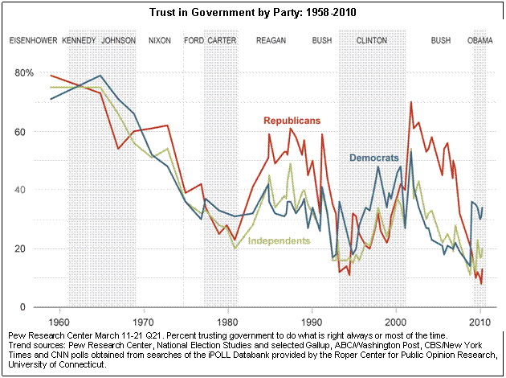
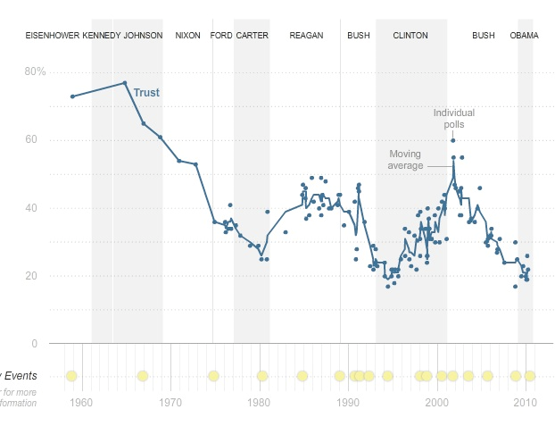
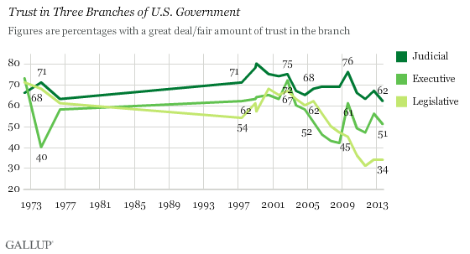
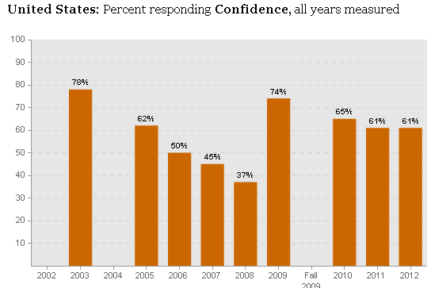

Slide 20
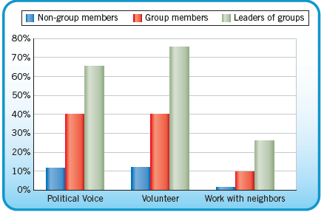
Civil society
Civil Society – Voluntary action that makes cooperation easier.
A belief in our civil society is more important as the trust in government declines.

Slide 21
Political tolerance
A minimal level of tolerance is crucial to democratic politics
Discussion of ideas
Selection of leaders
Most Americans support tolerance in the abstract
Most Americans would deny these rights in specific cases
Groups that individual citizens may dislike
Morality issues

Slide 22
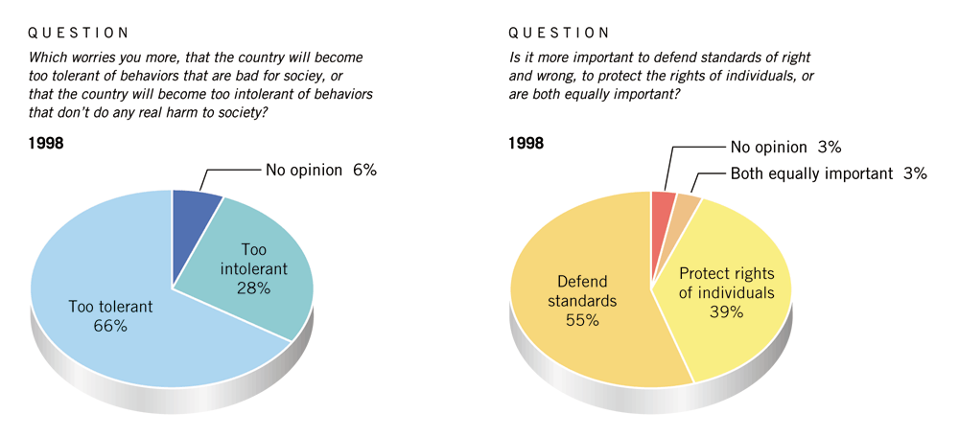
Views of toleration and morality
Source: The American Enterprise (January/February 1999): 37, reporting data from Roper, Washington Post, Harvard, and Kaiser Family Foundation polls.

Slide 23
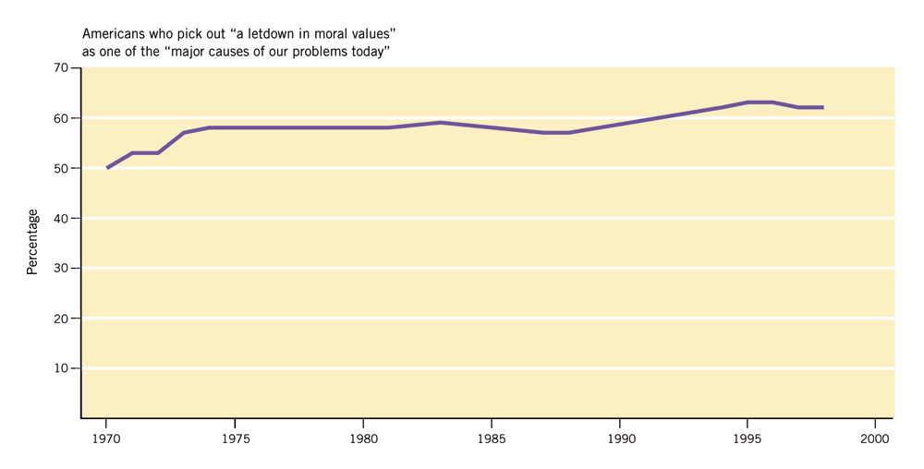
Views of toleration and morality
Source: The American Enterprise (January/February 1999): 37, reporting data from Roper, Washington Post, Harvard, and Kaiser Family Foundation polls.

Slide 24
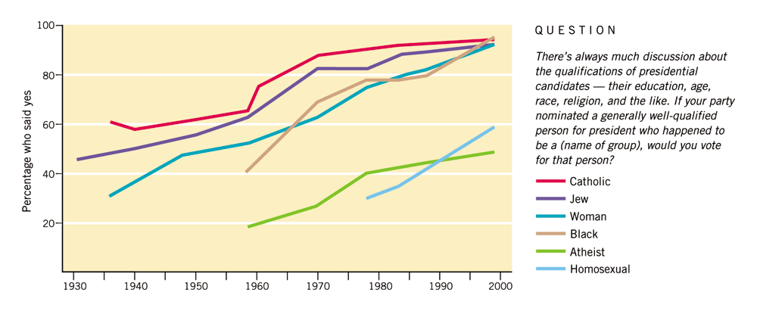
Changes in levels of political tolerance, 1930-1999
Source: Gallup poll data, various years, as compiled by Professor John Zaller, Department of Political Science, UCLA; The Gallup Organization, Poll Releases (March 29, 1999), 2-6.

Slide 25
How do unpopular groups survive?
Most people do not act on their beliefs
Officeholders and activists are more tolerant than the general public
Usually there is no consensus on whom to persecute
Courts are sufficiently insulated from public opinion to enforce constitutional protections because of life terms

Slide 26
Political tolerance
Overall, U.S. political culture fosters civic duty, upholds constitutional protections and supports civil liberties
Political equality most important value
Adversarial political system
We don’t reach decisions by consensus, but through debate and conflict

