Slide 1
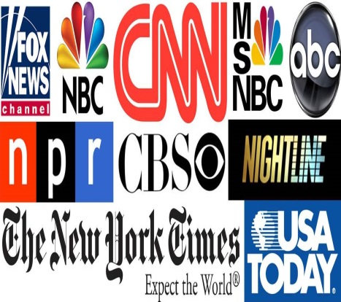
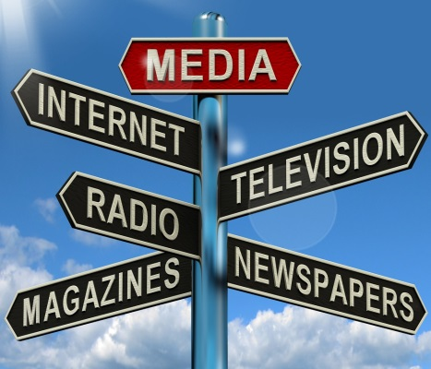
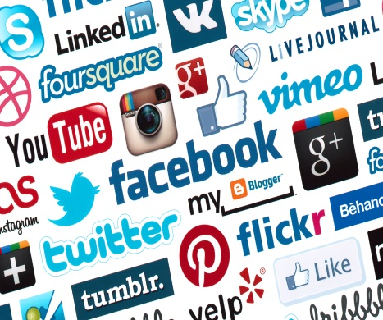
Media
SWBAT explain the evolution of the press in American politics, explaining how media coverage of politics has changed over time; summarize the most important sources of news for contemporary Americans, and discuss the consequences of consuming different news sources; explain the main political functions of the media in America, and discuss how the media both enhance and detract from American democracy; discuss the reasons behind lower levels of media trust today, and summarize the arguments for and against media bias; explain how government controls and regulates the media.

Slide 2
Media as an Institution
Media called "fourth estate" or "fourth branch"
Mass media vs. news media (part of mass media that stresses news)
Mass media ‑ messages often simplified, stereotyped, predictable
Characteristics:
More interactive
More emphasis on entertainment – “infotainment”
Personalized
Emotional
Informal
The mass media are means of communication, such as newspapers, radio, television, and the internet, that can reach large, widely dispersed audiences
The mass media connect people to their government officials by interviewing citizens, presenting poll results, and covering protests

Slide 3
Functions of the Media
Entertainment
Most Americans turn to the media for entertainment. But even in its entertainment function, the media also affect politics.
2008 campaign, Tina Fey’s portrayal of Republican VP Sarah Palin defined Palin
Many voters came to view Palin as unprepared for office
Surveillance
Media are “the eyes and ears of the world”
More coverage an issue draws, the more likely it becomes an issue which political leaders will view as serious and in need of attention >> media sometimes helps set the political agenda

Slide 4
Functions of the Media
Interpretation
Helps people make sense of the events taking place
Framing issues in ways that resonate with consumers
Socialization
Teaching us about the world around us
Reinforce economic and social values

Slide 5
Media & Politics
The US media has more freedom than a lot of European countries
Freedom of Information Act
Unrestricted Internet access
The US has a long history of private ownership of media but it has two potential limits
They have to make a profit and sometimes make up stories to entice readerships. Some truth to it but it’s very complicated
Media bias could be an issue if reporters and editors all shared the same viewpoints

Slide 6
History of Media
In the early days the political parties controlled the press but changes in technology and society created the popular press
Telegraph, high speed presses and population concentrated in cities
1848 the AP showed up (Associated Press) which provided objective reporting and equal distribution of information
Even so, the publishers views were reflected in the papers
Hearst and Pulitzer and Yellow Journalism helped start the Spanish/American War in 1898
Clearly there was a profit to be made in criticizing the government and sensational news reporting!!!

Slide 7
Media History
Rise of Popular Magazines
The middle class favored progressive periodicals (magazines)
Creation of Muckrakers - investigative reporting
Readers were more sophisticated and educated
Today, though, national magazines focusing on just politics account for only a very small percentage of total magazines

Slide 8
Radio
Dawn of the electronic media in the 1920s
Politicians could reach voters directly but it was also easy for listeners to “turn them off”
FDR was the first president to take advantage of radio – fireside chats
Talk radio has been a major growth medium in the last decade (Rush Limbaugh, Glenn Beck) – talk show hosts have begun to play a prominent and controversial role in discussing political issues

Slide 9
Television
1960 presidential debate
Between Senator John F. Kennedy and Vice President Richard Nixon
Watershed event when television replaced newspapers and radio as America’s principal source of political news
Most people now get their news from television
This innovation has changed the character of American politics
Focus is more on image and appearance
Communication is through "sound bites" (something quick and easy to remember); No in-depth analysis
30‑second commercials influence elections; 10 seconds for "sound bites"

Slide 10
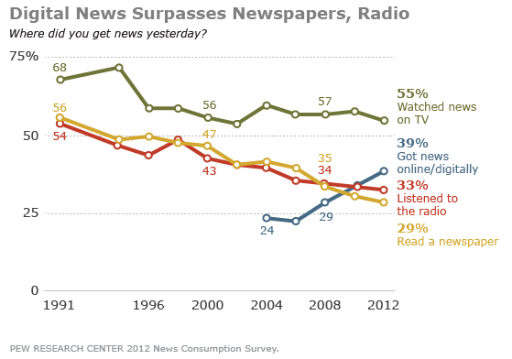
Television

Slide 11
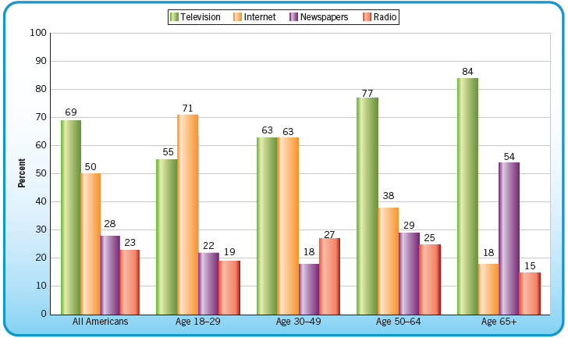
Americans’ Main Source for News

Slide 12
Television
Concern that television is allied with “big government:” use of television as electronic throne of President
President can now bypass journalists’ annoying questions and go right to the people with a speech
Decline of press conferences
White House manipulation of television with photo opportunities and sound bites.
Concern that television has fostered cynicism, distrust and negativism towards government and politics – adversarial journalism
Concern that people look at politics through the “camera lens” rather than the “party lens” –> further decline of parties

Slide 13
Newspapers
Typical perception of liberal bias, but they generally endorse Republican candidates. (Publishers tend to be Republicans.)
Complaints from both liberals and conservatives:
Conservatives claim that reporters are too liberal: college graduates (often from elite schools) with hostility towards middle class values.
Liberals claim that publishers are conservative and therefore are more concerned with sales and profits than exposing social/political/economic evils –> status quo bias.
Concern about “revolving door” in journalism: former govt. leaders who become journalists –> reporting is tainted.
Newspaper circulation rates continue to decline because of television and the internet

Slide 14
The Internet
Although TV continues to be the most widely used source for political news, the internet is rapidly becoming a key source of information for the American public
Especially popular with people under 30

Slide 15
Development of Media Politics
Herbert Hoover (1929-1933)-no media involvement in politics
Franklin D. Roosevelt (1933-1945)- invented modern media politics/Fireside Chats
Gave press conferences twice a week
First to use the radio extensively
Press respected FDR
Until the 1960s the press respected the government
Didn’t report private lives
Impact of Vietnam War and Watergate Scandal
Clinton-Lewinsky Scandal
Investigative Journalism

Slide 16
Development of Media Politics
Investigative journalism
Use of in-depth reporting to unearth scandals, scams and schemes
Watergate is an example
Contributes to a negative view of government and politics
The media serves as a watchdog, which may restrain government

Slide 17
Rules Governing the Media
Newspapers
Least governmental regulation
No license required
No prior restraint
Least competitive
Radio and TV
Most governmental regulation
License needed
FCC regulates
Most competitive
1934: Federal Communications Commission was created
Prevents Monopolies
Conducts exams over goals and performance
Stations must benefit society to get a license
Fair treatment rules provide equal airtime to both candidates

Slide 18
Rules Governing the Media
No prior restraint - can’t stop a story
Confidentiality of sources usually NOT allowed, especially if it bears on a crime
Licensing of broadcast media
Equal time laws for candidates including prices of commercial air time
Fairness doctrine was abolished in 1987 and has allowed the rise of controversial shows like Rush
Former federal policy in the US requiring television and radio broadcasters to present contrasting viewpoints on controversial issues of public importance
Other rules around elections

Slide 19
The Media and Public Opinion
The Media Influences Public Opinion:
Media help set national agenda
Agenda setting focuses public attention on certain aspects of American politics and ignores others
Influences what issues people think are important or not important
Stories that are likely to receive high ratings
Media can force politicians to confront issues that they might not have otherwise addressed
Television “personalizes” elections
Media stress short-term elements of elections at expense of long-term elements (e.g., party affiliation)
Those who “consume” media in turn influence others
Politicians frame issues; Influence the “spin” the media will give to their issues
Rise of advocacy journalism/adversarial journalism rather than a mere reporting of the news

Slide 20
The Media and Public Opinion
The Media Doesn’t Influence Public Opinion:
Mass public pays little attention to the news (e.g., surveys showing how little people know about current affairs)
Selective attention: many focus in on media sources they already agree with
Selective exposure: screening out those messages that do not conform to their own biases
Selective perception: many perceive news in the way they want to view it – they see what they want and filter out the rest
Media is only one source of influence – political socialization suggests importance of family, schools, peers, and other influences

Slide 21
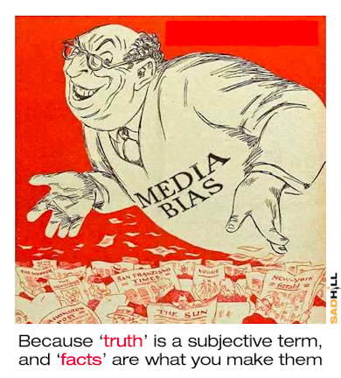
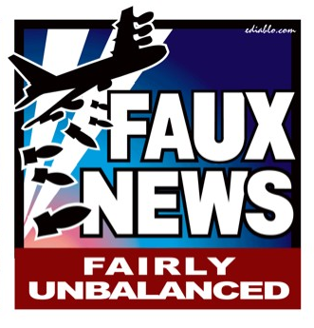
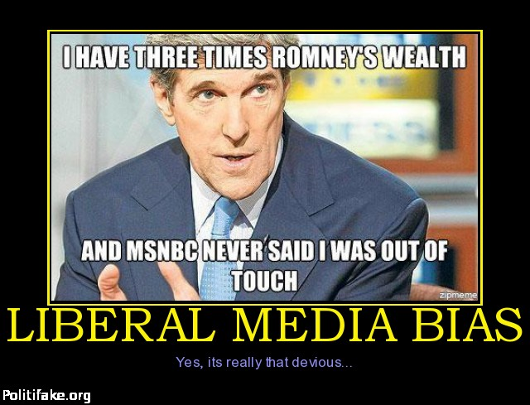
Media Bias?
Generally more liberal than the average person
But public believes it is more than that!!
Talk radio is predominately conservative
Many more conservative media outlets recently including Fox News and shows like Rush
Political Candidates DO believe the media including Johnson who gave up on Vietnam after the press did

Slide 22
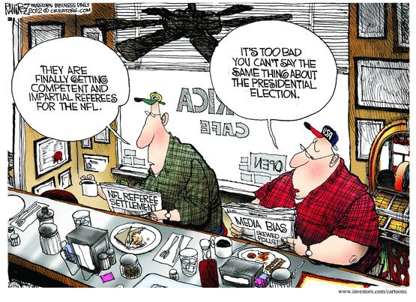

Slide 23
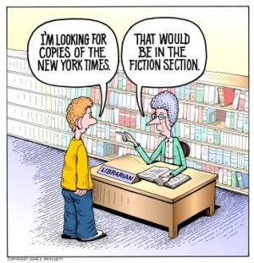

Slide 24
Media and Elections
SYMBIOTIC RELATIONSHIP BETWEEN GOVERNMENT AND THE PRESS
Journalists need politicians to inform and entertain their audiences
Politicians need journalists for media exposure
Big staffs of media people working for Congress and the President
Press releases – canned news
Leaks to reporters about news events
On-record, off-record information
Presidential rewards and punishments for reporters based on their stories

Slide 25
Roles of Media
GATEKEEPER
Influence which subjects are of national importance >> help to set national agenda
They make us believe what is important >> government has to address those issues
SCOREKEEPER
Keep track of, and help make, political reputations >> importance attached to Iowa caucuses and New Hampshire primary
Media follows day-to-day campaign activities, but emphasis on horse race element of elections at expense of issues
WATCHDOG
Scrutinize people, places and events (e.g., Watergate)
“Comfort the afflicted and afflict the comfortable”

Slide 26
Media Influences
Provide forum for building candidate images
Provide means for politicians to get public attention, e.g., McCarthy, Nixon’s role on House committee on Un-American Activities)
The president is the most covered
Congress coverage not equal to President and they are resentful!!
Senate more open than House
More coverage for Senators
100 vs. 435
States vs. Small districts
Act as linking mechanism between govt. and people:
In the past: People –> Parties –> Government
Now: People –> Media –> Government

Slide 27
Media Influences
Contribute to higher cost of campaigning
Contribute to candidate-centered campaigns
Increase the role of campaign consultants
White House manipulation of media:
Photo opportunities
Sound bites
Spin control
Staged events

Slide 28
Media and Voter Choice
Information about candidates
What voters know about candidates is based largely on media coverage
The images voters require from the media tend to be more stylistic than issue oriented
Journalists are more likely to comment on the "horse race" (who’s leading in the polls)
Negative advertising ‑ widespread perception among consultants is that it works; idea of vote suppression

Slide 29
Media and Voter Choice
Information about issues
Ignoring charges of the opposition is no longer done, as candidates trade charges and countercharges
Advertising is the most important source of information in referendum elections
Negative ads may reduce turnout
Decision making
Newspapers and television seem to have more influence in determining the outcome of primaries than of general elections
The mass media are more likely to influence undecided voters

Slide 30
Political Maxims of Media Relations
All secrets become public knowledge. The bigger the secret, the sooner it will leak.
All stories written about me are inaccurate; all stories written about my opponent are completely accurate.
The better the news, the higher ranking the official who announces it.
Always release bad news on Friday or Saturday; fewer people will notice it.
Taking out the trash
Never argue with a person who buys ink by the barrel.

Slide 31
How does the News Shape U.S. Citizens View of the World?
http://www.ted.com/talks/alisa_miller_shares_the_news_about_the_news
Good clip – 4min

