Slide 1
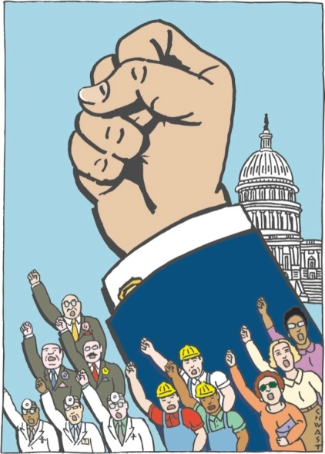
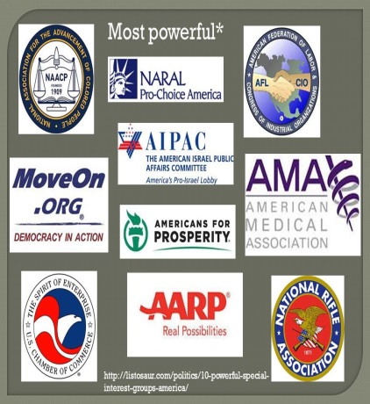
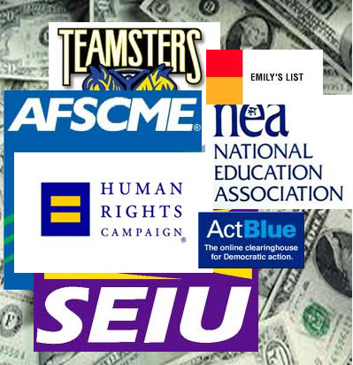
Interest Groups
Objectives:
Define interest group and identify the main factors that led to their rise in America;
Describe the various types of interest groups in America, and explain the types of people who join interest groups;
Analyze the ways interest groups relate to social movements;
Explain the various ways interest groups try to influence the policymaking process;
Describe the ways in which interest groups’ political activity is limited.

Slide 2
Interest Groups
Interest Group - any organization that seeks to influence public policy
Interest groups have often been viewed with suspicion.
In Federalist #10, James Madison warned against the dangers of “faction.” Although Madison was opposed to the elimination of factions, he believed that the separation of powers under the Constitution would moderate their effect.

Slide 3
Madisonian View
Madison called interest groups “factions”
Madison’s dilemma: allowing people the liberty to form groups and express their views could destroy the hope for an orderly society.
Political factions were inevitable, but we need to control their effects.
Madison addressed the problem of establishing a stable constitutional system that at the same time would respect liberty in The Federalist, No. 10 (freedom but limit factions)

Slide 4
Interest Groups
Interest groups are protected under the 1st Amendment of the Constitution
They are a linkage institution:
Linkage institution (along with elections, political parties, and mass media) – link citizens to government
Express their members’ preferences to government policymakers
Convey government policy information to their members
Raise and spend money to gain access to policymakers

Slide 5
Functions of Interest Groups
Raise awareness and stimulate interest in public affairs by educating their members and the public
Represent their membership, serving as a link between members and government (linkage institution)
Provide information to government, especially data and testimony useful in making public policy
Provide channels for political participation that enable citizens to work together to achieve a common goal

Slide 6
IG’s vs. Parties
Interest groups seek to support public officials and influence government policies.
Interest groups focus on specific issues & articulate policy positions.
Interest groups are private organizations that are accountable to their members.
Political parties nominate candidates, contest elections, control government.
Political parties have positions on a wide range of public issues.
Political parties are public organizations that are accountable to the voters

Slide 7
Why are there so many IGs?
Economic developments.
Government policies, whenever govt. creates an agency, it creates an entry point for interest groups – more groups needed to form in order to protect their stakes in these agency activities.
Diversity of population – countless social, racial, economic and geographic cleavages (divisions in popular opinion)
Diffusion of power in government. Political power shared by many –> plenty of places in which a group can argue its case. The more places there are to influence policy, the more organizations there will be to exercise that influence.
Increasing weakness of political parties.
Reforms of the 1970's opened up the lobbying process (FECA and the explosion of PACs).
Interest groups tend to beget interest groups ( when one is formed, another may be formed to counter it)
Technology, e.g., computerized mailing lists to solicit funds, use of communications media and Internet.

Slide 8
Reasons people Join Interest Groups
Solidarity – like-minded people
Material – economic/personal gain
Purposive
Ideological interest groups
Public-interest lobby
Upper-Class Bias?
Wealthy more likely to join groups and be active in them
Groups representing business/professions are numerous and well-financed

Slide 9
Types of Interest Groups
1. TRADITIONAL
Goal: to promote economic interests of its members
Types:
Agricultural: Grange, American Farm Bureau Federation
Labor: AFL-CIO, UAW, and Teamsters (declining)
Business: Chamber of Commerce, National Association of Manufacturers
Professional: AMA, ABA
These helped to solidify the Union movement

Slide 10
Types of IGs
2. EQUALITY INTEREST
Goal: to protest the status of its members and to convince government to take remedial action
Examples: NAACP, NOW
Feminist Movement, Civil Rights Movement
3. SINGLE ISSUE
Goal: to get government action on one overriding issue.
Examples: Right to Life League, National Abortion Rights Action League, NRA, and MADD
Polarizing effect of these

Slide 11
Types of IGs
4. PUBLIC INTEREST
Goal: to bring about good policy for society as a whole
Examples: Common Cause, various Nader organizations, Consumer’s Union, environmental groups
Environmental Movement
4. IDEOLOGICAL
Goal: to convince government to implement policies consistent with their philosophies
Examples: Christian Coalition, People for the American Way, Free Congress Foundation
5. GOVERNMENTAL
Goal: to represent the interests of government to other governments
National League of Cities, National Association of Governors

Slide 12
Characteristics of Interest Groups
SIZE
More members = more money, more votes
More members also mean greater cross-pressure among members and possibly less focus
As size increases, free rider problem increases.
Free riders are people who benefit from the interest group without making any contribution.
Ex: an elderly person will benefit from the group’s lobbying efforts whether or not he joins AARP.
IG try to prevent this by giving incentives for people to join the group.
SPREAD
The extent to which membership is concentrated or dispersed ‑ determines effectiveness.

Slide 13
Characteristics
ORGANIZATIONAL STRUCTURE: CENTRALIZED OR DECENTRALIZED
An organization with separation of powers tends to be less cohesive than a centralized, disciplined group
LEADERSHIP
Leaders may either bring the various elements of a group together or sharpen their disunity
RESOURCES
Money
Expertise
Reputation
Connections
Volunteers

Slide 14
Techniques of IGs
MASS MAILING (COMPUTERIZED AND TARGETED)
LITIGATION (USED BY NAACP, ACLU, NOW, ETC.)
Amicus curiae briefs - someone who is not a party to a case who offers information that bears on the case but that has not been solicited by any of the parties to assist a court
USE OF MASS MEDIA
Independent expenditures
Issue advocacy
BOYCOTTING

Slide 15
Techniques
ELECTIONEERING
Funneling volunteers to campaigns
Encouraging members to vote
Campaign contributions
Endorsement of candidates
“Targeting” of unfriendly candidates
Issuing “report cards” to rate candidates
INITIATIVE, REFERENDUM AND RECALL AT STATE AND LOCAL LEVELS
LOBBYING

Slide 16
Influence of Lobbyists
WHAT IS LOBBYING?
Attempting to influence the decisions of policymakers.
Interest group lobbying is generally most effective on narrow technical issues that are not well publicized (nobody has expertise on the issue except for the lobbyist)
WHO ARE LOBBYISTS AND WHAT DO THEY DO?
A person who is employed by and acts for an organized interest group or corporation to try to influence policy decisions and positions in the executive branch (bureaucratic agency) and legislative branch (congressional committee)
Influence governmental decisions, especially legislation
Provide information to Government (Lobbyist = policy specialist, congressman = policy generalist)
Testify at hearings
Help write legislation

Slide 17
Influence of Lobbyists
WHO ARE LOBBYISTS AND WHAT DO THEY DO?
The revolving door is the employment cycle from government to interest group
Government employee to lobby the agency they came from is illegal –> conflict of interest
Congress to lobbyist is legal (with a “cooling off” period)
Iron triangles are mutually supporting relationships among
Interest groups
Congressional committees and subcommittees
Government agencies

Slide 18
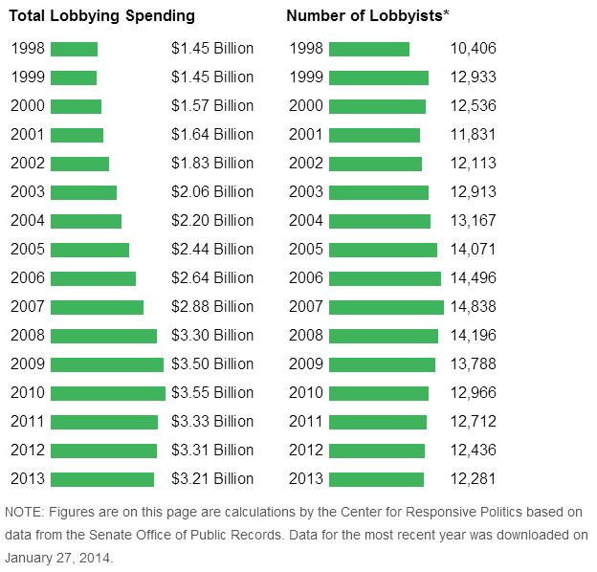

Slide 19
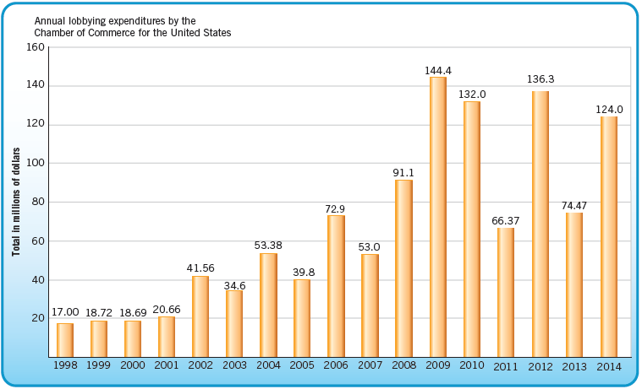
What the top Lobby spent, 1998-2014

Slide 20
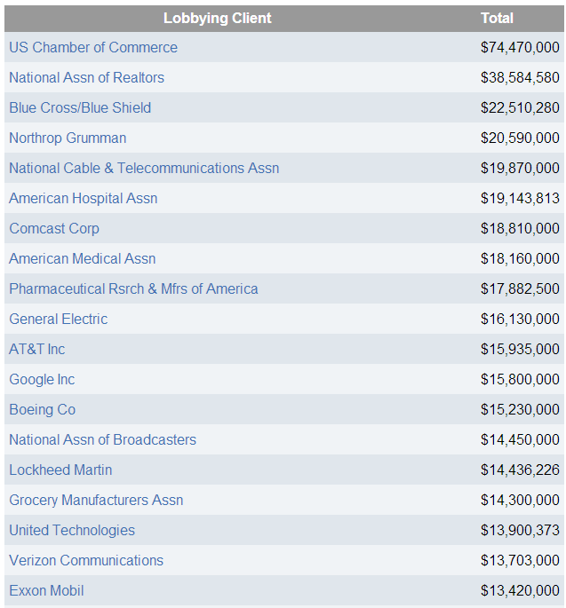
Top Spenders - 2013

Slide 21
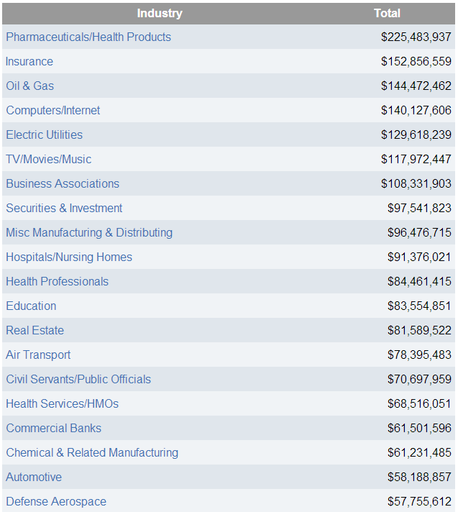
Top Industries - 2013

Slide 22
Growth of PACs
Interest groups use PACs to raise and spend money on election campaigns
A PAC is a registered organization that donates money to campaigns and causes
In 1974, only 600 PACs existed >>> Now: more than 4600.
Reason: Congressional legislation that had the intent of preventing a few wealthy campaign contributors from helping candidates “buy” elections. Instead, Cong. wanted to “open up” campaign contributions to the masses, as represented by PACs.
PACs even donate to candidates facing no opposition. Why would they do this?
Important to keep things in perspective: most congressional campaign money comes from individual contributions.

Slide 23
Growth of PACs
*Each PAC must have at least 50 individual members.

Slide 24
Role of PACs
PACs link two techniques of influence
Giving money and other political aid to politicians
Persuading officeholders to act or vote "the right way" on issues
The 1970s brought a near revolution in the role and influence of PACs, as the result of post Watergate reforms, increasing the number of PACs from 150 to more than 4,000 today
Corporations make up the majority of all PACs

Slide 25
PAC Spending
Campaign Contributions – Factors influencing who gets PAC money:
Incumbents (Political party affiliation is of little importance.)
Incumbents win
Incumbents have shown to support the PAC’s positions
Incumbents hold committee seats = more power
Winners
Those who share a similar philosophy
Those who are likely to grant access
Tightness of a race, and the likelihood that the money will help make a difference in the outcome
Whether or not a candidate holds a committee seat of special importance to the PAC
PAC money makes up a higher % of congressional campaign funds than presidential campaign funds

Slide 26
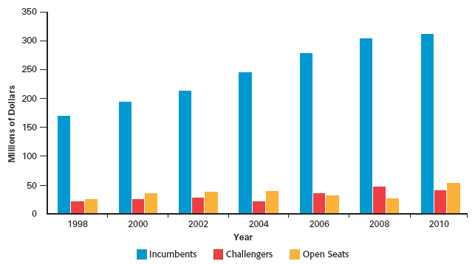
PAC Contributions to Cong. candidates

Slide 27
PAC Spending
Voter education projects (mailings, fliers, commercials)
Independent expenditures
Through "bundling" contributions, PACs increase their clout with elected officials

Slide 28
Dangers of PACs
Ethical concerns: does a contribution “buy” anything?
Special access of PACs that the average person lacks
Drives up the cost of campaigning
Over representation of those wealthy enough to have PAC representation
Under representation of those who lack such representation
Further incumbency advantage in elections

Slide 29
Defense of PACs
PACs provide a means of participation and representation for the average person
Without PACs, only the wealthy could afford to run for office
1st Amendment’s right to petition the government
Contributions are nonpartisan
No conclusive evidence that PACs change congressional votes. Contributions likely to make a difference in arcane, obscure issues with little public awareness more than in issues of major importance with much public awareness.
PACs provide political education
PACs diversify political funding – With over 4600 PACs, many interests are represented.

Slide 30
Regulation of Lobbying
1946 Federal Regulation of Lobbying Act and 1995 Lobbying Disclosure Act
Provisions
Defines lobbyist as one whose “principal purpose” is to influence legislation.
Registration required of lobbyists.
Disclosure required of lobbyist’s employer, finances, and legislation to be influenced.
Loopholes
“Principal purpose” is ambiguous – only 6800 of 80,000 lobbyists are registered.
Disclosure statements are merely filed, not analyzed.
No enforcement mechanism.
The act covers only lobbying of Congress, and omits lobbying of executive branch.

Slide 31
Other Regulations
1995 – Lobbying Disclosure Act
Created much stricter regulations by requiring registration if lobbying was directed at members of Congress, congressional staff, or policy makers within the executive branch.
It also requires the disclosure of more information concerning the activities and clients of lobbyists.
2006 –
Redefined lobbyist (broader)
Tightened disclosure requirements
Stricter rules on gifts and travel
We will talk about most of these when we cover Campaigns and Elections:
1971 – Federal Election Campaign Act (FECA)
2010 – Citizens United v. Federal Election Commission
2014 – McCutcheon v. Federal Election Commission

Slide 32
IGs & Democracy
Remember your theories!!!
Power-Elite
A small number of super rich individuals, powerful corporate interest groups, and large financial institutions dominate key policy areas.
PACs encourage a close connection between money and politics.
Pluralist Theory
Many interest groups compete for power in a large number of policy areas.
Because of our fragmented political system, no one group dominates the entire system.
Hyperpluralism
There are too many interest groups trying to influence public policy.
Political leaders try to please everyone and in the end, don’t make tough choices.

Slide 33
Lobbyists are Beneficial
They provide useful information to government
They provide a means of participation for people
They provide a means of representation on the basis of interest rather than geography. A “third house of Congress.”
1st Amendment protection
Lobbyists have always spent money. It’s more out in the open.
As Madison points out in Federalist #10, the “remedy” of curing the evils of faction by eliminating their causes is worse than the disease. Potential loss of liberty is worse than the abuses of lobbyists.

Slide 34
Lobbyists are not Beneficial
Rich and powerful interests are over represented.
Average and poor people are under represented.
By safeguarding, liberty, equality is sacrificed.
Single-issue lobbies, especially, contribute to political polarization.
Lobbies contribute even further to diffusion of power, making it even more difficult for govt. to get things done.

