Slide 1
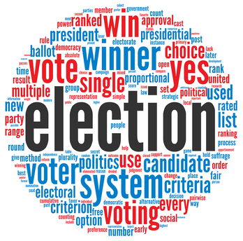
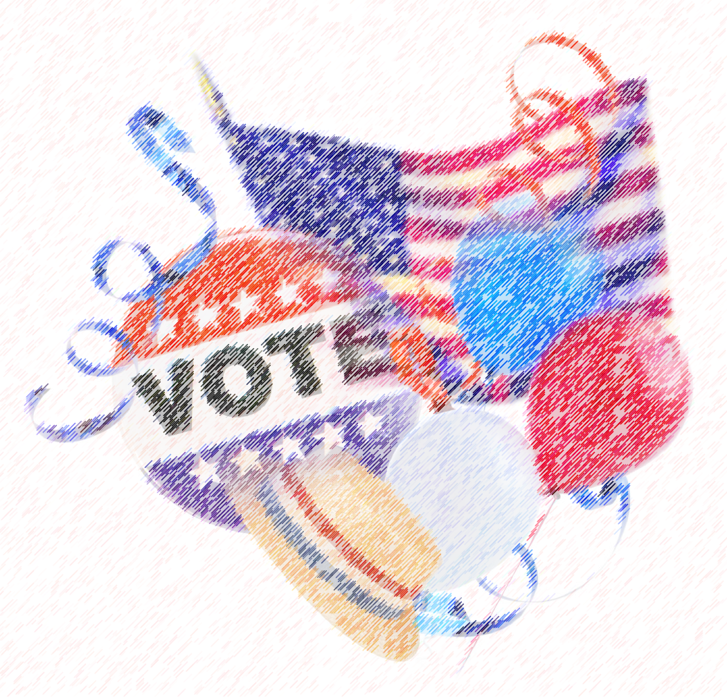
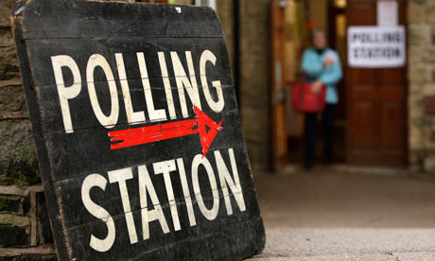
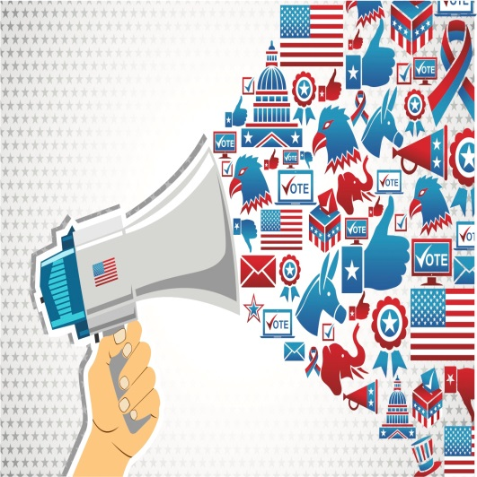
Campaigns and Elections
SWBAT describe factors that influence primaries; explain how campaigns shape the outcome of elections; analyze how voters learn about the candidates in elections; explain what groups have been loyal to the parties over time; describe differences between congressional and pres. elections; explain the history and current state of campaign finance; describe how elections shape policy.

Slide 2
Elections Review
Voter participation in the United States is low compared with other countries
In Congressional elections, in years when a president is not elected, the turnout rates are lower
Lower turnout in off years means that Congressional candidates must appeal to more motivated and partisan voters
Leads to more Polarization
Turnout rates are even lower yet for most local elections
Overall, the majority of voters don’t vote in most elections

Slide 3
Elections Review
Who Votes:
Age
Older = Voter
Educational attainment
More Education = Voter
Race/Ethnicity
Income level
More Money = voter
Two-party competition
Healthy competition improves voter turnout, if it seems like one party always wins, lower turnout can happen

Slide 4
Elections Review
Who can run:
President: natural born citizen, at least 35, resident of US for 14 years
Vice President: same as president, except that he/she cannot be from same state as president
Senator: citizen for 9 years, at least 30, resident of state where elected
Representative: citizen for 7 years, at least 25, resident of state where elected
Tradition/State laws state that you should be from the district you want to represent

Slide 5
Purpose of Elections
Legitimize government, even in authoritarian systems
Organize government
Choose issue and policy priorities
Electorate gives winners a mandate to do what they told the voters they wanted to do

Slide 6
Campaigns Today
Most campaign tasks are performed by the following:
Political Consultants
Public Relations and Media Professionals
Direct-Mail Firms
Polling Firms
Political Tech Firms
Expensive to run:
$7.1 Billion in 2012 from all races combined
Media consultants and ads largest campaign expense
Ads mostly target voters’ fears
Some work to engage positive emotions
Unclear if ads influence election outcomes
Remember Negative Ads tend to depress turnout, so most think they work

Slide 7
2014 Midterm Elections
 | Total Raised | Total Spent
House candidates | $1,034,013,175 | $960,862,567
Senate candidates | $637,151,089 | $655,767,975
Total, all candidates | $1,671,164,264 | $1,616,630,542

Slide 8
2004 – 2012 Campaign Spending
Presidential | Number of Candidates/Total Receipts
2012 | 14 / $1.37 billion
2008 | 20 / $1.67 billion
2004 | 12 / $904 billion
2000 | 17 / $578 million
Congressional Candidates
2014 | $1.67 billion
2012 | $1.87 billion
2010 | $1.86 billion
2008 | $1.41 billion
2006 | $1.44 billion
2004 | $1.29 billion
2002 | $979 million

Slide 9
Campaigns Today
Better or Worse?
Professional Staff & Volunteers:
organization
Media Blitz:
social media
TV ads
Focus Groups:
small groups of individuals who are led in discussion to gather opinions on candidates—helps candidate with strategy
try to reach “soccer moms”, “NASCAR dads”, etc.
Opinion Polls:
Regular pollsters (Roper, Harris, Gallup) & Private polling

Slide 10
Campaigns Today
Modern campaigning takes lots of money
Campaigning = Fundraising
The Idea that anyone can run for office is more myth than reality because of the costs of running for office

Slide 11
Campaigns in the U.S.
Here and Abroad
U.S. elections have two crucial phases:
Getting nominated and getting elected
Requires individual effort
In most of Europe, party organization decides
Who is allowed to run
What candidates appear on ballots
Campaigns in the U.S. are more than twice as long as they are in other countries

Slide 12
Presidential Elections
The Nomination Game:
Nominations are the Parties official endorsement of a candidate for office
Their campaign strategy requires money, media attention and momentum
Candidates attempt to manipulate each one of these strategies through their campaign strategy
Presidential Candidates are either announced or an “open secret” about a year before the election.
Candidates need to be risk takers and enough self-confidence to put everything on the line to pursue the presidency.
Goal of the nomination game is to win the majority of delegates’ support at the national party convention.

Slide 13
What do you need to become President?
Besides the basic qualifications:
Get name mentioned as possibility (name recognition)
Speeches (Reagan, Obama)
Sponsor Legislation (Bradley, McCain)
Be a Governor - recent trend (Bush, Carter, Clinton)
Modern Presidential Elections have become more and more focused on individual personalities/candidates than parties

Slide 14
Presidential Election Timeline
Exploration:
committee determines viability
Announcement:
announcement made declaring candidacy
Presidential Primaries/Caucuses:
States determine a party’s candidate
Nominating Conventions:
Party officially nominates candidate; platform announced
Campaigning/General Election:
candidates travel to “swing states” to persuade voters
Electoral College:
Each state’s popular vote determines winner of electoral college

Slide 15
Primary Elections
Primary elections:
Progressive reform from the early 20th century designed to weaken parties
Types: Used in Both Congressional & Presidential Process
Closed: Only registered party members can vote for partisan offices, no crossing of party lines—Independents left out
used in most states
Open: voters choose ballot of any one party they wish when they show up to vote; Independents may vote
Crossing of party lines allowed
Blanket: voters can "mix and match” their votes, i.e., vote for candidates of different parties for different offices; Independents may vote
Ruled Unconstitutional by the SC

Slide 16
Caucuses
Caucuses are different from primaries
There are two main ways caucuses are done.
Reps: Voters gather, hear from all the different candidates and then vote by secret ballot or raise hands.
Dems: Voters gather, hear from all the candidates, then move to a designated area of the room to vote.
If a candidate doesn’t get 15% of the votes possible, then those voters move to their second choice.
Both – Voters gather together to select their candidates

Slide 17
Front-Loading
Try to be the “Front-Runner” (win early primaries and caucuses)
Goal is for candidate to gain momentum
Front-Loading Primaries: try to have state’s primary as early as possible
Iowa & New Hampshire traditionally first states to host primary and caucus
Many other states think they should be first, so they may move their primaries earlier and earlier to try and have a role in choosing the nominee
Overall Goal: give nominee the most time to raise money and campaign against other party’s nominee

Slide 18
Criticisms
Disproportionate amount of attention goes to the early caucuses and primaries
Too long
Focus on image of candidate more than issues
Participation is low and not representative of the population
Proposed Reforms:
Regional Primaries
National Primary Day

Slide 19
Presidential Campaigns
After winning the most delegates, each nominee is presented to all voters at a National Convention
After the convention, they start the general election campaign
Campaign Teams are expanded
Three things needed to project right image to voters during campaigning!
High tech media campaign; get attention through advertising or free attention as news makers; Slogans; Target audience
Organization
Campaign manager; Campaign Counsel and Campaign Staff
Fund Raisers
Media consultants; Website
Research staff and policy advisors; Hire a pollster
Press secretary
Money
Most of these things should have been in place from the primaries/caucuses

Slide 20
How does the campaign matter?
Assigning Credit or Blame for the State of the Nation
Retrospective voting – voting for a candidate based on their past actions
Prospective voting – voting because you favor a candidate’s ideas for handling issues
Economic voting
Activating Latent Partisanship
Helping Partisan voters to understand WHY they should vote for their candidate
Judging the Candidates’ Character
Strong leader, good judgment, etc.

Slide 21
General Election
Presidential Election Day:
Every four years on Tuesday following the first Monday in November.
The Winner-takes-all system:
Presidential candidate who wins the most popular votes in a state receives the state’s electors.

Slide 22
Electoral College
“Electors”: people who pledge to vote for a candidate in the electoral college.
History of “Electors”: any of the German princes who were entitled to vote in the election of the new emperor to the Holy Roman Empire.

Slide 23
Electoral College
How it works today:
Each state has as many electoral college votes as it does Representatives and Senators
Winner of a state’s popular vote typically gets ALL the Electoral College votes
Electors meet in December, votes are reported by the vice president in January.
If no candidate gets 270 votes (a majority), the House of Representatives votes for president, with each state getting ONE vote.

Slide 24
Congressional Elections
US congressional elections are regularly scheduled
Members of Congress have fixed terms
US uses winner take all/single member district system: most votes wins the seat

Slide 25
Congressional Elections Timeline
Declaration of Candidacy
different rules per state
Primary or Caucus:
“party” elections: narrow down the field
General Election
who will hold a specific office

Slide 26
Congressional Elections Review
Incumbency affects outcomes of congressional elections:
Around 90% of congressmen who run are reelected
Around 80% of senators who run are reelected
Franking privilege
Gerrymandered districts = “Safe seats”
Name recognition
Casework done for constituents.
Pork barrel projects & earmarks for district
Money:
incumbents build a “war chest” to discourage challengers from running

Slide 27
Presidential vs. Congressional
Presidential Race
More competitive
Winner usually gets less than 55% of the vote
More voters
Held responsible by voters
“Coattail effect”: popularity of a presidential candidate may allow lesser known Congressional candidates to win by riding the “coattails” of the nominee
Congressional Race
Less Competitive
Winner usually gets over 60 % of the vote
Fewer voters (non- presidential years)
Closer to constituents
Can deny responsibility
Incumbency advantage

Slide 28
Campaign Finance Vocab
Hard Money:
Campaign contributions that are given directly to a candidate’s campaign
Soft Money:
campaign contributions to federal candidates and the national parties
Supposedly for generic “party building” activities (ex: get-out-the-vote drives, bumper stickers, yard signs, and “issue ads”)
Political Action Committee:
committee created by a corporation, union, or other interest group that gives hard & soft money with limits

Slide 29
Campaign Finance Vocab
Independent Expenditures:
money raised and spent to help a party or candidate
BUT the spending is done INDEPENDENTLY (w/o connection) of candidate and political party
527 Organizations:
raise and spend money to advance political issues & causes only—not specific candidates
named after section 527 of IRS code denoting tax exempt organizations

Slide 30
Campaign Finance
There have been many attempts to restrict the influence of money on elections
(Federal) Corrupt Practices Act (1910; 1911, 1925)
Main laws regulating campaign finance until FECA
Rarely enforced
General spending limits and required disclosure of donor names and spending amounts
Hatch Act (1939; Revised 1993)
Federal employees of the executive branch are prohibited from campaign activities (Fundraising)

Slide 31
Campaign Finance
Federal Election Campaign Act and creation of FEC (1972; amended 1974) – Known as FECA
Result of Watergate scandal and Nixon using CREEP (Committee to Re-elect the President) campaign
Created the Federal Election Commission to monitor election spending
Also created Federal public funding for Presidential campaigns donations inappropriately
Optional $3 donation from personal income taxes
Candidates may receive matching funds if they accept spending limits.
2008 limits: $42 million in primary; $84 million in general election
NOTE: Barack Obama was first candidate ever to refuse federal public funding. Romney then also refused public financing, as well.
Government will match each individual contribution up to $250
Minor Parties: Eligible if a Party received 5%+ of vote in previous election

Slide 32
Campaign Finance
Buckley v. Valeo (1976)
Direct challenge to FECA
Wealthy politician (Buckley) wanted to spend his own money on his own campaign
Court held that individuals spending their own money are exercising their 1st Amendment free speech rights. Candidate expenditures cannot be limited.

Slide 33
Campaign Finance
Bipartisan Campaign Reform Act (a.k.a. “McCain-Feingold”)—2002
Interesting…most politicians voted in favor of it since it claimed to “clean up politics” and they assumed the Court would strike down most of it anyway. But the Court upheld most of it until 2010.
Original individual contribution limits—adjusted up for inflation in odd-numbered years since then
One can give $1,000 per candidate, per election (Currently - $2,600)
One can give $20,000 to national party, per year (Currently - $32,400)
One can give $50,000 total in a two-year election cycle
Political party can accept $15,000 from PACs, but nothing from corporations or unions.
Donations must be disclosed to the FEC.
Limited broadcast of “issue advocacy” ads within 30 days of a primary and 60 days of a general election

Slide 34
Campaign Finance
PACs
PACs are Political Action Committees of corporations, labor unions, or other interest groups
Sole purpose is to raise money for the group to spend on elections—a fundraising arm of the organization
Regulated by McCain-Feingold (BCRA)
Around since FDR, but proliferated after McCain-Feingold severely limited corporations’ and interest groups’ spending
Corporations cannot contribute directly to PACs but can sponsor a PAC for employee donations.
Names and contributions must be disclosed
PACs can give
$5,000 to a named candidate per election (primary, general, or special are all considered separate)
$15,000 to a national party committee
$5,000 to another PAC (annually)
PACs may receive
$5,000 from any one individual, PAC or party committee (annually)

Slide 35
Campaign Finance
Citizens United v. FEC (2010)
Citizens United is a conservative non-profit 527 group that made a documentary bashing Hillary Clinton called “Hillary: The Movie”
Citizens United was not explicitly working with a candidate or political party
Citizens United planned on airing “Hillary: The Movie” on a video-on-demand service and advertising it on TV during the presidential primary elections.
The group receives corporate funding, and corporation-funded ads are against McCain-Feingold. Fined and banned by FEC; appeal ensues
Ruling: McCain-Feingold’s prohibition of broadcast, cable and satellite “electioneering communications” by either unions or corporations violated the First Amendment.
Corporations and Unions are no longer limited in amounts of spending

Slide 36
Bloomberg Poll - 2015

Slide 37
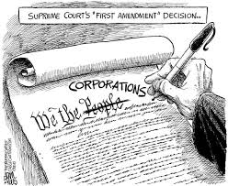

Slide 39
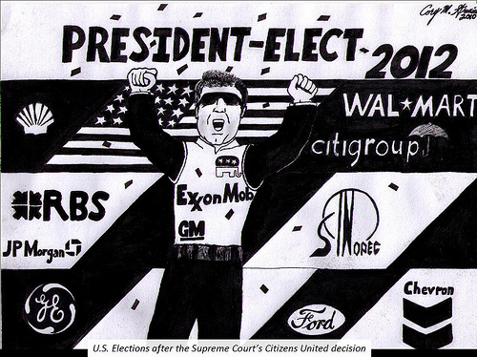

Slide 40
Campaign Finance
“Soft Money” Groups expanded dramatically after Citizens United
Characteristics
Unregulated/Unlimited Money
$ cannot be donated directly to a candidate
Group and their $ cannot coordinate with parties or candidate’s campaigns
2012 - Over $1.3 billion spent by 629 outside groups
Only 32% of money spent yielded intended result

Slide 41
Campaign Finance
527 groups
AKA Independent Organizations
Named for a section in the tax code
Do not “expressly advocate” for the “election or defeat” of a candidate or party.
Can accept unlimited individual and corporate contributions
MUST disclose donor names
CANNOT use a candidate’s name in an ad or they lose tax-exempt status
Maintain tax-exempt status only if their activities include “voter mobilization” and “issue advocacy”
MoveOn.org and Swift Boat Veterans for Truth were very influential.
E.g. MoveOn.org had a free Jay-Z concert in Miami with the explicit purpose of registering non-white, urban young people to vote outside the stadium (assuming Democrats voting for Obama). Thousands were registered.

Slide 42
Campaign Finance
“Super PACs” -- 2010
Formed after Citizens United v. FEC and SpeechNow.org v. FEC decisions
SpeechNow is a non-profit 527. Court held that individuals can now give unlimited donations to an “independent group” as long as they don’t communicate with parties or candidates directly. This directly supported the idea of Super PACs
Citizens United is a non-profit 527. Court held that corporations and unions cannot be limited in the amounts they donate.
Super PACs technically called “Independent Expenditure-Only Committees”
CANNOT donate money directly to a candidate like PACs do
Can raise unlimited sums of money from corporations, unions, associations and individuals
Can spend unlimited sums to overtly advocate for or against political candidates
Allowed to name candidates in ads
MUST disclose their donors to FEC (unlike 501Cs)
Must operate independently of candidates and cannot contribute to individual candidates

Slide 43
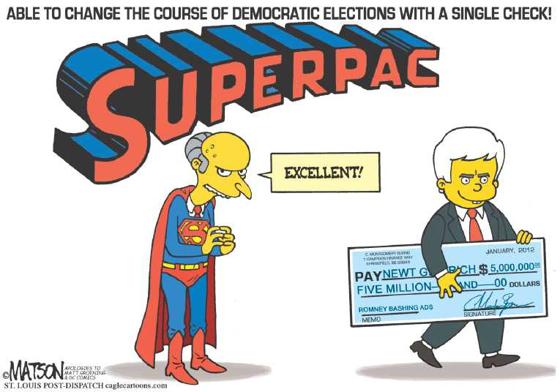

Slide 44
Campaign Finance
501Cs
Tax exempt group
Aka “Social Welfare Non-Profits”
Don’t have to disclose names of the donors (from 1958 NAACP v. Alabama case—protecting donors from harassment)
As long as they are only creating “issue ads” without using the “magic words” (vote for, vote against, support, elect, defeat) from a footnote in the Buckley v. Valeo case.
No “political activities” allowed except voter registration

Slide 45
Campaign Finance
McCutcheon v. FEC (2014)
Total limits set in McCain-Feingold were declared unconstitutional (previously, they were capped under the “aggregate limit” rule)
The OVERALL cap on individual donations was removed
The government cannot prevent citizens from giving campaign contributions to as many different candidates and political parties as they want

Slide 46
What decides an election?
Party Mobilization
Issues
Especially Economic Issues
The Campaign
Campaign Events
Debates
A Winning Coalition
Loyal Voter Groups
Evangelicals, Whites, Southerners, etc. – Republicans
Minorities, Jews, City Dwellers, etc. - Democrats

Slide 47
The Effects of Elections on Policy
Election Outcomes
Changes in policy are expected, but radical changes are not normal
Unless there was a dramatic shift (Critical Elections/Realignment)
Pace of change is slow due to our electoral system and constitutional checks
Politicians have to face voters every few years, so they can’t overreact to just one election

