Slide 1
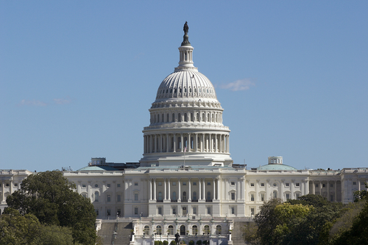
Congress
Objectives:

Slide 2
Intro to Congress
The founders feared that power in the hands of a single individual (a king), so they put the national legislative power in the hands of a group
Framers’ view of Congress:
“First branch” of government
Holds most national government powers
Essential to federalism
Maintains separation of powers
Linchpin of checks and balances

Slide 3
Intro to Congress (cont.)
Contemporary Americans’ view of Congress
“Broken branch” of government
Unable to address problems effectively
Too responsive to special interests
Nonstop campaign fundraising and/or corruption
Unlikely to fix itself
Despite this view:
Around 80-90% of incumbents are re-elected

Slide 4
Intro to Congress (cont.)
Congress was set up as a bicameral institution, with two chambers intended to serve different constituencies
The House = to be elected by ‘the people’
435 members (# est. in 1911)
The Senate = to be selected by state legislatures
17th Amendment changes this (direct election)
100 members = 2 for each state

Slide 5
Intro to Congress (cont.)
Terms of Congress lasts two years
Terms begin on Jan. 3 of every odd-numbered year
Terms numbered consecutively (113th from 2013-2015), 114th from 2015-2017, 115th after November 8 election
Adjournment: end of a term; date must be agreed upon by both houses
Two regular sessions per term
Periodic recesses (not to be confused w/adjournment)

Slide 6
Perks and Privileges
Franking privilege allows Congresspersons to correspond copiously with constituents
Mailing letters/newsletters to constituents for free – part of reason for re-election!
Permanent professional staffs
Privileges and immunities under the law
The “speech or debate” clause – while speaking on the floor, or coming to and from work, they can’t be arrested/penalized by law
Congressional caucuses are a source of support – caucus is a group of people with like characteristics
Currently more than 200 caucuses exist

Slide 7
Congress vs. Parliament
Congress
Independent representatives of districts or states
Primary system; voters choose among individual candidates
Principal work is representation and action
Parliament
Loyal to national party leadership
Voters choose among national parties
Principal work is debate

Slide 8
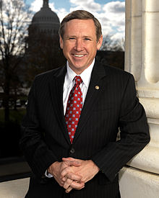
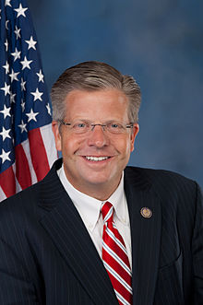
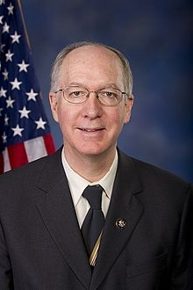
Qualifications
US Senator:
Citizen for 9 years
At least 30
Resident of state where elected
Representative:
Citizen for 7 years
At least 25
Resident of the state where elected (custom dictates they live in the district)

Slide 9
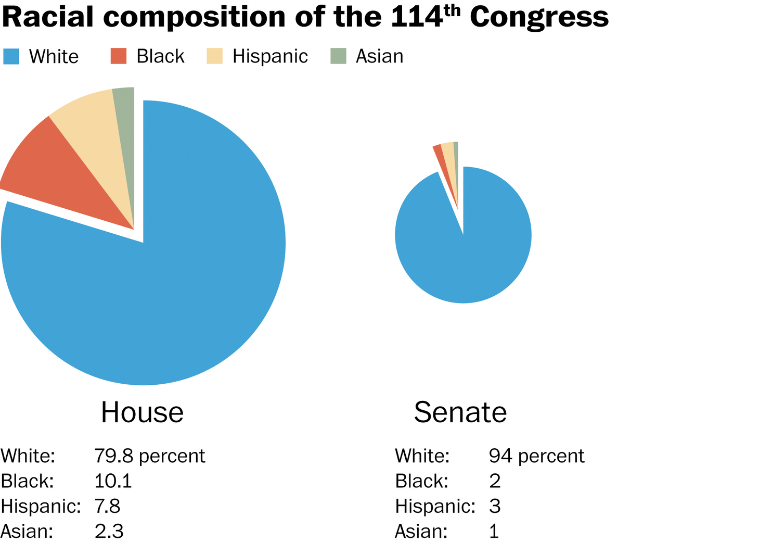
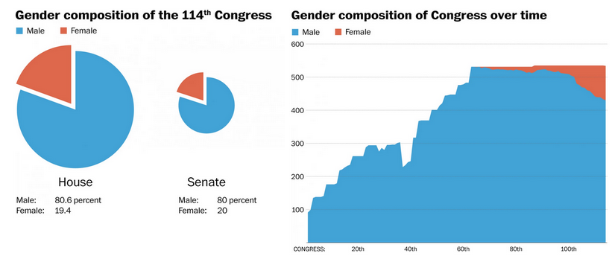
Who’s in Congress?
Slowly becoming less white and less male
114th Congress (2015-2017)
Average Age:
House – 57
Senate – 61
Occupations:
Law – 202
Business – 273
Military Service:
101 Members have served

Slide 10
House |  | Senate
435 Members | ← # of Members → | 100 Members
2 years | ← Length of Term→ | 6 years
Legislative Authority Impeach Power of the Purse Elect the Pres. if Electoral College tie Approve new VP Approve treaties that involve foreign trade Investigation and oversight Declare War | ← Special Powers→ | Legislative Authority Conduct Impeachment Trials Review and Approve Pres. Appointments Approve Treaties (2/3 vote) Investigation and oversight Declare War Elect VP if Electoral College tie
Many rules, more formal Expel Members with 2/3 vote Censure Members Decide disputed House elections Less media coverage Less prestige Represents Districts Limited debate | ← Procedures → | Few rules, less formal Expel members with 2/3 vote Filibuster/cloture Decide disputed Senate elections More media coverage More prestige Represents entire state Unlimited debate

Slide 11
Powers of Congress – Article 1, Section 8
To lay and collect taxes, duties, imposts, and excises
To borrow money
To regulate commerce with foreign nations/among states
To establish rules for naturalization and bankruptcy
To coin money, set its value, and punish counterfeiting
To fix the standard of weights and measures
To establish a post office and post roads
To issue patents and copyrights to inventors/authors

Slide 12
Powers of Congress – Article 1, Section 8
To create courts inferior to the Supreme Court
To define/punish piracies, felonies on high seas, and crimes against law of nations
To declare war
To raise and support an army and navy; make rules for their governance
To provide for a militia
To exercise exclusive legislative powers over seat of government, federal facilities
To “make all laws which shall be necessary and proper for carrying into execution the fore-going powers, and all other powers vested by this Constitution in the government of the United States.”

Slide 13
Congressional Powers
Legislative Powers: Make laws
Enumerated – Article I powers
Necessary & proper – Article I (Elastic Clause)
Denied – Bills of Attainder/Ex Post Facto
Non-legislative Powers: other duties
Electoral: choosing president (House) and VP (Senate) if nobody gets 270 electoral votes
Amendment: propose amendments by 2/3 vote of each chamber
Impeachment: House indicts, Senate acts as jury with Chief Justice presiding
Investigation/oversight: (see next slide)

Slide 14
Congressional Powers (cont.)
Congressional Oversight: the ability for Congress to review and monitor the executive branch and its federal agencies
“inherent” power of all legislatures
General Accountability Office (GAO)
Purpose of Oversight:
Compliance with legislative intent
Program performance
Improve efficiency/effectiveness of govt. operations
Investigate wrongdoings, abuse, waste, dishonesty, fraud

Slide 15
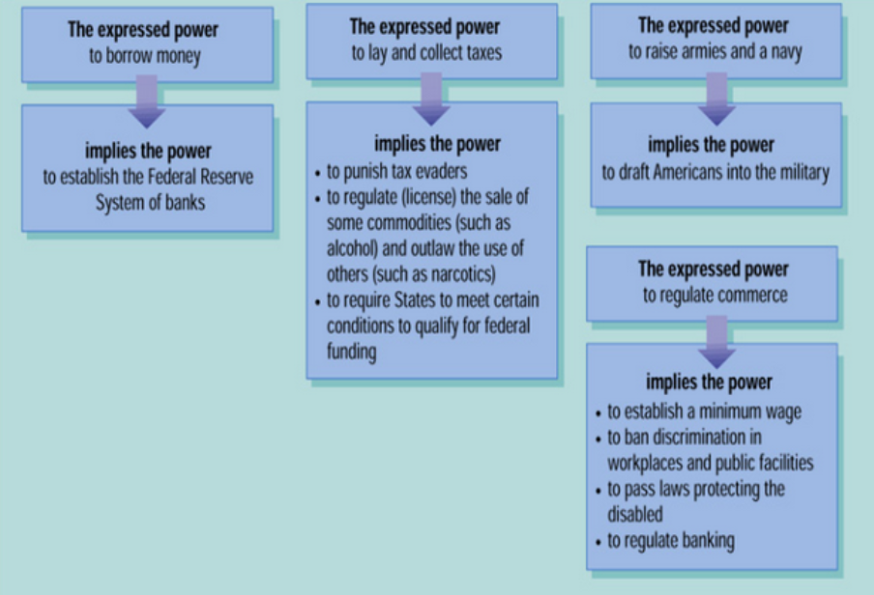
Reviewing Necessary & Proper Clause Uses

Slide 16
Evolution of the House
Powerful House – Legislature very powerful in the early years
Divided House – Leadership of the House becomes less powerful and the Presidency becomes more powerful
Speaker Rules – power of the Speaker of the House grew
House Revolts – Speaker of the House stripped of major powers and committees become more powerful
Members Rule – Majority party imposes rules on committees and how house is run
Leadership Returns – power is restored to Speaker

Slide 17
Roles of Congresspersons
Policymaker –make policy via laws
Representative of constituents:
Delegate: vote based on wishes of people
Representational View of Governing
Trustee: vote based on their own opinions
Attitudinal View of Governing
Partisan: vote based on party leaders commands
Organizational view of Governing
Politico: All four of the above combined
Committee Member—serve on committees
Politician/party member—work to support their political party and get reelected!

Slide 18
Congressional Elections
Incumbency Advantage:
House Incumbents are reelected more often than in the Senate
Most incumbents win
Marginal districts
Districts where candidate is elected with less that 55% of the vote
Safe districts
Candidates win district with over 55% of the vote

Slide 19
Congressional Elections
The Advantages of Incumbents
Advertising:
The goal is to be visible to your voters
Frequent trips home & newsletters are used
Credit Claiming:
Service to individuals in their district
Casework:
Specifically helping constituents get what they think they have a right to
Pork Barrel Legislation:
Federal projects, grants, etc. that only helps a specific congressional district or state

Slide 20
Congressional Elections
The Advantages of Incumbents
Position Taking:
Portray themselves as hard working, dedicated individuals
Occasionally take a partisan stand on an issue
Weak Opponents:
Most opponents are inexperienced in politics
Most opponents are unorganized and underfunded
Campaign Spending:
Challengers need to raise large sums to defeat an incumbent
The Role of Party Identification
Most members represent the majority party in their district

Slide 21
Reelection Rates for House and Senate Incumbents, 1964–2014

Slide 22
Congressional Elections
Defeating Incumbents
Some incumbents face problems after a scandal or other complication in office
They may face redistricting
Changing boundaries after every census
They may become a victim of a major political tidal wave
Many Democrats lost in 1994 & 2014
Many Republicans lost in 2006 & 2008

Slide 23
Congressional Elections
Open Seats
Greater likelihood of competition.
Big issue in 2008 elections!
Stability and Change
Incumbents provide stability in Congress
Change in Congress occurs less frequently through elections

Slide 24
Congressional Elections
Congressional Apportionment & Redistricting
The USA uses Single-Member Districts (a geographic district from which a single member is elected by a majority or plurality of the popular vote to represent it in a legislative body)
Every 10 years the USA takes a census
A state’s representation in the House of Representatives is determined by a state’s population

Slide 25
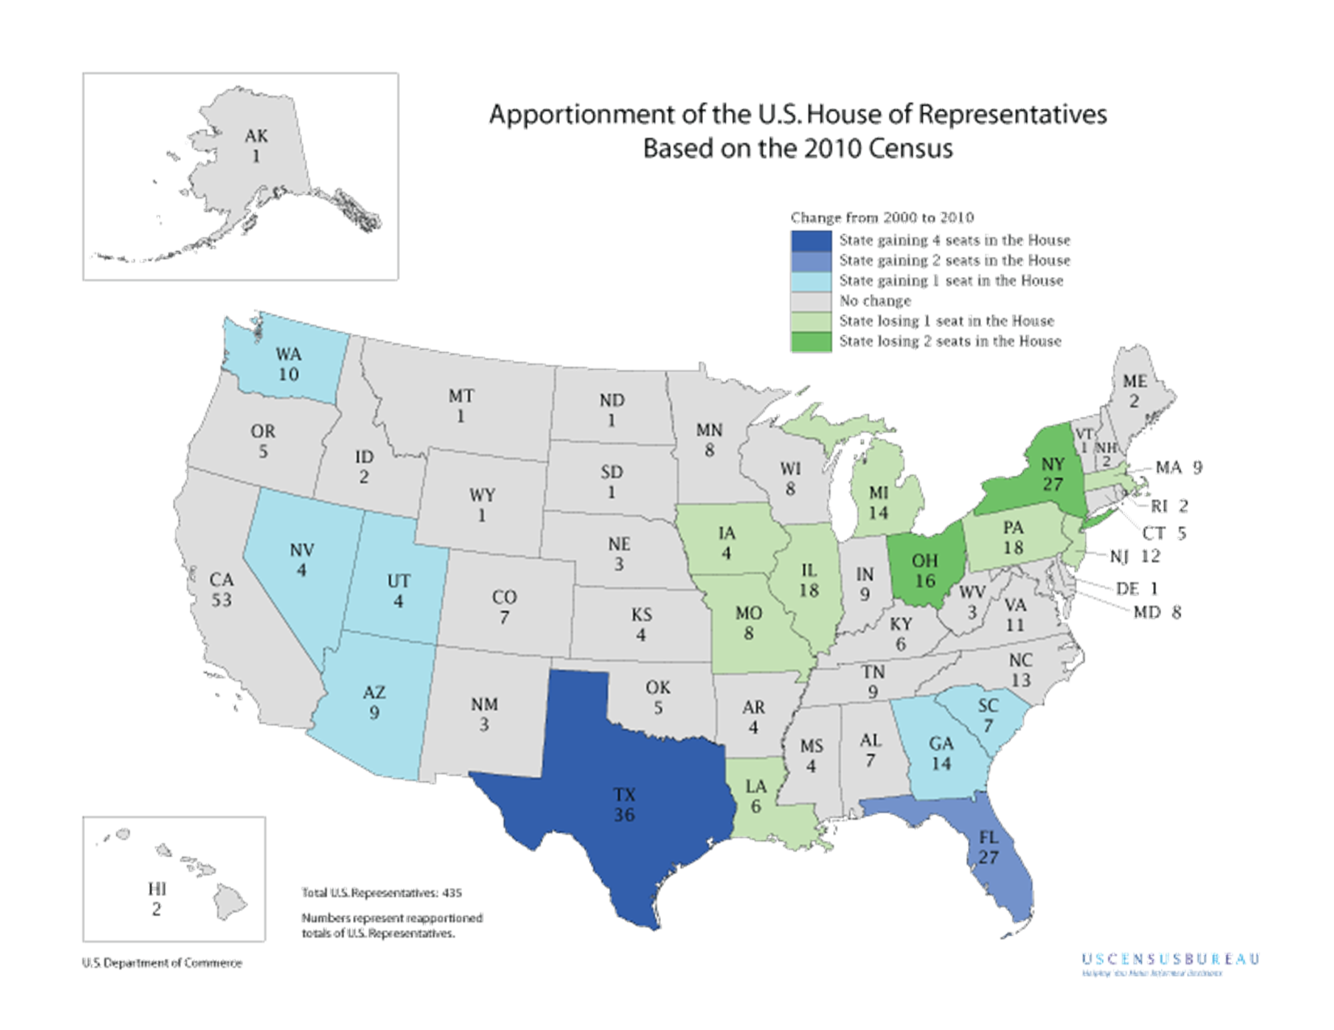

Slide 27
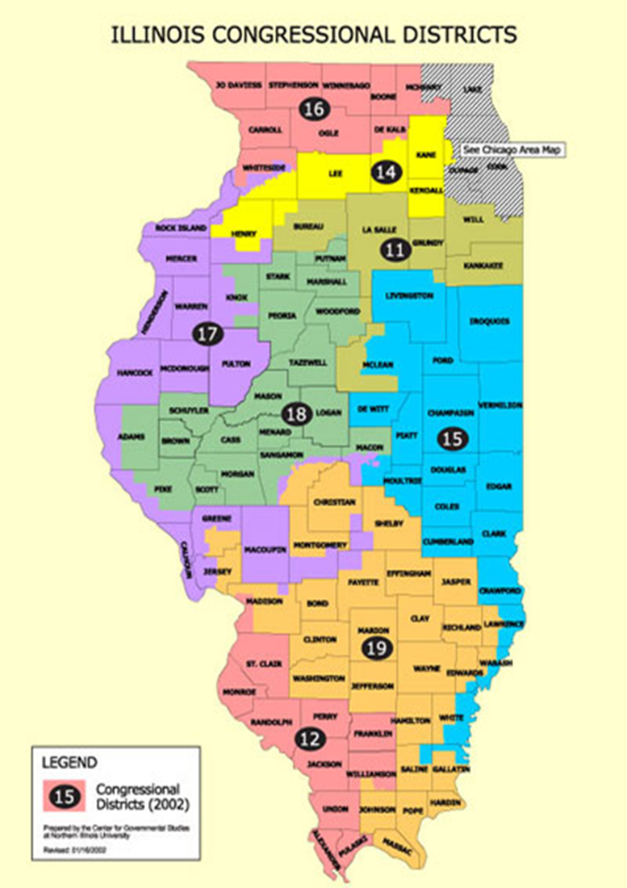
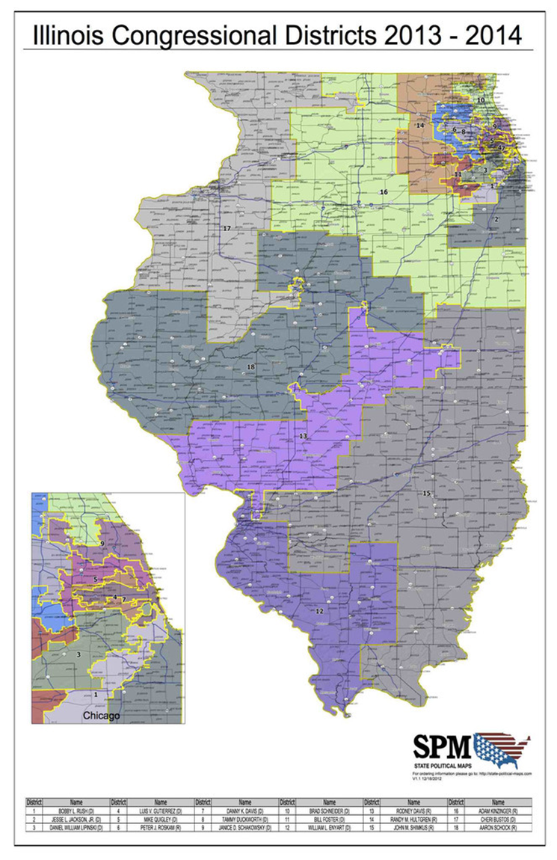

Slide 28
Congressional Elections
STATES redistrict by drawing new Congressional boundaries based upon new census data
Redistricting Requirements:
“One person, One Vote” = districts must be equal in population size
Districts must be contiguous (can’t split districts up)
States can’t redistrict solely on the basis of race

Slide 29
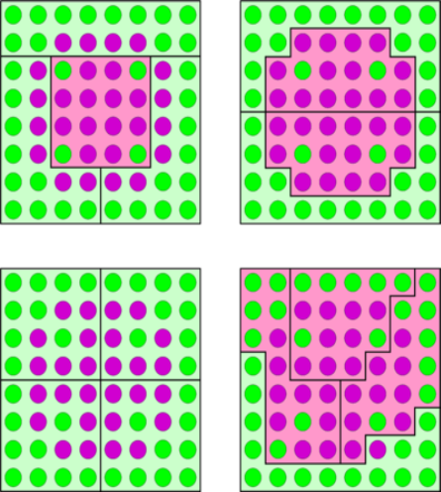
Congressional Redistricting
Almost every state redistricts using controversial methods to help the majority political party in state legislature = Gerrymandering
Drawing districts that benefits your party
Gerrymandering Strategies:
Packing: concentrate as many voters of a particular type into a single electoral district to reduce their influence in other districts
Cracking: involves spreading out voters of a particular type among many districts in order to deny them a sufficiently large voting block in any particular district

Slide 31
Gerrymandering Explained
http://www.youtube.com/watch?v=Mky11UJb9AY
http://www.cnn.com/video/data/2.0/video/politics/2011/11/17/gerrymandering-matter.cnn.html

Slide 32
Gerrymandering and the Courts
Baker v. Carr (1962) - upheld the concept of “one person, one vote”- districts have to be equal in terms of population sizes
Allows the courts to reapportion election districts across the nation
Shaw v. Reno (1993) - a congressional district in North Carolina was so irregular in shape that it was clearly drawn to secure the election of a minority representative
The Court ruled that the district violated the voters' equal rights protection of the 14th Amendment
States can’t redistrict solely on the basis of race

Slide 33
Congressional Leadership

Slide 34
House’s Formal Leadership
The MAJORITY POLITICAL PARTY controls the legislative process, including the selection of Congressional leaders
Leadership in the House
The Speaker of the House
The Majority Leader
The Minority Leader
Whips

Slide 35
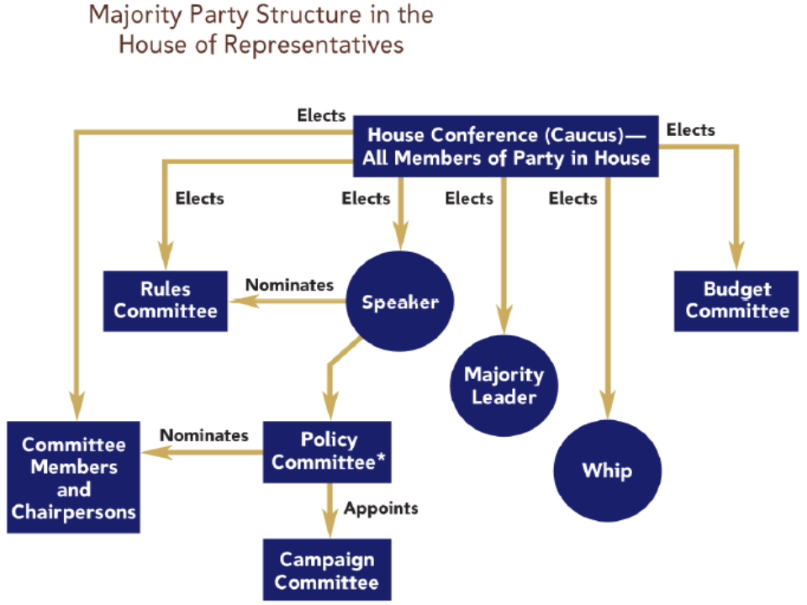

Slide 36
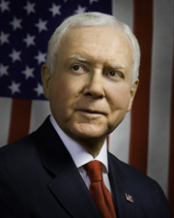
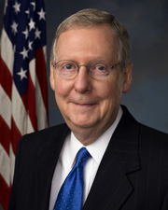
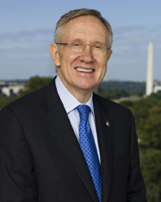
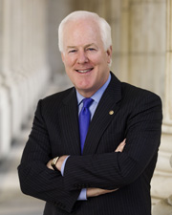
Senate’s Formal Leadership
The MAJORITY POLITICAL PARTY controls most of the legislative process
The U.S. Vice President (tie-breaker)
The President Pro Tempore (ceremonial)
Majority Leader = the real power
Minority Leader
Whips

Slide 37
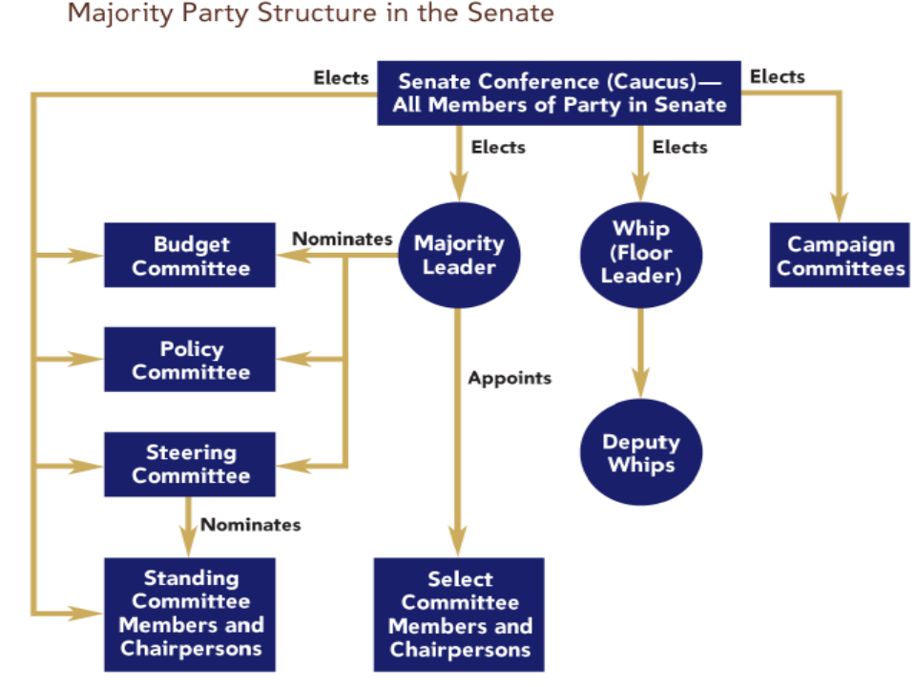

Slide 38
Organization of Congress
Caucuses
Advocates a political ideology or advances a regional, ethnic or economic interest
Examples:
Democratic Study Group
Tuesday Lunch Bunch
Congressional Black Caucus
Tea Party Caucus

Slide 39
Organization of Congress
Congressional Staff and Specialized Offices
Tasks of Staff Members:
Constituent problem-solving – helping voters in their districts with services
Legislative functions – help write bills, summarize bills for their bosses, etc.
Staff Agencies
Congressional Research Service
Politically neutral and gives information to members of Congress for both sides of an issue
Government Accountability Office
Investigates policies and makes recommendations
Congressional Budget Office
Assesses impact of spending programs and estimates future economic trends

Slide 40
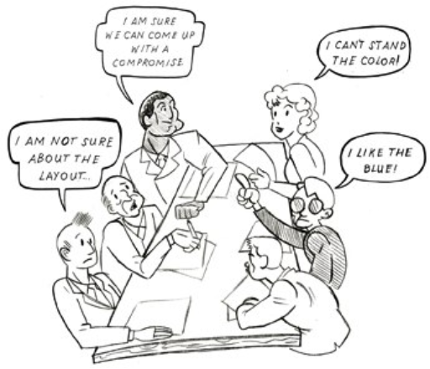
Organization of Congress
Committee System:
Nonexistent 1789-1810
Review & Screen policy proposals!
Increase in workload:
Hearings
Markup of legislation
Become specialists in policies
Committee membership proportional to majority & minority parties in chamber

Slide 41
Committee Structure
Standing Committee: permanent; deals with specific policy matters; i.e. agriculture, energy
Select Committee: temporary; appointed for a specific purpose; i.e. Senate Watergate Committee
Joint Committee: includes members of both chambers; i.e. Joint Committee on Taxation
Conference Committee: temporary; includes members from both chambers; purpose is to resolve different versions of House/Senate bills

Slide 43
Committee System
The Committees and Subcommittees
Getting on a Committee
Members want committee assignments that will help them get reelected, gain influence, and make policy
New members express their committee preferences to the party leaders
Support of the party is important in getting on the right committee
Parties try to grant committee preferences=Have you been loyal lately?

Slide 44
Committee System
The Committees and Subcommittees
Getting Ahead on the Committee: Chairs and the Seniority System.
The chair of a committee is the most important position for controlling legislation
Chairs were once chosen strictly by the seniority system
Now seniority is a general rule, and members may choose the chair of their committee

Slide 45
How a Bill Becomes a Law
Introducing a bill:
Bill: A proposed law
Anyone can draft a bill, but only members of Congress can introduce them
All spending measures must originate in the House of Representatives
More rules in the House than in the Senate
Party leaders play a vital role in steering bills through both houses, but less in the Senate
Assign a bill to the appropriate committee
If bill doesn’t make it out of committee, bill will die—unless a discharge petition is signed (only used in the House)
Most bills die b/c they never make it out of committee
Countless influences on the legislative process
Lobbyists, Interest Groups, Constituents, Elections

Slide 46
How a Bill Becomes a Law
In addition to bills, Congress can also pass resolutions
Simple resolution – expression of opinion in either the House or Senate to settle procedural matters (rules)
Concurrent resolution – expression of opinion without the force of law that must pass both houses to settle procedural and housekeeping matters for both houses
Joint resolution – expression of congressional opinion that passes both houses and needs a presidential signature (just like a law).
This is also the process for proposing Constitutional Amendments, but without a president’s signature

Slide 47
How a Bill Becomes a Law - Committees
Before the entire chamber votes on a bill, the bill must make it through committee(s):
Committee Steps:
Bill is referred to committee
This depends on type of bill
Example: Bill dealing with Social Security Payroll taxes goes to the House Ways and Means Cmte. because they deal with all bills dealing with taxes
Bill put on committee calendar:
If bill not put on calendar, the bill dies!

Slide 48
How a Bill Becomes a Law - Committees
Committee Steps:
Most bills go through subcommittees:
People testify for/against bill
Bills often “marked-up” – changed/modified in order to pass
Back to the full committee:
Sometimes more hearings take place
Vote on bill and any amendments
Full committee votes for bill—if bill passes committee, the committee writes a report of the bill

Slide 49
How a Bill Becomes a Law
After passing out of Committee
Bill goes to full floor
House – Rules committee sets rules for debate
Restrictive – permits certain kinds of amendments to a bill, but not others during floor debate
Closed rule – sets a time limit on debate; forbids a bill from being amended on the floor
Open rule – permits any amendment from the floor
Rules committee is the traffic cop
Senate
The majority leader and minority leader agree when to bring bills to the floor
Overall, any bill can be considered at any time whenever a majority of senators choose to

Slide 50
How a Bill Becomes a Law
House debate on the floor:
Most bills discussed in the Committee of the Whole (at least 100 members present)
Committee of the Whole debates and amends in accordance of the rules and with guidance from the committee the bill came from
When this is done, the bill must pass with a vote from the full house
Quorum – at least 218 members (a majority of 435)
Overall, most bills pass in the form that they came out of committee

Slide 51
How a Bill Becomes a Law
Senate debate on the floor:
No rules limiting debate
No Committee of the Whole
Bills that passed the House can be placed on the calendar without going to a committee
Riders – amendments that have no relation to the current bill. A lot of riders = Christmas tree bill

Slide 52
How a Bill Becomes a Law
Senate debate on the floor:
Filibusters – one senator can stop the consideration of a bill by not agreeing to let the bill pass or be debated (they speak without letting anyone else speak)
Cloture – 3/5’s of all Senators vote to end a filibuster
Double tracking – shelving a bill until the opposing senator gives up their filibuster. This is so the Senate can do other things. Basically, this means that effectively any bill can be required to have 60 votes to pass if there is even a threat of a filibuster.

Slide 53
How a Bill Becomes a Law
Voting
All amendments and the final bill must be voted on
Voice vote – members shout “yea” or “nay” in order to vote quickly and anonymously
This leaves the presiding officer in charge of deciding which side was loudest
Division vote – members stand and are counted based on how they vote (names not recorded)
Roll-call vote – voting by machine where your vote is recorded in the record
1/5 of house members must request this
Senate – only use voice or roll-call

Slide 54
How a Bill Becomes a Law
Conference Committee
If a bill passes both the House and Senate, it must be word for word the same.
Minor revisions – one house can refer their bill back to the other for passage and it’s done
Major revisions – Conference committee must hammer out a compromise
Each house must vote to form a conference committee
Another way to derail passage of the bill
If formed, the committee is formed with the committees that created the bills sitting on it
After the negotiations, they send a report to both houses and each house must approve or reject without amendments
Once a bill passes both houses, it goes to the president for his signature or veto
Veto can be overridden with 2/3’s vote

Slide 55
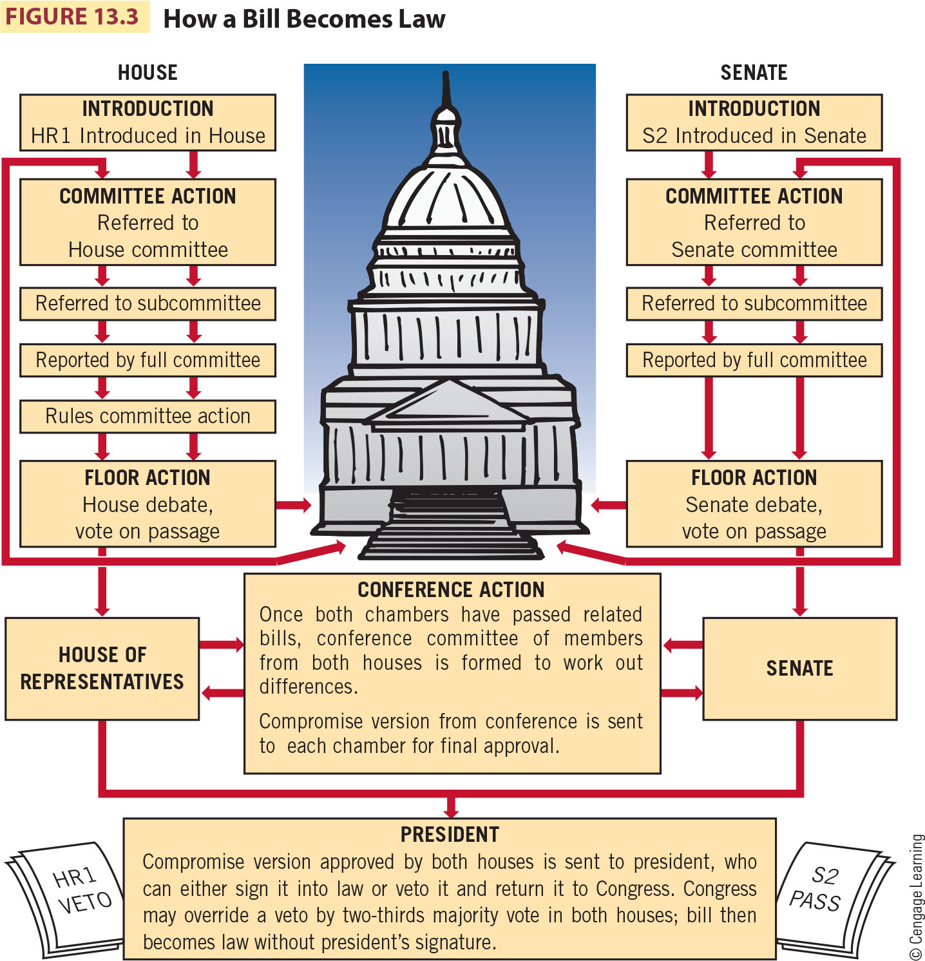
How a Bill Becomes a Law

Slide 56
Legislative Tactics
Logrolling: if you vote for my bill, I will vote for your bill (reciprocity)
Pork Barrel: “pet projects” for specific jurisdictions. EX: “bridge to nowhere”
Earmarks: last minute add-on to a bill that helps a specific group of people, usually done anonymously
Leaders of Congress can offer these as incentives to pass legislation
Due to public outcry, they are not specifically called “earmarks” any more
Filibuster/Cloture
The Committee System: bills may die if committees fail to act or reject them
“Killing a Bill” or “Pigeonholing”

Slide 57
Legislative Tactics
Amendments: additions/changes to bills
Can be added in committee debate or floor debate
Riders
The Germaneness Rules:
The House prohibits non-germane riders to be added during floor debate
The Senate traditionally does not allow non-germane riders during floor debate, though no rule prohibits their use

Slide 58
Other Issues to Consider
A lot has been made on the productivity of Congress, but how do we measure that?
The number of bills passed doesn’t always indicate the level of work done
Divided Government – one party controls the WH and another party controls one or both houses of Congress
Unified Government – same party controls the WH and both houses of Congress
Disaster – if something happens to a majority of Congress, should we have special procedures in place
Senators – depending on state law (appointed by Governor or special election
House members – only special elections
Is this all too slow in a crisis?

Slide 59
The Congressional Process
Presidents and Congress: Partners and Adversaries
Presidents have many resources to influence Congress (often called the “Chief Legislator”)
Press conferences, holding rallies, etc.
Threats of vetoes can influence process
White House staff often lobbies Congress
Party, Constituency, and Ideology
Party Influence: Party leaders cannot force party members to vote a particular way, but many do vote along party lines
Whips – whip votes and get members to vote with party

Slide 60
The Congressional Process
Campaign Finance Committee assistance
We’ll help fund your re-election if you vote on important matters with us
Constituency versus Ideology: Most constituents are uninformed about their member
Trustee v. Delegate
Controversial issues bring lots of voices

Slide 61
The Congressional Process
Lobbyists and Interest Groups
There are several thousand lobbyists trying to influence Congress - the bigger the issue, the more lobbyists will be working on it
Lobbyists can be ignored, shunned and even regulated by Congress
A combination of lobbyists and interest groups that can influence members of Congress

Slide 62
Reforming Congress
Proposals to reform Congress
Term limits?
Pork-barrel legislation tends to get passed, but controversial and larger issues get ignored
Franking privilege – should it be abolished?
Congressional Accountability Act (1995)
Forcing Congress to follow the laws everyone else does would put them under the scrutiny of executive branch administration, so they created the independent Office of Compliance and an employee grievance procedure to deal with it without violating separation of powers.

Slide 63
Reforming Congress
Proposals to reform Congress
Price of citizen-oriented Congress is a pork-oriented Congress
Not all pork barrel legislation is bad. Some of these projects are badly needed. Since Congress is an independent branch, they are free to do business they see fit and make rules that they deem necessary.

