Slide 1
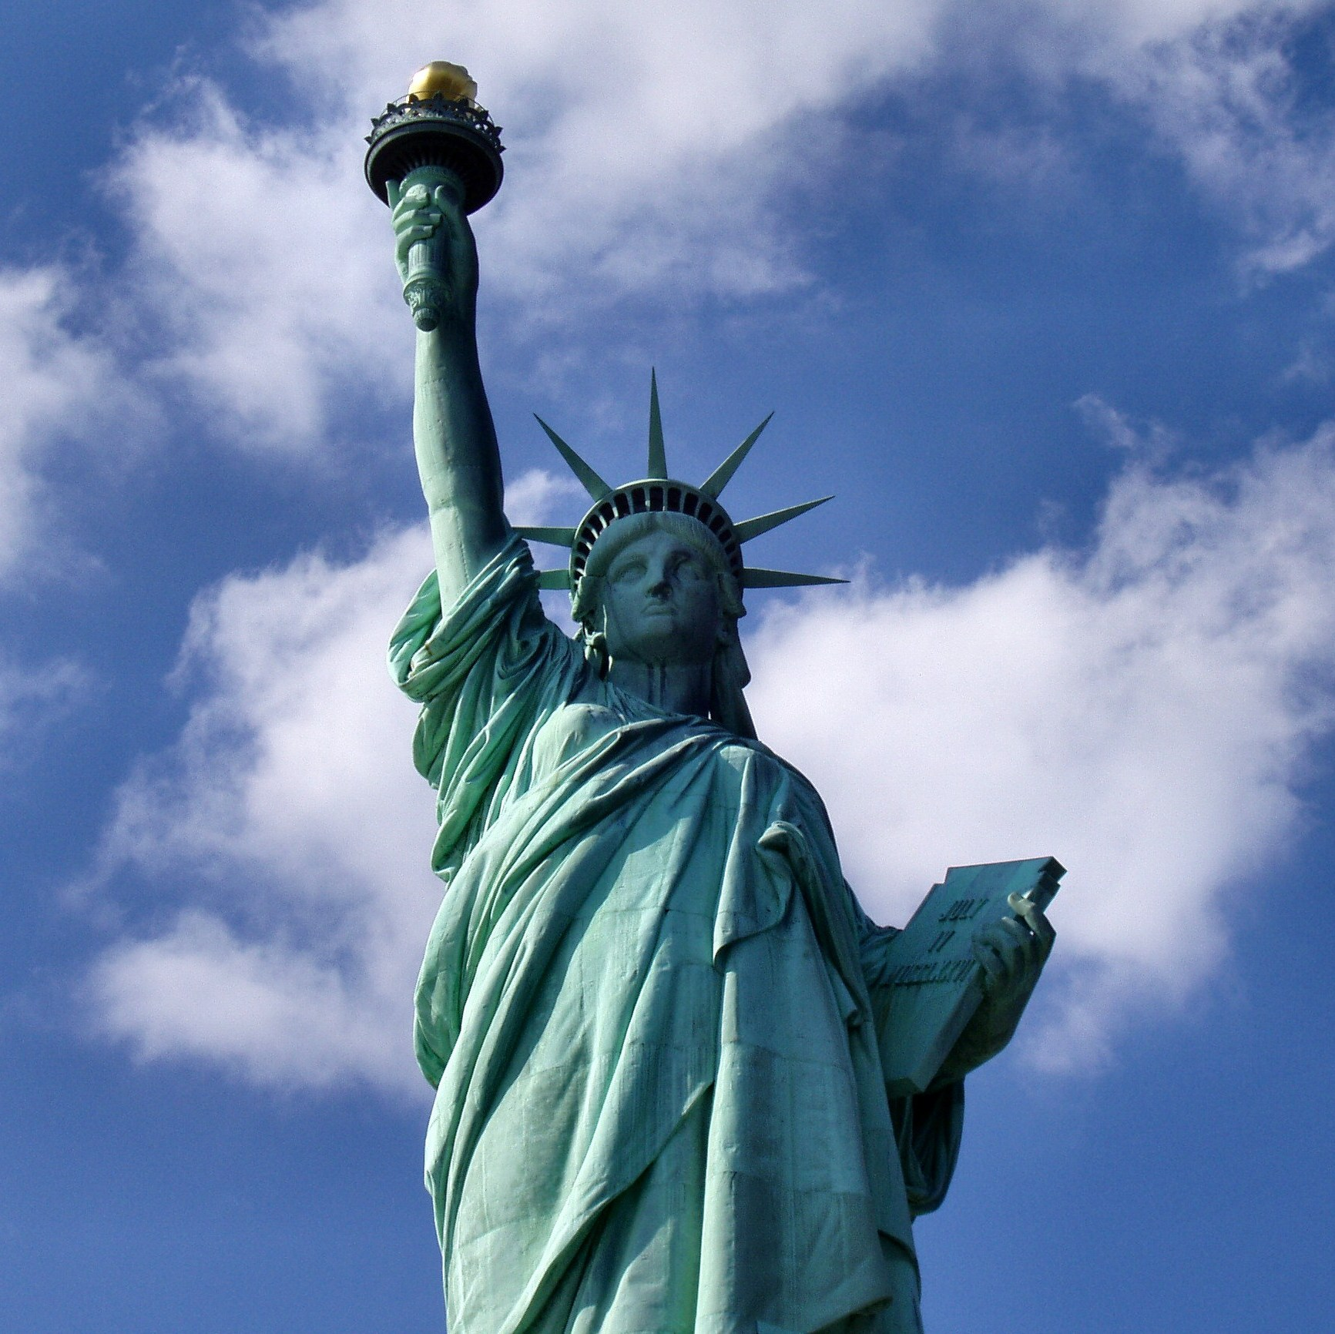
Civil Rights
Objectives
Describe how SC rulings and federal legislation have attempted to end racial discrimination and advance women’s rights;
Explain the evolution of affirmative action programs;
Analyze how court doctrine and public opinion on gay rights has changed;
Summarize how American political institutions and public opinion have expanded civil rights overall.

Slide 2
Questions to Consider
WHO GOVERNS?
Since Congress enacts our laws, why has it not made certain that all groups have the same rights?
After the Supreme Court ended racial segregation in the schools, what did the president and Congress do?
TO WHAT ENDS?
If the law supports equality of opportunity, why has affirmative action become so important?
Under what circumstances can men and women be treated differently?

Slide 3
Civil Rights
Civil Rights: Rights of people to be treated without unreasonable or unconstitutional differences
The term civil rights refers to rights, freedoms and liberties and that should be given to people no matter their race, ethnicity, lifestyles, or beliefs
They also can refer to the nonpolitical rights of a citizen or person

Slide 4
Civil Rights – The Basics
Other Definitions:
The rights of personal liberty guaranteed to U.S. citizens by the 5th and 14th Amendments to the Constitution and by acts of Congress.
The rights of citizens to vote, to receive equal treatment before the law, and to share equally with other citizens the benefits of public facilities.
Civil Rights Laws:
Civil rights laws increased the power of government as it limits individual rights often the majority in order to protect the rights of the minority.

Slide 5
The Government and Civil Rights
A powerful federal government was seen as the greatest threat to liberty in 1789.
Today, women and minorities look to the federal government for them equality.
This added role has increased the scope and power of the federal government.
Courts role:
Minorities/women have used the courts to enforce laws and declare laws unconstitutional because it tends to be faster than legislatures.

Slide 6
SC Rulings on Discrimination
The suspect classification doctrine – classifications of people based on their race or ethnicity; laws so classifying people are subject to “strict scrutiny.”
The U.S. Supreme Court has held that certain kinds of government discrimination are inherently suspect and must be subjected to strict judicial scrutiny
Constitutional basis in the Fifth Amendment and the Equal Protection Clause of the Fourteenth Amendment, and it applies to actions taken by federal and state governments.

Slide 7
SC Rulings on Discrimination
When a suspect classification is at issue, the government has the burden of proving that the challenged policy is constitutional.
The Supreme Court has ruled that some particular groups or “Classifications” may not be discriminated against
Classifications that have been ruled on in the past include:
Age, religion, race, gender, national origin
Most recently sexual orientation

Slide 8
How the Court Decides Discrimination
Rational Basis – if the policy uses reasonable means to achieve a legitimate government goal, it is constitutional
Intermediate Scrutiny - If the policy serves an important government interest and is substantially related to serving that interest, it is constitutional
Strict Scrutiny – To be constitutional the discrimination must serve a compelling government interest, it must be narrowly tailored to attain that interest and it must use the least restrictive means to attain it.

Slide 9
SC Rulings on Classifications
Age
The Supreme Court has ruled that age classifications are “reasonable” AND constitutional
Is there any rational foundation for discrimination?
Lowest Level
Ex: Age 18 for voting and 21 for drinking alcohol
Race
It is illegal to discriminate because of race
Strict Scrutiny – Is classification necessary to the accomplishment of a permissible state goal? Is it the least restrictive way to reach the goal?
The Court has ruled that most classifications based on race or ethnicity are “inherently suspect.”
Only exceptions are in the classification is designed to undo past discrimination (Affirmative Action).

Slide 10
SC Rulings on Classifications
Gender
The Court has ruled that classifications based on gender fit in-between being constitutional and unconstitutional
Does the classification serve an important governmental objective, and is it substantially related to those ends?
Intermediate Scrutiny
Ex: The golf club at Augusta was for men only and this was ruled constitutional because it is a private institution but some public institutions and universities have been forced to accept women because they take public monies

Slide 11
SC Rulings on Classifications
Sexual orientation
Homosexuals have not always been considered a suspect class. But the Court has ruled on several cases concerning gay rights since Bowers v Hardwick in 1986.
The changing face of gay and lesbian rights has taken a “new road” in the United States since the controversial Stonewall riots in 1969. Current cases center around marriage equality.
In the face of newer cases, the classification may be changing.

Slide 12
Constitutional Conception of Equality
Neither the Constitution nor the Bill of Rights mentions the word equality
The Declaration of Independence said, “all men are created equal.”
This equality did not apply to women, slaves or Native Americans.
The Due Process Clause of the 5th Amendment implies equal treatment under the law for all persons.
“No person (shall) be deprived of life, liberty, or property without due process of law; nor shall private property be taken for public use, without just compensation”

Slide 13
Constitutional Conception of Equality
The first and only mention of equality is in the 14th Amendment, which prevents states from denying anyone “equal protection under the law.”
The 14th Amendment provided “equal protection of the laws” while establishing citizenship rights for newly freed slaves
Not until the 1950’s (Brown v. Board of Education) and 60’s (The Civil Rights Act 1964 and the Voting Rights Act) was the full force of the 14th amendment felt and equal rights for women and minorities been protected.

Slide 14
Evolution of African American Rights
In Dred Scott v. Sanford (1857) the Supreme court ruled a black man, slave or free, was “chattel and had no rights”
Furthermore, Congress could not ban slavery in any territory of the United States.
Declared the Missouri Compromise unconstitutional
Civil War Amendments – 13th, 14th, 15th
1883 Civil Rights Cases:
Congress can only prohibit government discrimination based on race, not private individuals even if it concerned public accommodations

Slide 15
Evolution of African American Rights
Plessy v. Ferguson (1896)
“Separate but Equal” is Constitutional
In short, segregation does not in itself constitute unlawful discrimination
After the Civil War most states in the South passed anti-African American legislation.
These became known as Jim Crow laws.
This included laws that discriminated against African Americans with concern to attendance in public schools and the use of facilities such as restaurants, theaters, hotels, cinemas and public baths.
Trains and buses were also segregated and in many states marriage between whites and African American people.

Slide 16
Sweatt v. Painter (1950)
Facts of the Case
In 1946, Herman Marion Sweatt, a black man, applied for admission to the University of Texas Law School. State law restricted access to the university only to whites, and Sweatt's application was automatically rejected because of his race.
When Sweatt asked the state courts to order his admission, the university attempted to provide separate but equal facilities for black law students.
Question
Did the Texas admissions policy violate the Equal Protection Clause of the Fourteenth Amendment?

Slide 17
Sweatt v. Painter (1950)
In a unanimous decision, the Court held that the Equal Protection Clause required that Sweatt be admitted to the university.
The Court found that the "law school for Negroes," which was to have opened in 1947, would have been grossly unequal to the University of Texas Law School.
The Court argued that the separate school would be inferior in a number of areas, including faculty, course variety, library facilities, legal writing opportunities, and overall prestige.
The Court also found that the mere separation from the majority of law students harmed students' abilities to compete in the legal arena.

Slide 18
Brown v. Bd. of Ed. (1954)
Ended “separate but equal” doctrine for public schools – class action lawsuit
Brown v. Board II (1955)
After its decision in Brown I which declared racial discrimination in public education unconstitutional, the Court convened to issue the directives which would help to implement its newly announced Constitutional principle.
The Court held that the problems identified in Brown I required varied local solutions.
CJ Warren urged localities to act on the new principles promptly and to move toward full compliance with them "with all deliberate speed."

Slide 19
Green v County School Board of New Kent County 1968
New Kent County, VA – school board created a “freedom of choice” plan under which every student would be allowed to attend the school of choice
Court decided this unconstitutional b/c it did not produce the “ultimate end” of integration since 100% of white students stayed in white schools and 85% of blacks stayed in black schools
Seemed to say that racial integration was as important as repealing laws that caused racial separation

Slide 20
Swann v Charlotte-Mecklenburg County Board of Education (1971)
Facts of the Case
After the Supreme Court's decision in 1954 in Brown v. Board of Education, little progress had been made in desegregating public schools.
One example was the Charlotte-Mecklenburg, North Carolina, system in which approximately 14,000 black students attended schools that were either totally black or more than 99 percent black.

Slide 21
Swann v Charlotte-Mecklenburg Board of Education 1971
In a unanimous decision, the Court held that once violations of previous mandates directed at desegregating schools had occurred, the scope of district courts' equitable powers to remedy past wrongs were broad and flexible.
Remedial plans were to be judged by their effectiveness, and the use of mathematical ratios or quotas were legitimate "starting points" for solutions
Predominantly or exclusively black schools required close scrutiny by courts
Non-contiguous attendance zones, as interim corrective measures, were within the courts' remedial powers
No rigid guidelines could be established concerning busing of students to particular schools.

Slide 22
Civil Rights Vocabulary
De jure segregation
Separation by law (by law or “jury”)
Plessy v. Ferguson
De facto segregation
Separation as a matter of fact (housing patterns, neighborhoods, etc.)
Swann v Charlotte-Mecklenburg County Board of Education (1971)

Slide 23
Campaign for Legislative Remedies
Get on national political agenda through:
Dramatic confrontations
Civil disobedience
Violent demonstrations
Conflict between agenda-setting and coalition-building factions
Developments advancing change:
Public opinion changing
Moral force
JFK assassination
1964 elections

Slide 24
Civil Rights Legislation
Civil Rights Act 1964 –
Made racial discrimination in public places, such as theaters, restaurants and hotels, illegal.
It also required employers to provide equal employment opportunities.
Projects involving federal funds could now be cut off if there was evidence of discrimination based on color, race or national origin.
Dealt with the problem of African Americans being denied the vote in the Deep South.
The legislation stated that uniform standards must prevail for establishing the right to vote.
Schooling to sixth grade constituted legal proof of literacy and the attorney general was given power to initiate legal action in any area where he found a pattern of resistance to the law.

Slide 25
Civil Rights Legislation
1965 Voting Rights Act
This legislation removed the right of states to impose restrictions on who could vote in elections.
Johnson explained how, “Every American citizen must have an equal right to vote. Yet the harsh fact is that in many places in this country men and women are kept from voting simply because they are Negroes."
Passed by large majorities in the House of Representatives (333 to 48) and the Senate (77 to 19).
The legislation empowered the national government to register those whom the states refused to put on the voting list.

Slide 26
Effects of Voting Rights Act 1965
Increased minority voting in elections
African-American Legislators:
Blacks make up around 12.1% of the population
But in 1965, only 70 African Americans held elected office in all 11 southern states.
That number rose to 2,500 by the early 1980’s, after passage of the Voting Rights Act.

Slide 27
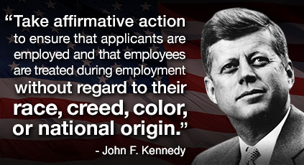
Affirmative Action
Designed to overcome the effects of past discrimination, and bring about the increased employment, promotion or college admission for women and minorities.
The goal is to “move beyond equal opportunity towards equal results”.
The federal government mandated affirmative action programs for state and local governments during the Nixon administration.

Slide 28
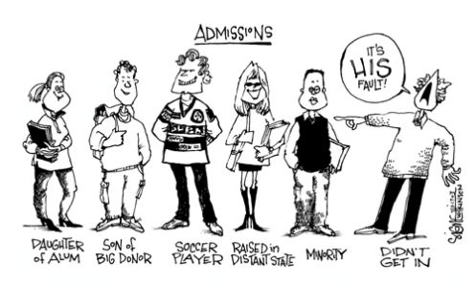
Affirmative Action Cases
Regents of the University of California v. Bakke (1978):
35yo white man denied admission into Medical School twice b/c the school reserved certain seats for minorities
A quota-like ban on Bakke’s admission was unconstitutional but “diversity” was a legitimate goal that could be pursued by taking race into account.
Grutter v. Bollinger and Gratz v. Bollinger (2003): Numerical benefits cannot be used to admit minorities into college, but race can be a “plus factor” in making those decisions.

Slide 29
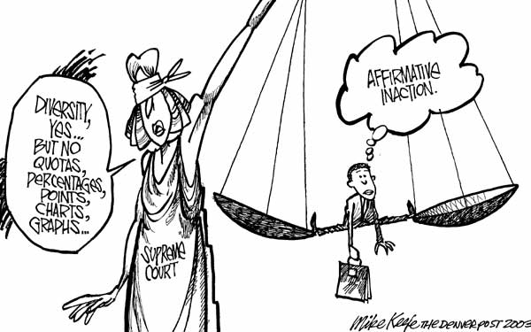
Affirmative Action Cases
Adarand Contractors v. Pena (1995):
SC decision in this case holds that whenever government provides any preferential treatment based on race, that action is almost certainly unconstitutional, even if it is intended to benefit minority groups suffering from past injustices.

Slide 30
Other Minorities
Asian Americans are the fastest growing minority.
Nearly 120,000 Japanese-Americans and Japanese aliens were interned in concentration camps during WWII
Hispanic Americans are the largest minority group in the US with increasing electoral influence
Native-Americans were not made US citizens until 1924 – because of small size electorate, they benefit least from public policy and have the highest rate of poverty related problems

Slide 31
Korematsu v. U.S. (1944)
Facts of the Case
During World War II, Presidential Executive Order 9066 and congressional statutes gave the military authority to exclude citizens of Japanese ancestry from areas deemed critical to national defense and potentially vulnerable to espionage. Korematsu remained in San Leandro, California and violated Civilian Exclusion Order No. 34 of the U.S. Army.
Conclusion
The Court sided with the government and held that the need to protect against espionage outweighed Korematsu's rights and that Japanese internment was a “military necessity” during wartime.
Justice Black argued that compulsory exclusion, though constitutionally suspect, is justified during circumstances of "emergency and peril.“
Congress authorized token compensation for loss of property and violation of rights years later in 1988

Slide 32
Women’s Rights
“Coverture”- legal concept that made married women subject to their husbands
Could not sign contracts or dispose of property. Divorce laws and child custody favored the husband.
Legal concept prevailed during the 19th century.
19th Amendment 1920 – women’s suffrage
Change in status during WWII – Rosie the Riveter – women in factories, baseball☺
Rise in feminism, 1960s, Betty Friedan’s “Feminine Mystique”
The Equal Pay Act of 1963
Businesses cannot discriminate salaries because of gender

Slide 33
Women’s Rights
Civil Rights Act of 1964 – prohibits gender discrimination in hiring, firing, and compensation
Reed v. Reed (1971)
Facts of Case –
After the death of their adopted son, both Sally and Cecil Reed sought to be named the administrator of their son's estate (the Reeds were separated).
The Idaho Probate Code specified that "males must be preferred to females" in appointing administrators of estates.
In a unanimous decision, the Court argued that “to give a mandatory preference to members of either sex over members of the other, merely to accomplish the elimination of hearings on the merits, is…forbidden by the Equal Protection Clause of the Fourteenth Amendment. . .

Slide 34
Examples of Illegal Gender Discrimination
Women cannot be barred from jobs by arbitrary height and weight requirements
Employers can’t discriminate against a pregnant woman nor make her take a mandatory pregnancy leave
Girls cannot be barred from Little League baseball teams
High school coaches of girls and boys sports must be paid the same

Slide 35
Allowable Gender Differences
A law that punishes males but not females for statutory rape is permissible – men and women are not similarly situated with respect to sexual relations
All boy and all girl public schools are permitted if enrollment is voluntary and quality is equal
Widows may receive a property tax exemption from the state while widowers cannot
The Navy may allow women to remain officers longer than men without being promoted.

Slide 36
Sexual Harassment
It is illegal to request sexual favors as a condition of employment or promotion – employer is “strictly liable”
Illegal to experience a hostile or intimidating work environment by a steady pattern of offensive sexual teasing, jokes, or obscenity – employer is only guilty if found negligent
Vague and inconsistent decisions at the federal level.

Slide 37
Women’s Rights
The Equal Rights Amendment ERA
Proposed by Congress in 1972
Section 1. Equality of Rights under the law shall not be denied or abridged by the United States or any state on account of sex.
Section 2. The Congress shall have the power to enforce, by appropriate legislation, the provisions of this article.
Section 3. This amendment shall take effect two years after the date of ratification.
Never Ratified – 35 states did, needed 38
The Education Amendment Act of 1972
AKA… “Title IX”
Gender equity in sports at high school and college levels

Slide 38
Privacy and Abortion
Griswold v Connecticut (1965)
Found a right to privacy in the Constitution that would ban any state law against selling contraceptives
Roe v Wade (1973)
States laws prohibiting abortion were unconstitutional
Webster v. Reproductive Health Services (1989)
Allowed states to ban abortions from public hospitals and permitted doctors to test to see if fetuses were viable
Planned Parenthood v Casey (1992)
Reaffirmed Roe v Wade but upheld certain limits
Gonzales v Carhart (2007)
Federal law may ban certain forms of partial-birth abortion – currently banned in 19 states

Slide 39
Limitations on Abortion
Partial birth (specific definition) is banned
D&C and D&E are allowed late-term if life of mother is endangered
Do not need husband’s consent
States may require 24 hr waiting period
States may not require husband’s consent
Teenagers need parental consent in some states

Slide 40
Women in the Military
Women are admitted to all military academies and make up 15% of the armed forces.
However, only men must register for the draft
Rostker v. Goldberg (1980)
In a 6-to-3 decision, the Court held that Congress's decision to exempt women from registration "was not the 'accidental by-product of a traditional way of thinking about females'" and did not violate the Due Process Clause.
This was, however, based on the combat restrictions for women, which have since been removed.
United States v Virginia (1996) – State may not finance an all male military school

Slide 41
Americans with Disabilities
Americans with Disabilities Act was signed by President GHW Bush in 1990
Required “reasonable accommodations” be made and prohibits discrimination in employment
The ADA prohibits private employers, or the government from discriminating against qualified individuals with disabilities in
Job application procedures
Hiring, firing, advancement
Compensation, job training
And other terms, conditions and privileges of employment

Slide 42
Immigrants’ Rights
Non-citizens may not vote or run for office, but must pay taxes
Entitled to rights even if illegal
Entitled to welfare benefits if legal status
May own property
Illegal immigrants are not entitled to social security
Children of illegal immigrants
Plyler v. Doe (1982) - struck down a state statute denying funding for education to unauthorized immigrant children and simultaneously struck down a municipal school district's attempt to charge unauthorized immigrants an annual tuition

Slide 43
Gay Rights
Rights upheld under “right to privacy” statutes
Lawrence v. Texas 2003 – states may not ban sexual relations between same-sex partners
Boy Scouts of America v. Dale (2000): A private organization may ban gays from its membership
Eventually allowed openly gay members but not openly gay leaders – later banned that too
Gays in the military
1990s – “Don’t Ask, Don’t Tell”
2010 – The Don't Ask, Don't Tell Repeal Act

Slide 44
Gay Rights
Same Sex Marriage
United States v. Windsor (2013)
Restricting U.S. federal interpretation of "marriage" and "spouse" to apply only to heterosexual unions, by Section 3 of the 1996 Defense of Marriage Act (DOMA), is unconstitutional under the Due Process Clause of the Fifth Amendment
Gay married couples must receive the same health and tax benefits as heterosexual couples
Obergefell v. Hodges (2015)
Case in which the Court held that the fundamental right to marry is guaranteed to same-sex couples by both the Due Process Clause and the Equal Protection Clause of the Fourteenth Amendment

