Slide 1
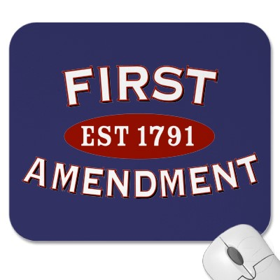
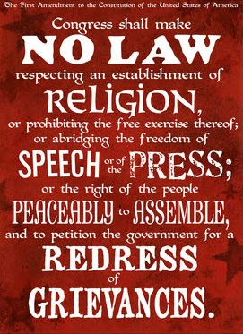
Civil Liberties
Objectives:
explain why the courts are so important in defining civil liberties;
describe which forms of expression are protected and why;
analyze how the Constitution protects religious freedom;
explain how in the 21st century, the Constitution protects civil liberties for people accused of crimes or designated “enemy combatants.”

Slide 2
Culture & Civil Liberties
Rights in Conflict
Competing rights and duties
Does one person’s right trump another’s?
Congress has attempted to restrict rights (especially during war/crisis)
Sedition Act of 1798
Espionage and Sedition Acts (1917-18)
Smith Act (1940)
Internal Security Act (1950)
Communist Control Act (1954)

Slide 3
Civil Liberties and Civil Rights
Civil liberties: freedoms (choices) enjoyed by individuals in a democratic society
Freedom in government (to participate)
Freedom from government (to live one’s life)
Civil rights: rights of all persons to equal protection of the laws; the right not to be discriminated against because of race, ethnic background, religion, or gender. Obligations placed on government to protect freedoms.

Slide 4
Civil Liberties and Civil Rights
Civil Liberties
Located in Bill of Rights
The legal constitutional protections against the government
Limitations on government power
What the government can’t do
Civil Rights
Located in 5th & 14th Amendment
Due Process & Equal Protection Clauses
What the government must do to ensure equal protection
Protects against discriminatory treatment
Race, gender, physical, religious
Requires government action

Slide 5
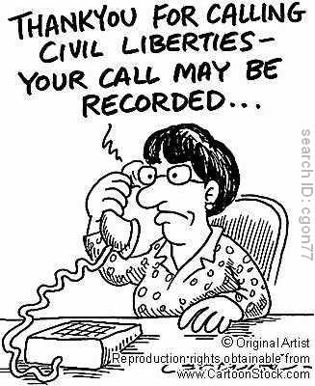
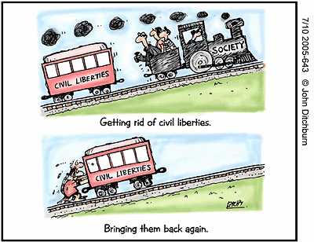
Civil Liberties
Civil liberties include freedom of speech, freedom of religion, and freedom of the press, as well as guarantees of a fair trial
Civil Rights
Civil rights sometimes reserved for those positive acts of government that seek to make constitutional guarantees a reality for all people (equality).

Slide 6
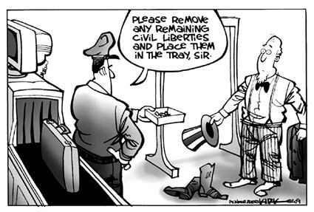
The Bill of Rights -- Then and Now
Civil liberties -- individual legal and constitutional protections against government
***** essential for democracy *****
Civil liberties set down in the Bill of Rights
Courts are arbiters of these liberties
First ten amendments (ratified in 1791) comprise Bill of Rights
Challenge -- people cherish rights until their own are usurped

Slide 7
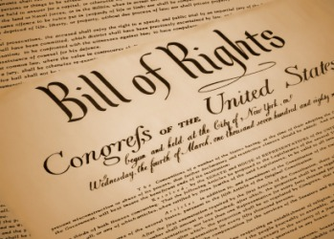
The Bill of Rights and the States
The scope of the Bill of Rights
In 1791, every state constitution included a bill of rights
First ten amendments were intended to restrict the new federal government, not the existing state governments
Note First Amendment begins with the words, “Congress shall make no law…”

Slide 8
The Bill of Rights and the States
The scope of the Bill of Rights
A Bill of Limits: the package was assembled by Madison, who collected nearly 200 suggestions
Originally, the B.O.R. included no explicit limits on state government powers

Slide 9
The Bill of Rights
Amendment | Rights Guaranteed
First | Speech, Press, Religion, Assembly, Petition
Second | Bear Arms
Third | No Quartering of Troops
Fourth | No Illegal Search & Seizure
Fifth | Eminent Domain, Remain Silent, Due Process, No Double Jeopardy
Sixth | Speedy/Public Trial, Jury Trial, Confront Witnesses, Lawyer
Seventh | Trial by jury in civil cases
Eighth | No excessive bail/fines, No cruel & unusual punishment
Ninth | Can’t deny rights not listed
Tenth | Powers not listed reserved for states

Slide 10
The Bill of Rights and the States
Barron v. Baltimore (1833)
John Marshall -- Bill of Rights “contains no expression indicating an intention to apply them to the state government. The court cannot so apply them.”
Supreme Court established a precedent that the freedoms guaranteed by the Bill of Rights did not restrict the state governments

Slide 11
The Bill of Rights and the States
The Bill of Rights was applicable only to the national government until the 14th Amendment incorporated some of these rights (through the S.C.)
Selective Incorporation: Through the Supreme Court, nearly all of the rights in the B.O.R. have been incorporated at the state level

Slide 12
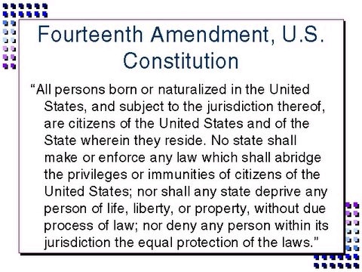

Slide 13
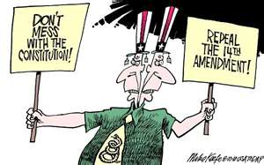
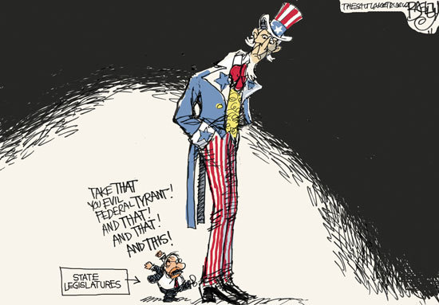
The Bill of Rights and the States
Fourteenth Amendment
Contains two keys clauses that have had a significant impact on Supreme Court decisions and U.S. politics:
Due Process Clause
Equal Protection Clause

Slide 14
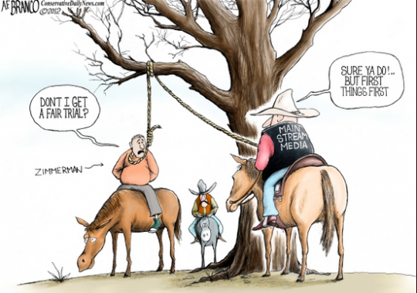
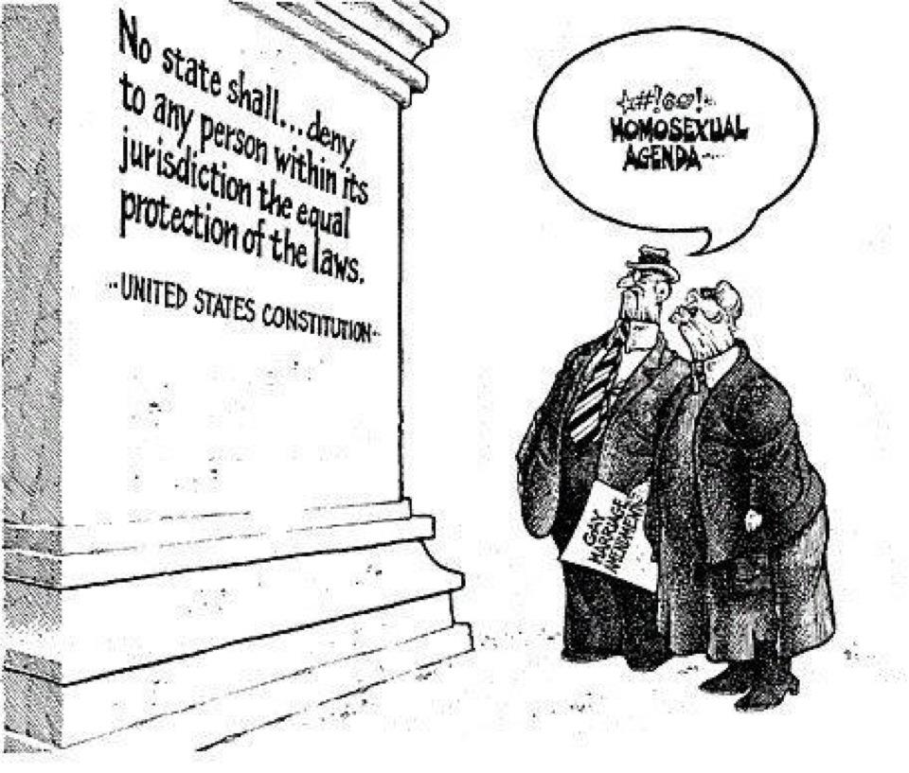
The Bill of Rights and the States
Fourteenth Amendment
Due Process Clause: Denies the government of the right, without due process, to deprive people of life, liberty and property.
Equal Protection Clause: Standard of equal treatment (equal protection of law) that must be observed by the government.

Slide 15
Selective Incorporation Chart
Year | Amendment | Rights Protected | Court Case to KNOW
1925 1931 1937 1940 1947 1989 | First | Speech Press Assembly Religion (Free Exercise) Religion (Est.) Expression | Gitlow v. New York Near v. Minnesota DeJonge v. Oregon Cantwell v. Connecticut Everson v. Bd of Ed Texas v. Johnson
2008 2010 | Second | Bear Arms Bear Arms | D.C. v. Heller McDonald v. Chicago
 | Third | Quartering of Troops | NOT INCORPORATED
1949 1961 | Fourth | No unreasonable search or seizure Exclusionary rule | Wolf v. Colorado Mapp v. Ohio
1897 1964 1969 | Fifth | Just compensation Self-incrimination Double jeopardy Grand jury indictment | Chicago B&O RR Co. v. Chicago Malloy v. Hogan Benton v. Maryland* NOT INCORPORATED
*Benton overruled Palko v. Connecticut

Slide 16
Selective Incorporation Chart
Year | Amendment | Right Protected | Court Case
1948 1963 1965 1966 1967 1967 1968 | Sixth | Public trial Right to Counsel Confront witnesses Impartial trial Speedy trial Compel witnesses Jury trial | In re Oliver Gideon v. Wainwright Pointer v. Texas Parker v. Gladden Klopfer v. NC Washington v. TX Duncan v. LA
 | Seventh | Right to trial by jury in civil cases | NOT INCORPORATED
1962 | Eighth | Freedom from cruel and unusual punishment Freedom from excessive fines and bail | Robinson v. CA NOT INCORPORATED
1965 | Ninth | Privacy (Not Specifically Mentioned) | Griswold v. Connecticut

Slide 17
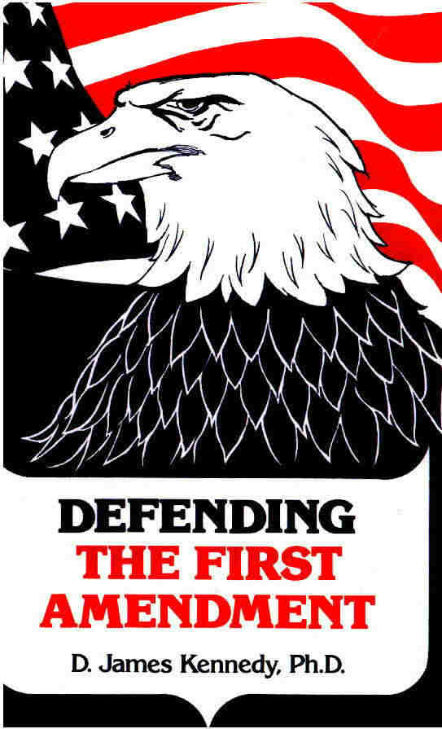
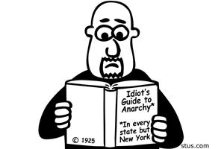
The Bill of Rights and the States
Gitlow v. New York (1925)
Court says freedoms of speech and press “were fundamental personal rights and liberties protected by the due process clause of the Fourteenth Amendment from impairment by the states”
Palko v. Connecticut (1937)
Supreme Court says that states must observe all “fundamental” liberties. This case will be overturned by Benton v. Maryland.
Notes:
Gitlow - Gitlow and Larkin were both Communist Party members and publishers of The Revolutionary Age, a radical newspaper in which they printed “The Left Wing Manifesto” (modeled on The Communist Manifesto by Karl Marx and Friedrich Engels), which advocated the violent overthrow of the U.S. government.
Palko - Frank Palko had been charged with first-degree murder. He was convicted instead of second-degree murder and sentenced to life imprisonment. The state of Connecticut appealed and won a new trial; this time the court found Palko guilty of first-degree murder and sentenced him to death. SC- Protection against double jeopardy is not a fundamental right and thus falls outside constitutional protection.

Slide 18
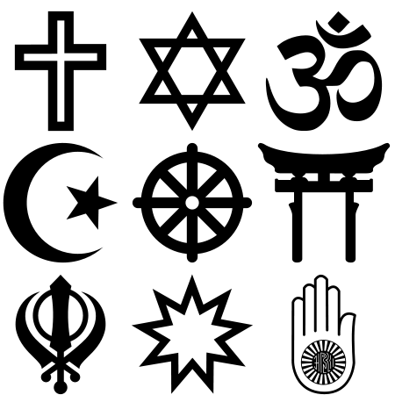
Freedom of Religion
The First Amendment
America’s religious liberties originated in colonial opposition to government-sponsored churches
1st Amendment contains two fundamental guarantees of religious freedom:
Establishment Clause prohibiting “an establishment of religion…”
Free Exercise Clause prohibits government from interfering with the practice of religion
Note: both these protections have been extended to the states by the Due Process Clause of the Fourteenth Amendment

Slide 19
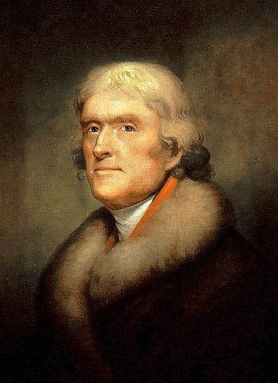
Freedom of Religion
Establishment clause
“Congress shall make no law respecting an establishment of religion.”
Clearly prohibits an establishment of a national church
What else was meant by this? TJ argued that 1st Amendment created a “wall of separation” between church and state, which would prohibit not only favoritism but any support for religion at all
"It does me no injury for my neighbor to say there are twenty gods, or no God. It neither picks my pocket nor breaks my leg.” -- TJ

Slide 20
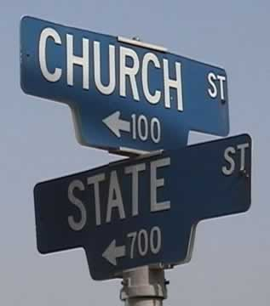
Freedom of Religion
Establishment clause
School prayer: Engel v. Vitale (1962)
Supreme Court ruled that state-sponsored prayer in public schools was an unconstitutional violation of the Establishment Clause that “breaks the constitutional wall of separation between Church and State.”
Notes:
Engel - The Board of Regents for the State of New York authorized a short, voluntary prayer for recitation at the start of each school day. This was an attempt to defuse the politically potent issue by taking it out of the hands of local communities. The blandest of invocations read as follows: "Almighty God, we acknowledge our dependence upon Thee, and beg Thy blessings upon us, our teachers, and our country.“ SC - Neither the prayer's nondenominational character nor its voluntary character saves it from unconstitutionality. By providing the prayer, New York officially approved religion.

Slide 21
Freedom of Religion
Establishment clause
Aid to parochial schools: Lemon v. Kurtzman (1971)
Supreme Court declared that aid to church-related schools must meet the following three tests:
The test (Lemon Test) --
Statute must have a secular purpose
Primary effect of the statute should not be to advance or inhibit religion
Statute must not excessively entangle government with religion
Notes:
Lemon - Both Pennsylvania and Rhode Island adopted statutes that provided for the state to pay for aspects of non-secular, non-public education. SC - unconstitutional under the religion clause of First Amendment for excessive entanglement of state and church.

Slide 22
Freedom of Religion
Free Exercise Clause
General Points
First Amendment’s Free Exercise Clause guarantees each person the right to believe what they want
Cantwell v. CT (1940), CT required a solicitation certificate for anyone (including religions) to hand out materials to determine if they were a real organization or not. The Cantwells were handing out pamphlets attacking organized religion and were charged with violating the law. SC said that the state had no right to try and “define” what was a legitimate religion and what was not.
Religion cannot make an act legal that would otherwise be illegal
Government can act when religious practices violate criminal laws, offend public morals, or threaten community safety
Example, in Oregon v. Smith (1990), SC banned the use of illegal drugs in religious ceremonies

Slide 23
Freedom of Religion
Free Exercise Clause
Limits on the Free Exercise Clause: Reynolds v. United States (1879)
Issue – Polygamy “duty to marry many women”
SC made an important distinction between religious beliefs and religious practices
Court cannot restrict what a person believes because that “lies solely between a man and his God.”
(However) society has a right to legislate against religious activities that violate a law of the land
SC rules against Reynolds, arguing that permitting polygamy would “make the professed doctrines of religious belief superior to the law of the land, and in effect to permit every citizen to become a maw unto himself.”
Notes:
Reynolds - George Reynolds, secretary to Mormon Church leader Brigham Young, challenged the federal anti-bigamy statute. Reynolds was convicted in a Utah territorial district court. His conviction was affirmed by the Utah territorial supreme court. SC - The First Amendment protected religious belief, but it did not protect religious practices that were judged to be criminal such as bigamy. Those who practice polygamy could no more be exempt from the law than those who may wish to practice human sacrifice as part of their religious belief.

Slide 24
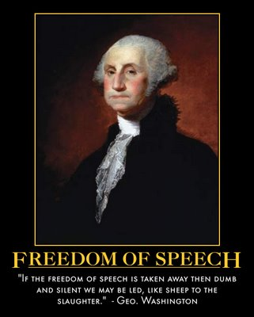
Freedom of Speech and Press
Does “no law” in the First Amendment
really mean “no law”?
Is freedom of expression absolute? -- Not always!
IMPORTANT -- Must find a balance between freedom of expression and competing values like public order, national security, and the right to a fair trial
What exactly is speech?
(like picketing) -- non verbal – symbolic speech?

Slide 25
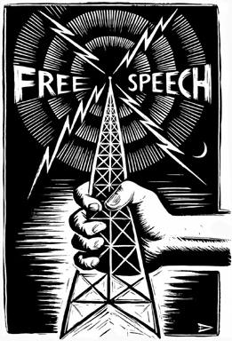
Freedom of Speech and Press
The Defense of Free Speech
The First Amendment
Framers believed right to free speech is a fundamental natural right
1st AM clearly states that, “Congress shall make no law… abridging the freedom of speech or of the press.”
First and Fourteenth Amendments protect free speech from incursions of both federal and state governments

Slide 26
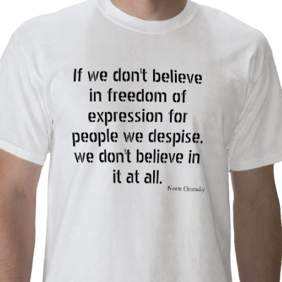
Freedom of Speech and Press
The Defense of Free Speech
Protections of unpopular views
Guarantees of free speech are intended to protect expressions of unpopular views
“The freedom to differ,” Justice Jackson wrote, “ is not limited to things that do not matter much.”
Even if a doctrine is “wrong,” it does not follow that it should be silenced
English philosopher John Stuart Mill argued that wrong or offensive ideas force us to sharpen our own views
IF we believed in free expression, we must believe in its power to overcome error in a fair debate

Slide 27
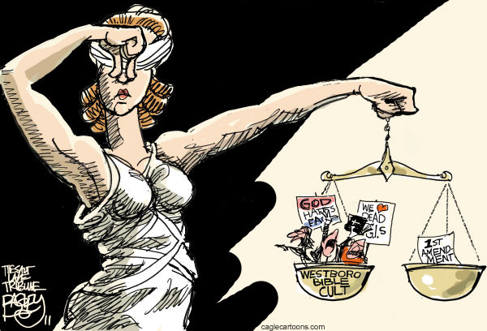

Slide 28
Freedom of Speech and Press
The “Clear and Present Danger” Test
Schenck v. United States (1919)
Espionage Act of 1917 prohibited forms of dissent deemed to be harmful to the nation’s war effort in World War 1
Charles Schenck opposed America’s participation in World War I so he mailed 15,000 leaflets to potential draftees comparing military conscription to slavery and urged his readers to “assert your rights” by resisting the military draft
Government responded by arresting Schenck for violating the Espionage Act
Schenck argued Espionage Act unconstitutional because it violated the 1st Amendment’s promises of free speech

Slide 29
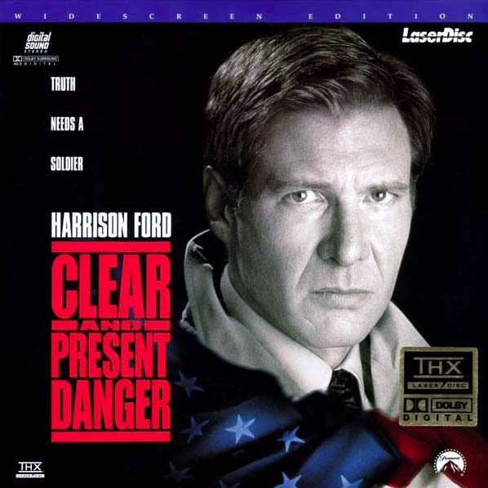
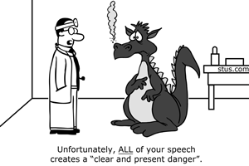
Freedom of Speech and Press
The “Clear and Present Danger” Test
Justice Oliver Wendell Holmes wrote, “[T]he character of every act depends on the circumstances in which it is done. The most stringent protection of free speech would not protect a man in falsely shouting fire in a theatre, and causing a panic… The question in every case is whether the words are used in such circumstances and are of such a nature as to create a clear and present danger that they will bring about substantive evils that Congress has the right to prevent.”

Slide 30
Freedom of Speech and Press
The “Clear and Present Danger” Test
Clear and present danger test created a precedent that First Amendment guarantees of free speech are not absolute
Smith Act of 1940 forbade advocacy of violent overthrow of American government
Free speech advocates did little to stem the relentless persecution known as McCarthyism during the “cold war” of the 1950s, when Senator Joseph McCarthy’s unproven accusations that many public officials were Communists created an atmosphere in which broad restrictions were placed on freedom of expression

Slide 31
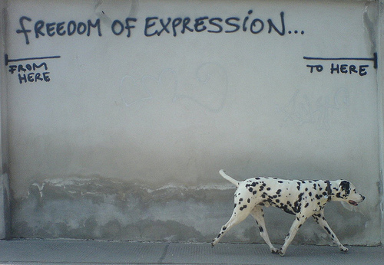
Freedom of Speech and Press
The “Clear and Present Danger” Test
1960s, political climate changed Court narrowed interpretation of Smith Act so that government could no longer use it to prosecute dissenters Brandenburg v. Ohio (1969)
SC limited the clear and present danger test by ruling that the government could punish the advocacy of illegal action only if “such advocacy is directed to inciting or producing imminent lawless action and is likely to incite or produce such action.”
Notes:
Brandenburg - Brandenburg, a leader in the Ku Klux Klan, made a speech at a Klan rally and was later convicted under an Ohio criminal syndicalism law. The law made illegal advocating "crime, sabotage, violence, or unlawful methods of terrorism as a means of accomplishing industrial or political reform," as well as assembling "with any society, group, or assemblage of persons formed to teach or advocate the doctrines of criminal syndicalism.“ SC - The Court used a two-pronged test to evaluate speech acts: (1) speech can be prohibited if it is "directed at inciting or producing imminent lawless action" and (2) it is "likely to incite or produce such action." The criminal syndicalism act made illegal the advocacy and teaching of doctrines while ignoring whether or not that advocacy and teaching would actually incite imminent lawless action. The failure to make this distinction rendered the law overly broad and in violation of the Constitution.

Slide 32
Freedom of Speech and Press
Limits on Free Speech
Libel and Slander
libel -- publication of statements known to be false that tend to damage a person’s reputation
slander -- spoken defamation
Not protected by the First Amendment!
Libel / slander involve freedom of expression issues that involve competing values
If public debate is not free, no democracy
Conversely, some reputations may be unfairly damaged in process

Slide 33
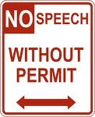
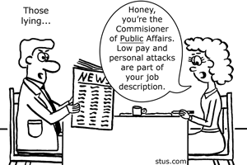
Freedom of Speech and Press
Limits on Free Speech
Libel and Slander
Court says statements about public figures are libelous only if made with malice and reckless disregard for the truth
New York Times v. Sullivan (1964), SC ruled statements about public figures are libelous only when both false and purposely malicious
Private persons only need to show that statements about them were defamatory falsehoods and that the author was negligent

Slide 34
Freedom of Speech and Press
Limits on Free Speech
Obscenity
Public standards vary from time to time, place to place, and person to person
Work that some call “obscene” may be “art” to others
No nationwide consensus exists that offensive material should be banned

Slide 35
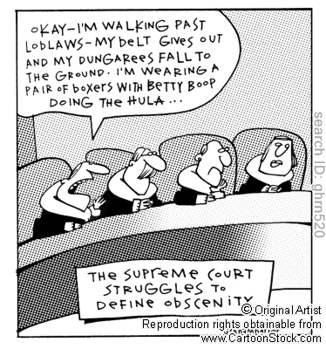
Freedom of Speech and Press
Limits on Free Speech
Obscenity
Roth v. United States (1957), Supreme Court ruled that “obscenity is not within the area of constitutionally protected speech or press.”
Problem –
What is obscene???
Notes:
Roth - Roth operated a book-selling business in New York and was convicted of mailing obscene circulars and an obscene book in violation of a federal obscenity statute. Roth's case was combined with Alberts v. California, in which a California obscenity law was challenged by Alberts after his similar conviction for selling lewd and obscene books in addition to composing and publishing obscene advertisements for his products. SC - The Court noted that the First Amendment was not intended to protect every utterance or form of expression, such as materials that were "utterly without redeeming social importance."

Slide 36
Freedom of Speech and Press
Limits on Free Speech
Obscenity
Miller v. California (1973)
Court tried to clarify what could be classified as obscene
Chief Justice Warren Burger wrote that materials were obscene if the work, taken as a whole, appealed to a “prurient interest” in sex; and if it showed “patently offensive sexual contact”; and if it “lacked serious artistic, literary, political, or scientific merit.”
Miller, Court ruled decisions should be made to reflect standards of local (not national) communities
Notes:
Miller - Miller, after conducting a mass mailing campaign to advertise the sale of "adult" material, was convicted of violating a California statute prohibiting the distribution of obscene material. Some unwilling recipients of Miller's brochures complained to the police, initiating the legal proceedings. SC - The Court modified the test for obscenity established in Roth v. United States and Memoirs v. Massachusetts, holding that "[t]he basic guidelines for the trier of fact must be: (a) whether 'the average person, applying contemporary community standards' would find that the work, taken as a whole, appeals to the prurient interest. . . (b) whether the work depicts or describes, in a patently offensive way, sexual conduct specifically defined by the applicable state law; and (c) whether the work, taken as a whole, lacks serious literary, artistic, political, or scientific value."

Slide 37
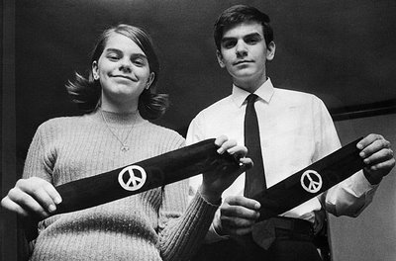
Freedom of Speech and Press
Limits on Free Speech
Symbolic speech
Symbolic speech includes forms of nonverbal communication such as carrying signs, wearing armbands, or burning flags
Tinker v. Des Moines Independent School District (1969)
Free expression case
Justice Abe Fortas states that students and teachers do not “shed their constitutional right to freedom of speech or expression at the school house gate.”
Notes:
Tinker – Students decided to wear black armbands throughout the holiday season and to fast on December 16 and New Year's Eve. The principals of the Des Moines school learned of the plan and met on December 14 to create a policy that stated that any student wearing an armband would be asked to remove it, with refusal to do so resulting in suspension. SC - In order to justify the suppression of speech, the school officials must be able to prove that the conduct in question would "materially and substantially interfere" with the operation of the school. In this case, the school district's actions evidently stemmed from a fear of possible disruption rather than any actual interference.

Slide 38
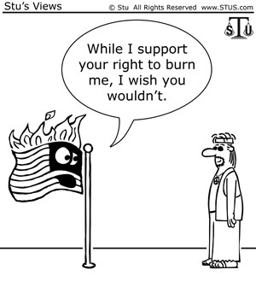
Freedom of Speech and Press
Limits on Free Speech
Symbolic speech
Texas v. Johnson (1989), SC ruled that flag burning is a form of symbolic speech protected by 1st Am.
Note SC has ruled 1st Amendment does not protect symbolic speech intended to incite illegal actions
Example, states may make it a crime to burn a cross with the intent to threaten racial terror
Notes:
Texas - In 1984, in front of the Dallas City Hall, Gregory Lee Johnson burned an American flag as a means of protest against Reagan administration policies. Johnson was tried and convicted under a Texas law outlawing flag desecration. SC - The Court found that Johnson's actions fell into the category of expressive conduct and had a distinctively political nature. The fact that an audience takes offense to certain ideas or expression, the Court found, does not justify prohibitions of speech. The Court also held that state officials did not have the authority to designate symbols to be used to communicate only limited sets of messages, noting that "[i]f there is a bedrock principle underlying the First Amendment, it is that the Government may not prohibit the expression of an idea simply because society finds the idea itself offensive or disagreeable."

Slide 39
Freedom of Speech and Press
Free press versus free trial
Bill of Rights is a source of potential conflicts between different types of freedoms
Constitution clearly meant to guarantee the right to a fair trial as well as the right to a free press
Problem:
Trial may not be fair if pretrial press coverage makes it impossible to select an impartial jury

Slide 40
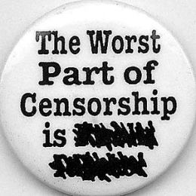
Freedom of Speech and Press
Prior Restraint
Attempt to limit freedom of press by preventing material from being published
Prior restraint is thus a form of censorship
Supreme Court has repeatedly ruled that prior restraint is a violation 1st Amendment protection of freedom of press
Important test cases have included Near v. Minnesota (1931) and New York Times Company v. United States (1971)
Near v. MN - A Minnesota law that imposed permanent injunctions against the publication of newspapers with "malicious, scandalous, and defamatory" content violated the First Amendment.

Slide 41
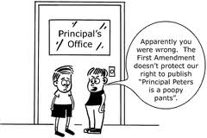
Freedom of Speech and Press
Prior Restraint
Hazelwood School District v. Kuhlmeier (1988)
Supreme Court ruled school administrators can exercise “editorial control over the style and content of student speech in school-sponsored expressive activities so long as their actions are reasonably related to legitimate pedagogical concerns.”
Notes:
Hazelwood - The Spectrum, the school-sponsored newspaper of Hazelwood East High School, was written and edited by students. In May 1983, Robert E. Reynolds, the school principal, received the pages proofs for the May 13 issue. Reynolds found two of the articles in the issue to be inappropriate, and ordered that the pages on which the articles appeared be withheld from publication. SC - The Court held that schools must be able to set high standards for student speech disseminated under their auspices, and that schools retained the right to refuse to sponsor speech that was "inconsistent with 'the shared values of a civilized social order.'"

Slide 42
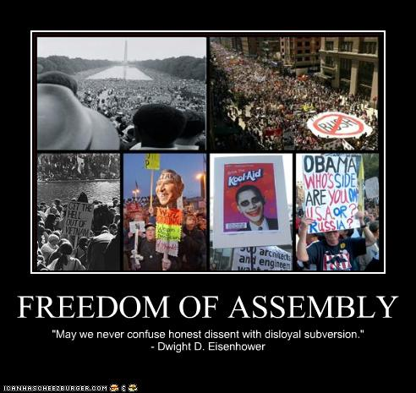
Freedom of Assembly
Freedom of assembly
Constitutional basis for forming interest groups / political parties, for picketing and protesting in groups
Two facets of freedom of assembly
Right to assemble
Right to associate

Slide 43
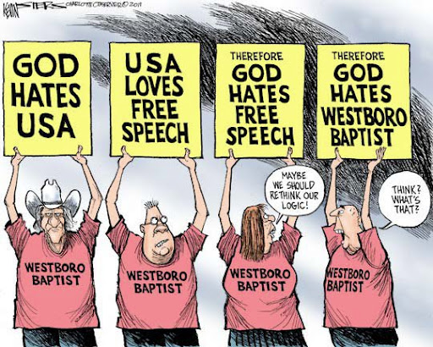
Freedom of Assembly
Right to assemble
Right to gather together in order to make a statement within reasonable limits
Called time, place, and manner restrictions
Includes rights to parade, picket, protest
Supreme Court has generally upheld the right of any group -- no matter how controversial or offensive – to peaceably assemble on public property
Balance between freedom and order
When does protest verge on harassment?
Westboro Baptist Church

Slide 44
Freedom of Assembly
Right to associate
Freedom to associate with people who share a common interest
Includes right to meet with people who want to create political change
DeJonge v. Oregon (1937) - Even though the Communist Party generally advocated violent revolution, the First Amendment bars a prosecution for attending a peaceful public meeting called by that Party.
NAACP v. Alabama (1958) - Court found Alabama’s attempt to require NAACP to turn over its membership list to be an unconstitutional restriction of freedom of association

Slide 45
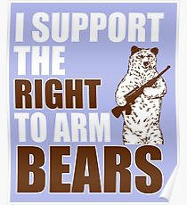
Right to Keep and Bear Arms
Right to Bear Arms
DC v. Heller (2008) - The Second Amendment guarantees an individual's right to possess a firearm unconnected with service in a militia, and to use that arm for traditionally lawful purposes, such as self-defense within the home in a federal enclave.
McDonald v. Chicago (2010) - The Second Amendment right to keep and bear arms for self defense in one's home is fully applicable to the states through the Fourteenth Amendment.

Slide 46
Rights of the Accused
Interpreting defendants’ rights
First Amendment guarantees freedoms of religion, speech, press, assembly
Most of remaining rights in the Bill of Rights concern rights of people accused of crimes
Rights were originally intended to protect accused in political arrests and trials
Today -- protections in Fourth, Fifth, Sixth, Eighth Amendments are primarily applied in criminal justice cases
Language of the B of R vague, defendants’ rights are not well defined
Incorporation -- these rights at state level as well

Slide 47
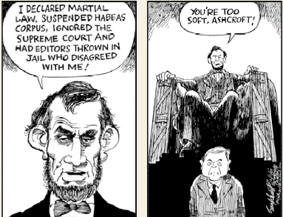
Rights of the Accused
Rights in the original Constitution
Constitution expressly states, “The Privilege of the Writ of Habeas Corpus shall not be suspended, unless when in cases of Rebellion or Invasion the public safety may require it.”
Writ of habeas corpus is a court order directing that a prisoner be brought before a court and that court officers show cause why the prisoner should not be released
Writ of habeas corpus thus prevents unjust arrests and imprisonments

Slide 48
Rights of the Accused
Rights in the original Constitution
Bills of Attainder
Constitution prohibits Congress and the state legislatures from passing a bill of attainder
Legislative act that provides for the punishment of a person without a court trial
Ex post facto laws
Constitution prohibits Congress and the state legislatures from enacting ex post facto laws
Ex post facto law is a law applied to an act committed before the law was enacted

Slide 49
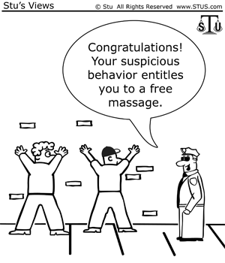
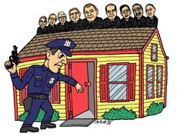
Rights of the Accused
Search and Seizures
4th Amendment declares, “The right of the people to be secure in their persons, houses, papers, and effects, against unreasonable searches and seizures, shall not be violated….”

Slide 50
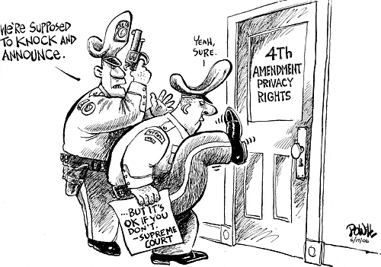
Rights of the Accused
The exclusionary rule
Exclusionary rule prohibits evidence obtained by illegal searches or seizures from being admitted in court
Supreme Court first established the exclusionary rule in Weeks v. United States (1914)
Mapp v. Ohio (1961)
Case illustrates process of incorporation by which the Fourth Amendment was applied to the states through the Due Process Clause of the Fourteenth Amendment.
This case further established the exclusionary rule.
Notes:
Weeks - Police entered the home of Fremont Weeks and seized papers which were used to convict him of transporting lottery tickets through the mail. This was done without a search warrant. Weeks took action against the police and petitioned for the return of his private possessions. SC - The Court also held that the government's refusal to return Weeks' possessions violated the Fourth Amendment. To allow private documents to be seized and then held as evidence against citizens would have meant that the protection of the Fourth Amendment declaring the right to be secure against such searches and seizures would be of no value whatsoever. This was the first application of what eventually became known as the "exclusionary rule.“
Mapp - Dollree Mapp was convicted of possessing obscene materials after an admittedly illegal police search of her home for a fugitive. She appealed her conviction on the basis of freedom of expression. SC - The Court brushed aside the First Amendment issue and declared that "all evidence obtained by searches and seizures in violation of the Constitution is, by [the Fourth Amendment], inadmissible in a state court." Mapp had been convicted on the basis of illegally obtained evidence. This was an historic -- and controversial -- decision. It placed the requirement of excluding illegally obtained evidence from court at all levels of the government.

Slide 51
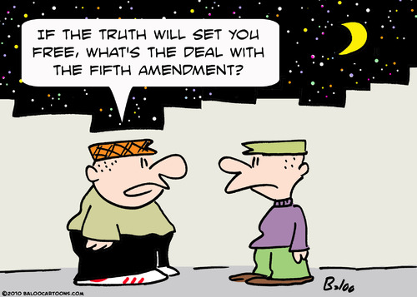
Rights of the Accused
The Miranda Rule
The Fifth Amendment
Forbids forced self-incrimination, stating that no person “shall be compelled to be a witness against himself.”
Suspects cannot be compelled to provide evidence that can be used against them
Malloy v. Hogan (1964) - deemed defendants' Fifth Amendment privilege not to be compelled to be witnesses against themselves was applicable within state courts as well as federal courts
Burden of proof rests on police and prosecutors, not the defendant
Right applies to congressional hearings and police stations, as well as to courtrooms

Slide 52
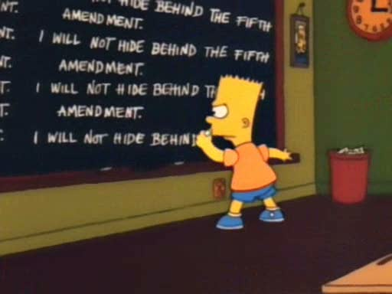

Slide 53
Rights of the Accused
Miranda v. Arizona (1966)
Expanded Malloy v. Hogan
Set guidelines for police questioning of suspects
Suspects must be informed of their constitutional right to remain silent
Suspects must be warned that what they say can be used against them in a court of law
Suspects must be told that they have a right to have a lawyer present during
Questioning, and that a lawyer will be provided if the accused cannot afford one
"You have the right to remain silent. Anything you say can and will be used against you in a court of law. You have the right to have an attorney present during questioning. If you cannot afford an attorney, one will be appointed for you. Do you understand these rights? "

Slide 54
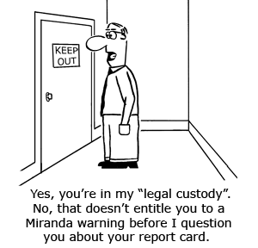
Rights of the Accused
Arizona v. Fulminante (1991)
Court held that a coerced confession is “harmless error” if other evidence is sufficient for conviction
If law enforcement officials encourage persons to commit crimes (such as accepting bribes or purchasing illicit drugs) that they otherwise would not commit, convictions for these crimes will be overturned by the courts
Notes:
Fulminante - Arizona law officials suspected that Oreste Fulminante murdered his stepdaughter. He was later arrested in New York for an unrelated crime after the murder and incarcerated. While in prison he became friends with Anthony Sarivola, an inmate paid by the Federal Bureau of Investigation to collect information on other inmates while he served his term. Fulminante initially denied killing his stepdaughter to Sarivola, but admitted it when Sarivola offered him protection from other inmates in exchange for the truth. After his release, Fulminante also confessed to Donna Sarivola, Anthony's wife. SC - The Court held that Fulminante was coerced to confess in violation of the Fifth and Fourteenth Amendments. The Court found that "it was fear of physical violence, absent protection from his friend Sarivola, which motivated Fulminante to confess." This motivation invalidated his confession. Since Fulminante's confession to Donna Sarivola was closely tied to his first coerced confession, the Court dismissed both.

Slide 55
Rights of the Accused
6th Amendment –
Right to Public Trial, Confront Witnesses, Impartial Trial by Jury, Speedy Trial, Compel Witnesses
In re Oliver (1948) – SC ruled that states must allow for a public trial.
Pointer v. Texas (1965) – SC ruled that defendant’s have the right to confront witnesses in court.
Parker v. Gladden (1966) – “the accused shall enjoy the right to a…trial, by an impartial jury”
Duncan v. Louisiana (1968) - requires states to honor requests for jury trials.
The Court maintained the common-law exception for "petty crimes," which are defined as those punishable by a maximum of a $500 fine and six months in prison. In such cases, states are not obligated to provide jury trials.

Slide 56
Rights of the Accused
6th Amendment –
Right to Public Trial, Confront Witnesses, Impartial Trial by Jury, Speedy Trial, Compel Witnesses
Klopfer v. North Carolina (1967) – SC ruled that states must provide a speedy trial. The prosecutor had employed a tactic that allowed for him to prosecute at any time in the future.
Washington v. Texas (1967) – SC ruled that defendant’s have the right to subpoena witnesses to testify for the defendant in court.
Warren wrote that it was critical to the ability to "present a defense ... [a] defendant's version of the facts".
This ruling was later narrowed in Taylor v. Illinois so that defendant’s must prove that the witness is material to the case.

Slide 57
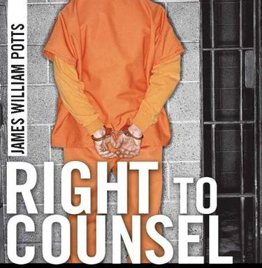
Rights of the Accused
The Right to Counsel
6th Amendment states, “The accused shall enjoy the right… to have the assistance of counsel for his defense.”
Note when Sixth Amendment was ratified,
that right did not apply to
people tried in states courts

Slide 58
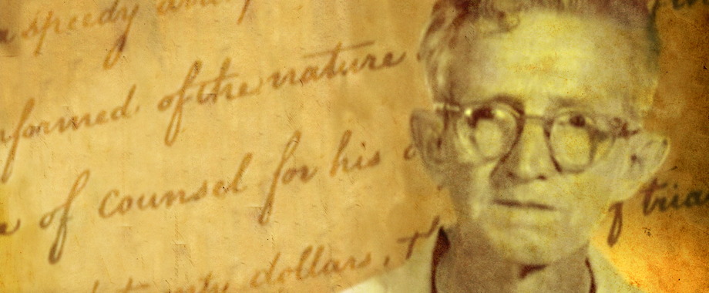
Rights of the Accused
The Right to Counsel
Gideon v. Wainwright (1963)
Gideon was accused of breaking and entering a Florida poolroom and stealing a small amount of money
Judge refused Gideon’s request for a court-appointed free lawyer
Gideon appealed his conviction, arguing that by refusing to appoint a lawyer to help him, the Florida court violated his rights promised by the Sixth and Fourteenth Amendments
Unanimous decision, the Supreme Court ruled that to those accused of major crimes under state laws
This landmark case illustrates the process of incorporation, by which the Sixth Amendment was applied to the states through the Due Process Clause of the Fourteenth Amendment.

Slide 59
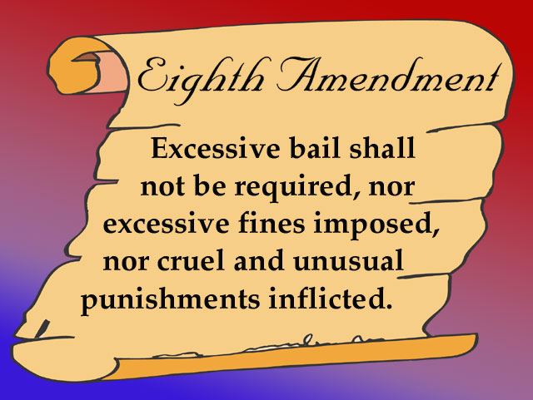
Rights of the Accused

Slide 60
Rights of the Accused
Eighth Amendment -- forbids cruel and unusual punishment
Robinson v. California (1962) - Punishing a person for a medical condition is a violation of the Eighth Amendment ban on cruel and unusual punishment.
Furman v. Georgia (1972) - Court ordered for consistency in the application of the death penalty.
Justice Brennan wrote, "There are, then, four principles by which we may determine whether a particular punishment is 'cruel and unusual'.“
The "essential predicate" is "that a punishment must not by its severity be degrading to human dignity," especially torture.
"A severe punishment that is obviously inflicted in wholly arbitrary fashion.“
"A severe punishment that is clearly and totally rejected throughout society.“
"A severe punishment that is patently unnecessary."

Slide 61
Rights of the Accused
Eighth Amendment -- forbids cruel and unusual punishment
What does that mean???
Most constitutional debate over cruel and unusual has centered on death penalty
Gregg v. Georgia (1976)
Found death penalty is “an extreme sanction, suitable to the most extreme of crimes”
Court has recently held constitutionally unacceptable to execute 16- or 17-year-olds or mentally challenged persons
Death sentences in steep decline today due to DNA testing and public concerns over wrongful sentences

Slide 62
The Rights to Privacy
The Right to Privacy
Justice Louis D, Brandeis defined privacy as “the right to be left alone.”
Bill of Rights doesn’t specifically grant Americans a right to privacy
(However) following constitutional provisions imply a right to privacy:
1st AM’s guarantee of freedom of religion
3rd AM’s prohibition against the government forcing citizens to quarter soldiers in their homes
4th AM’s protection against unreasonable searches and seizures
5th AM’s rule that private property cannot be seized without “due process of law.”

Slide 63
The Rights to Privacy
Griswold v. Connecticut (1965)
Estelle Griswold challenged constitutionality of an 1879 Connecticut law that prohibited the use of “any drug, medicinal article or instrument for the purpose of preventing conception.”
Supreme Court ruled the Connecticut law criminalizing the use of contraceptives violated the right to marital privacy
Justice William O. Douglas argued that the right to privacy was found in the unstated liberties implied by the explicitly stated state rights in the Bill of Rights or “penumbras”
Penumbras -- unstated liberties implied by explicitly stated rights

Slide 64
The Rights to Privacy and
Abortion Rights
Right to privacy established in Griswold v. Connecticut set an important precedent for
Roe v. Wade
Roe v. Wade (1973)
Jane Roe (A pseudonym for Norma McCorvey) challenged constitutionality of a Texas law allowing abortions only to save the life of the mother
Roe argued that the decision to obtain an abortion should be protected by the right to privacy implied in the Bill of Rights
The Supreme Court struck down the Texas law by a vote of 7 to 2

Slide 65
The Rights to Privacy and
Abortion Rights
Challenges to Roe
Webster v. Reproductive Health Services (1989)
Supreme Court upheld a Missouri law prohibiting abortion (except those preserving the mother’s health) in any publicly operated hospital or clinic in Missouri
Planned Parenthood of Southeastern Pennsylvania v. Casey (1992)
Supreme Court ruled that a state may place reasonable limits that do not place an “undue burden” on a woman’s right to have an abortion
Example, a state may impose a 24-hour waiting period and require parental consent for minors

Slide 66
Other Rights to Privacy
Bowers v. Hardwick (1986)
Supreme Court upheld a Georgia law classifying homosexual sex as illegal sodomy because there was no constitutionally protected right to engage in homosexual sex.
Lawrence v. Texas (2003)
Supreme Court ruled that a Texas law classifying consensual, adult homosexual intercourse as illegal sodomy violated the privacy and liberty of adults to engage in private intimate conduct.
Overturned the Bowers decision

Slide 67
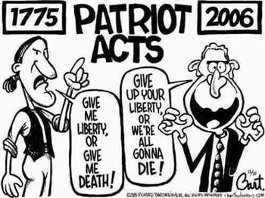
Privacy Post 9/11
More security
We tend to relinquish rights in the name of security.
USA Patriot Act/USA Freedom Act
Allows government officials to secretly search a suspected terrorist house with special warrant
Allows government to monitor internet, phone conversation, banking, and book purchases with special warrant
Allows government to open mail with special warrant
FBI must present evidence why warrant is necessary, but judge has no authority to reject warrant
Individuals targeted by these investigations are forbidden to discuss investigation, including the facts of its existence, with anyone

Slide 68
Privacy Post 9/11
Terrorism and Civil Liberties
Congress has tried to relax the “exclusionary rule.”
Dickerson v. United States (2000): The Mapp decision is based on the Constitution and cannot be altered by Congress.
However, the SC has relaxed it in some ways:
“Good faith” exception: If police made a minor error in gathering evidence, it may still be allowed.
United States v. Leon (1984)
Inevitable Discovery: The police can use evidence if it would have been discovered anyway.
Notes:
Dickerson - During questioning about a robbery he was connected to, Charles Dickerson made statements to authorities admitting that he was the getaway driver in a series of bank robberies. Dickerson was then placed under arrest. The timing of his statement is disputed. The FBI and local detectives testified that Dickerson was advised of his Miranda rights, established in Miranda v. Arizona, and waived them before he made his statement. Dickerson said he was not read his Miranda warnings until after he gave his statement. SC - Court held that Miranda governs the admissibility of statements made during custodial interrogation in both state and federal courts. "Miranda has become embedded in routine police practice to the point where the warnings have become part of our national culture," wrote Rehnquist. "Miranda announced a constitutional rule that Congress may not supersede legislatively. We decline to overrule Miranda.
Leon - The police applied to a judge for a search warrant of Leon's home based on the evidence from their surveillance. A judge issued the warrant and the police recovered large quantities of illegal drugs. Leon was indicted for violating federal drug laws. A judge concluded that the affidavit for the search warrant was insufficient; it did not establish the probable cause necessary to issue the warrant. SC - The justices held that evidence seized on the basis of a mistakenly issued search warrant could be introduced at trial. The exclusionary rule, argued the majority, is not a right but a remedy justified by its ability to deter illegal police conduct.

Slide 69
Criminal Rights Post-9/11
Terrorism and Civil Liberties
Relaxing of “Miranda”:
Public Safety Exception: Police can question an un-Mirandized suspect if there is an urgent concern for public safety.
This was used with the Boston Marathon bomber.
After 9/11, the President tried to hold people indefinitely that had been captured and accused of terrorism
Rasul v. Bush and Hamdi v. Rumsfeld (2004): Terrorist detainees must have access to a neutral court to decide if they are legally held.

Slide 70
Understanding Civil Liberties
American government:
Democratic (because it is governed by officials elected by the people and answerable to them)
and
Constitutional (because it has a fundamental organic law, the Constitution, that limits the things government can do)
Democratic and constitutional components of government can produce conflicts, but they also reinforce one another

Slide 71
Understanding Civil Liberties
Civil liberties and democracy
Individual rights may conflict with other values
Rights guaranteed by the First Amendment are essential to a democracy
Individual participation and the expression of ideas are crucial components of democracy
However
So is majority rule, which can conflict with individual rights
Rights guaranteed by Fourth, Fifth, Sixth, and Eighth Amendments protect all Americans
but
They also make it harder to punish criminals

Slide 72
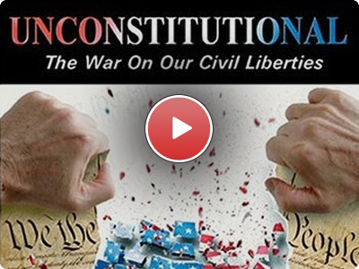
Understanding Civil Liberties
Civil liberties and democracy
Ultimately, the courts decide what constitutional guarantees mean in practice:
Federal courts are the branch of government least subject to majority rule
Courts enhance democracy by protecting liberty and equality from the excesses of majority rule

Slide 73
Understanding Civil Liberties
Civil liberties and the scope of government
Today’s government is huge and commands vast, powerful technologies
Since Americans can no longer avoid the attention of government, strict limitations on governmental power are essential -- limitations that are provided by the Bill of Rights
(Freedom v. Order dilemma)
In general, civil liberties limit the scope of government

