Slide 1
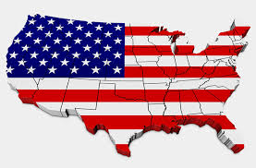
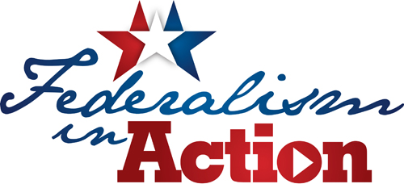
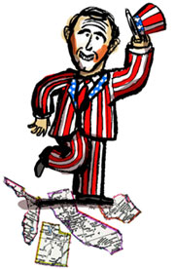
Federalism
Objectives:
Discuss the origins of federalism and how it has evolved
Summarize the pros and cons of federalism
Describe how funding underlies federal-state interactions
Describe devolution and whether this is revolutionizing the concept of federalism.

Slide 2
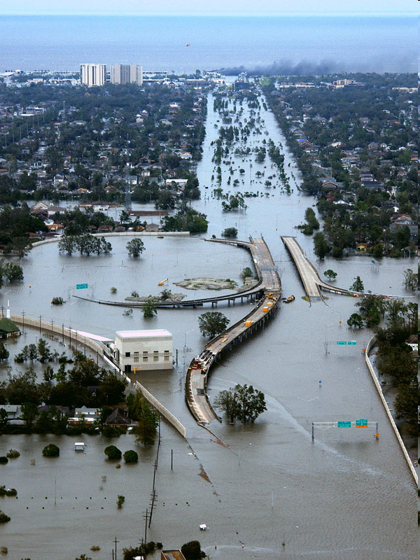
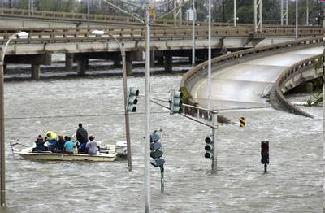
Disaster Relief
Whose job was it to clean up New Orleans and the rest of the coast after Katrina?

Slide 3
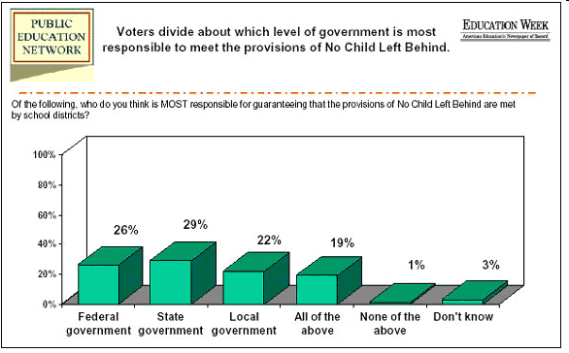
No Child Left Behind
Should the national gov’t step in to regulate school performance?

Slide 4
Why Federalism Matters
Federalism is behind many things that matter to many people:
Tax rates
Speed limits
Liquor laws
School funding
Health insurance
Voting rights

Slide 5
What is Federalism?
Federalism – Two or more governments exercise power and authority over the same people in the same territory
OR… the relationship between the federal government and the state governments

Slide 6
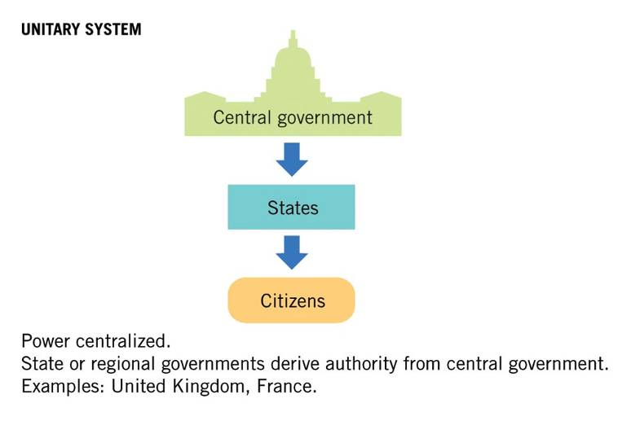
Unitary System

Slide 7
Confederal System

Slide 8
Federal System

Slide 9
Why Federalism?
Federalist #51
Defends the Constitution
Explains why a strong gov’t is necessary
“If men were angels, no government would be necessary. If angels were to govern men, neither external nor internal controls on government would be necessary.”
Defends separation of powers between state and national gov’t

Slide 10
Why Federalism?
The authors of the Constitution wanted to combine a strong central government while allowing states to retain power too!
‘Have their cake and eat it too’
The large geographical size of a country → need to provide people an access point to government officials
State governments have served as training grounds for national politicians and as laboratories of experiment in which new ideas can be tested.
Justice Louis D. Brandeis wrote in 1932, “…that a single courageous state may, if its citizens choose, serve as a laboratory; and try novel social and economic experiments without risk to the rest of the country."

Slide 11
Pros & Cons of Federalism
Pros:
- Ideal for a large geographic area b/c it encourages diversity in local govt.
- Avoids concentration of political power
- Accommodated already existing state govts.
- States are training grounds
- Keeps govt. close to people
Cons:
Complex, with many layers of government to deal with
Duplication of offices and functions
Conflicts of authority may arise

Slide 12
Reviewing the Powers of Government
Expressed, Implied, Inherent = National Powers
Reserved = State Powers
Concurrent = National & State Powers
Prohibited/Denied Powers = Powers for No One!

Slide 13
The Struggle for Power
Constitutional Text that Promotes the Power of the National Government:
“Necessary & Proper Clause” aka the “Elastic Clause”
- “Supremacy Clause”
- “Interstate Commerce Clause”
Constitutional Text that Promotes the Power of State Governments:
- 10th Amendment
- 9th Amendment (sort of)

Slide 14
Powers of State Governments
According to the Tenth Amendment, all powers that were not delegated to the national government belong to the states
In theory states still retain all powers not delegated to the national government, but in reality the national government has expanded the scope of its power over the last 80 years
Police power: the authority to legislate for the protection of the health, safety, and welfare of the people
In the US, most police power is reserved to the states

Slide 15
Powers of the National Government
Enumerated/Expressed Powers– specific national govt. powers (Article 1, Section 8)
Implied Powers —allow the national government to make decisions that fall outside the expressed powers
The “Necessary and Proper Clause”
The “Commerce Clause”
Inherent Powers —powers that are ‘innate’ in all national governments
defend borders, acquire territory

Slide 16
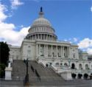
The Federal Government can’t…
Create a public school system
Create uniform marriage and divorce laws
Set up local government
Tax states

Slide 17
Feds are expected to…
Protect the states from invasion
Help with disasters (like a hurricane)
Respect state territory
Admit new states
Recognize state sovereignty – in other words, the federal government has to allow the states to exist!!!

Slide 18
The States can’t…
Make treaties or tax the federal government
The 10th Amendment says states have certain rights but it also denies them certain things
The Constitution does not expressly grant the states any power except in the 21st Amendment which is…???

Slide 19
State vs. State
Funny, they don’t all get along…
Sunbelt vs Frostbelt
How does the state spend the $$$
Population – the big boys get more $$$

Slide 20
Power Sources in States
The Big 7
Mayors
Governors
Counties
Cities
State governments
City/county managers
State legislatures
All trying to get more $ with less strings

Slide 21
How the Necessary and Proper Clause Works…
Article 1, Section 8 Power
Necessary & Proper Clause (Article 1, Section 8)
Legitimacy for Expanded National Government Power
In order for the government to create a policy, there must be a Constitutional basis!

Slide 22
Example of Using Necessary & Proper Clause
National Health Care
Necessary & Proper Clause (Article 1, Section 8)
Legitimacy for Expanded National Government Power
What enumerated power in the Constitution would justify the national government mandating all Americans have health insurance? (multiple answers possible)

Slide 23
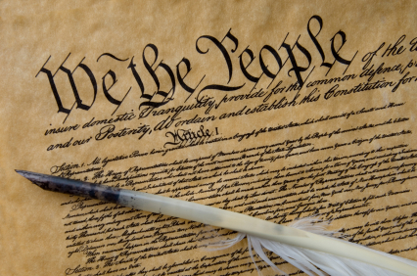
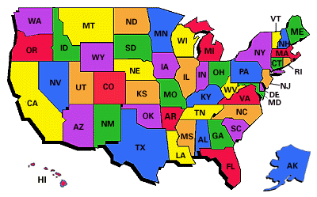
Supremacy Clause
Article VI of the Constitution mandates that actions by the national government are SUPREME
If a conflict exists between an action of the national government and a state govt.→ the national government wins!

Slide 24
Interstate Relations
Article IV of the Constitution attempts to resolve potential problems between states by stipulating the following:
Full Faith & Credit Clause—states must honor legal actions of other states:
Marriage & Driver’s licenses
Interstate extradition – commit a crime in one state and try to flee – you’ll be sent back.

Slide 25
Commerce Clause
Art. I, Sec. 8, Cl. 3 – ‘The Congress shall have power - To regulate commerce with foreign nations, and among the several states, and with the Indian tribes.”
Congress has used this elastic clause to stretch this power
What is commerce? “Buying and selling of goods and services.”
Congress given the power to regulate commerce between foreign countries and US as well as state to state… they control business law.

Slide 26
McCulloch v. Maryland (1819)
Background
Bank of the US operated in Maryland
Maryland did not want BoUS to operate in state, competition unwanted, unfair
Maryland taxed the bank to put it out of business
McCulloch, BoUS employee, refused to pay the state tax
Is a Bank of the US Constitutional?
YES. The national gov’t has certain implied powers that go beyond delegated powers. US needs a national bank for borrowing, lending, holding minted money, etc. All of which are delegated powers.

Slide 27
McCulloch v. Maryland (1819)
Can a state tax the federal gov’t?
NO. The federal gov’t is supreme. Since the BoUS is constitutional, only the feds may tax it.
John Marshall reaffirmed Supremacy Clause and Elastic Clause
National (Federal) Govt gets STRONGER

Slide 28
Gibbons v. Ogden (1824)
Background:
1824 – aka “The Steamboat Case”
Ogden received a state licensed monopoly to run a ferry across the Hudson River
Gibbons also saw the potential of the traffic between NJ and NY and obtained a federal license.
Ogden sued saying he had the valid state license, even though Gibbons had US license
Result – Gibbons wins
Expanded national power in all areas of commerce law because nation overruled state in interstate trade issues
Fed Govt. gets STRONGER
All trade today is primarily controlled by national law

Slide 29
Commerce Clause
Who cares? Why is it important?
Gibbons v. Ogden ruling makes a loop hole giving Congress power to take control over any issue involving the movement of people or things
Fed govt. power increased

Slide 30
Checks & Balances Review
Vertical ‘Checks & Balances’: Federalism can be seen as an additional way of preventing the central government from growing too strong
Horizontal ‘Checks and Balances’: govt. is divided into a legislative, executive, and judicial branches.

Slide 31
A Little Bit of History…
Limits – McCulloch case and the necessary and proper cause
Nullification – states can nullify (void) any federal laws and tried in the early 1800s.
Civil War settled the question – NO States CAN’T nullify federal laws and it came from the Virginia and Kentucky resolutions
Dual federalism – national government is supreme in its realm and the state is supreme in its realm and the two should remain separate (ex: interstate vs. inTRAstate commerce). The doctrine is still argued, sometimes successfully

Slide 32
Federalism Clips
Colbert Report:
http://www.cc.com/video-clips/k95k9v/the-colbert-report-gun-control---state-sovereignty
http://www.cc.com/video-clips/7c8y4f/the-colbert-report-gun-control---state-sovereignty---cliff-sloan

Slide 33
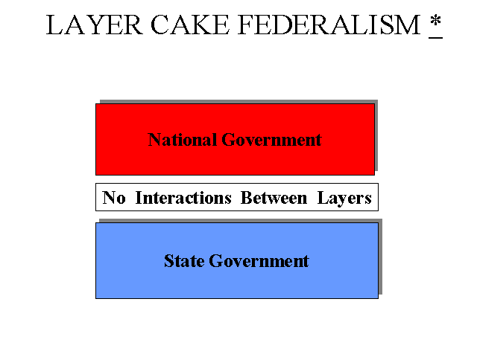
Dual Federalism
Until the 1930s, we had a “Dual System” of governments
Relatively weak national govt.
Emphasized dividing the state and national spheres of power into entirely separate jurisdictions

Slide 34
Post Civil War
Small break in “Dual Federalism”
The Civil War and the return to national government supremacy:
Post Civil War amendments represented a serious enhancement of national power
13th Amendment: abolished slavery
14th Amendment: defined who was an American citizen; LATER used to limit state govts
15th Amendment: attempted (with limited success) to provide voting rights to freed, male slaves
Beginnings of a “new” federalism
In the later 1800s, national government does recede a bit

Slide 35
The New Deal and Cooperative Federalism
New Deal legislation vs. Dual Federalism
Cooperative federalism emphasized an expanded role for the national government, and cooperation between the national government and the states.
Roosevelt’s programs typically were funded by the federal government, but administered by states and local governments, thus creating a cooperative framework for federalist relations.
LBJ expanded cooperative federalism → Great Society (Medicaid, Medicare, Food Stamps)

Slide 36
“Marble Cake” Federalism

Slide 37
American Federalism

Slide 38
Fiscal Federalism is Modern Federalism
Fiscal means $
Q – How do you get the states to do things they normally wouldn’t do?
A – Money
Q – What is the answer to any question ever asked?
A – Money

Slide 39
Central Government Spending

Slide 40
What is “Fiscal Federalism?”
Fiscal federalism = the central government providing grants-in-aid to state governments
Grants-in-aid – money given by the federal government to the states
Primary way the Federal Government can influence states→ “Strings Attached”
Originally designed them to fund agriculture, land grant colleges, and farm-related education
Grew to encompass many other types of funding → public housing, urban development, and school lunch programs

Slide 41
Fiscal Federalism
The Grant System: Distributing the Federal Pie
Categorical Grants (“coupons”): Federal grants that can be used for specific purposes. They have “strings attached”.
“Matching funds” requirement?
States receive funds if state raised drinking age to 21 and lowered BAC to .08
Block Grants (“gift cards”): Grants of money from the national government that states can spend within broad guidelines determined by Washington (ex. Welfare reform)
Grants are given to states & local governments

Slide 42
Fed. Grants to State and Local (2014)
The federal government spent more than $577 billion on grants to states in 2014.
Among the biggest items:
Health care (including Medicaid) | $320 billion
Income security | $100.9 billion
Transportation | $62.3 billion
Education, training, employment, and social services | $60.5 billion
Community and regional development | $13.2 billion

Slide 43
Fiscal Federalism (cont.)
Fiscal Federalism continued
The Scramble for Federal Dollars
$400 billion in grants every year
The Mandate Blues
Mandates - terms set by the federal government that states must meet whether or not they accept federal funds. Often times the states or local gov’ts have to pay the bill of the mandate set by Congress
Most federal mandates concern civil rights and environmental protection to control the states
Americans with Disabilities Act
Federal Clean Water Act
Voting Rights Act
Civil Rights Act of 1964

Slide 44
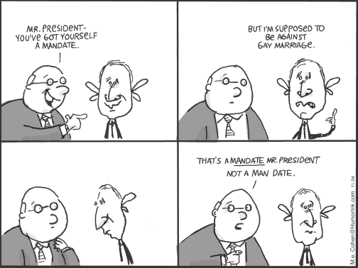
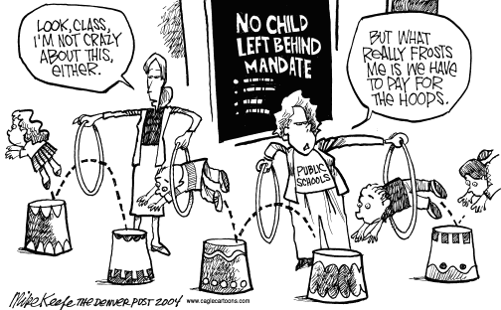
More Terms…
Revenue sharing – federal sharing of a fixed percentage of its revenues with the states
Conditions of aid – terms set by the federal government that states must meet in order to receive certain aid

Slide 45
The Changing Purpose of Federal Grants to State and Local Governments

Slide 46
Federalism as a Partisan Issue
“New Federalism”:
Beginning with President Richard Nixon (1969–1974)
Republican Party championed devolution, or the transfer of powers from the national government to the states.
Idea is fueled by distrust of the federal gov and the desire to save money by reducing the size of the “bloated federal government”

Slide 47
Devolution Example
Personal Responsibility and Work Opportunity Reconciliation Act of 1996
Eliminated welfare and transferred the money to states as block grants
States received wide latitude on how to administer “workfare” but with the knowledge that Congress was counting on anti-poverty spending”
Strings attached: head of family must work or lose benefit; lifetime benefits limited to 5 years; unmarried mother < 18 only receive $ if stay in school and live with adult; immigrants ineligible for 5 years

Slide 48
State Sovereignty
Recently the Supreme Court has strengthened states rights in cases such as:
Lopez, Morrison and Printz vs. US (gun rights and domestic violence)
States still control their own police, education, criminal justice, roads, highways, public welfare and they can provide for direct democracy

Slide 49
United States v. Lopez (1995)
1995 – “Gun Free School Zone” law banned possession of a firearm within 1000 feet of a school, 12 year old Lopez carried a gun on to the property
Declared law unconstitutional – “nothing to do with commerce” – carrying a weapon through a school zone is too much of a stretch for “commerce”
LIMITED National government power

Slide 50
Federalism: Good or Bad?
Good:
Living under 2 governments is great…
Built on compromise, promotes unity
Gov’t duties can be split up
Brings gov’t closer to people
Allows for state gov’t to address issues in unique regions of the country
Allows states to experiment with policy before enacting it at the federal level
Ex. Vermont’s free health care for children

Slide 51
Federalism: Good or Bad?
Bad:
Living under 2 governments is bad…
States can impede progress of Nation
States are unequal
States have different policy
Easier for states to be dominated by interest groups

Slide 52
A Final Thought…
The 10th Amendment only allowed the federal gov. certain rules over the states.
BUT the “necessary and proper” clause (defined by the McCulloch case) broadened federal authority over the states.
It seems the basic issue is over economics, commerce and funding.
After the Depression the feds had more power but the courts have shifted power back to the states
Grants-in-aid programs allow states to work on projects. It’s all about the money…

Slide 53
Arizona Immigration Law: Supreme Court Decision (1 of 2)

Slide 54
Arizona Immigration Law: Supreme Court Decision (2 of 2)
Taking a closer look:
Should individual states or the federal government determine immigration policy? Why?
What unique challenges are faced by border states?
Does the Supreme Court decision support national supremacy or states’ rights?

