Slide 1
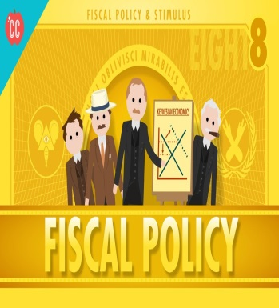
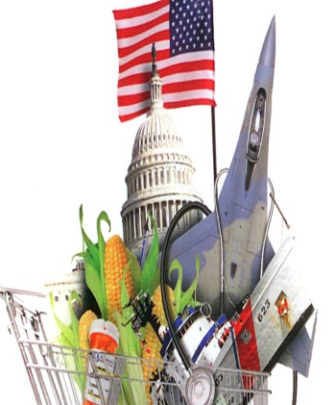
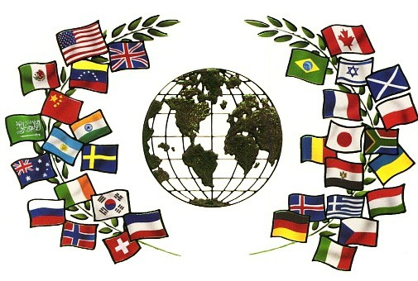
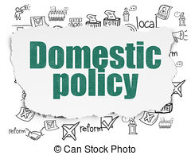
Public Policy
Objectives: SWBAT do the following:
Summarize the policymaking classification that explains the types of politics that may matter to whether and how government acts on any given issue.
Explain how America’s social welfare policies differ from those of many other modern democracies, and why some programs are politically protected while others are politically imperiled.
Discuss how government regulations on certain big businesses have been imposed over the objections of those industries.
Explain why environmental policies are designed and enforced differently in America than in other industrialized nations, and the politics that drive environmental programs.
Discuss the difficulty with changing policies—domestic, economic, and foreign—or developing new programs in the United States today.
Summarize how politics and public opinion shape economic policy.
Summarize four main theories of economic policymaking.
Describe how American institutions work to set economic policy.
Explain the budget process, and in particular state why it is difficult to either cut spending or increase taxes.
Discuss the constitutional and legal context for making American foreign policy.
Explain how political elites and public opinion influence American foreign policy.
Explain the key challenges that the United States faces in foreign affairs and defense politics today.

Slide 2
What is Public Policy?
Action that government (any public official who influences or determines public policy, including school officials, city council members, county supervisors, etc.) takes about a problem that comes before them for consideration.
Key attributes:
Policy is made in response to some sort of issue or problem that requires attention. Policy is what the government chooses to do (actual) or not do (implied) about a particular issue or problem.
Policy might take the form of law, or regulation, or the set of all the laws and regulations that govern a particular issue or problem.

Slide 3
What is Public Policy?
Key attributes:
Policy is made on behalf of the "public."
Policy is oriented toward a goal or desired state, such as the solution of a problem.
Policy is ultimately made by governments, even if the ideas come from outside government or through the interaction of government and the public.
Policymaking is part of an ongoing process that does not always have a clear beginning or end, since decisions about who will benefit from policies and who will bear any burden resulting from the policy are continually reassessed, revisited and revised.

Slide 4
Policy Making Process
Agenda Setting (Problem Identification)
Public attention focuses on a public problem or issue.
Officials’ words and actions help focus attention.
Policy Formulation
Policy makers in the legislature and the bureaucracy take up the issue.
They create legislative, regulatory, or programmatic strategies to address the problem.
Policy Adoption
Policy makers formally adopt a policy solution, usually in the form of legislation or rules.
Policy Implementation
Government agencies begin the job of making the policy work by establishing procedures, writing guidance documents, or issuing grants-in-aid to other governments.
Policy Evaluation
Policy analysts inside and outside government determine whether the policy is addressing the problem and whether implementation is proceeding well.
They may recommend revisions in the agenda, in the formulation of policy, or in its implementation.

Slide 5
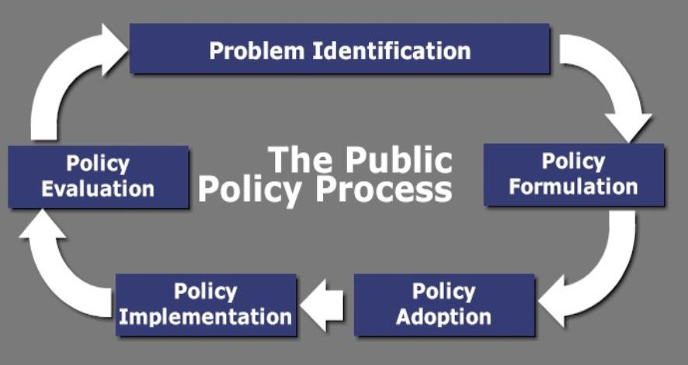

Slide 6
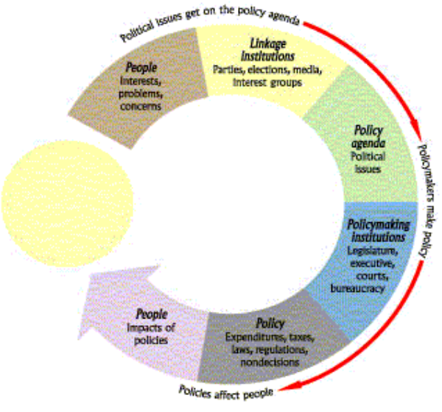

Slide 7
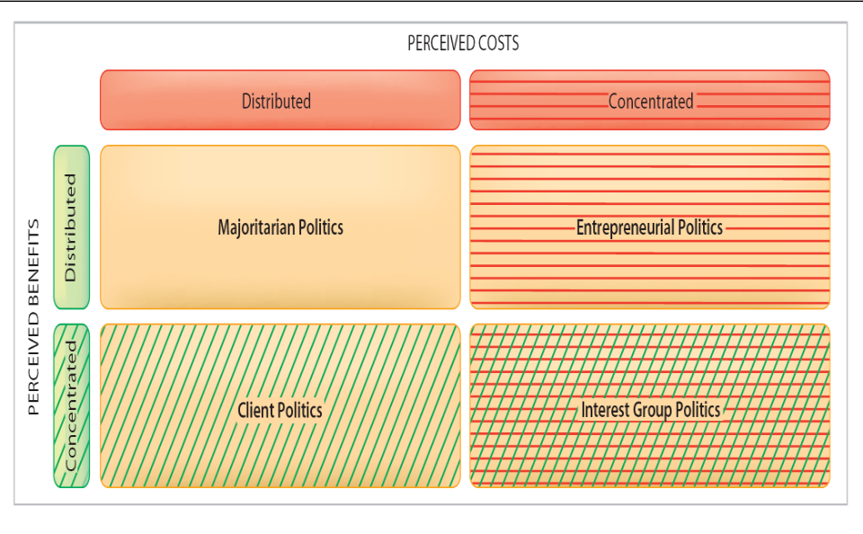
Costs, Benefits, & Effects
In order to make a policy decision, policymakers must assess the following items:
Cost: any burden, monetary or non-monetary, that affect a group/people by a policy
Benefit: any satisfaction, monetary or non-monetary, that affect a group/people by a policy
Politics = who actually benefits/pays and who ought to benefit/pay
Getting items on the policy agenda
Helping one group over another group

Slide 8
The Politics of Public Policy
Majoritarian politics: benefits for all & costs for all
Ex: Military spending
Interest group politics: benefits for a few & costs for a few
Ex: NFL Players Union vs. NFL Owners
Client politics: benefits for a few & costs for all
Ex: Pork-Barrel Projects/“Earmarks”
Entrepreneurial politics: Benefits for all & costs for a few
Ex: food safety regulations, environment safety

Slide 9
Social Welfare Policy
When you think of policy for the United States…think back to the Preamble and the basic things that the government should do for Americans
“To provide for the…general Welfare”
Social Welfare Policy has grown starting with the New Deal
Insurance programs, Assistance programs
Ex: Subsidies to purchase food, educational assistance for people who are blind, income for mothers of dependent children, public housing for low-income families
FDR and the New Deal
Social Security
Johnson and the Great Society
Medicare & Medicaid
Obama
Patient Protection and Affordable Care Act

Slide 10
Two Kinds of Social Welfare Policies
Benefits most:
Most pay
No means test
Majoritarian politics
Social Security and Medicare
Issue: cost
Benefits few:
Most pay
Means tested
Client politics
TANF and SNAP
Issue: legitimacy

Slide 11
Distinctive Features of Social Welfare Policy
More restrictive view of who is entitled to governmental assistance
Slower to embrace the welfare state
States play a large role
Nongovernmental organizations play a large role

Slide 12
Government Subsidies
Governmental financial support. Main types of subsidies:
Cash: Aid to Families with Dependent Children (AFDC), payments to farmers (“agricultural subsidies”) to keep crop prices and farms incomes high.
Tax Incentives: Home mortgage interest payments are tax deductible, oil companies receive tax credits for exploration and production, tariffs that protect domestic industries.
Credit Subsidies: Veterans’ Administration provides lower-than-normal interest rates for veteran home loans, student loans.
Benefit-In-Kind Subsidies: Non-cash benefits (food stamps, Medicaid, Medicare).

Slide 13
Politics of Subsidies
Most Americans complain about subsidies: however, most of them also receive them in one form or another.
Once subsidies are established, they are extremely difficult to eliminate.
“Iron triangles” or issue networks develop and work quite hard to keep the subsidies.
Some subsidies even become “sacred cows.”
Woe to the member of Congress who votes against these!
Think about Social Security in this regard – Many voters support this program and don’t want it changed!

Slide 14
Politics of Subsidies
Another reason subsidies are hard to eliminate is that they are often difficult to “see.”
The dairy industry, for example, receives heavy subsidies for milk production, yet few people are aware of this.
Supermarkets don’t exactly state how much of the price of milk comes from subsidies.
The federal govt. today provides loans and cash payments to farmers (“crop support payments”), and in some cases pays farmers to not grow crops to prevent surpluses.
Criticisms of these subsidies: Though these are supposed to help farmers, much (30%) of these subsidies go to huge “agribusiness” firms, leading to charges of “corporate welfare.”
Consumers end up paying higher prices for food, yet so much of the subsidies go not to the small farmers, but instead agribusiness.

Slide 15
Social Welfare Subsidies
Major social welfare programs:
Programs that have NO MEANS TEST – one does not have to prove that he lacks the means in order to qualify for benefits – one does not have to have a low level of income to qualify for these benefits.
Social Security: for elderly, survivors, and disabled. Even upper income people qualify for benefits if they fall into one of the three categories.
Medicare: Federal medical coverage for the elderly.
Unemployment Insurance: Payments to the unemployed.

Slide 16
Social Welfare Subsidies
Major social welfare programs:
MEANS TEST programs
Aid to Families with Dependent Children (AFDC): Payments to poor families with children.
The program that most people are talking about when they discuss the “welfare system.”
Supplemental Security Income (SSI): Cash payments to disabled people whose income is below a certain amount.
Food Stamps: Coupons given to the poor to buy food.
Medicaid: Federal medical coverage for the poor on AFDC and SSI.

Slide 17
Recent Developments
Entitlements (Social Security - which started in 1935) threaten to produce massive budget deficits in the future.
Entitlements are programs that are government sponsored that provide mandated/guaranteed/required benefits to those that meet eligibility.
Some have called for reforms for Social Security
Increasing the age of recipients for 65 to 67 or 70
Adopting means testing for recipients
GOP (Grand Old Party - Republicans) Contract with America (1990s) stressed the role of federalism
Returning power back to the states by ending the federal entitlement status of various welfare programs (AFDC), and replacing that with a system of block grants to the states.
This would enable states to become “laboratories” and free them up to experiment with what works best for their own particular situations. GOP argues that states know what is best for them.

Slide 18
Recent Developments
WELFARE was a huge political issue for the two parties:
Republicans linked the current “welfare mess” to various social pathologies: a higher illegitimacy rate, a higher rate of single-parent families, higher crime rate, drug problems, etc. They stressed welfare reform and claimed that the Democrats blocked their efforts at reform.
Given the political climate, even Democrats had to stress the importance of welfare reform.

Slide 19
Recent Developments
President Clinton promised to “end welfare as we know it,” and signed a huge WELFARE REFORM BILL IN 1996 that was passed by the Republican Congress.
Some of the bill’s highlights:
Ends the federal entitlement status of various welfare programs. More state authority. Note the impact of federalism.
Limits welfare payments to no more than five years.
Welfare recipients must work within two years of applying for benefits.
Requires food stamp recipients to work.
Prohibits aliens (legal or illegal) from receiving various welfare benefits.
Requires teen mothers to live with parents and attend school to receive welfare benefits.

Slide 20
Regulatory Policies
Relationship between wealth and power (business vs. labor/government)
Antitrust Laws: Majoritarian Politics
Sherman Act (1890)
Federal Trade Commission Act (1914)
Clayton Act (1914)
Labor and Occupational Health and Safety: Interest Group Politics
Wagner Act
National Labor Relations Board – regulates labor organizations, ensures collective bargaining rights
Occupational Safety and Health Act (1970)
Created OSHA – inspects factories for occupational hazards
Agricultural Subsidies: Client Politics
Consumer and Environmental Protection: Entrepreneurial Politics
Auto safety
Antipollution – Emissions standards for cars

Slide 21
Environmental Policy
Environmental Policy in America: Three Distinctive Features
Adversarial
State dependent
Interest group pressures
Environmental Protection Agency (1970)
Sets environmental guidelines for country
Clean Air Act (1970)
Clean Water Act (1972)

Slide 22
Economic Policy
Who’s in charge of Economic Policy?
President
No formal powers over taxation and spending
Influence over the federal budget has expanded dramatically over time
Most important role is submission of the budget >> Outlines the president’s priorities and spending recommendations
Congress
Power to tax
Power to pay the debts of America
Power to “provide for the common defense and general welfare”
Power to borrow money and appropriate money
Congress is not bound by a balanced-budget requirement >> U.S. government regularly runs large deficits
Congress must approve of the president’s budget

Slide 23
U.S. Economy
Mixed Economy:
Combination of:
Market Economy & Command Economy
We have economic choices (market), with some government regulation and monitoring (command)
Government’s 3 Goals for the US Economy:
Keep production levels growing (GDP)
Maintain steady prices (CPI)
Encourage everyone to have a job (Unemployment)
US Govt. measures each economic goal monthly
US Govt. creates policies “to help” the economy meet each goal:
Congress & President = Fiscal Policy
The Federal Reserve = Monetary Policy

Slide 24
U.S. Economy
Gross Domestic Product (GDP) = measures the total value of all new goods & services produced in the USA
Consumer Price Index (CPI)= measures how much money people spend on consumer goods
Measures changes in inflation (increase in the price of goods)
In the U.S., the rate of inflation generally remains from 2 to 3 percent per year
Too much money in circulation can lead to HIGH levels of inflation
Unemployment Rate: measures the percentage of people who want a job, but can’t find one
In the U.S., the rate of unemployment has generally hovered from 4 to 7 percent

Slide 25
Definition
GDP Data
CPI (inflation)
Data
Employment Data
Prosperity
Economy is booming!
High
Slowly Rising
BIG labor demand (low unemployment)
Recession
Economy is slowing
Slowing
Slowing Down
Slowing labor demand
Depression
Economy is in bad shape
Really LOW
Really
LOW
Really LOW demand (high unemployment)

Slide 26
Two Types of Economic Policies
Fiscal Policy
Refers to the taxing, spending, and borrowing activities of the national government
Conducted by the President and Congress
President proposes the budget and Congress passes it
Quicker way to affect the economy
Monetary Policy
Refers to the regulation of the money supply, controlling inflation, and adjusting interest rates
Controlled by the “Fed” or Federal Reserve Board
Slower way to affect the economy

Slide 27
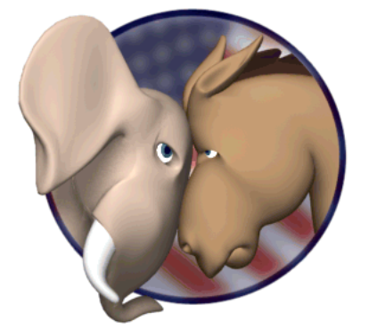
Ideology & the Economy
Ideology plays large role in shaping policy choices
Democrats tend to want the government to play an active role to improve the economy
Republicans tend to want the government to play a minimal role to improve the economy
BOTH parties desire:
High GDP
Low unemployment
Steady inflation

Slide 28
Fiscal Policy
The Budget Process
Executive Branch
Agencies prepare their estimates of budget needs and present them to the Office of Management and Budget (OMB = charged with overseeing the budget process on behalf of the president).
Amount requested is typically based upon the amount granted in the previous year.
OMB reviews these requests and makes recommendations to the President.
President reviews OMB recommendations and then submits a budget to Congress.
Presidential Action
President signs or vetoes entire taxing and spending bills – no line item veto
Congress can override a veto with 2/3 vote in both houses

Slide 29
Fiscal Policy
The Budget Process
Congress (Power of the Purse)
Congressional Budget Office (CBO) provides an independent analysis of the President's budget -- a check on OMB
Roles of Budget, Ways and Means, Finance, and Appropriations Committees
Input and lobbying from agencies
Majority vote needed in both houses
Government Accountability Office (GAO) is a congressional watchdog agency that ensures money is spent as prescribed by law
Fiscal Year – October 1 through the following September 30 (federal)

Slide 30
Fiscal Policy
FISCAL POLICY - DEFINITION
Fiscal policy affects the economy by making changes in government’s methods of raising money and spending it
Policy that describes the impact of the federal budget (including taxes, spending, and borrowing) on the economy
TOOLS AND IMPACT OF FISCAL POLICY
Governments try to stimulate the economy to prevent a recession/depression
Government can lower taxes >> stimulates the economy by encouraging consumer spending or by encouraging investment
Government can increase its own spending, which offsets declines in consumer demand >> Keynesian economic policy
Economy is growing too quickly and economists fear inflation may increase >> government can attempt to cool the economy down by increasing taxes or by reducing its own spending

Slide 31
Politics of Taxing and Spending
Majoritarian politics yields conflicting recommendations: lower taxes, less debt
Meaningful tax cuts are politically difficult
Who should get their taxes cut?
New programs tend to be more popular with politicians, but how will they be funded?
Different Fiscal Policy philosophies exist…

Slide 32
Two Fiscal Theories
Keynesian Economics
During Depression, New Deal was influenced by of British economist John Maynard Keynes.
Keynes suggested that government could manipulate the economic health of the economy through its level of spending.
In hard times, govt. should increase spending (even if it means running large deficits) to stimulate economic health.
In inflationary “boom” times, govt. should decrease spending to “cool down” the economy.
Difficulty posed by Keynesian Economics: Once govt. spending rises, it is politically difficult to cut it (consider the fights in recent years over entitlement reform). This helps to explain why we have such high budget deficits.
Dems = Like; GOP = Dislike

Slide 33
Two Fiscal Theories
Supply-Side Economics
Definition: Cuts in taxes will produce business investment that will compensate for the loss of money due to the lower tax rates. Tax rates will be lower, but business will boom, unemployment will go down, incomes will go up, and more money will come into the Treasury.
Most associated with the Reagan Administration (1981-1989).
Unfortunately, the Reagan tax cuts were not accompanied by spending cuts, so the national debt tripled from $1 trillion to $3 trillion.
Tax cuts under Bush 43 prompted concern that they have contributed to a rising national debt.
GOP = Like; Dems = Dislike

Slide 34
Fiscal Policy
Where does the money come from?
Types of Taxes:
Progressive: The more you make, the more you pay (Income Tax)
Flat Tax: Everyone pays the same rate (Sales Tax)
Regressive Tax: Poor citizens pay a higher percentage of their incomes compared with wealthier citizens
Ex: Person A and Person B pay a $1 tax on cigarettes, but Person A makes $100/year = 1% tax; Person B makes $10/year = 10% tax.

Slide 35
Fiscal Policy
Where does the money come from?
Individual income taxes (progressive tax)
The individual income tax is the federal government’s largest source of revenue
Payroll taxes (regressive tax)
Pay for social insurance (Social Security and Medicare)
Fastest-rising source of federal revenue
Corporate income taxes
The corporate income tax is set at 35 percent of net corporate income profits; however, corporations find many ways of reducing their taxable income, often to zero.

Slide 36
Fiscal Policy
Where does the money come from?
Social security taxes
The second largest source of federal revenue is the Social Security tax.
Excise taxes
Taxes on the consumption of liquor, tobacco, gasoline, telephones, air travel, and other so-called luxury items
Other
Estate and gift taxes
Tariffs - taxes on imports
Borrowing
Budget deficit - borrow money
Selling Treasury notes and savings bonds
Adds to national debt

Slide 37
Federal Taxes on Income, Top Percentage Rates, 1913-2013

Slide 38
Fiscal Policy
Where does the money go?
Nearly half of federal spending in 2012 went to required benefit payments for individuals/ entitlement programs (Social Security, Medicare, Medicaid, etc.)
This has seen a steady increase since 1960.
2/3 of all spending was mandatory/ nondiscretionary/uncontrollable
National Defense: 21%. Discretionary/controllable.
Interest Payments: 9%. Nondiscretionary/mandatory
Nondefense discretionary (grants to states and local governments): 16%.

Slide 39
Fiscal Policy
Entitlements
“Uncontrollables”: federal money that is
Provided to those who meet eligibility requirements and
Automatically spent each year without congressional review.
Some have a built in COLA, also without annual review. This in turn creates additional budget pressures.
Examples: Social Security, Medicare, federal pensions
These account for about 2/3 of the federal budget, which causes difficulties of balancing the budget.
Attempts to change/reduce/alter extremely difficult >> many voters who support these programs (especially old people)

Slide 40
Fiscal Policy

Slide 41
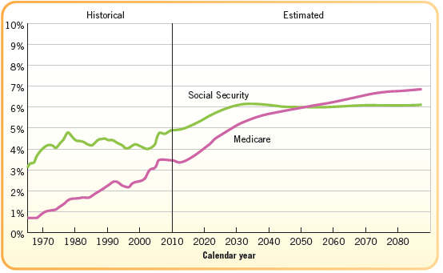
Social Security and Medicare Cost as a % of GDP

Slide 42
Monetary Policy
Monetary policy is the government’s control of the money supply
Manipulating the amount of money in circulation to alter credit markets, employment, and the rate of inflation
The government can control how much or how little is in circulation
Federal Reserve System makes monetary policy
Monetary Policy Philosophies: The Fed can either increase/reduce the money supply:
Increasing the rate of growth is loose monetary policy
Reducing the rate is tight monetary policy

Slide 43
Monetary Policy
The Fed
The powerful arm of government that controls the money supply is the Federal Reserve System, which is headed by the Federal Reserve Board.
The board is designed to operate with a great deal of independence from government control.
One important way that the “Fed” controls the money supply is by adjusting interest rates - high rates discourage borrowing money, and low ones encourage it.
Established by Congress in 1913 to help govern the nation’s monetary policy through an independent and apolitical process
Overseen by a seven-member Board of Governors
Members of the board are appointed by the president and confirmed by the Senate to 14-year terms and cannot be removed
The length of their terms intended to insulate the Fed from political pressures from both the president and the Congress
The Fed’s primary role is to regulate the nation’s money supply. Priority is placed on limiting the rate of inflation and preventing recessions.

Slide 44
Monetary Policy
How does the Fed control monetary policy?
Open-market operations
Refers to the efforts by the central bank to buy or sell government bonds
This is the most common form of monetary policy and is generally used to try to control short-term interest rates
By selling bonds, the Fed effectively removes money from circulation, slowing the economy
By purchasing bonds, the Fed effectively expands the money supply, encouraging economic activity
Reserve ratios
The Federal Reserve establishes the minimum cash reserves any bank must hold.
By increasing the ratio, the Fed can effectively reduce the amount of money in circulation, slowing the economy down.
By contrast, reducing the requirement increases the amount of money in circulation, generally leading to an expansion of economic activity.

Slide 45
Monetary Policy
How does the Fed control monetary policy?
Federal funds rates
Interest rate at which banks trade balances held at the Federal Reserve
This rate is an important benchmark, as many other interest rates, including credit card rates and home mortgage rates, are often based on the federal funds rate
Increasing the federal funds rate thus makes borrowing more expensive, slowing economic activity
Lowering the federal funds rate makes borrowing cheaper, increasing economic activity
Discount rate
Cost banks pay to borrow money from the Federal Reserve Bank
By reducing the discount rate, the Fed makes it more attractive for banks to borrow money, effectively increasing the amount of money in circulation and encouraging economic activity
By contrast, increasing the discount rate generally slows the economy down

Slide 46
Monetary v. Fiscal Policy
Monetary policy is slow, but the Fed can make a policy change more quickly than fiscal policy actions
Monetary policy cannot force people to borrow money in a recession
Monetary policy is more powerful against inflation
Fiscal policy is more effective against recessions, because the government does the borrowing itself (rather than hoping private institutions will borrow money)

Slide 47
Modern Deficit Spending
Budget deficit: incurred when govt. spending exceeds revenue during a one year period
National (public) debt: amount owed by fed. govt. -- accumulation of past budget deficits
Reagan
Huge budget deficits during the 1980's (>$200 billion per year) ---> national debt tripled from $1 trillion to $3 trillion during the 1980's. Tax cuts and increases in defense spending were among the main causes.
Bush 41
In 1990, Congress and Bush 41 agreed on a pay-as-you-go (“paygo”) proposal that would allow Congress to increase spending ONLY if that increase was offset by higher taxes and/or spending cuts elsewhere. The “paygo” agreement, however, expired in 2002. Its expiration helps to explain the rising deficits since then.

Slide 48
Modern Deficit Spending
Clinton
Government shutdown in mid-90s as a result of budgetary politics
Reduction of deficits under Clinton and development of SURPLUSES ---> political differences over what to do with these surpluses: Republicans favored tax cuts, Democrats wanted to apply the surpluses to the Social Security System to bolster it.
Bush 43
Tax cut in 2001 ($1.36 trillion) + recession + terrorist attacks of 9/11 + wars in Afghanistan and Iraq + end of “paygo” ended budget surpluses ---> resumption of record-high budget deficits
Economic crisis of 2008-09 once again led to soaring budget deficits and therefore a soaring national debt.
Obama
Current national debt: >$18 trillion.
Failure of Congress to pass the Balanced Budget Amendment.

Slide 49
Balancing the Budget
Balanced Budget Act of 1985 (Gramm-Rudman Act)
Sequester – automatic spending cuts
Budget Enforcement Act of 1990
Limits on discretionary spending
The Push for a Balanced Budget Amendment
High deficits have led some to believe that Congress needs to be “tied down” to a constitutional amendment that would require that spending not exceed income.
Supporters say that this is the only way to end the “spending bias” of Congress, and that it is the only way to overcome the political difficulties of cutting spending.
Opponents say that such an amendment would be “tinkering” with the Constitution: It would decrease needed flexibility in times of crisis, and Congress would figure out a way of evading the amendment anyway.
This amendment was proposed in the Senate, but was voted down by the House in 1992.
The line-item veto could have precluded the need for such an amendment. Wasteful spending could be deleted with a “stroke of the pen.” Declared unconstitutional.

Slide 50
Trade Policy
Increasing trade deficits (where imports exceed exports) caused by:
Expanding economy in China
Rising oil prices from our overseas suppliers
Trade deficits have led to calls for protectionism
Off-shoring >> loss of American jobs
However, there has been more of a push for free trade rather than for tariffs
NAFTA – US, Mexico, Canada
CAFTA – Central American countries & US
TPP

Slide 51
Foreign Policy
What is foreign policy?
Goals that outline how a country will interact with other countries in the world
Some of the tools used in carrying out foreign policy include:
Diplomacy— negotiation/communication with other countries
Economic aid —assistance to other nations in the form of grants, loans, or credits to purchase goods
Technical assistance —sending experts with technical skills in agriculture, engineering, or business to aid other nations
Sanctions— punishments towards a country/govt. (boycotts, tariffs, quotas)
Fight— use military (last resort)

Slide 52
Foreign Policy
Who makes foreign policy?
Many people and organizations within government have a hand in setting United States foreign policy.
The main objective of foreign policy is to use diplomacy - conferences, meetings, and agreements - to solve international problems.
They try to keep problems from developing into conflicts that require military settlements.
Foreign Policy Players
Foreign policy is shared responsibility of the President and Congress. Checks and Balances applies:
War – Congress declares and funds, but President is commander-in-chief
Treaties – President makes them, but Senate ratifies
Appointments – President makes them, but Senate approves them

Slide 53
Key Foreign Policy Players
Despite shared responsibilities; the President is primarily responsible for foreign policy and has extensive support within the executive branch:
Secretary of State: Responsible for foreign affairs
State Department: Responsible for day-to-day management of foreign policy
Other Cabinet officials: Since foreign policy affects domestic policy, other Cabinet officials (Commerce, Treasury, Defense, Agriculture) also have inputs
National Security Council (NSC)
Coordinates policies that affect national security
Members include Pres., V.P., State, Defense, CIA Director, National Security Adviser, and others.
National Security Adviser has emerged as a key player who sometimes has more influence than the Secretary of State
Presidents tend to rely more upon the NSA because he is literally “closer” to the President (office in the White House) and his loyalties are not divided between the President and a Cabinet Department (as with the Secretary of State)

Slide 54
Key Foreign Policy Players
Executive Branch:
Department of Homeland Security: Responsible for coordination of domestic law enforcement and intelligence agencies to thwart terrorism
CIA (Central Intelligence Agency)
Functions: Gather and evaluate intelligence and information about other nations.
Created in 1947 to monitor the Soviet threat. Fall of communism since 80's has led the agency to branch out into other areas, e.g., international drug trafficking, terrorism, nuclear proliferation.
Agency’s covert operations have led to some concern about govt. secrecy in a democracy. Can these two co-exist?
This concern has led to the creation of intelligence oversight committees in both the House and Senate.

Slide 55
Making Foreign Policy
Worldviews: comprehensive opinion of how the US should respond to world crises.
Isolationism
Policy of avoiding participation in foreign affairs (rarely absolute)
Containment
US should resist the expansion of aggressive nations
Disengagement
US was harmed by war in Vietnam and should avoid similar events
Human rights
Belief that we should try to improve the lives of people in other countries

Slide 56
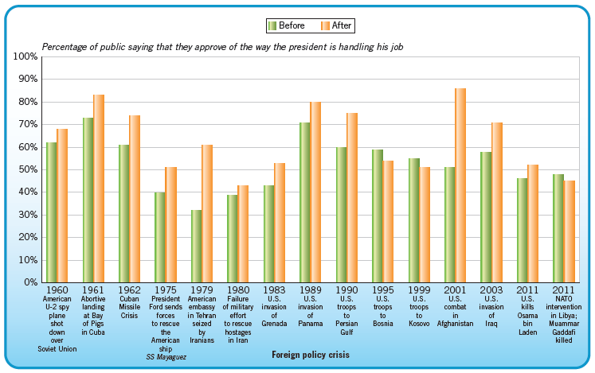
Popular Reactions to Crises

Slide 57
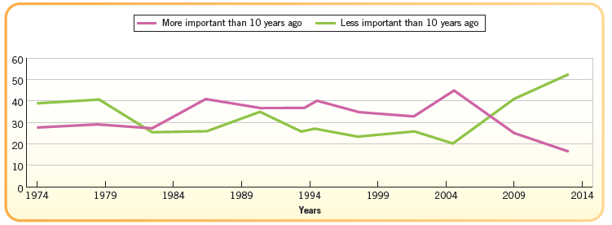
Public’s View of America as a World Leader

Slide 58
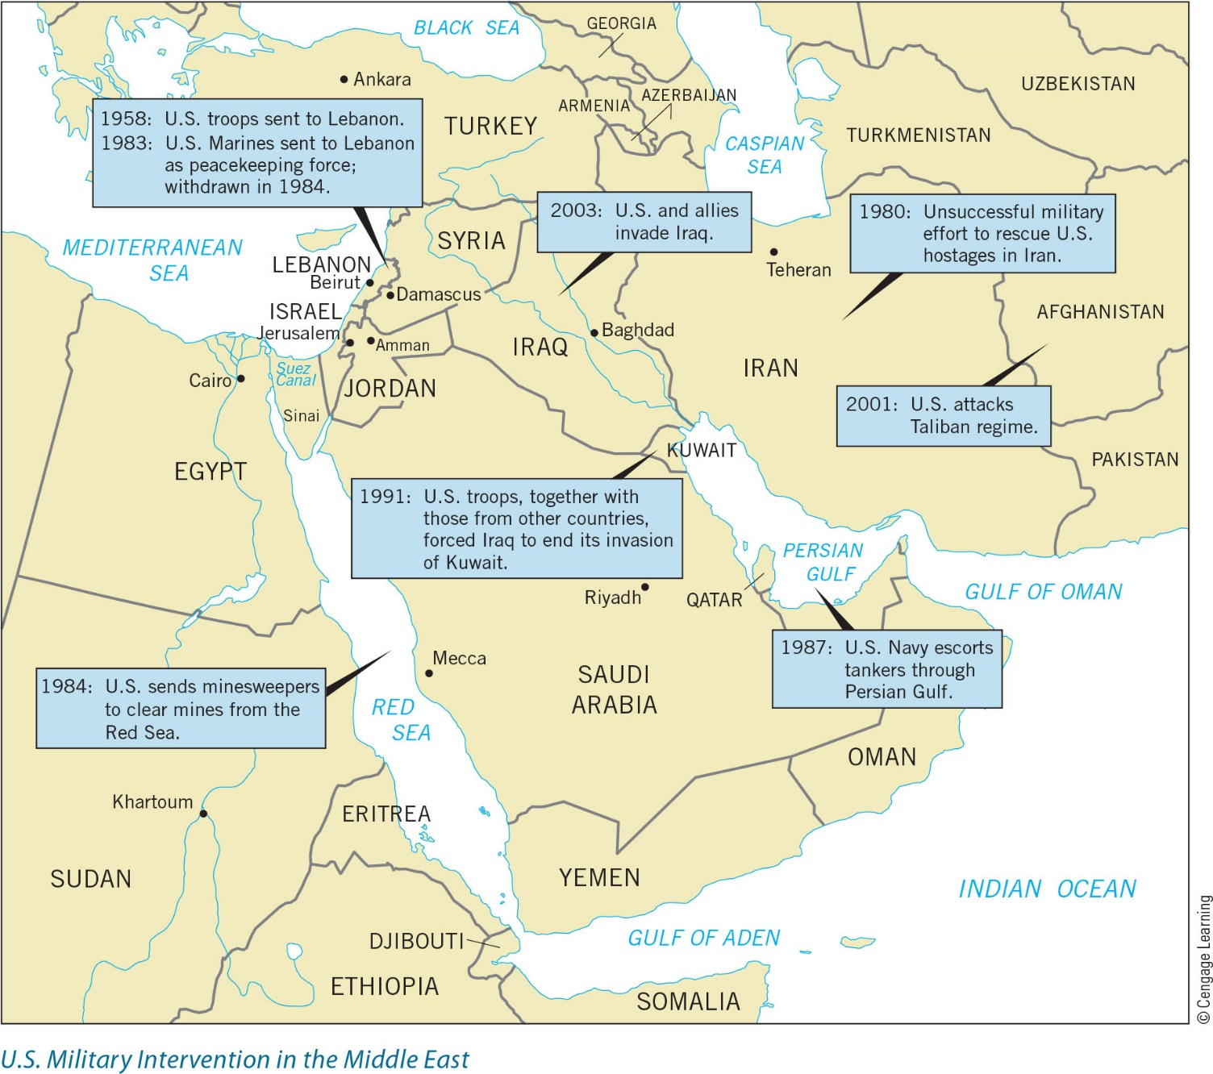
Politics of Foreign Affairs

Slide 59
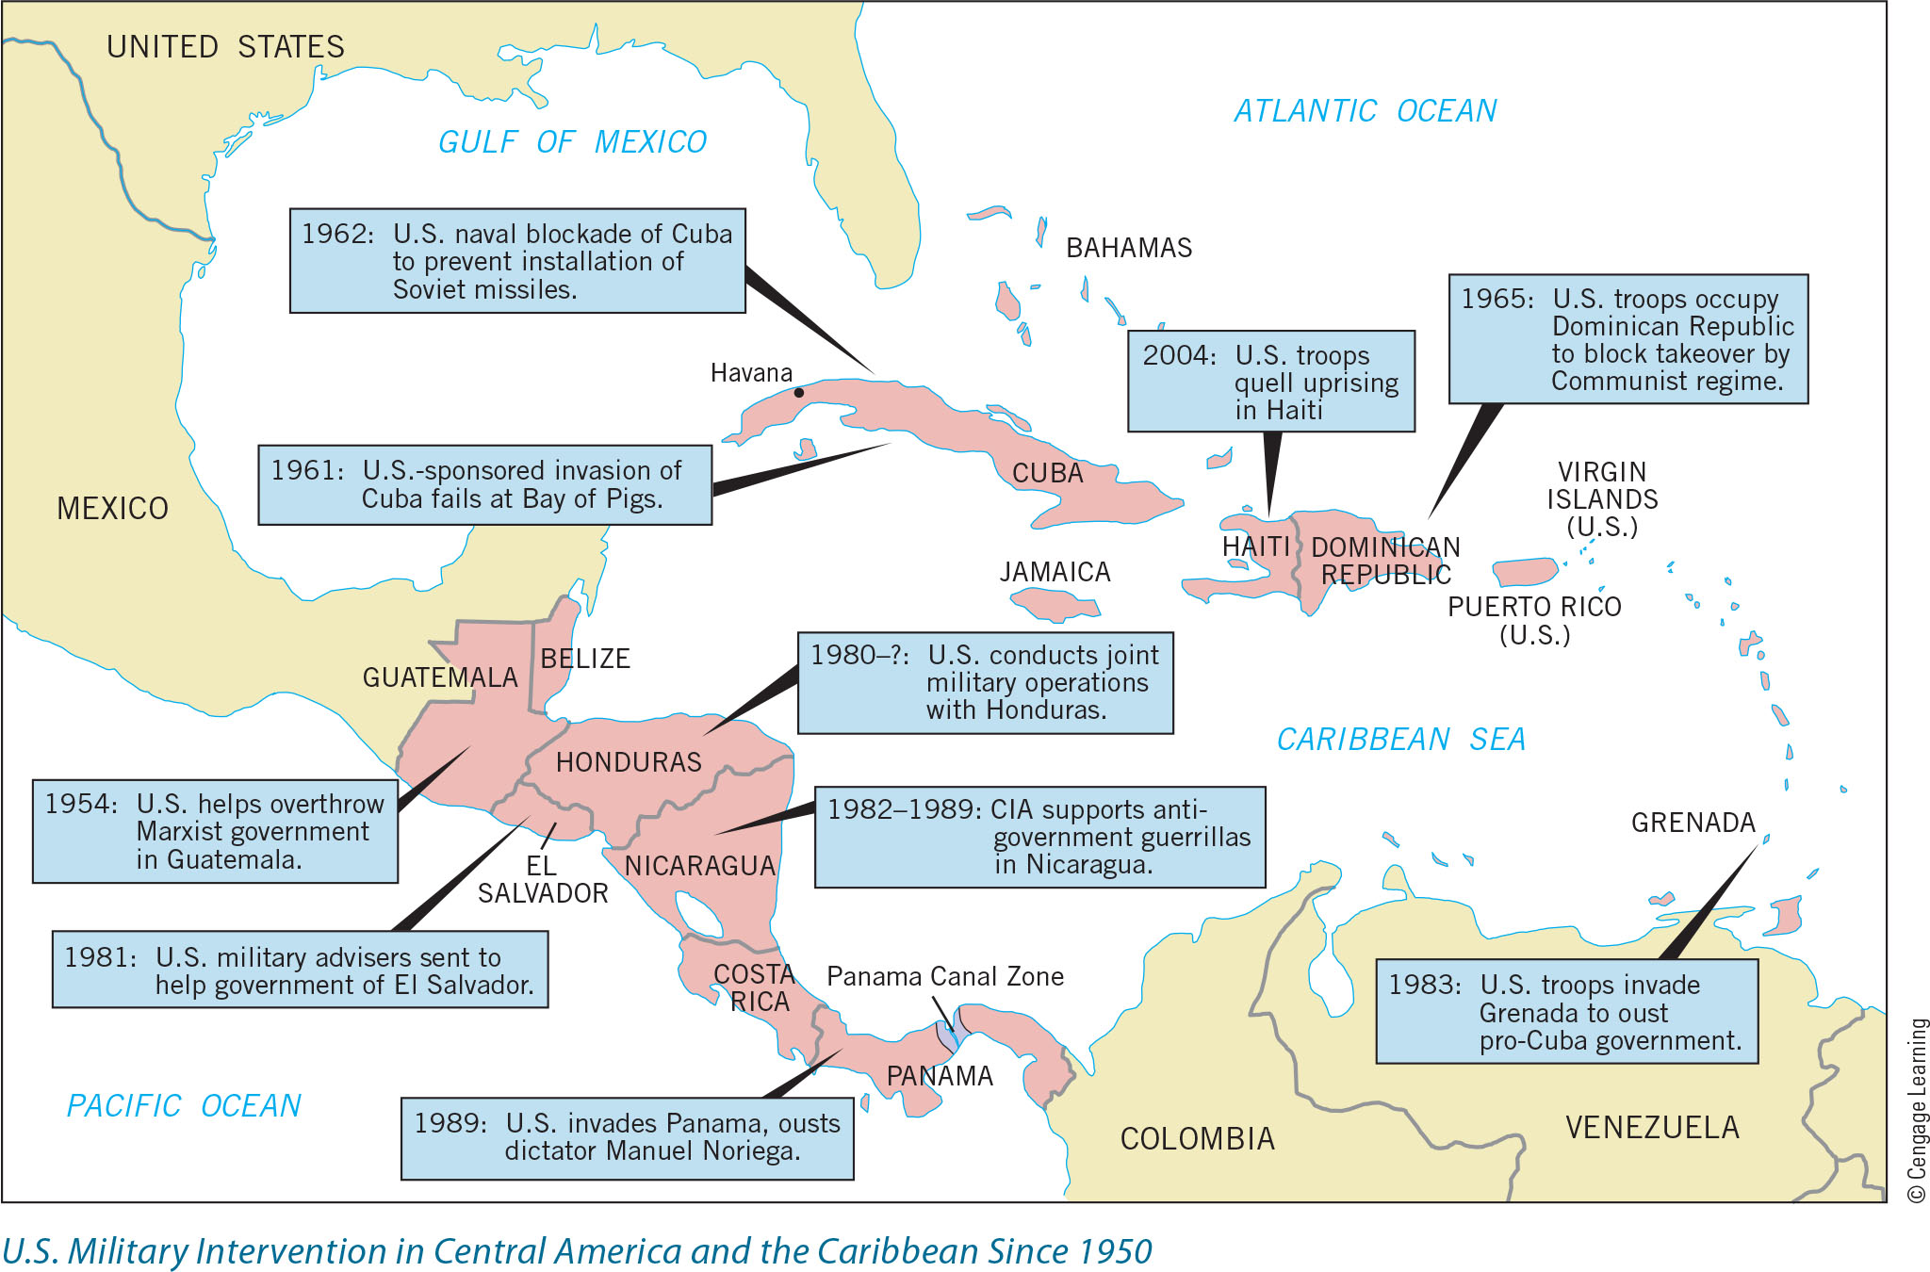
Politics of Foreign Affairs

Slide 60
Defense Budget
Total Spending
Escalation after 1950
Containment policy
Reflects changes in public opinion
Most Americans think spending on defense is “about right” or “not enough”
What Do We Get with Our Money?
Personnel
Big-Ticket Items
Technology, weapons, etc.
Where most of the budget goes
Readiness

Slide 61
Trends in Spending

Slide 62
Military Policymakers
Until 1947 the Cabinet-level official most directly responsible for military policy was called the Secretary of War.
The name changed to “Secretary of Defense,” and the department that this official heads has more federal employees than any other in the government.
The Department of Defense is headquartered in the Pentagon, where about 25,000 military and civilian personnel work.
The Secretary of Defense is always a civilian, and he supervises three large military departments - Army, Navy, and Air Force.

Slide 63
Military Policymakers
Under the Constitution, the President is commander-in-chief of the armed forces, and he has used that authority to order American military forces into combat on many occasions.
During peacetime, his most important military powers are those he exercises through the Secretary of Defense in managing the Department of Defense.
The President and Secretary of Defense make important decisions regarding the military budget and distribution of funds among the military services.

Slide 64
Military Policy
The most important military advisory body to the Secretary of Defense is the Joint Chiefs of Staff.
Its five members are the chiefs of staff of the three military departments, the commandant of the Marines, and a chair.
All of the service chiefs are appointed by the president and must be confirmed by the Senate.
Only the Secretary of Defense, however, sits on the president’s cabinet and on the National Security Council.

