Slide 1
The Bureaucracy
Objective: SWBAT describe the unique features of the federal bureaucracy; the evolution of the bureaucracy; how it functions today; and problems with the bureaucracy and how it can be reformed.

Slide 2
WHO GOVERNS?
What happened to make the bureaucracy a “fourth branch” of American national government?
What are the actual size and scope of the federal bureaucracy?
TO WHAT ENDS?
What should be done to improve bureaucratic performance?
Is “red tape” all bad?

Slide 3
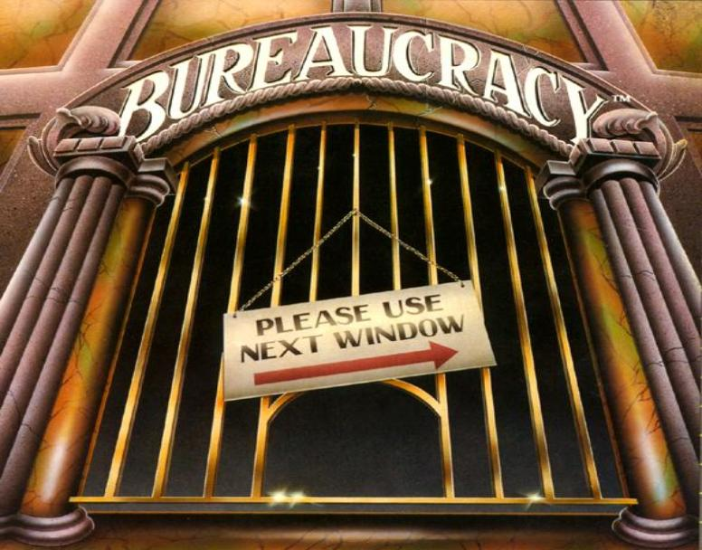

Slide 4
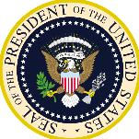
Bureaucracy
Literally means – “rule by desks”
A large organization that is structured hierarchically to carry out specific functions
Used to refer to the departments and agencies of the federal government
Characteristics:
Administration of government through departments
Consists of unelected often highly trained professionals
Task specialization
Hierarchical authority

Slide 5
Nature of Bureaucracy
All bureaucracies follow 3 general rules:
Hierarchical authority—similar to a pyramid
Job specialization—each worker has defined duties/responsibilities
Formal rules– rules/regulations must be followed
Its purpose is carrying out the day-to-day administration of rules, regulations, and policies
They are the experts/specialists
“Fall Guy” = Easy for politicians to blame for problems

Slide 6
The Constitution and Bureaucracy
The Constitution made little mention of a bureaucracy
“All other officers of the United States whose appointments are not herein otherwise provided for, and which shall be established by law" (Article II, Section 3)
No provisions mentioned departments or bureaus, but Congress created the first bureaucracy during George Washington’s presidency
Executive administers the bureaucracy, but Congress regulates agencies

Slide 7
Distinctiveness of American Bureaucracy
Political authority shared among several institutions
Federal government agencies share functions with state/local governments
Quasi- Legislative:
Congress gives agencies power to make rules/regulations
Quasi-Executive:
Have power to enforce regulations/rules
Quasi-Judicial:
Develop investigative and punishment procedures to use against people who break rules and regulations

Slide 8
Criticisms
“Red tape” – the web of government rules, regulations, and paperwork – makes government so overwhelming to citizens that many people try to avoid any contact
Conflict – agencies that often work at cross purposes with one another
Duplication – a situation in which two agencies appear to be doing the same thing
Unchecked growth – the tendency of agencies to grow unnecessarily and for costs to escalate proportionately
Waste – spending more on products and/or services than is necessary.
Lack of accountability – the difficulty in firing or demoting an incompetent bureaucrat

Slide 9
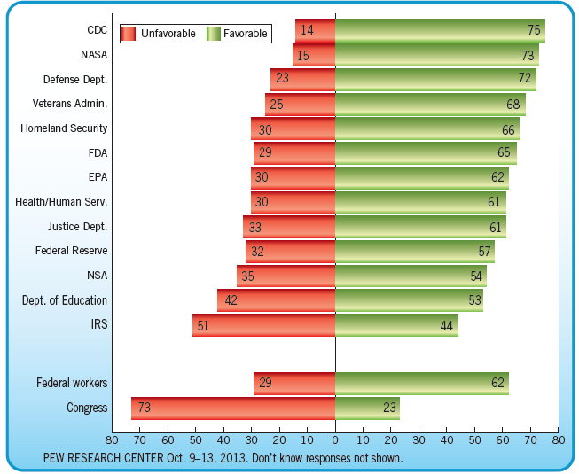
How the Public Views Particular Federal Agencies

Slide 10
Evolution of the Bureaucracy
Early Days:
“To the victor belong the spoils”
The spoils system or patronage, started by Andrew Jackson, was used for filling federal jobs
President rewarding supporters with jobs based on service, not on merit
Were not good for employees - could be fired at will
Turning Point:
Garfield’s assassination by a disappointed office-seeker (1881)
Charles Giteau

Slide 11
Evolution of the Bureaucracy
Creation of the Pendleton Act (1883)
Eliminated the spoils system (patronage); created merit system
An exam-based merit system would be used to fill government jobs
Civil Service Commission was created to administer these exams
Hatch Act (1939)
Prevents bureaucrats from engaging in “political activities” while on duty
Can’t run for public office
Can’t become an officer in a political party
Can’t be a delegate to a party convention
Law is eventually altered!

Slide 12
Evolution of the Bureaucracy
Civil Service Reform Act (1978)
Abolished the U.S. Civil Service Commission
Created the OPM (Office of Personnel Management) to provide guidance to agencies of the executive branch
Human Resources Department for the Govt.
Merit Systems Protection Board (MSPB):
Oversees promotions, employee rights, hears employee appeals of wrongdoing

Slide 13
Evolution of the Bureaucracy
Hatch Act overhauled in 1993:
Federal employees can:
Run for public office in nonpartisan elections (ex: school board, board of supervisors)
Give money to political organizations
Campaign for or against candidates in partisan elections, but not at work
Federal employees are prohibited from:
Engaging in political activity while on duty
Soliciting contributions from the general public
Running for office in partisan elections (ex: VA house of delegates, congress)
Firing a Bureaucrat
A tenured government employee technically “owns” their job:
Loudermill Rights:
From a 1985 Supreme Court case
Public-sector employees can have a property interest in their employment

Slide 14
Modern Bureaucracy
LARGE: Three million civilian federal employees
Department of Defense is the largest department = about 50% (even without active military which is about 1.4 million)
Post Office has about 28%
Less than 10% of top-level jobs are appointed (political appointees) by the President >> PATRONAGE
More than 90% of federal employees are civil service workers >> MERIT SYSTEM
Tenure protection, difficult to fire (unless appointed by president)
Specialized units with expertise in a field

Slide 15
Bureaucrats
Federal government employees currently account for 3 percent of all civilian jobs
The number of federal government employees has remained constant since 1950
The number of state and local government employees has steadily increased since 1950
Block grants have contributed to the widening gap between the number of federal and state employees by shifting resources from the federal government to states and local governments
Federal mandates have also shifted more responsibility to states, causing an increase in the number of their public employees

Slide 16
Characteristics of Federal Civilian Employees, 1960 and 2013
Notes:
Figure 15.3
Sources: Statistical Abstract of the United States, 1961, pp. 392–394; Office of Personnel Management, Common Characteristics of
the Government Fiscal Year 2013.
Notes: *Blacks, Native Americans, Hispanics, Asians, and Pacific Islanders

Slide 17
Power of the Bureaucracy
Implementation and Discretionary authority
Carry out laws of Congress, executive orders of the president
Agencies have power to set specific guidelines when receiving a general mandate from Congress
Congress gives them the bones, bureaucracy adds the meat
Regulation
Issue rules and regulations that impact the public and that the private sector must follow (EPA sets clean air standards); Labels on food, emissions of cars, etc.
Administrative Law
Rules and regulations created by an agency that have the effect of law
Helping Congress draft legislation
Providing advice to the White House
Settling disputes

Slide 18
Organization – see handout
Agencies of the executive branch may be organized into four basic types:
Cabinet departments
Independent regulatory agencies or commissions
Government corporations
Independent executive agencies

Slide 19
Federal Bureaucracy
Federal Bureaucracy
President
Congress
Executive
Office
of the
President
(Ex: OMB, NSC)
Independent
Regulatory
Commissions
(Ex: FCC, SEC)
Cabinet
Departments
(Ex: State, Defense)
Independent
Executive
Agencies
(Ex: CIA, NASA)
Government Corporations
(Ex: Amtrack, Postal Service)

Slide 20
The Cabinet
The President . . . “may require the Opinion, in writing, of the principal Officer in each of the executive Departments, upon any Subject relating to the Duties of their respective Offices”
2 Purposes of the Cabinet:
Advise President (report directly to him/her)
Operate a specific policy area of govt. activity
Each has its own budget, staff and policy areas
Secretaries often develop a strong loyalty to their departments. They become closer to the department than to the President.
15 Departments
All of the heads are chosen by the President and confirmed by the Senate
President can fire dept. heads at will

Slide 21
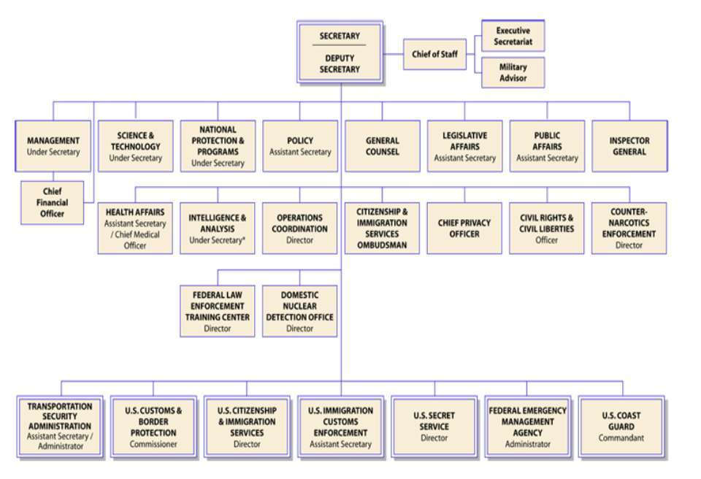
Department of Homeland Security Structure

Slide 22
Independent Regulatory Agencies
Agencies (also known as independent regulatory commissions) are created by Congress
Regulate important parts of the economy
Make rules for large industries and businesses that affect the interests of the public
Since regulatory agencies are watchdogs that by their very nature need to operate independently, they are not part of a department
Small commissions govern the regulatory agencies
Five to ten members appointed by the president and confirmed by the Senate
Commissioners are somewhat more "independent" than are the cabinet secretaries because they cannot be removed by the president during their terms of office
Commissioners serve rather long terms (5-14 years)
Terms of the commissioners are staggered

Slide 23
Independent Regulatory Agencies
These factors help to insulate regulatory commissions from political pressure
Commissions have quasi-legislative powers because they have the authority to make rules and regulations that have the force of law
Commissions also have quasi-judicial powers because they can settle disputes in their fields (such as the FCC fining Howard Stern for objectionable material that was broadcast on his radio program)

Slide 24
Independent Regulatory Agencies
Examples:
Federal Communications Commission (FCC)
Regulates all communications by telegraph, cable, telephone, radio, and television.
The Federal Trade Commission (FTC)
Prevents businesses from engaging in unfair trade practices; stops the formation of monopolies in the business sector; protects consumer rights.
Federal Election Commission (FEC)
Administers and enforces the Federal Election Campaign Act (FECA); discloses campaign finance information and oversees the public funding of presidential elections.
The Securities and Exchange Commission (SEC)
Regulates the nation’s stock exchanges; requires full disclosure of the financial profiles of companies that wish to sell stocks to the public.
The Federal Reserve Board (The Fed)
Establishes monetary policy >> refers to the money supply and interest rates.
Monetary policy = controlling the money supply. Fiscal policy = taxing and spending.
Sets bank interest rates; controls inflation; regulates the money supply; adjusts banks reserve requirements.

Slide 25
Government Corporations
Blend of private corporations and government agency.
Created to allow more freedom and flexibility than exists in regular government agencies.
Have more control over their budgets, and often have the right to decide how to use their own earnings.
Since the government still ultimately controls them, they do not operate like true private corporations.

Slide 26
Government Corporations
Examples:
The U.S. Postal Service
The post office is a corporation that competes with private services.
National Railroad Passenger Corporation (AMTRAK)
Congress created Amtrak to provide railroad passenger service that is heavily subsidized by the federal government. Part of the motivation for its creation was the lack of private companies providing the service, and Amtrak has suffered some huge financial losses. Recently, in an attempt to make the corporation more profitably, Congress has allowed Amtrak to drop some of its less popular routes.
The Corporation for Public Broadcasting
This controversial government corporation still operates public radio and television stations. Although largely funded by private donations, the government still provides policies and money to support their programs.

Slide 27
Independent Executive Agencies
Agencies that do not fall into the first three categories
Closely resemble Cabinet departments, but they are smaller and less complex
Generally, they have narrower areas of responsibility than do cabinet departments
Most are subject to presidential control and are independent only in the sense that they are not part of a department
Their main function is not to regulate, but to fulfill a myriad of other administrative responsibilities
Report directly to President (part of executive branch)
President can fire heads of I.E.A’s at will

Slide 28
Independent Executive Agencies
Examples:
Central Intelligence Agency –
The CIA is responsible for providing national security intelligence to senior US policymakers.
Environmental Protection Agency –
The EPA was established to consolidate in one agency a variety of federal research, monitoring, standard-setting and enforcement activities to ensure environmental protection.
The National Aeronautics and Space Administration –
NASA administers the United States space program, financing ventures into space since 1958.

Slide 29
Controlling the Bureaucracy
Congress has a great amount of power over the bureaucracy because Congress can exercise LEGISLATIVE OVERSIGHT
What are the numerous ways in which Congress can exercise “oversight” of the bureaucracy?
Creation of agencies
Constitutional power to create and abolish executive departments and independent agencies, or to transfer their functions
Advice and consent
Congress can influence the appointment of agency heads
The Senate has the power to confirm presidential appointments

Slide 30
Controlling the Bureaucracy
Congressional Control Continued:
Appropriations of agency budgets
Congress determines how much money each agency gets
Annual authorization legislation
No agency may spend money unless it has first been authorized by Congress
Authorization legislation originates in a congressional committee and states the maximum amount of money that an agency may spend on a given program
Even if funds have been authorized, Congress must also appropriate the money
Rewriting legislation
If they wish to restrict the power of an agency, Congress may rewrite legislation or make it more detailed
The more detailed the instructions, the better able Congress is to restrict the agency's power

Slide 31
Controlling the Bureaucracy
Congressional Control Continued:
Duplication
Giving any one job to more than one agency, keeping any single agency from becoming all powerful
For example, drug trafficking is the task of the Customs Services, the FBI, the DEA, the Border Patrol, and the Department of Defense
Keeps any one agency from becoming all-powerful
Holding hearings and conducting investigations
Congress can call bureaucrats to testify before committees and subcommittees to determine whether the agency is complying with congressional intent
Congress can investigate agencies
Reorganization
By realigning or restructuring departments, agencies and their responsibilities, Congress can contain costs, reduce bureaucratic overlap and improve accountability.
Sunset laws
Provides for the law to cease to have effect after a specific date, unless further legislative action is taken to extend the law
Sunset laws create a finite lifespan for a bureaucratic agency
In order to be reauthorized, these bureaucracies must prove their effectiveness and merit

Slide 32
Controlling the Bureaucracy
Government Accountability Office
Investigative arm of Congress charged with examining matters relating to the receipt and payment of public funds by conducting audits
Created by Congress to track how money is spent in the federal bureaucracy.
Monitors how policies are implemented
Notifies Congress immediately if problems with agency work are uncovered

Slide 33
Controlling the Bureaucracy
Congressional Budget Office:
Primary congressional agency charged with reviewing congressional budgets and other legislative initiatives with budgetary implications
Nonpartisan agency created by the Congressional Budget and Impoundment Control Act of 1974 to counterbalance the President’s OMB.
Gives Congress objective, nonpartisan analysis to aid the legislative branch in its economic and budgetary decisions.
Conducts oversight studies

Slide 34
Controlling the Bureaucracy
What are the limits on congressional influence?
Congress may not really want to clamp down on the bureaucracy:
Members profit politically from the existence of federal programs within their states or districts (e.g., military base closure)
Easier for Congress to simply pass broadly worded laws and have experts within the bureaucracy fill in the holes
No electoral payoff; Political ramifications
Oversight is labor intensive/hard work; Lack of technical expertise
Congress creates opportunities for casework through red tape
Congress lacks expertise/agencies have expertise
Congress does not want to be blamed for bad policy
Time-consuming

Slide 35
Controlling the Bureaucracy
Presidential Influence:
Appointments
Appointment of top-level bureaucrats (including Cabinet secretaries)
Fire top-level bureaucrats (including Cabinet secretaries)
Executive Orders
An executive order is a directive, order, or regulation issued by the president
An executive order of the President must find support in the Constitution, either in a clause granting the President specific power, or by a delegation of power by Congress to the President
Economic Powers
Proposes agency budgets (either an increase or a decrease in $)
Other Powers
Propose the reorganization of the executive branch
Presidential power of influence over different agencies direction

Slide 36
Controlling the Bureaucracy
Office of Management and Budget
Prepares the president’s annual budget proposal
Reviews budget and programs of executive departments and make sure these proposal align with the president’s priorities and agenda
Along with the CEA, supplies the president with economic forecasts
Conducts detailed analyses of proposed bills and agency rules

Slide 37
Controlling the Bureaucracy
What are the limits on presidential influence?
Senate confirmation needed for top personnel
President cannot fire vast majority of bureaucrats
Reorganization must go through Congress
Agency budgets must go through Congress

Slide 38
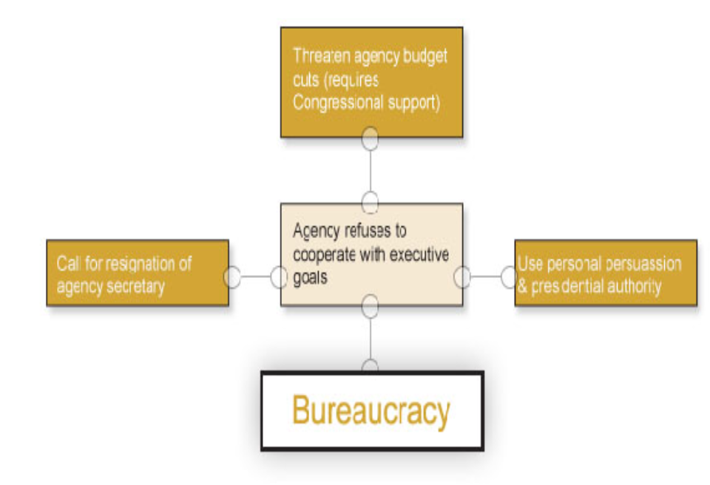
Presidential Checks

Slide 39
Controlling the Bureaucracy
COURTS AND THE BUREAUCRACY
Court rulings that limit bureaucratic practices
Judicial review - can declare bureaucratic actions unconstitutional
Injunctions (a judicial order that restrains a person/group from beginning or continuing an action threatening or invading the legal right of another) against federal agencies

Slide 40
Interest Groups and the Bureaucracy
Lobbying
“Revolving door” - Agencies are staffed by people who move back and forth between the public/private sector
Agency employees are recruited from the regulated industry (vice versa)
Client groups
Some agency-interest group relations are so close that the interest group is said to be a client of the agency (e.g., dairy groups and Agriculture Dept)
Iron triangles: congressional committee, relevant agency, related interest groups
Issue networks: informal groups of people within both the public/private sectors who have common interests
Agencies rely on support from regulated industries in making budget requests
Litigation: Take a bureaucratic agency to court

Slide 41
Bureaucratic Influence
Iron Triangles and Issue Networks
Iron Triangles:
A mutually dependent relationship between bureaucratic agencies, interest groups, and legislators (subcommittees)—work to influence legislation/policy
Alliances among bureaucrats, interest groups, and congressional subcommittee members and staff sometimes form to promote their common causes. Also known as subgovernments.
Exist independently of each other
Each part has similar goals
Tough to remove: thus, an IRON Triangle

Slide 42
Bureaucratic Influence
How an Iron Triangle Works:
Committee members (Congress) show favor to the interest groups in hopes of getting votes and campaign contributions
When this occurs, the interest group is said to have "captured" the agency.
The bureaucratic agency does the committee's bidding to gain support and budget appropriations
Committee members may be reluctant to closely monitor the agency's activities because they rely on the agency to implement policies favored by their constituents

Slide 43
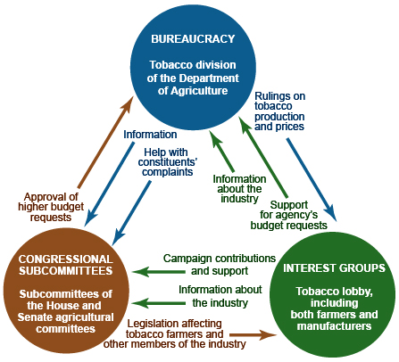

Slide 44
Bureaucratic Influence
Some argue iron triangles are being replaced by wider issue networks that focus on more policies
Issue Networks:
Loose & informal relationships that exist among a large number of actors who work in broad policy areas
Comprised of people in interest groups, congressional staffers, advocates from think tanks, academics, and members of the media
They debate & advocate for policies that promote their respective political philosophies
Much larger and Currently More Prevalent than Iron Triangles!

Slide 45
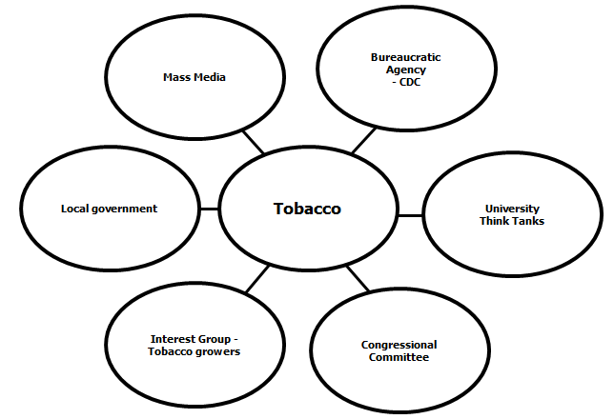

Slide 46
Bureaucratic Influence
Differences between Iron Triangles and Issue Networks:
The relationships within Iron Triangles seek only to benefit the three actors involved by pursuing a favorable policy for the interest group, at the expense of the constituencies that Congress and the Federal bureaucracy are supposed to represent, namely the general public.
Issue Networks differ from Iron Triangles in that they seek to support the public interests, not private ones, by seeking to benefit a wide ranging constituency that supports their side of the issue.
Issue networks can be antagonistic to iron triangles as they may oppose a policy pushed by a private interest group, and carried out by a government agency.

Slide 47
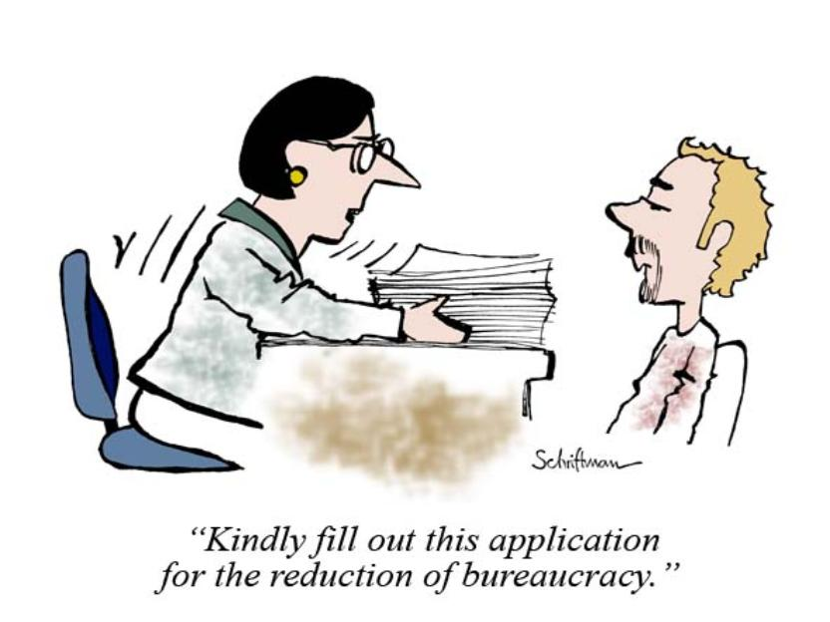
Bureaucratic Reforms

Slide 48
Bureaucratic Reforms
Alternatives to Bureaucracy:
Termination: eliminate programs
Very drastic, hard to accomplish
Devolution: downsizing the federal bureaucracy by delegating the implementation of programs to local/state govts.
“Politically safer” than termination
How is this related to the stats on civil servants?
Privatization: replacing government services with services provided by private firms
Works best at local Level: Trash collection
Leads to fewer govt. workers, though the govt. still funds these private contracts

Slide 49
Bureaucratic Reforms
Most reforms have centered on give the president more control:
The Brownlow Commission (1936-37)
Give presidents more assistants
The First Hoover Commission (1947-49)
Improve top level management
The Ash Council (1969-71)
Consolidate agencies into “super departments”

Slide 50
Bureaucratic Reforms
Incentives for efficiency and productivity
Government Performance and Results Act of 1997
Wanted more employee control and fewer detailed rules
Performance Assessment Rating Tool
Link reform to budget process (W. Bush)
Reform is hard
Reform could lead to other problems
May make the bureaucracy even more powerful or
Make one part of government more powerful than the others

Slide 51
Bureaucratic Reforms
Helping out the Whistleblowers
Definition: Anonymously bring public attention to govt. inefficiency and/or illegal action
Whistle Blower Protection Act (1989)—investigates possible illegal punishment of bureaucrats who report waste/fraud/abuse
Sunshine laws: require agencies to conduct many sessions in public
The 1966 Freedom of Information Act: opened up government files to citizen requests for information, in particular about themselves
After 9/11, however, the government established a campaign to limit disclosure of any information that could conceivably be used by terrorists
Sunset laws

