Slide 1
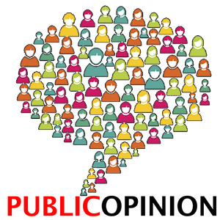
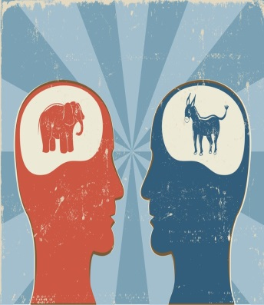
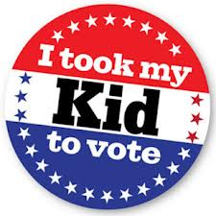
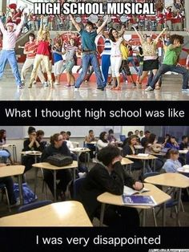
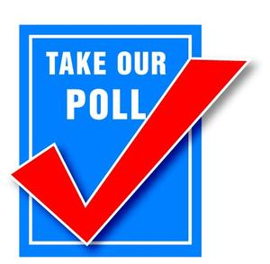
Public Opinion, Socialization and Ideology
Objective: SWBAT describe what public opinion is and how we measure it; outline the major factors that shape public opinion; describe the relationship between public opinion and public policy; and explain both sides of the argument that claim that low levels of political knowledge among ordinary voters impacts US democracy.
Agenda:
Unit 1 Reflection
Discuss Tests/Grades
Notes
HW:
Key Terms
Start Reading Debate

Slide 2
What is Public Opinion?
Public opinion: How people think or feel about particular things
Politics, weather, sports teams, clothing, etc.
Not easy to measure
The opinions of active and knowledgeable people (elites) carry more weight
Public Opinion Polls: an investigation into public opinion conducted by interviewing a random sample of people
Usually scientific…but be careful!
Who did the poll?
Who paid for it and why?
How many people were questions?
How were they chosen?
What area, nation, state or region – or what group, teachers, lawyers, Democrats?

Slide 3
Measuring Public Opinion
The Role of Polls in American Democracy
Help politicians figure out public preferences
Does it make politicians think more about following the polls?
The wording of questions makes a difference
Are questions ‘loaded’?

Slide 4
Modern Polling Characteristics
Sampling: Need a “Random” sample
Method of selection in which every citizen has an equal probability of being selected
Valid Questions: Questions need to be phrased and ordered in a fair way (clear, fair, unbiased)
How were the questions asked and were the questions “weighted” to force a desired response?
How Poll is Taken:
Respondent needs to have some knowledge of issues; pollsters appearance/tone can’t influence responses
Methods include: phone [use of Interactive Voice Response (IVR)], mail, and in-person interviews

Slide 5
Other Terms
Universal sample – means the whole population the poll aims to measure
Quota sample – looking for a specific audience
Sampling error – reflects the difference in results of random samples taken at the same time
Exit poll – done on election day By interviewing voters on Election Day as they leave (exit) the voting site
Predict winners before votes are tallied
Provide valuable information about voters and their preferences
Helps us understand the outcome

Slide 6
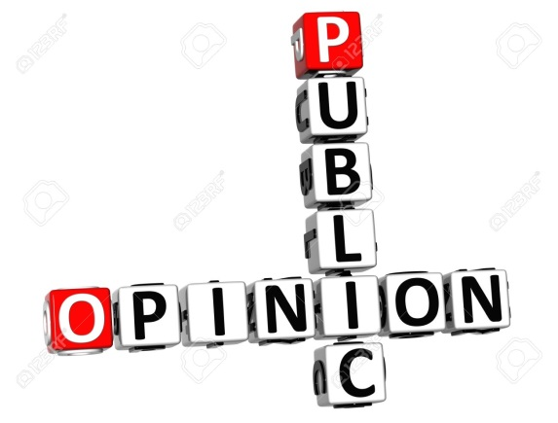
Modern Polling
Analysis & Results Reporting: Many factors must be observed
Margin of Error (MOE): The level of confidence in the findings of a public opinion poll
For populations over 500,000, pollsters need to make about 15,000 phone calls to reach 1,065 respondents, ensuring the poll has a margin of error of only +/- 3%
Sample Size Sampling Error (+ or -)
2,430 = 2.0
1,536 = 2.5
1,067 = 3.0
600 = 4.0
150 = 8.0
42 = 15.0

Slide 7
Modern Polling – Internet/texting TV shows
Poll bearers:
http://www.cc.com/video-clips/xd8n18/the-daily-show-with-jon-stewart-poll-bearers

Slide 8
Analysis of Poll Qs
Compare these questions:
Question 1: Should laws be passed to eliminate all possibilities of special interests giving huge sums of money to candidates?
Yes = 99%
No = 1%
Question 2: Should laws be passed to prohibit interest groups from contributing to campaigns, or do groups have a right to contribute to the candidate they support?
Prohibit Contribution: 40%
Groups Have Right: 55%

Slide 9
Analysis
Compare these questions:
Sometimes you hear it said there should be a law to ensure that a certain number of federal contracts go to minority contractors. Do you favor such a law?
Favor Law: 43%
Oppose Law: 57%
The Congress of the US—both the House of Representatives and the Senate—have passed a law to ensure that a certain number of federal contracts go to minority contractors. Do you favor such a law?
Favor Law: 57%
Oppose Law: 43%

Slide 10
Problems with Polls
Yes/no answers pose problems when the issues admit to shades of gray
Often people will attempt to please the interviewer
Sometimes people don’t really know anything about the topic
Push polls: attempts to spread negative statements about a candidate by pretending to be a polltaker

Slide 11
Technology and Polling
The advent of telephone polling
Easier and less expensive than door-to-door polling
But many entities are conducting “polls” and “market research” so nonresponse rates have skyrocketed
Cell Phone Only Homes
Young people
Hard to know who has cell phone and home phone #’s
More polls are starting to include these because of the loss of landlines and not being able to get adequate samples
Internet polling
Many unscientific “nonpolls” are seen on the Internet
Used to be considered less reliable because only people who want to respond click on the links
However, they are becoming more and more reliable for some things

Slide 12
Why do we need to measure Public Opinion?
Easy Answer:
There are differences among people and what they believe

Slide 13
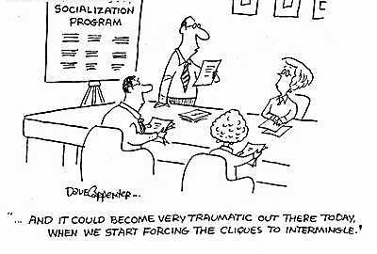
Shaping Public Opinion
Political Socialization:
Process by which background traits influence one’s political views
ONGOING, LIFE-LONG PROCESS.
Helps us comprehend the political system
Helps us learn to be citizens (members of a political society)

Slide 14
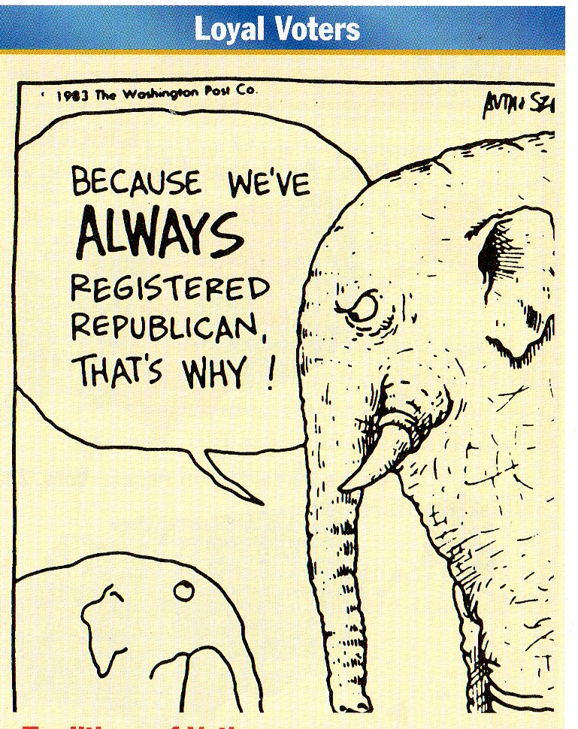
Agents of Socialization
#1 – Family
Our first political ideas are shaped within the family.
Parents seldom “talk politics” with their young children directly, but casual remarks made around the dinner table or while helping with homework can have an impact.
Family tradition is particularly a factor in party identification, as indicated by the phrases “lifelong Republican” and “lifelong Democrat.”
Families create loyal voters

Slide 15
Agents of Socialization
Compare the Child’s Party with the
Parents’ Party
Child's party | Parent Democrat | Parent Independent | Parent Republican
Democrat | 66% | 29% | 13%
Independent | 27% | 53% | 36%
Republican | 7% | 17% | 51%

Slide 16
Agents of Socialization
#2 – Schools and education
Children are introduced to elections and voting when they choose class officers, and the more sophisticated elections in high school and college teach the rudiments of campaigning.
Political facts are learned through courses in American history and government, and schools, at their best, encourage students to critically examine government institutions.
Studies show the more formal education one receives, the more knowledge of issues and events, the more likely we are to participate.

Slide 17
Agents of Socialization
#3 – Religion
The concept of the separation of church and state does not prevent religion from acting as a force in American politics.
Very complicated but most pronounced regarding social issues
Strongly held beliefs affect the stand individuals take on issues such as public school prayer and state aid to private or parochial schools.
Religion can also determine attitudes on abortion and gay and lesbian rights, irrespective of other factors.
It is important to recognize, however, that the major religious groups in the United States—Protestant, Catholic, and Jewish as well as the growing Islamic—have their own liberal and conservative wings that frequently oppose each other on political issues.

Slide 18
Agents of Socialization
#4 – Peers
Although peer pressure certainly affects teenagers' lifestyles, it is less evident in developing their political values.
Exceptions are issues that directly affect them, such as the Vietnam War during the 1960s.
Later, if peers are defined in terms of occupation, then the group does exert an influence on how its members think politically.
For example, professionals such as teachers or bankers often have similar political opinions, particularly on matters related to their careers.

Slide 19
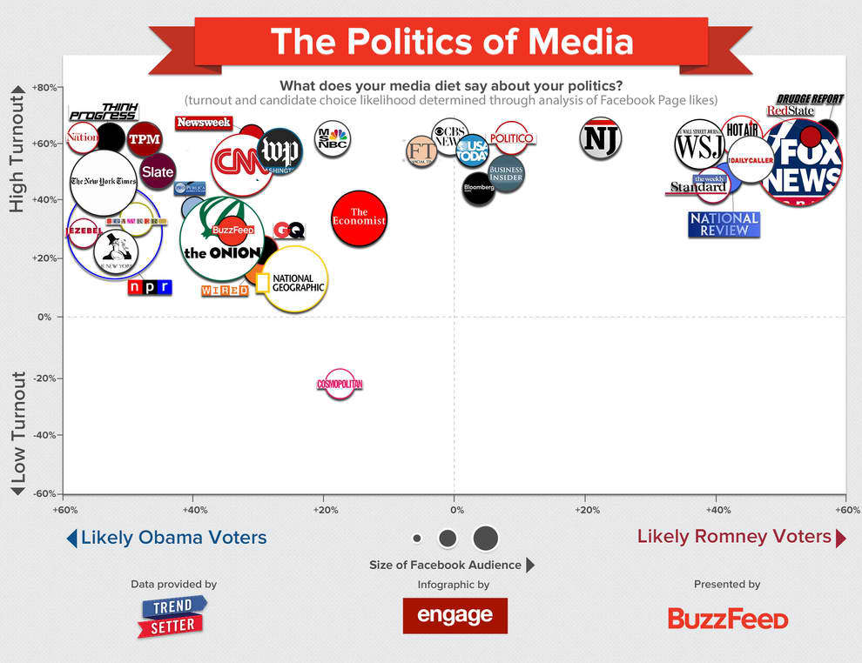
Agents of Socialization
#5 – Media
Much of our political information comes from the mass media: newspapers, magazines, radio, television, Internet.
TV not only helps shape public opinion by providing news and analysis, but also its entertainment programming addresses important contemporary issues that are in the political arena, such as drug use, abortion, and crime.
People tend to gravitate towards media that matches their views = Selective attention

Slide 20
Agents of Socialization
#6 – Socio-economic status
All Americans generally favor a limited government and emphasize the ability of everyone to succeed through hard work.
But, low-income Americans tend to endorse a stronger economic role for the federal government than do wealthier Americans, particularly by supporting programs such as welfare and increases in the minimum wage.
Wealthier Americans are the ones who mostly pay for social programs, and they naturally want to hold down their tax burden.
This belief in individual responsibility may overcome a worker's self-interest in endorsing large social programs.

Slide 21
Agents of Socialization
#7 – Gender
Gender gap: a term that refers to the varying political opinions men and women hold, is a recent addition to the American political lexicon.
Unmarried women hold political views distinct from those of men and married women, views that lead them to support the Democratic party at a disproportionate rate.
Men have become increasingly Republican since the mid-1960s
Studies indicate that more women than men approve of gun control, want stronger environmental laws, oppose the death penalty, and support spending on social programs.
These “compassion” issues are usually identified with the Democratic party.

Slide 22
Agents of Socialization
#8 – Race and ethnicity
Self-interest plays a significant role in attitudes on racial policies.
Racial and ethnic minorities tend to favor affirmative action programs, designed to equalize income, education, professional opportunity, and the receipt of government contracts.
Because such policies make it easier for members of minority groups, such as African Americans and Hispanics, to get good jobs and become affluent, group members naturally support them at a high rate.

Slide 23
Agents of Socialization
#8 – Race and ethnicity – continued
Beginning with the presidency of Franklin Roosevelt, African Americans switched their allegiance from the Republicans, the “party of Lincoln,” to the Democrats
African-Americans and Latinos tend to be democrats
Asian-Americans tend to be republican, but that looks as if it’s changing

Slide 24
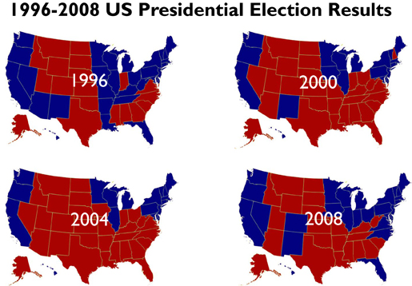
Agents of Socialization
#9 – Region
The region of the country a person lives in can affect political attitudes.
The Southern states tend to support a strong defense policy, a preference reinforced by the presence of many military installations in the region.
Moreover, issues that are vital in one particular region generate little interest in others—agricultural price supports in the Midwest or water rights and access to public lands in the West, for example.
Questions about Social Security and Medicare have an added importance in the Sunbelt states with their high percentage of older adults.
Overall:
Pacific states, upper Midwest and northeast – Democrat
South, plains, and mountain states - Republican

Slide 25
Agents of Socialization
#10 – Age
Think of the different views between a 25 year old father and a 70 year old grandfather!
Elderly tend to oppose increases in public school spending while supporting Social Security & Medicare increases.
Strong political lobby in the AARP
While some younger people are concerned that Social Security won’t be around when they retire, favor changes, public school financing, etc. Many are apathetic and disconnected

Slide 26
Cleavages in Public Opinion
If you noticed, many of the things that socialize us to participate in politics also cause what are called political cleavages (divisions)
Gender
Age
Race and ethnicity
Socioeconomic status

Slide 27
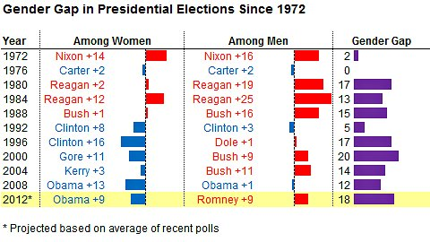

Slide 28
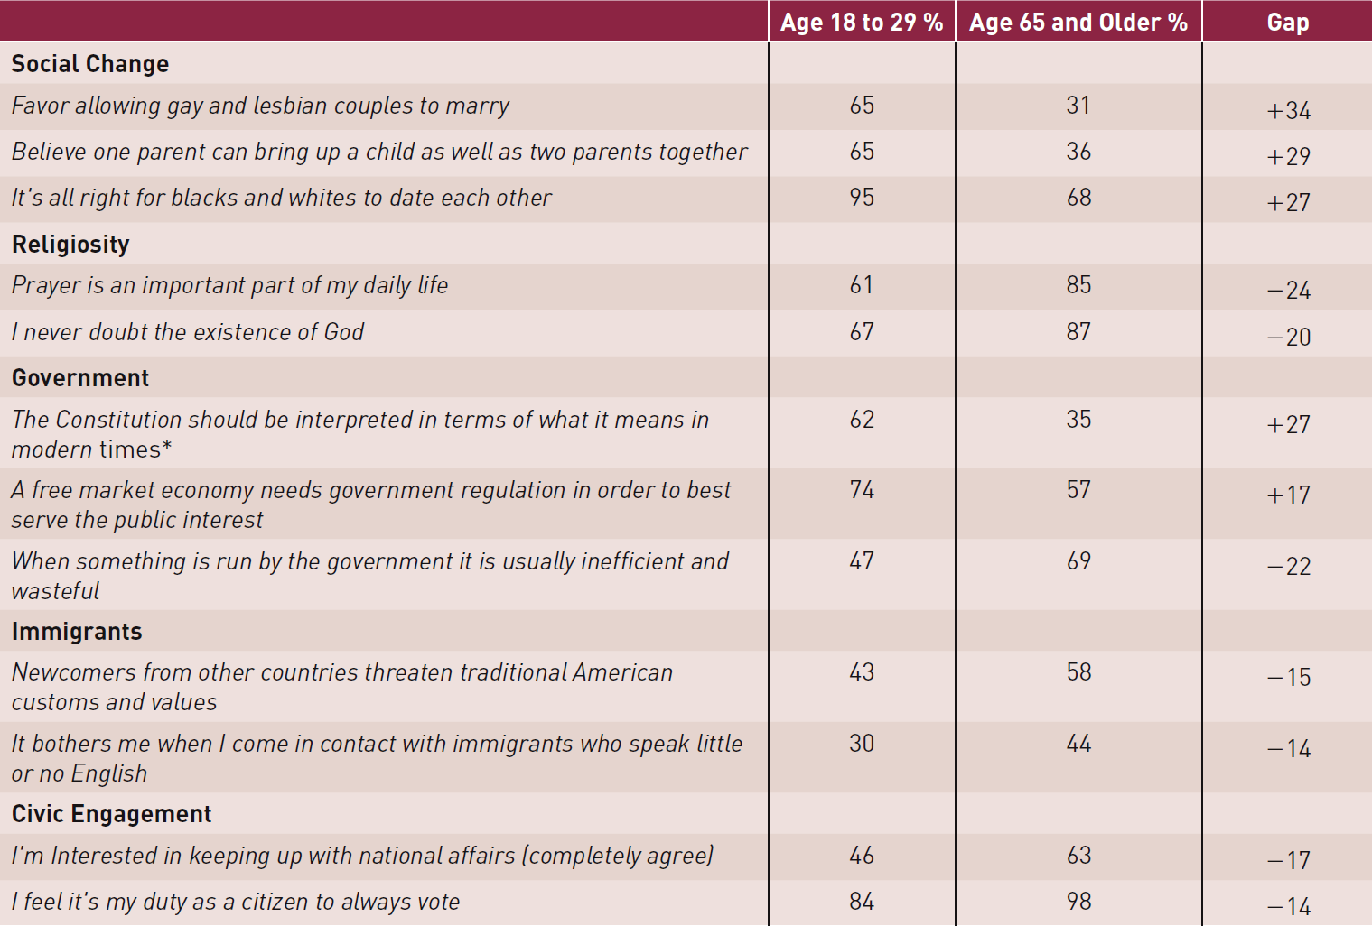
Opinion Gaps Between Young Adults and Senior Citizens in 2012

Slide 29
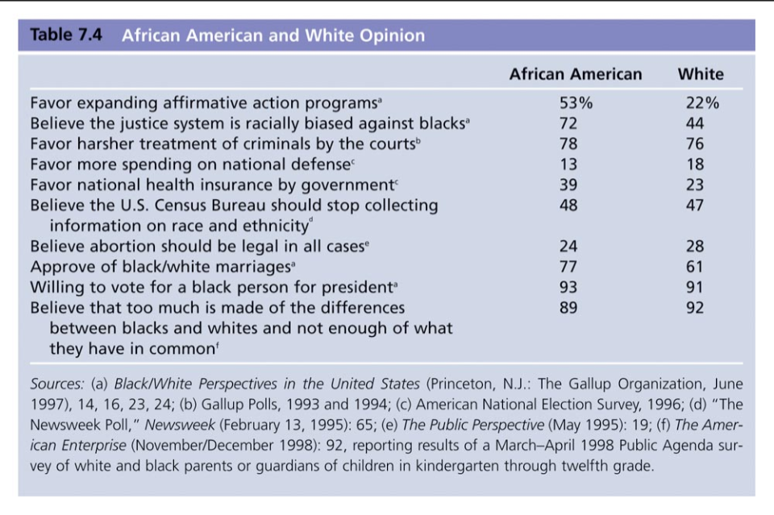

Slide 30
Political Ideology
Political ideology: a more or less consistent set of beliefs about what policies government ought to pursue
Tells us two things about people’s beliefs:
How much change in government a person is willing to allow (and how fast that change should take place)
How much the government should intervene, or get involved, in the lives of people (particularly with respect to the economy)

Slide 31
Political Ideology
Traditional political ideologies:
Liberal (Lefty): favor use of governmental power to promote individual liberties & social progress
‘Hands Off’ Socially, while ‘Hands On’ Economically
Conservative (Righty): favor traditional values (the status quo), and the idea that govt. should stay out of the affairs of private citizens
‘Hands Off’ Economically, while ‘Hands On’ Socially
Moderate (Center): opposed to extreme views - fall between being a Liberal & Conservative
Most Americans are Moderate

Slide 32
Quick Overview
LEFT
Used to describe people who support change in society and government intervention
RIGHT
Refers to people who hold traditional values and want less government intervention

Slide 33
POLITICAL SPECTRUM OF IDEOLOGIES
LEFT
RIGHT
LIBERAL
CONSERVATIVE
RADICAL
MODERATE
REACTIONARY
For rapid change
Violence/revolution may be taken to achieve chg.
Go back to “Good ol’ days”
Govt. repression of citizens/dictatorship is fine.

Slide 34
Modern View of American Ideologies
Includes two more divisions:
Populists: liberal in economic affairs favoring govt. regulation of the economy, but conservative in social affairs
“Hands on everything!”
Libertarians: consistent in favoring sharp limitations on govt. action in both economic & social issues
“Hands off everything!”

Slide 35
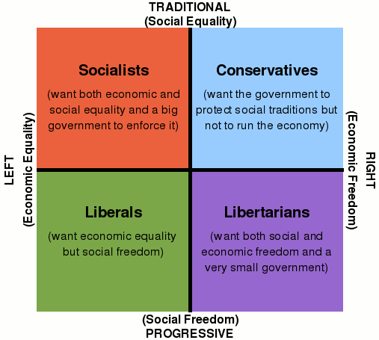
A Four-Cornered Ideological Grid
In this grid, the colored squares represent four different political ideologies.
The vertical choices range from cultural order to cultural liberty. (Fascism to Anarchism)
The horizontal choices range from economic equality to economic liberty. (Communism to Libertarianism/Neo-Liberalism)

Slide 36
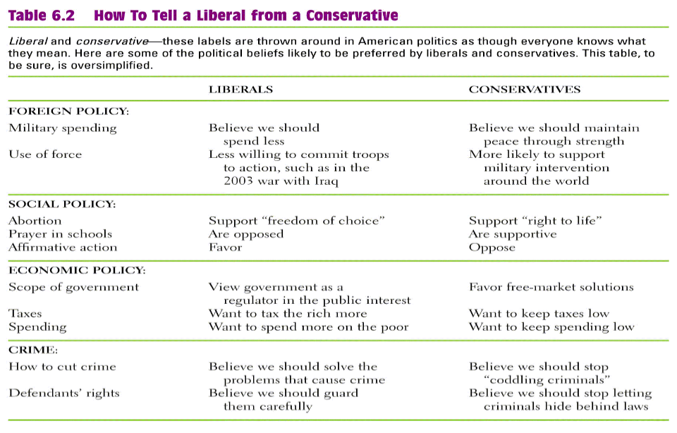
What Americans Value: Political Ideologies

Slide 37
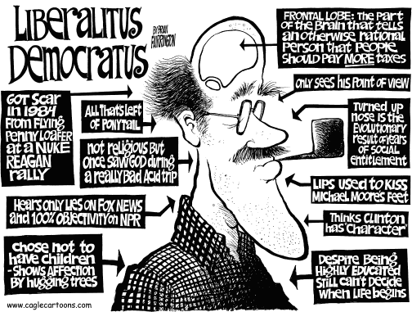

Slide 38
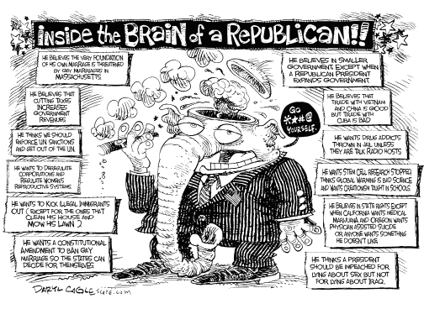

Slide 39
Spectrums vs. Parties
Political parties are loosely formed around these broad political ideologies.

Slide 40
TWO MAJOR U.S. PARTIES
DEMOCRATS
Generally seen as liberal because they support government regulation of the economy
REPUBLICANS
Generally seen as conservative because they advocate a reduction in government

Slide 41
More Specifically…
Within parties, there are people who hold a variety of opinions on social and economic issues that fall along the spectrum of political ideologies
Examples are liberal Democrats, moderate Democrats, moderate Republicans, and conservative Republicans

Slide 42
BOTH PARTIES LEAN TOWARD MODERATE
Current theorists say that U.S. political parties are becoming increasingly moderate and therefore less easily separated on the political spectrum
DEMOCRATS
REPUBLICANS

Slide 43
Political Elites, Public Opinion and Public Policy
Liberal and Conservative Elites
Political elites: persons with disproportionate share of political power
This is why people tend to perceive Americans as more ideologically divided
Activists – People most involved in politics
Elites do
Raise and frame issues (get public to side with them)
State norms
Norms: a Standard of right or proper conduct
Define thinking on foreign affairs
Elites do not
Define economic problems
Influence thinking on crime/drug problems

Slide 44
Ideology Typology: Eight Types of Americans | Percent of …
 | General Public % | Registered Voters % | Politically Engaged %*
The Partisan Anchors | 36 | 43 | 57
Steadfast Conservatives Socially conservative populists | 12 | 15 | 19
Business Conservatives Pro-Wall Street, Pro-Immigrant | 10 | 12 | 17
Solid Liberals Liberal across the board | 15 | 17 | 21
Less Partisan, Less Predictable | 54 | 57 | 43
Young Outsiders Conservative views on Government, not Social Issues | 14 | 15 | 11
Hard-Pressed Skeptics Financially stressed and pessimistic | 13 | 13 | 9
Next-Generation Left Young, liberal on social issues, less so on social safety net | 12 | 13 | 11
Faith and Family Left Racially diverse and religious | 15 | 16 | 12
Bystanders Young, diverse, on the sidelines of politics | 10 | 0 | 0
*Politically engaged are registered to vote, closely follow public affairs, and say they always or nearly always vote. **2014 Political Typology Survey by the Pew Research Center**
Notes:
Table 7.8
Source: Adapted from Beyond Red v. Blue: The Political Typology , Pew Research Center for the People and the Press, May 4, 2011.

Slide 45
Public Opinion and Policy Making
General public believes that leadership should pay attention to popular opinion
Limits on government action
Public opinion is strongest in preventing politicians from embracing highly unpopular policies

Slide 46
Proud To Be An American
Click picture to play video
http://college.cengage.com/polisci/polisci_shared/courseware/media/player.html?video=proud_to_be_an_american

