Slide 1
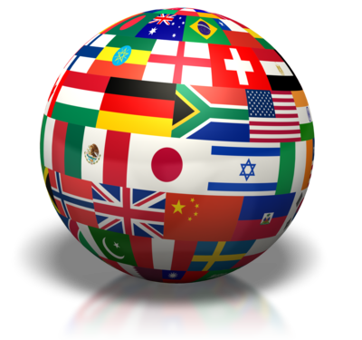
Part Six: Public Policy
“Justice is itself the great standing policy of civil society; and any eminent departure from it, under any circumstances, lies under the suspicion of being no policy at all.” – Edmund Burke (Irish statesman)

Slide 2
Public Policy
Public Policy Definition: Decisions the govt makes to address issues and solve problems
All political systems set policy
Discussion Question: How do political systems set policy?

Slide 3
Public Policy
Public Policy Definition: Decisions the govt makes to address issues and solve problems
All political systems set policy
Discussion Question: How do political systems set policy?
Legislative vote
Executive decisions
Judicial Rulings
Interest groups and/or political parties (in some countries)

Slide 4
Public Policy
Many issues are similar in almost all countries, but governments differ in the approaches they take to various issues & the importance they place on addressing certain issues
Common issues:
Economic Performance
Social Welfare
Civil Liberties
Environment

Slide 5
Public Policy – Economic Performance
Common Measures of Economic Performance
Gross Domestic Product (GDP)
All the goods and services produced by a country’s economy in a given year, excluding income earned outside country
GDP per Capita: GDP divided by population of country
Gross National Product (GNP)
GDP + income citizens earned outside the country
GNP per Capita: GNP divided by population of country
Purchasing Power Parity (PPP)
Like GNP, except it takes into account what people can buy using their income in local economy
PPP per Capita: PPP divided by population of country

Slide 6
Comparative Economic Indexes (2013)
INDEX | CHINA | IRAN | MEXICO | NIGERIA | RUSSIA | BRITAIN
GDP (in billions) | 12, 380 | 997.4 | 1,761 | 450.5 | 2,504 | 2,323
GDP per Capita | 6,076 | 7,211 | 8,900 | 1,631 | 14,247 | 38,589
PPP per Capita | 9,100 | 13,100 | 15,300 | 2,700 | 17,700 | 36,700
Notes:
Sources: IMF (2012), CIA World Factbook (2013) via Ethel Wood

Slide 7
Public Policy – Economic Performance
Discussion Question:
Analyze the data in the previous slide. How does the measure of economic performance (index) used change the conclusions you are likely to make when comparing countries in the AP6? (Be specific)

Slide 8
Public Policy – Economic Performance
Discussion Question:
Analyze the data in the previous slide. How does the measure of economic performance (index) used change the conclusions you are likely to make when comparing countries in the AP6? (Be specific)
If you just use GDP, Iran appears far below China and slightly below Mexico, but if we use PPP per capita, Iranians are economically better off than the Chinese and are similar to the Mexicans
Russia almost doubles Iran’s GDP per capita, but when adjusted for PPP per capita, Russians do not earn twice as much

Slide 9
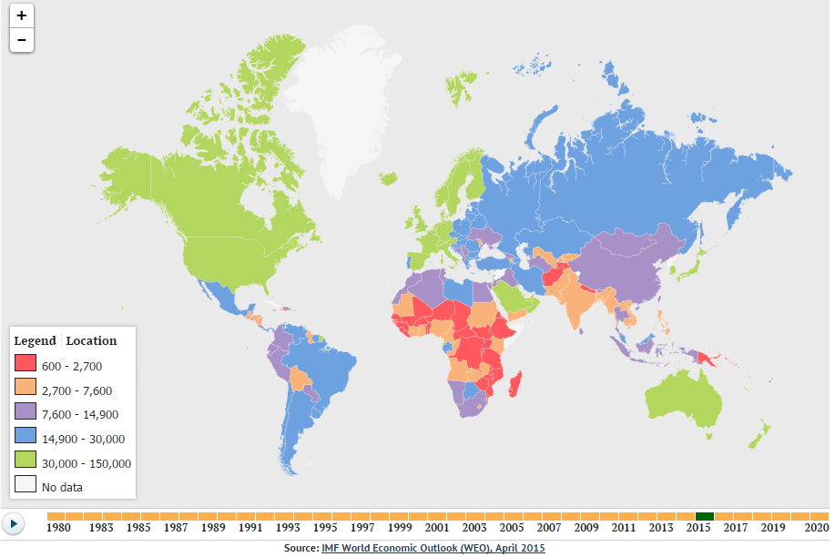
Purchasing Power Parity

Slide 10
Public Policy – Social Welfare
Social Welfare
Health
Employment
Family assistance
Education
Measures of Social Welfare
Literacy rates
Distribution of income
Life expectancy
Education levels
Notes:
States provide different levels of support in each area and may have different attitudes toward gov’t responsibility for social welfare

Slide 11
Public Policy – Social Welfare
Gini Index
A mathematical formula that measures the amount of economic inequality in a society
0 = perfect equality, 1= complete inequality
U.S. (2009) | .41
UK | .36
Russia | .375
Iran | .383
China | .415
Nigeria | .43
Mexico | .48
Notes:
Other countries: Norway .26, Canada .33

Slide 12
Public Policy – Social Welfare
Discussion Question:
Analyze the data in the previous slide. How does the U.S. compare in terms of inequality to the countries in the AP6? (Be specific)

Slide 13
Public Policy – Social Welfare
Discussion Question:
Analyze the data in the previous slide. How does the U.S. compare in terms of inequality to the countries in the AP6? (Be specific)
More inequality than: UK, Russia, Iran
About the same as: China & Nigeria
Less than Mexico

Slide 14
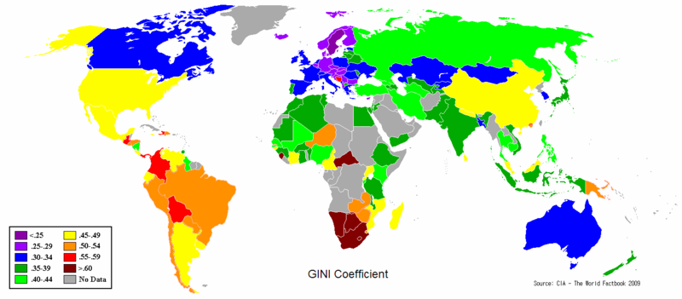

Slide 15
Public Policy – Social Welfare
Human Development Index (HDI)
Measures the well-being of a country’s people by factoring in life expectancy (health), mean & expected years of school (education) and GNP per capita (living standards)
Health + Education + Living Standards = HDI
Index Scale
Index scale is 0 – 1 (decimal score)
Scores over .80 = high levels of HD
Scores under .50 = low levels of HD

Slide 16
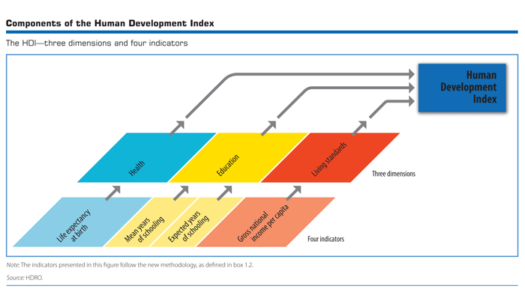
Public Policy – Social Welfare

Slide 17
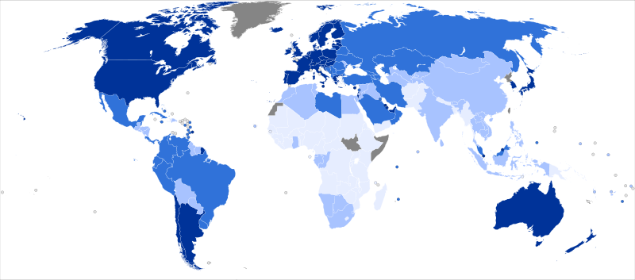
Human Development Index Darker colors indicate more developed
Notes:
2012 Rankings:
Very High: 1. Norway, 2. Australia, 3. U.S., 4. Netherlands, 5. Germany (Britain = #26)
High: 55. Russia, 61. Mexico, 76. Iran
Medium: 101. China
Low: 153 Nigeria

Slide 18
Public Policy
Civil Liberties: Political Rights and Freedoms
Political rights – promotion of equality
Political freedoms – promotion of freedom
Freedom House Rankings
Ranks countries on 1 to 7 scale
1 = most free, 7 = least free
Country (2015) | Rating | Political Rights | Civil Liberties
China | 6.5 Not Free | 7 | 6
Iran | 6 Not Free | 6 | 6
Mexico | 3 Partly Free | 3 | 3
Nigeria | 4.5 Partly Free | 4 | 5
Russia | 6 Not Free | 6 | 6
UK | 1 Free | 1 | 1
US | 1 Free | 1 | 1
Notes:
Civil Liberties:
Freedoms for invidiviuals such as speech, assembly, religion, property, life, fair trial
Freedoms or protection from gov’t
Political Rights differ from civil liberties in that they often refer to political participation, such as voting, lobbying, protesting or running for office
Gov’t may grant or protect political rights

Slide 19
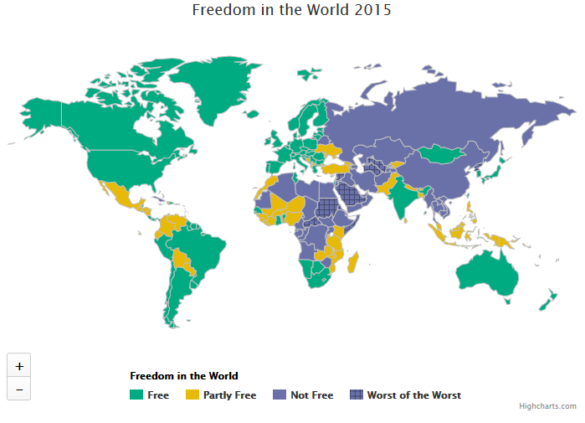
Public Policy
Notes:
Civil Liberties:
Freedoms for invidiviuals such as speech, assembly, religion, property, life, fair trial
Freedoms or protection from gov’t
Political Rights differ from civil liberties in that they often refer to political participation, such as voting, lobbying, protesting or running for office
Gov’t may grant or protect political rights

Slide 20
Public Policy - Challenges
Globalization
The increasing interconnectedness and interdependence of people, cultures, economies, and nation-states facilitated by technology, trade, and cultural diffusion
Environment
European countries – formation of “green” parities
International conferences
Population
Immigration + migration
Terrorism

Slide 21
Public Policy - Challenges
Corruption:
The illegitimate use of political or economic power for personal or illegal purposes
Transparency International is an NGO that evaluates & publicizes report of corruption in business/politics.
Corruption Perceptions Index (CPI)
Ranks Countries 0 (very corrupt) – 100 (very clean)
Predict: Which countries of the AP6 will have the least corruption? The most?

