Slide 1
Part Five: Political & Economic Change
“A confidence problem exists on the part of the people of the region who desire democratic rule in principle, but remain suspicious of both the fashion with which democratization is presented and the purposes of the democratic world.” -- Recep Tayyip Erdogan (Prime Minister of Turkey)

Slide 2
Political and Economic Change
Occur together and often influence one another
China has implemented rapid economic change (capitalist reforms) but have resisted political change
Types of Change
Reform – change the methods used to reach generally accepted goals
Does not advocate overthrowing basic institutions
Revolution
Either a major revision or overthrowing basic institutions
Usually has major impact in more than one area
Examples: American/French Revolution or Industrial Revolution
Coup d'état
Replace leadership with new leaders
Use of force, often by the military
New leaders are always vulnerable to another coup
Notes:
Political and Economic Change:
If one occurs without the other, tensions are created that have serious consequences.
Ex: rapid economic changes in China have strongly pressured the govt to institute political changes. So far they have resisted those changes.
Reform:
Want to change some of the methods that political and economic leaders use to reach goals that society generally accepts
Ex – may want to change business practices in order to preserve real competition in a capitalist country, or may want govt to become more proactive in preserving natural environment
Revolution:
Ex: Industrial Rev changed economies of Europe (feudalism to capitalism) but eventually changed political systems, social classes, etc
Ex: Fr/Amer Rev were directed at changing political systems, but also changed economies and societal practices
Coup d’etats:
Literally “blows to the state”
Most limited of the 3 types of change
Typically occur in countries where govt institutions are weak and leaders have taken control by force
New leaders are always vulnerable to being overthrown by another coup

Slide 3
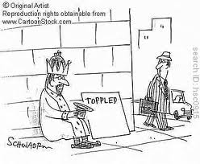

Slide 4
Attitudes Toward Change
Radicalism – often lead a revolution
Rapid, dramatic changes
Replace current system with something better
Liberalism – supports reform (not the same as liberal ideology)
Gradual change instead of revolution
Belief in a need for improvement
Conservatism
Less supportive of change/seen as disruptive
Don’t want to undermine legitimacy of state
Reactionaries
Protect against change
Want to turn the clock back to an earlier era
Similar to radicals, would be willing to use force
“When you are right you cannot be too radical; when you are wrong, you cannot be too conservative. “ Martin Luther King, Jr.
Notes:
Radicalism
Ex: In 1917 in Russia, the old czarist regime was replaced by communist USSR
Radicals are often leaders of revolution
Liberalism:
Not the same as liberal ideology
Supports reform – don’t think political/econ systems are permanently broken, but need to be fixed/improved
Conservatism
Tend to see change as disruptive
Don’t want to undermine legitimacy of state/regime
Reactionary:
Oppose revolution and reform, but also don’t want status quo
Want to reinstate political, social and econ institutions that once existed (ex. KKK wants to restore institutional racism)
Like radicals they are more willing to use violence than Liberals/Conservatives

Slide 5
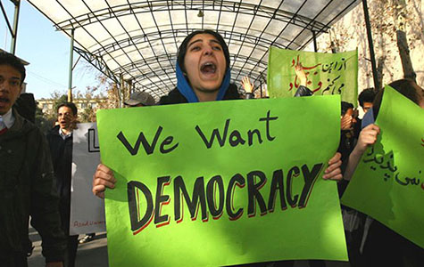
Three Trends of Development
Democratization
Move Towards Market Economies
Revival of Ethnic/Cultural Politics
Indicates growing commonalities among nations
Represents fragmentation
Notes:
Review of Democracies:
Democracy takes many forms
One broad, essential requirement is existence of competitive elections (regular, free and fair)
Gray area – Russia, Nigeria, Indonesia
Liberal/Substantive Democracies:
Competitive elections, civil liberties, rule of law, neutral judiciary, open civil society, civilian control of military
Illiberal/Procedural Democracies:
Have democratic procedures in place, but have significant restrictions
Ex. Have rule of law, but not always followed by those in power
Ex. Presidents have disproportionate share of power
Ex. Elections lack true competitiveness
*Presence of a procedural democracy (illiberal) is a necessary condition for development of a substantive democracy (liberal)

Slide 6
Review of Democratization
Democratization:
The spread of representative governments to more countries and the process of making governments more representative…
The transformation process from a nondemocratic regime to a illiberal/procedural democracy to a liberal/substantive democracy
What must be present to qualify as a illiberal/procedural democracy?
What must be present to qualify as a liberal/substantive democracy?
Notes:
Review of Democracies:
Democracy takes many forms
One broad, essential requirement is existence of competitive elections (regular, free and fair)
Gray area – Russia, Nigeria, Indonesia
Liberal/Substantive Democracies:
Competitive elections, civil liberties, rule of law, neutral judiciary, open civil society, civilian control of military
Illiberal/Procedural Democracies:
Have democratic procedures in place, but have significant restrictions
Ex. Have rule of law, but not always followed by those in power
Ex. Presidents have disproportionate share of power
Ex. Elections lack true competitiveness
*Presence of a procedural democracy (illiberal) is a necessary condition for development of a substantive democracy (liberal)

Slide 7
Review of Democratization
Discussion Question:
TRUE or FALSE (be prepared to defend your answer):
The presence of an illiberal/procedural democracy is a necessary condition for development of a liberal/substantive democracy
Notes:
True!
Presence of a procedural democracy (illiberal) is a necessary condition but not sufficient for development of a substantive democracy (liberal)

Slide 8
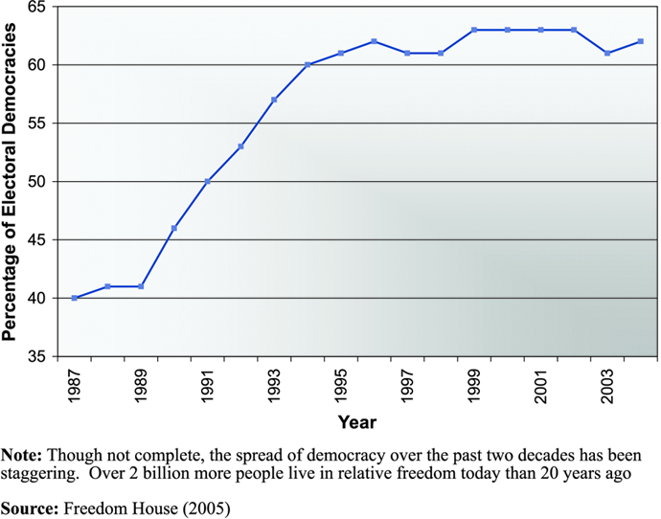

Slide 9
Three Trends of Development - #1 Democratization
Huntington’s 3 Waves of Democratization
1st wave – developed gradually over time
2nd wave – occurred after Allied victory in WWII 1945-1960’s
3rd wave – characterized by defeat of totalitarian rulers in S. America, Eastern Europe, and parts of Africa 1970’s-now
Notes:
Samuel Huntington, political scientist
Huntington’s 3 Waves:
2nd wave continued until 1960s –characterized by decolonization around the globe
3rd wave began during 70’s - now

Slide 10
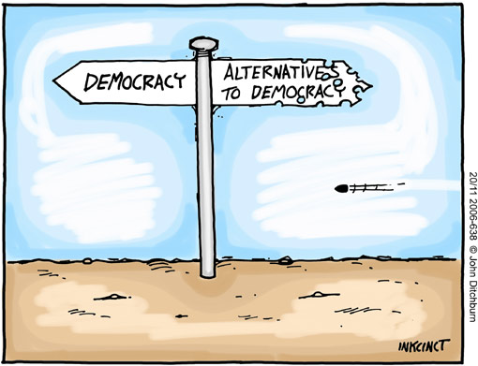
Three Trends of Development - #1 Democratization
Reasons for Democratization
Loss of legitimacy by authoritarian regimes
Expansion of middle class in developing countries
New emphasis on human rights
“Snowball Effect”
Examples: Arab Spring, & Poland in Eastern Europe
Starts with political liberalization and leads to other states recognizing it as a liberal democracy
Democratic consolidation
A stable political system is supported by all parts of society
Trigger event like and economic crisis or military defeat
Revolution of rising expectations
Willingness of ruling elite to share power and allow popular participation
Notes:
Reasons for Democratization
Loss of legitimacy by both right and left wing authoritarian regimes
Expansion of middle class in developing countries
New emphasis on human rights by U.S. and European Union
Snowball Effect – when one country in a region becomes democratic, it influences others to do so
Ex. Poland’s influence on other nations of eastern Europe in 1980’s, also Arab Spring
Huntington believes democracy may be declared when a country has had a least two successive peaceful turnovers of power.
Democratic Consolidation
An authoritarian regime may transition to a democracy as a result of a “trigger event,” such as an economic crisis or military defeat
Political discontent is generally fueled if the crisis is preceded by a period of relative improvement in standard of living – called “revolution of rising expectations.”
Democratization begins when these conditions are accompanied by a willingness on part of ruling elite to accept power-sharing arrangements and readiness of ppl to participate in democratic process
Political Liberalization
Eventually leads other states to recognize it as a liberal democracy

Slide 11
Three Trends of Development - #2 Economic Liberalism and Market Economies
Ideology of liberalism from 19th century Europe
Bourgeoisie – middle class professionals/businessmen – wanted views represented in government
More political & economic freedoms
Right to own property, freedom of speech, representation, free trade
Radicals (such as Karl Marx) advocated even more equality – even favored equality over liberty
Command Economy
Government owned industrial enterprises & sales outlets
Economy managed by central government planning
5-year plans very common
Central planning supported economic growth but by 1980’s most communist countries were in deep economic trouble.
Notes:
Ideology of Liberalism from 19th century Europe
Bourgeoisie wanted their views to be represented in government and their economic goals to be unhampered by govt interference
These values clashed with radicals who emphasized equality more than liberty
Command Economies:
Central planning supported economic growth by in many cases, esp in Soviet Union, by 1980s most communist countries found themselves in deep economic trouble.

Slide 12
Three Trends of Development - #2 Economic Liberalism and Market Economies
Discussion Question:
What was a major problem for 20th century communist countries with command economies?
Economic growth of major industries had not translated into higher standards of living for the citizens.
Notes:
A major problem was that economic growth of major industries had not translated into higher living standards for citizens

Slide 13
Three Trends of Development - #2 Economic Liberalism and Market Economies
Discussion Question: What was a major problem for 20th century communist countries with command economies?
A major problem was that economic growth of major industries had not translated into higher living standards for citizens
Notes:
A major problem was that economic growth of major industries had not translated into higher living standards for citizens

Slide 14
Three Trends of Development - #2 Economic Liberalism and Market Economies
Trend toward market economies based on private ownership of property and little interference from govt regulation
Mixed economy – some government involvement
Pure Market economy – no government involvement
Economic Liberalization:
Process of limiting the power of the state over private property and market forces
Privatization:
Transfer of state-owned property to private ownership
Notes:
Economic Liberalization:
Less gov’t involvement in economy

Slide 15
Command vs. Mixed vs. Market Economies
More Centralization
Less Centralization
COMMAND
ECONOMY
MIXED
ECONOMY
MARKET
ECONOMY
Right to own property is greatly restricted
All industry is owned by the govt
Competition and profit are prohibited
Elements of command and market economies are present/mixed
Right to own property is accepted/guaranteed
Most industry is owned by private individuals.
Competition and profit are not controlled by the govt

Slide 16
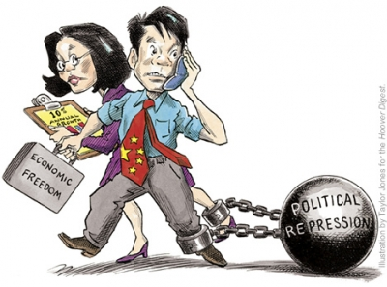
Three Trends of Development – #2: Economic Liberalism and Market Economies
Discussion Question: Is there a correlation between democratization and marketization?
Mexico has moved steadily toward a market economy since 1980’s and democratization has appeared to follow
China has been moving toward capitalism since late 1970’s without any clear sign of democratization

Slide 17
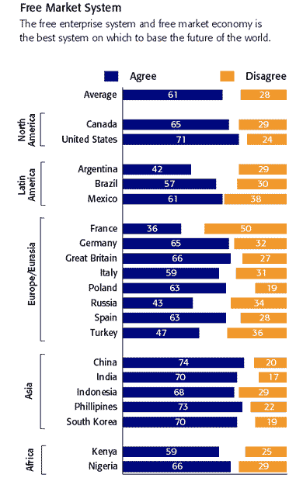

Slide 18
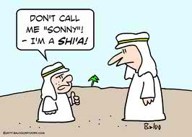
Three Trends of Development #3 Revival of Ethnic or Cultural Politics
Fragmentation vs. nationalism
Fragmentation – divisions based on ethnic or cultural identity
Nationalism – identities based on shared history, culture etc. (this is declining because of globalization)
Politicization of Religion – Samuel Huntington argued that our most important and dangerous future conflicts will be based on clashes of civilizations.
Esp. in Middle East
Tends to emphasize difference among nations
Notes:
Fragmentation – divisions based on ethnic or cultural identity
Nationalism – identities based on nationhood – had been declining in favor of increasing globalization
Politicization of Religion – 21st century
Samuel Huntingon argued that our most important and dangerous future conflicts will be based on clashes of civilizations:
The West
Orthodox world (Russia)
Islamic Countries
Latin American
Africa
The Hindu world
The Confucian world
The Buddhist world
Japan

