Slide 1
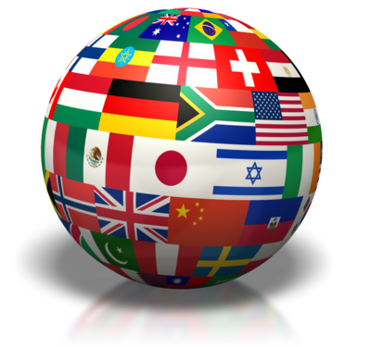
Part Four: Citizens, Society & the State
“I was in civil society long before I was ever in politics or my husband was ever even elected president.” – Hillary Clinton (American politician)

Slide 2
Social Cleavages
Definition
Factors that separate groups within a society
Considerations:
What are the types of social cleavages?
How are cleavages expressed in the political system?
Do multiple cleavages lead to more or less division?
Notes:
Social cleavages create us-them divisions in society

Slide 3
Bases/Types of Social Cleavages
Social Class
Examples?
Ethnic Cleavages
Based on different cultural identities, including religion/language
Most divisive and explosive
Examples?
Religious Cleavages
Closely intertwined with ethnicity
Examples?
Regional Cleavages
Involves competition for jobs, money and development projects
Examples?
Notes:
Bases of Social Cleavages:
What mix of social classes, ethnic/racial groups, religions and languages does a country have?
How deep are they – to what degree do they separate ppl from one another?
Which cleavages have the most impact on the political system?
Social Class:
Class awareness has declined in industrial and post-industrial societies but still is a cleavage
GB – traditionally middle class voters have supported Conservative Party and working-class have supported Labour Party
LDC – class tensions btw landless peasants and property owners
India – vestiges of old caste system
Ethnic:
Examples – civil wars in former Yugoslavia, Russia (Chechnya), Nigeria (Biafra)
Religious:
Northern Ireland – Irish Nationalists = strong Catholics, loyalists = strong Protestants
Iran and Iraq (Shiite/Sunni)
May also exist among people of similar ethnic backgrounds (ex: in U.S. between fundamentalist and non-fundamentalist Christians)
Regional:
Nigeria – ec. Inequalities resulted in regional conflicts and the secession of Biafra and civil war

Slide 4
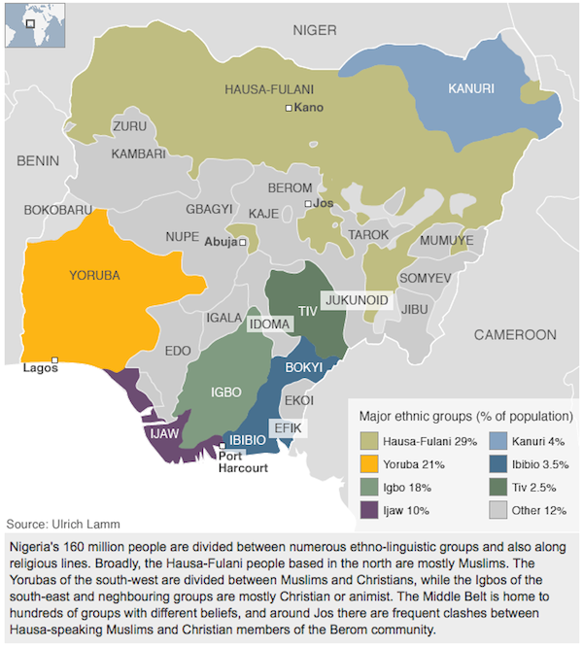

Slide 5
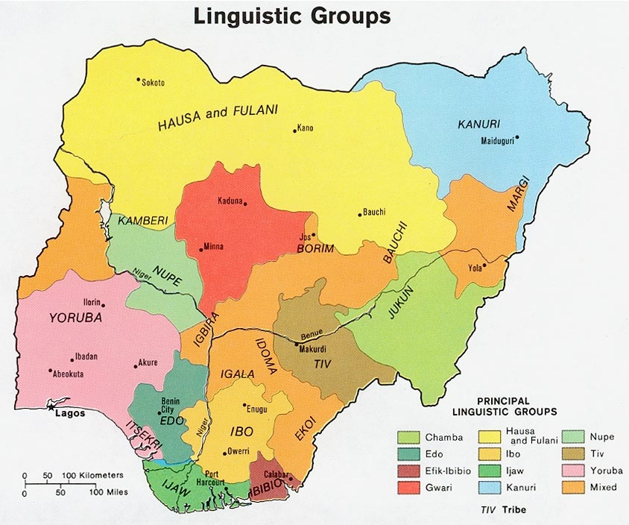

Slide 6
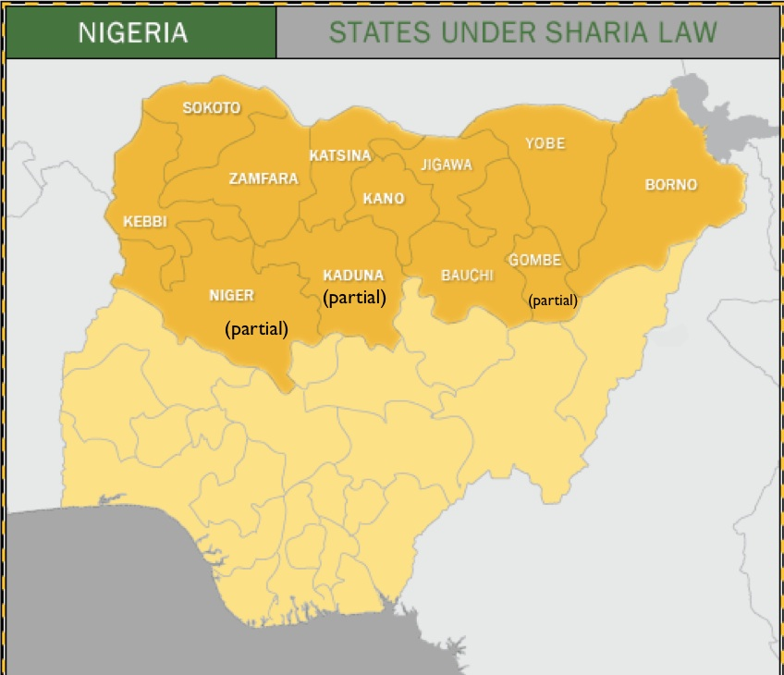

Slide 7
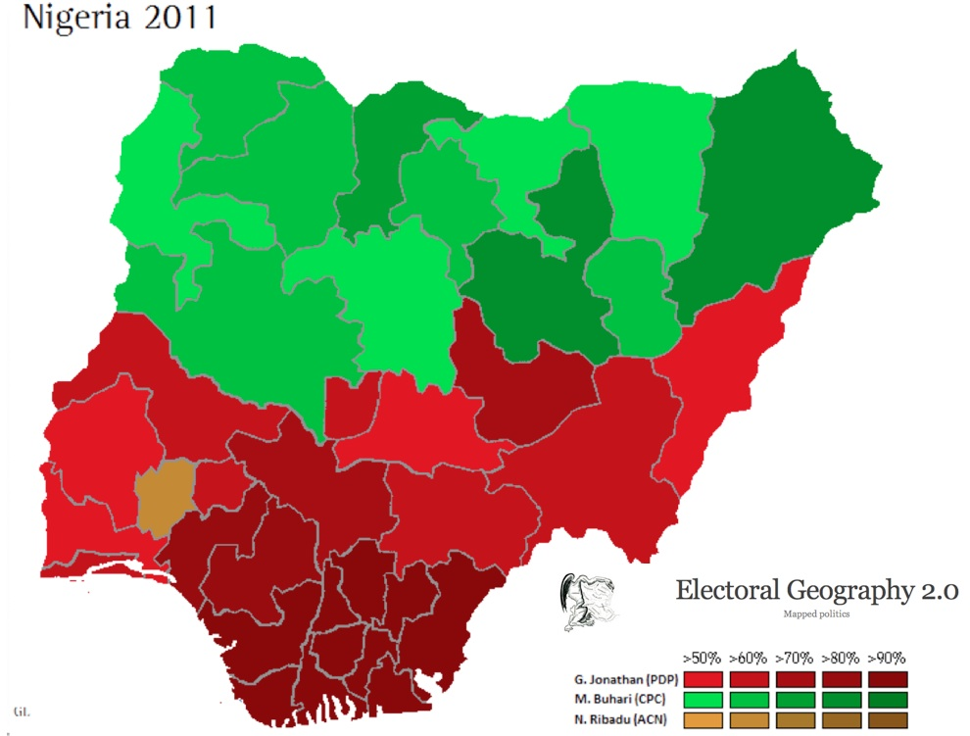
Cleavages and Political Institutions
How are cleavages expressed in the political system?
Is political party membership based on cleavages?
Do political elites (those who hold power) usually come from one group or another?
Do these cleavages block some groups from fully participating in government?
Notes:
How are cleavages expressed in the political system?
Does the lower class vote for one political party or another?
Are women’s beliefs and behaviors different from those of men?
Are younger people as likely to vote as older people are?
Do people in rural areas participate in government?
Political Elites: those who hold political power

Slide 8
Coinciding vs Cross-Cutting Cleavages
Do multiple cleavages lead to more or less division?
Coinciding (Reinforcing) Cleavages
Identity divisions that coincide with one another for large numbers of individuals
More likely to be explosive
Cross-Cutting Cleavages
Divide society into many potential groups that may conflict on one issue, but cooperate on another
Tend to keep conflict to more moderate levels
Notes:
Coinciding:
When every dispute aligns the same groups against each other

Slide 9
Belgium
North
Flemish-speaking Flanders
Wealthier
Highly Fragmented Parties
South
French-speaking Walonia
Poorer
Coinciding Cleavages
German
French
Italian
Switzerland
Economic interests in tourism or banking
Stable Society
Different Dialects
Mixed Religions
Cross-Cutting Cleavages
Notes:
Belgium – Social cleavages are coinciding on every issue (region, ethnicity/language), social class

Slide 10
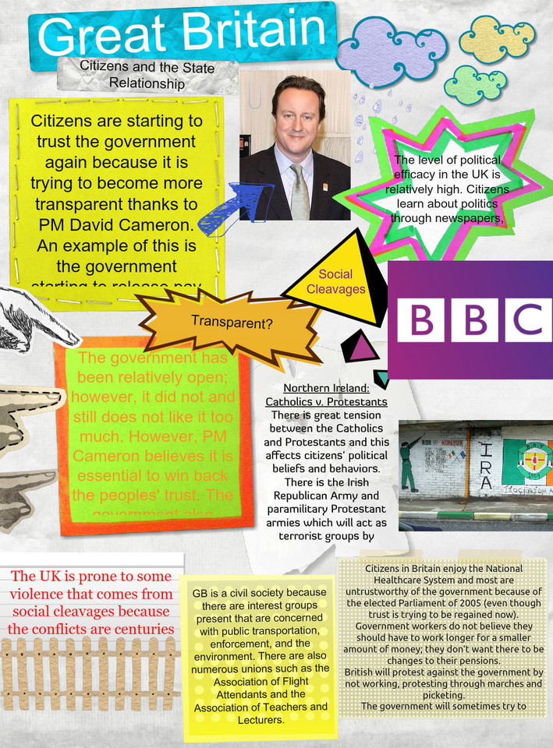
Comparing Citizen/State Relationships

Slide 11
Citizen/State Relationship
Political Efficacy:
A citizen’s capacity to understand and influence political events
Make a hypothesis based on political efficacy…
Social capital
Amount of trust between citizens and the state
Societies with low social capital may be more inclined toward authoritarian and anti-individual govts.
Societies with more social capital may be inclined toward democracy.
Transparency
Transparent govt operates openly
What is the connection between transparency and political efficacy? Corruption?
Notes:
Attitudes & Beliefs:
Do citizens trust their government?
Do they believe that the government cares about what they think?
Do citizens feel that government affects their lives in significant ways?
High level of political efficacy = govt takes their input seriously, cares abt what they have to say, believe they can understand issues and participate in solving problems
Low level of political efficacy = not important to vote/participate, ignore govts laws, etc
Transparency:
Transparent govt is one that operates openly by keeping citizens informed about government operations and political issues and by responding to citizens’ questions and advice.
This does not have to be limited to democracies, but low levels of transparency are often found in authoritarian governments, and corruption also tends to be lower in countries where government activities are relatively transparent.

Slide 12
Citizen/State Relationship
Political Socialization
Process through which citizens learn about politics in their country and become part of the political culture
Identify agents of socialization:
Notes:
Political Socialization:
How do citizens learn about politics in their country?
Do electronic and print media shape their learning?
Does the government put forth effort to politically educate their citizens?
If so, how much of their effort might you call “propaganda”?
How do children learn about politics?
Agents of Socialization
Involves schools, families, communications, media, religious organizations, and all the various political structures that develop, reinforce, and transform the political culture, the attitudes of political significance in the society.

Slide 13
Political Culture
Political Culture: collection of political beliefs, values, practices, institutions that government is based on
Traditions can be important
Varies from one country to another
Types of Political Culture
Consensual
General agreement on how decisions are made
Conflictual
Citizens are sharply divided on legitimacy of regime
Notes:
If the govt does not reflect the basic political values of a people, it will have difficulty remaining viable.
Consensual:
May disagree on some political processes and policies, BUT generally agree on how decisions are made, what issues should be addressed, and how problems should be solved.
Accepts legitimacy of regime and solutions to major problems.
Conflictual:
Example – if citizens disagree on capitalism vs communism, or religion if major issue

Slide 14
Political Culture
Discussion Question: Can you think of a time when political culture was conflictual in the U.S.?

Slide 15
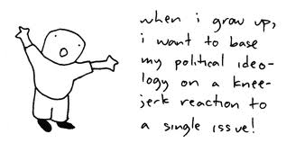
Political Ideologies
Sets of political values held by individuals
Examples:
Liberalism
Emphasis on individual political & economic freedom
Ideology vs. stereotypes (particularly in the U.S.)
Communism
Values equality over freedom
Notes:
Political Ideologies – sets of political values held by individuals regarding the basic goals of govt and politics.
Liberalism:
Ideology is different from U.S. stereotype
Part of political culture in many democracies
Liberals seek to maximize freedom for all people, including free speech, freedom of religion, and freedom of association.
Believe citizens have the right to disagree with state decisions and act to change those decisions
Public opinion generally has some political impact in liberal democracies, such as US and GB.
Communism:
Believe liberal democracies value the ideal of equal opportunity, but have a great deal of inequality, esp in economy
Communism rejects idea that personal freedom will ensure prosperity for the majority.
It holds that an inevitable result of the competition for scarce resources will be small group of wealthy controlling everything.
To eliminate this, they advocate the state take over all resources (no private property) to ensure economic equality for all.
Individual liberties must give way to the needs of society as a whole, creating what they believe to be a “true democracy.”

Slide 16
Political Ideologies
Socialism
Shares value of equality with Communism
But, favors freedom, private ownership and free market principles
State has a strong role to play in economy and public benefits
Fascism
Rejects the idea of equality and devalues individual freedom (Nazi Germany)
Religion
Plays a varied role in many governments
Notes:
Socialism
Shares value of equality with Communism BUT is also influenced by idea of individual freedom.
Unlike communists, socialists accept and promote private ownership and free market principles.
In contrast to liberals, socialist believe that the state has a strong role to play in regulating the economy and providing benefits to public in order to ensure some measure of equality.
Is much stronger in Europe than U.S.
Fascism:
Often confused with communism bc they both devalue the idea of individual freedom.
Rejects the value of equality and accepts the idea that ppl and groups exist in degrees of inferiority/superiority.
Believe that the state has the right/responsibility to mold society/economy to eliminate obstacles (including ppl) that might weaken them.
Powerful authoritarian state makes superiority possible.
No strictly facist regimes currently exist
Religion:
Different role in many govts
Many advanced democracies, like U.S. have separation of church and state
Some European countries have state religion BUT religious leaders are usually not same as political leaders (But GB - Queen of England is still head of Anglican Church)
China – squelched Falon Gong religious movement
Iran – bases its entire political system on Shia Islam
Nigeria – religious law (sharia) is an important basis of legitimacy in Muslim north, but not Christian south.

Slide 17
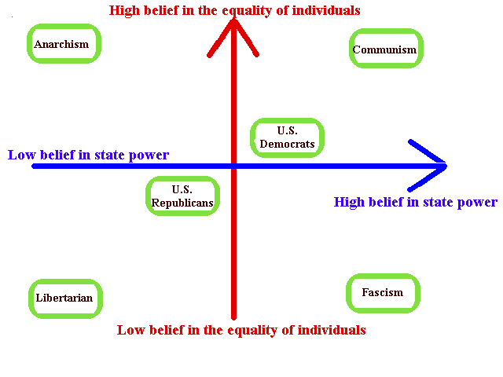
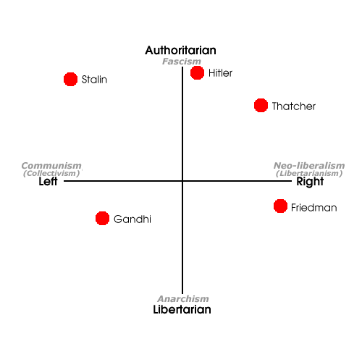
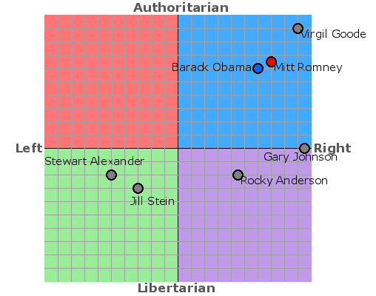

Slide 18
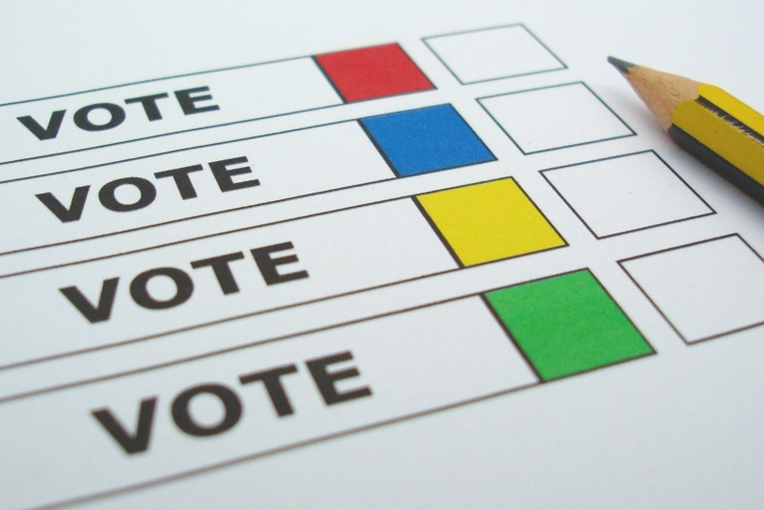
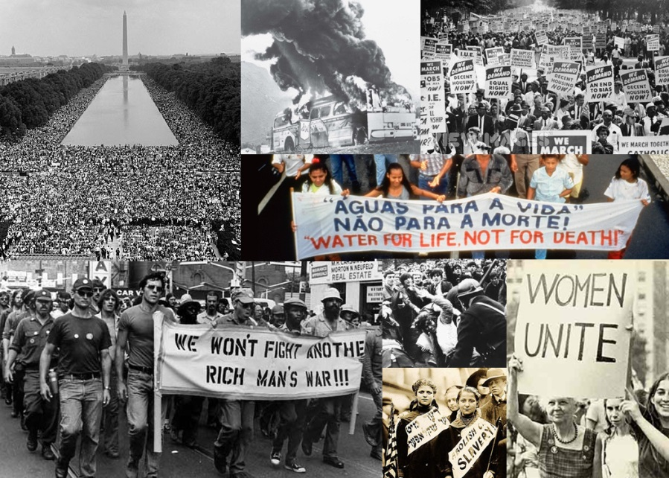
Types of Participation
Interest Groups
Political Parties
Voting
Social movements
Organized collective activities that aim to bring about/resist change in an existing group/society
Notes:
Voting:
Do citizens in the country participate in regular elections?
If so, are the elections truly competitive?
If not, what is the purpose of the elections?
What citizens are eligible to vote, and how many actually vote?
Do politicians pay attention to elections, and do elections affect policymaking?
Social Movements:
Organized collective activities that aim to bring about or resist fundamental change in an existing group or society.
Try to influence political leaders to make policy decisions that support their goals
Often step outside traditional channels for bringing about social change
Usually take stands on issues that push others in mainstream society to reconsider their positions
Even if they fail they often bring awareness and influence political opinion

Slide 19
Types of Participation
Discussion Question: How does participation in authoritarian regimes differ from participation in democratic regimes?

Slide 20
Types of Participation
Discussion Question: How does participation in authoritarian regimes differ from participation in democratic regimes?
Participation in Authoritarian Govts
Most citizens contact govt through subject activities that involve obedience
Obeying laws, following military orders, paying taxes, voting (although limited choices)
Participation in Democratic Govts
Citizens usually play a more active part in political process
Most common – voting. Also working for candidates, political meetings/rallies, contributing to campaigns, political parties

Slide 21
Civil Society
Civil Society
Organized life outside the state
Voluntary groups
Help people define and advance their own interest
Usually strong in liberal democracies
Help prevent “tyranny of the majority”
Global Civil Society: Nongovernmental organizations (NGO’s)
Doctors Without Borders for example, Amnesty International, Red Cross
Notes:
Civil Society
Although groups in civil society are not political, they are an essential part of free societies because people can promote, defend, and articulate what is important to them.
Civil society gives substance to politics and checks the power of the state.
Generally, civil society is weak in most less-developed and newly-industrializing countries.
One step in the development of civil society is civic education (citizens learn about rights)
By nature, authoritarian states do not encourage civil society – often feel threatened by it
CS does not necessarily disappear under authoritarian rule – ex. Survival of Russian Orthodox Church under communist rule.
Global Civil Society
A global civil society is emerging where citizens have similar concerns as those of other nations and can join together to reinforce individual efforts.
Human rights, environmental groups
NGO’s – national and international groups, independent of any state, that pursue policy objectives and foster public participation.
Examples: Doctors Without Borders, Amnesty International
UN list of NGO’s: http://www.unrol.org/article.aspx?article_id=23

Slide 22
Voluntary Associations and Organizations
Professional and Business Organizations
Trade Unions
Charities
Social Clubs
Environmental Groups
Churches
Women’s Groups
Community Associations
Youth Clubs
Consumer Groups
Arts, Science, Leisure, Sports Clubs
Civil Society: arena outside of the state and family (i.e., mainly voluntary organizations and civic associations) that permits individuals to associate freely and independently of state regulation

Slide 23
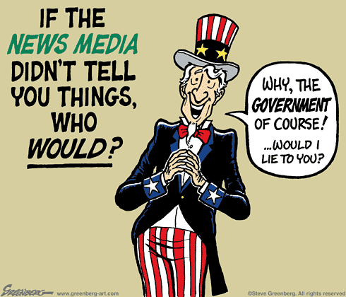
Mass Media
An important way to legitimately access political elites
When a message receives national attention, the message to policy makers carries added weight because they know millions of voters have been exposed to the issues
When control over mass media is loosened, democracy tends to receive a huge boost
Notes:
It can mobilize support for interest group efforts, which lead to donations of time and money. It can also stimulate the sympathy of various supporters.

