Slide 1
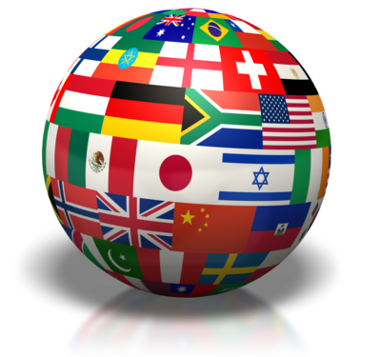
Part Three: Political Structures/Institutions
“Our political institutions work remarkably well. They are designed to clang against each other. The noise is democracy at work.” -- Michael Novak (American philosopher)

Slide 2
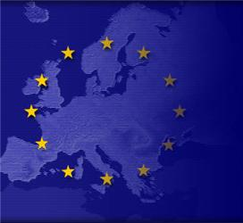
Levels of Government
Supranational Organizations – organizations in which nations are not totally sovereign actors
International or regional
Trend towards states pooling their sovereignty to gain political, economic or social clout
Examples
NATO
EU
NAFTA
OPEC
UN
Growing because of globalization – integration of social, environmental, economic, & cultural activities of nations resulting from increased international contacts.
Notes:
Examples?
NATO (North Atlantic Treaty Organization)
European Union
NAFTA (North American Free Trade Agreement)
OPEC (Organization of the Petroleum Exporting Countries)
United Nations
Globalization:
Integration of social environmental, economic, cultural activities of nations resulting from increased international contacts

Slide 3
Levels of Government
Unitary System - 172
Concentrates all policymaking powers in one geographic place
Central government is responsible for most policies
Most countries have unitary
GB, China, Iran
Federal System – 21(38% of people, 49% of land)
Power divided between the central government & sub-units
Regional bodies have significant powers (taxation, lawmaking, keeping order)
Russia, Mexico, Nigeria (U.S.)
Confederal
Power spread among many sub-units (states for example)
Weak central government
EU
Notes:
Unitary Countries – 172
Federal Countries:
21 countries
11% of countries, 38% of people, 49% of land
AP 6:
Unitary: GB (although devolving power to regional), China, Iran
Federal: Russia, Mexico, Nigeria
Confederal: European Union

Slide 4
Levels of Government
Discussion Questions:
What are the advantages of a federal system over a unitary one?
What are the disadvantages of a federal system over a unitary one?

Slide 5
Levels of Government
Advantages of Federal System:
Makes it easier to govern a very large country (physically largest countries tend to have fed arrangements – not China though)
Better accommodates regional differences
Helps guard against concentration of political power
Disadvantages:
Lack of uniformity in policy (ex: voting registration requirements, education requirements)
If territorial lines of subunits correspond to deep social divisions, federalism reinforces those divisions
Notes:
Advantage of Unitary: Are in a better position to redistribute resources from richer regions to poorer regions (thus creating more equality)

Slide 6
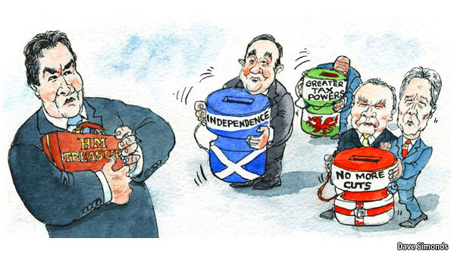
Devolution
Sometimes, leaders of unitary systems voluntarily choose to decentralize power
Called devolution – transfer of power from a central govt to lower/regional govt
Why would they do this?
To keep country unified
Reaction to forces that divide and destabilize
Notes:
Devolution is a reaction to centrifugal forces – those that divide and destabilize the country.
Leaders attempt to keep the country unified by devolving power to certain regions.

Slide 7
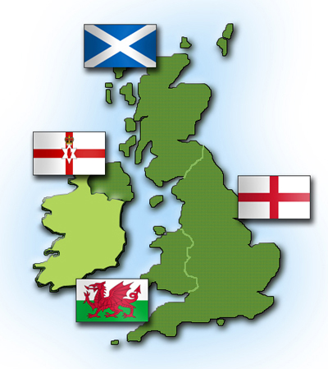
Three Causes of Devolution
Ethnic Forces
Identity based on language, religion, customs
Ethnonationalism
See themselves as a distinct nation with a right to autonomy
Example – Britain devolved power to Scotland and Wales
Economic Forces
Regional inequalities in income or standard of living
Spatial Forces
Usually occur on the margins/borders of the state
Especially if water/mountains separate from central power and neighbor nations support separation
Example – Puerto Rico is island close to other independent islands even though a territory of the U.S.
Notes:
Ethnic: Britain has devolved power to Scottish and Welsh parliaments
Spatial: Puerto Rico is island close to other independent islands

Slide 8
Devolution
Discussion Question: How is devolution in a unitary system different from Federalism?
Power can be taken away in a unitary system (by the central government)
Subnational government’s powers are not constitutionally protected
In a unitary system decentralization is not necessarily symmetrical
Local legislature/government can be dissolved in unitary systems but not in federal systems
Notes:
By devolution, it may grant powers to subnational governments BUT retains the right to unilaterally recall or reshape those powers.

Slide 9
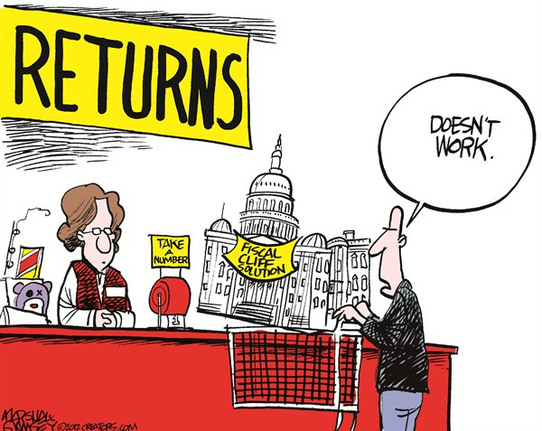
Political Institutions
Structures of the political system
Carry out the work of governing
Vary by country
Common structures that exist in most countries are legislatures, executives, judicial systems, bureaucracies, and armies
Discussion Question: Does the same type of institution (say legislatures) serve the same function in two different countries?
Maybe not
Notes:
Just because you see the same type of institution in two different countries, don’t assume they serve the same functions

Slide 10
Example - Legislatures Vary in Importance
U.S. Congress Extremely active role in forming public policy. | House of Commons in Britain Public policy is usually initiated by the cabinet members and this house is usually a deliberating body that formally enacts and amends legislation. | National People’s Congress (China) Essentially, a tool of party leaders. They meet and listen to statements by party leaders and “rubberstamp” decisions made by someone else.

Slide 11
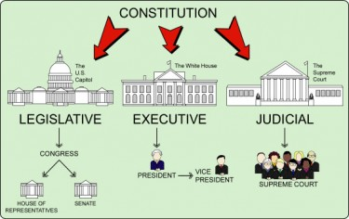
Separation/Fusion of Powers
Separation of Powers:
the system of governance in which gov’t power is divided into several bodies with the ability to check the power of the other
Fusion of Powers:
A system of governance in which all or most of the authority of the gov’t is concentrated in one body

Slide 12
Discussion Question
Is separation of powers necessary for a liberal democracy to exist?

Slide 13
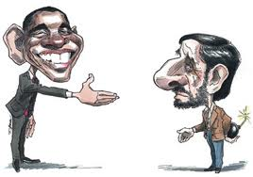
Executive Office
Carries out the laws & policies of the state
Head of State
Symbolizes and represents the people
May or may not have policymaking power
Head of Government
In charge of actually running the government
The Chief Executive
Most important person in policymaking
Varies by government
The Cabinet
Most important decision making body in parliamentary systems
Group of advisors in our presidential system

Slide 14
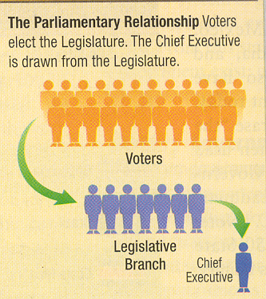
Parliamentary vs. Presidential Systems
Parliamentary Systems (GB)
Citizens vote for legislative reps, which pick leader of executive branch from majority party (UK)
Head of State = mostly symbolic figurehead
Head of Gov’t = day to day (PM, Premier, Chancellor)
Fusion of powers between executive & legislative branches
Cabinet members = leaders of majority party in Parliament
Chief executive usually does not have veto power
Irregular intervals between elections* and votes of confidence
*UK no longer has irregular interval btw elections; Fixed at 5 year terms (5/7/2020)
Notes:
Parliamentary:
AP 6: GB
The date of the next general election is set at 7 May 2015 after the Fixed Term Parliament Act was passed on 15 September 2011.
The act provides for general elections to be held on the first Thursday in May every five years. There are two provisions that trigger an election other than at five year intervals.
A motion of no confidence is passed in Her Majesty's Government by a simple majority and 14 days elapses without the House passing a confidence motion in any new Government formed
A motion for a general election is agreed by two thirds of the total number of seats in the Commons including vacant seats (currently 434 out of 650)
Previous to this act, the duration of a Parliament was set at five years, although many were dissolved before that, at the request of the Prime Minister to the Queen.
Votes of Confidence/No Confidence: If sitting gov’t fails to get support for a bill, govt is forced to resign and new elections may be held

Slide 15
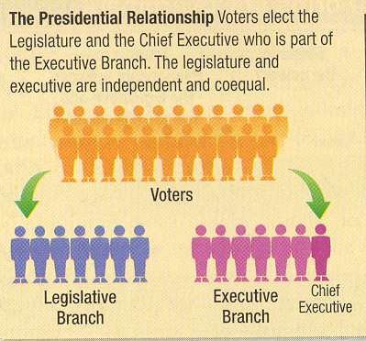
Parliamentary vs. Presidential Systems
Presidential Systems
(Mexico, Nigeria and Iran)
Citizens vote for legislative reps and executive branch leaders (Mexico, Nigeria + Iran – dual exec)
President – both Head of State & Head of Gov’t
Separation of powers/System of checks and balances
President picks cabinet members
President can veto
Fixed Terms
Semi-Presidential Systems
Prime Minister and President Coexist (Russia, China)
Notes:
Presidential:
Mexico, Nigeria, Iran (+Supreme Leader)
Semi Pres:
Russia, China (non-democratic)

Slide 16
Parliamentary vs. Presidential Systems
Parliamentary:
Advantages: efficiency in passing legislation, clearer accountability to voters
Disadvantages: instability, hasty decision-making
Presidential:
Advantages: checks power of legislature; since directly elected, more of a national mandate
Disadvantages: difficulty removing unpopular president until next election, gridlock!, creeping authoritarianism
Semi Pres:
Advantages: shields president from criticism (can blame on PM), can remove unpopular PM and maintain stability from pres. fixed term, additional checks and balances
Disadvantages: confusion about accountability, confusing and inefficient legislation

Slide 17
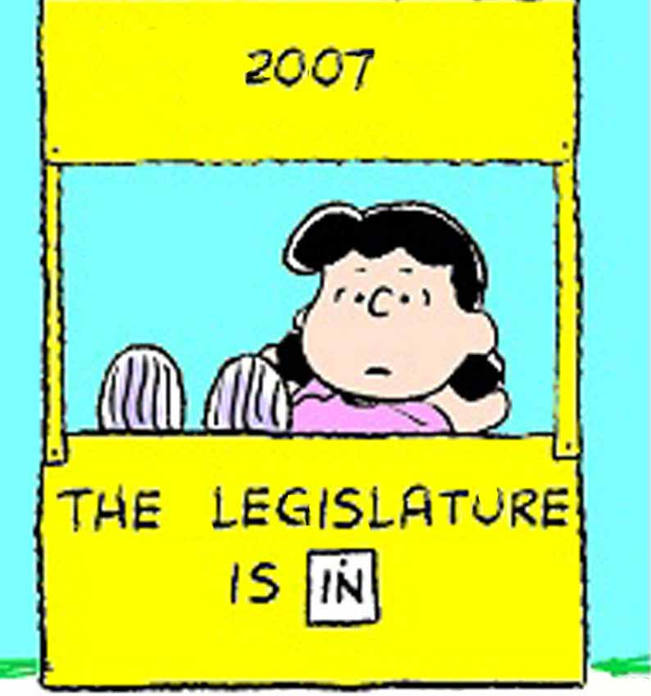
Legislatures
Branch that makes laws
Bicameral
Two houses (UK, Russia, Mexico, Nigeria)
Advantages – increases legitimacy, checks and balances
(80% of countries have this)
Disadvantages – slows progress
Unicameral
One house (China, Iran)
Advantages – no gridlock
Disadvantages no check on power
Notes:
Today, more than 80% of the countries belonging to UN have legislatures, suggesting that a govt that includes a representative popular component increases its legitimacy
Bicameral: more practical with federalism, check and balance, BUT gridlock
Unicameral: no gridlock, BUT no check on power

Slide 18
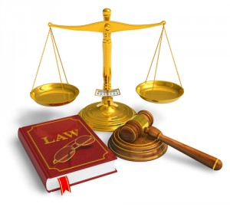
Judiciaries
Judiciary: the set of institutions that are created to
Interpret the application of public laws and policies
Settle public disputes in the nation-state
Enforce criminal law
If it is functioning ideally, the judiciary plays a large role in maintaining rule of law
Judiciaries are relatively weak in most AP6
Rule of Law: constitutionalism; a governance system operating predictably under a known and transparent set of procedural rules (laws) Nobody is above the law.
Notes:
The judiciary is still a relatively weak branch in most of the AP6, but takes different forms in each.

Slide 19
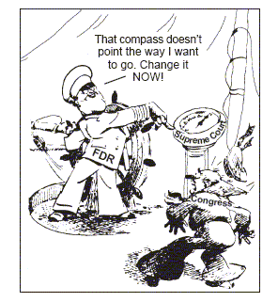
Judiciaries
Vary significantly from country to country
Courts in authoritarian systems generally have little/no independence; decisions controlled by chief executive.
Constitutional Courts
Highest judicial body, rules on constitutionality of laws
Judicial review
Power of the judiciary to review laws and executive actions for their constitutionality
Notes:
The judiciary is still a relatively weak branch in most of the AP6, but takes different forms in each.

Slide 20
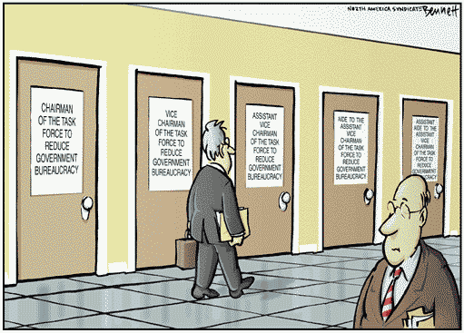
Bureaucracies
Agencies that implement government policy
Weber: a well-organized complex machine that is a “rational” way for a modern society to organize its business
In democracies
Discretionary power
power given to bureaucrats to make small decisions in implementing legislative/executive decisions
Continuity over time
In authoritarian regimes
Head of government exercises control
Patronage system –
political supporters receive
jobs in return for getting
leader elected.
Notes:
Weber: a well-organized complex machine that is a “rational” way for a modern society to organize its business.
Discretionary power: power given to bureaucrats to make small decisions in implementing leg/ex decisions.
Patronage system: political supporters receive jobs in return for getting leader elected.

Slide 21
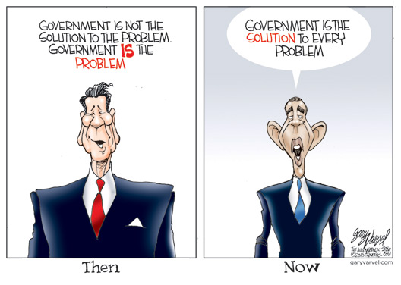
Common Characteristics of Bureaucracies
Non-elected positions – appointed & salaried
Impersonal, efficient structures – goal oriented
Formal qualifications for jobs – education and experience
Hierarchical organization – everyone has a boss
Red tape/inefficiency – as it grows in size
Notes:
Bureaucrats are appointed, usually salaried and are not elected by public.
Impersonal bc they are goal oriented, have little concern for personal feelings.
Formal qual. – Authoritarian (must at least have education/experience; Dem – have institutionalized as prerequisites form appt.
Everyone has a boss, except for the guy at the top.
As grow in size and complexity efficiency breaks down.

Slide 22
Other Institutions
Military
Armed forces that are used to protect the nation-state against possible or actual invasion by the military forces of other nations
Also used to maintain the power of the gov’t within the nation-state’s borders
Also used to project the power of the nation-state beyond its borders by displays of military might and technology
Intelligence Agencies
All AP6 countries operate domestic & international intelligence
In recent times expanded to include cyber intelligence
Notes:
Bureaucrats

