Slide 1
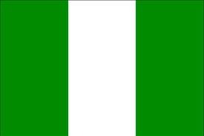
NIGERIA: Lesson 1: Geography & Population

Slide 2
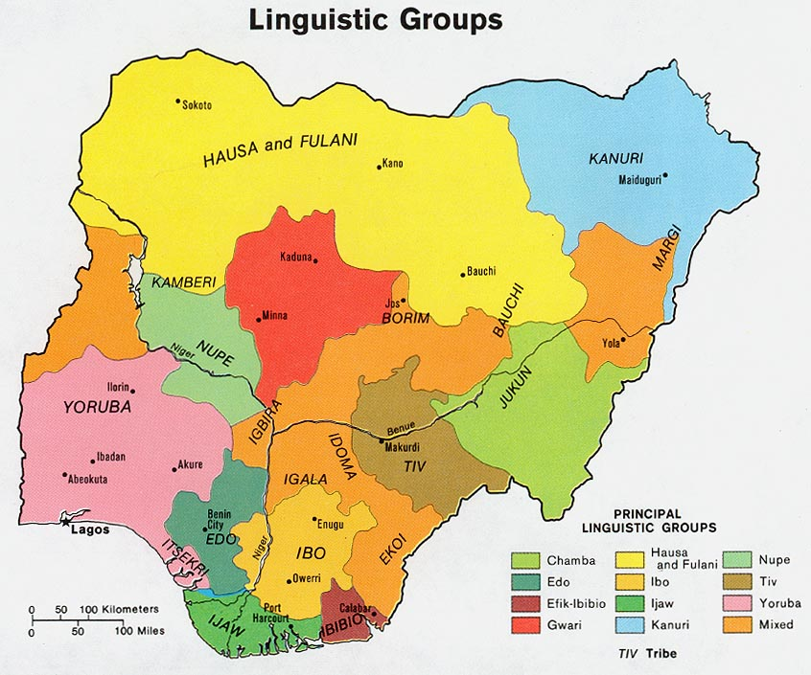

Slide 3
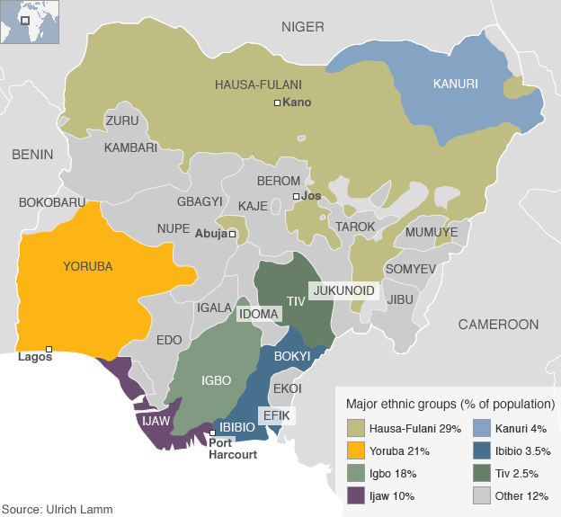

Slide 4
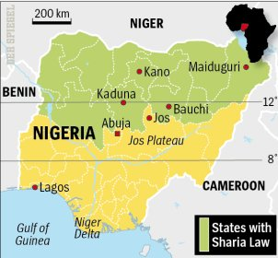

Slide 5
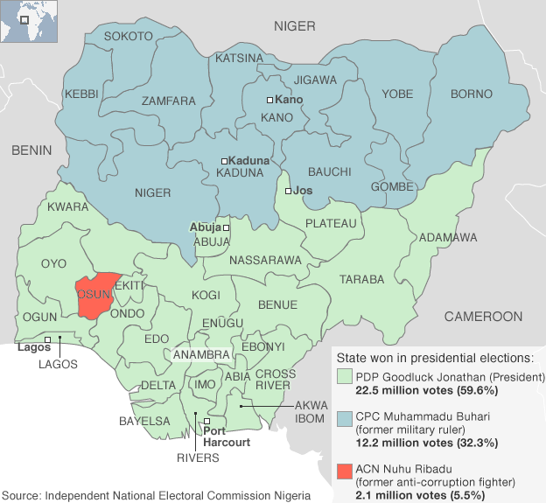
2011 Presidential Election

Slide 6
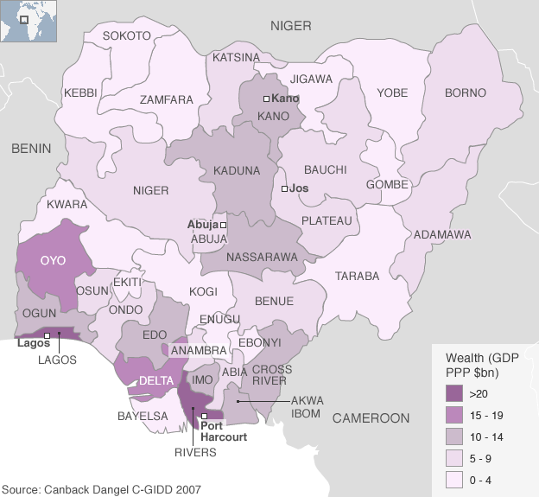

Slide 7
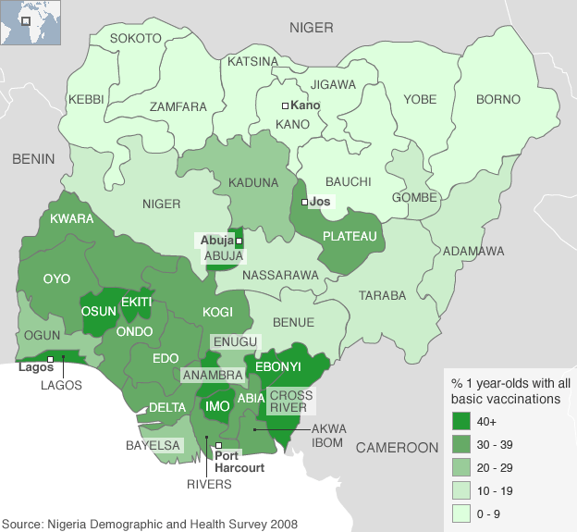

Slide 8
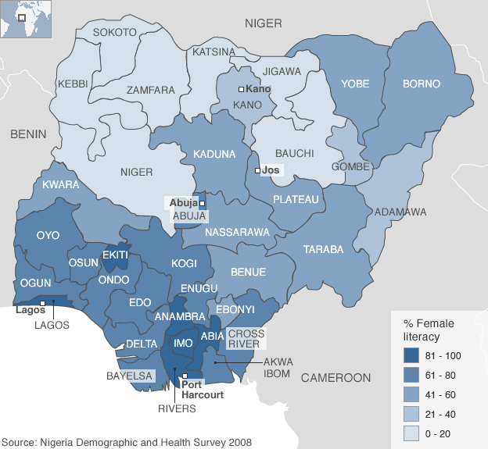

Slide 9
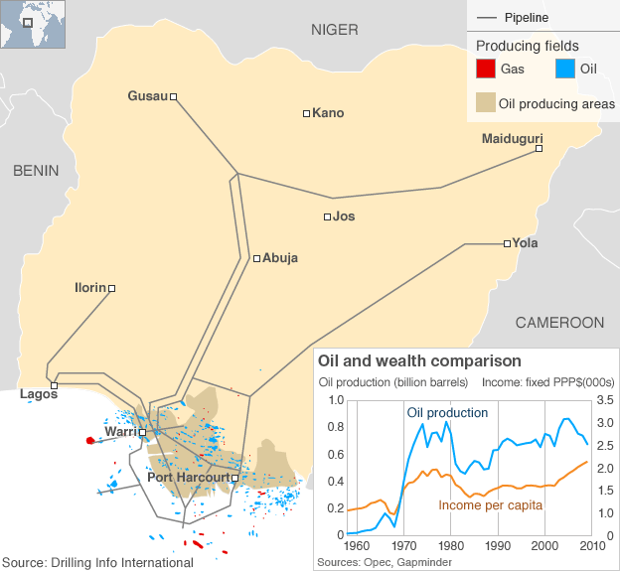

Slide 10
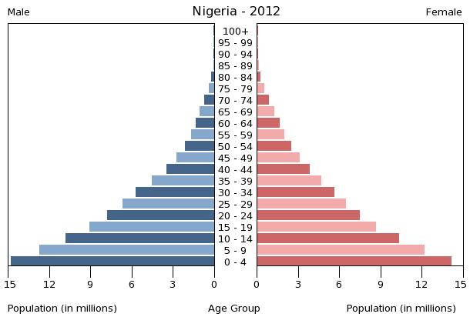

Slide 11
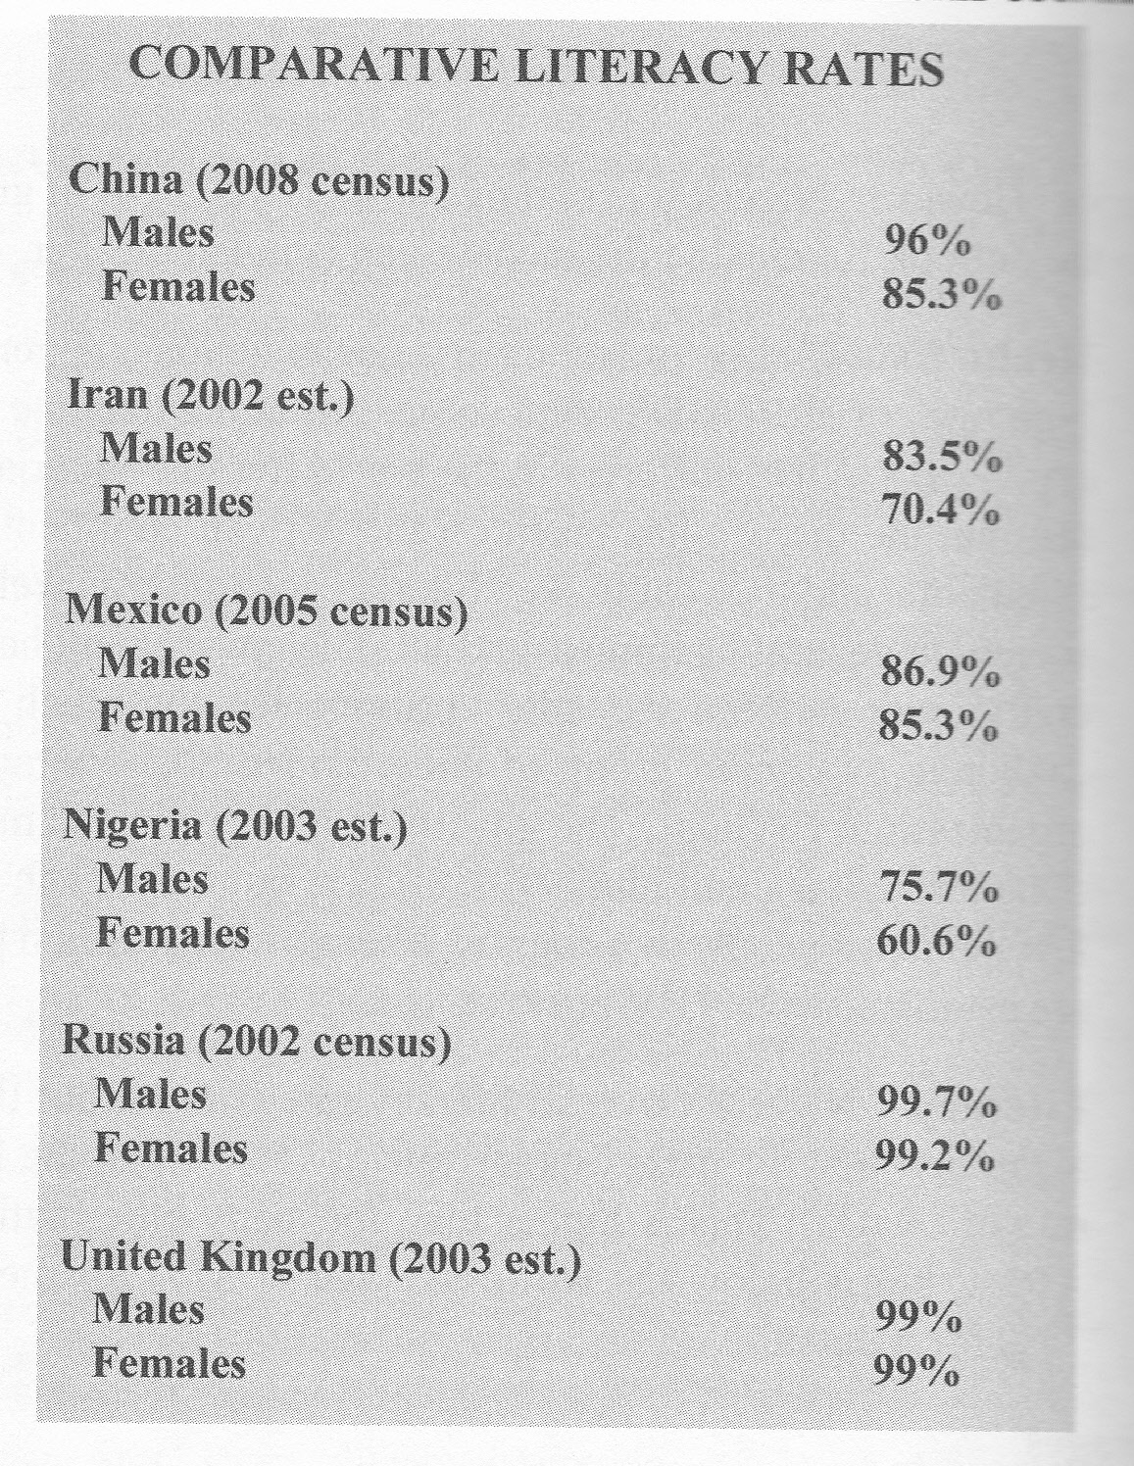

Slide 12
NIGERIA: Lesson 2: History

Slide 13
British Colonial Rule
Although the British did not occupy most of Nigeria until 1904, they had a strong presence in West Africa since the early nineteenth century. The British were a major buyer of African slaves in the seventeenth and eighteenth centuries.
In 1807, however, the British outlawed slave trade within their empire. At the time, they did not yet control Nigeria, and internal wars continually increased the available supply of captured slaves. In 1861, frustrated with the expanding slave trade, the British decided to occupy Lagos, a major slave-trading post and the capital of present-day Nigeria. Slowly and hesitantly, the British occupied the rest of Nigeria.
Ultimately, the British were prompted to occupy Nigeria for more than the slave trade. The British were in competition with other Europeans for control of the natural wealth of West Africa. At the Berlin Conference of 1884-85 — a meeting arranged to settle rivalries among European powers — the British proclaimed Nigeria to be their territory. They bought palm oil, peanuts, rubber, cotton, and other agricultural products from the Nigerians. Indeed, trade in these products made some Nigerian traders very wealthy. In the early twentieth century, the British defined the collection of diverse ethnic groups as one country, Nigeria, and declared it a colony of the British Empire.

Slide 14
British Colonial Rule
The British moved into Nigeria with a combination of government control, religious mission, and economic incentive. In the north, the British ruled indirectly, with the support of the local Muslim leaders, who collected taxes and administered a government on behalf of the British. In the south, however, where communities were often not under one central authority, the British had to intervene directly and forcefully to control the local population.
After creating general fear and chaos within the society, the British colonizers then split families, divided tribal communities, destroyed the societal leadership, and undermined their religion.
The British operated an efficient administrative system and introduced a form of British culture to Nigeria. They also sent many capable young Nigerians to England for education. The experience of Nigerians who lived overseas in the years preceding, during, and after World War II gave rise to a class of young, educated nationalists who agitated for independence from Great Britain. The British agreed to the Nigerians' demands and, in 1947, instituted a ten-year economic plan toward independence. Nigeria became an independent country on October 1, 1960, and became a republic in 1963.

Slide 15
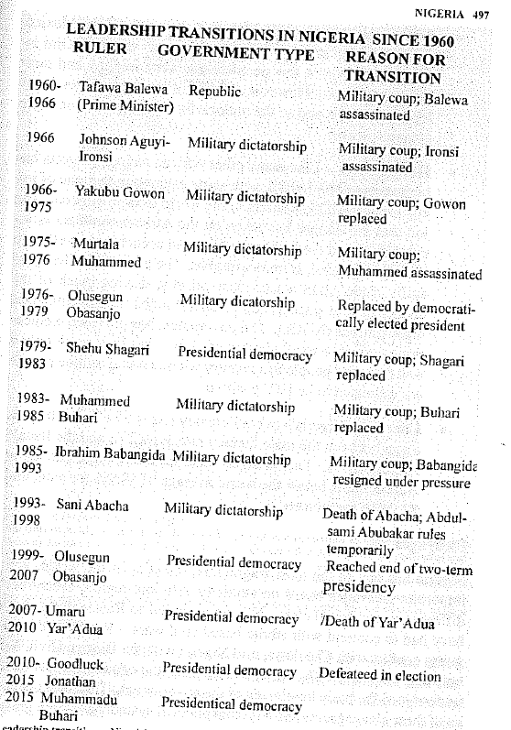

Slide 16
NIGERIA: Lesson 3: The Constitution

Slide 17
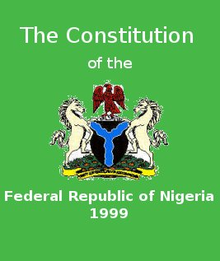
Click on the link below for Nigeria’s Constitution
http://www.nigeria-law.org/ConstitutionOfTheFederalRepublicOfNigeria.htm

Slide 18
NIGERIA: Lesson 4: Oil & Political Corruption

Slide 19
Percentage Contribution of Different Sources of Government Revenue to Allocated Revenue
Years | Oil Revenue (Naira Millions) | Non-Oil Revenue (Naira Millions | Oil as % of Revenue | Non-Oil as % of Revenue
2003 | 2074281 | 500815 | 80.5 | 19.5
2007 | 4462950 | 1252550 | 78 | 22
2008 | 6530630 | 1335960 | 83 | 17
2009 | 3191938 | 865561 | 78.6 | 21.4

Slide 20
“Blood for Oil” Vanity Fair, February 2007
Several boatloads of heavily armed Ijaw militants overran a Shell oil facility in the Niger delta and seized four Western oil workers. The militants called themselves the Movement for the Emancipation of the Niger Delta and said they were protesting the environmental devastation caused by the oil industry, as well as the appalling conditions in which most delta inhabitants live. There are no schools, medical clinics, or social services in most delta villages. There is no clean drinking water in delta villages. There are almost no paying jobs in delta villages. People eke out a living by fishing while, all around them, oil wells owned by foreign companies pump billions of dollars' worth of oil a year. . . MEND released (Western Oil Workers) a few weeks later, but the problems were far from over. MEND's demands included the release of two Ijaw leaders who were being held in prison, $1.5 billion in restitution for damage to the delicate delta environment, a 50 percent claim on all oil pumped out of the creeks, and development aid to the desperately poor villages of the delta. MEND threatened that, if these demands were not met—which they weren't—it would wage war on the foreign oil companies in Nigeria.

Slide 21
“Blood for Oil” Vanity Fair, February 2007
"Leave our land while you can or die in it," a MEND spokesman warned in an e-mail statement after the attack. "Our aim is to totally destroy the capacity of the Nigerian government to export oil."
In mid-February, MEND struck again, seizing a barge operated by the American oil-services company Willbros and grabbing nine more hostages. Elsewhere on the same day, other MEND fighters blew up an oil pipeline, a gas pipeline, and a tanker-loading terminal, forcing Shell to suspend 477,000 barrels a day in exports. The nine hostages were released after a reportedly huge ransom was paid.
In early June, militants shocked industry experts by overrunning a rig 40 miles out at sea. Offshore oil platforms generally sit 40 or 50 feet above water level, but their legs are crisscrossed with brackets and struts that are not difficult to climb. After firing warning shots, dozens of militants scampered up the legs and ladders to the main platform, rounded up eight foreign oil workers—including an American—and forced them at gunpoint into their boats. They were back in the creeks within hours.

Slide 22
“Blood for Oil” Vanity Fair, February 2007
The militants are also capable of striking in the cities. In January of last year, about 30 militants ran their speedboats straight into the Port Harcourt compound of the Italian oil company Agip, killed eight Nigerian soldiers, robbed the bank, and made their getaway. In May, a man on a motorbike shot an American oil executive to death while he sat in Port Harcourt traffic in his chauffeured car. In August, members of another militant group walked into a popular bar named Goodfellas and abducted four Western oil workers. By the end of September, militants had kidnapped—and released for ransom—more than 50 oil workers.
In early October, two separate attacks in the creeks reportedly killed at least 27 Nigerian soldiers and sank or captured two navy gunboats. In response, militants claimed, Nigerian helicopters strafed and then torched an Ijaw village named Elem Tombia. No one was killed, but it was a clear escalation of the conflict. By mid-October, the Niger River delta was on the brink of all-out war.

Slide 23
Prebendalism
Prebendalism, the peculiarly Nigerian version of corruption, is the disbursing of public offices and state rents to one’s ethnic-based clients.” It is an extreme form of clientelism that refers to the practice of mobilizing cultural and other sectional identities by political aspirants and officeholders for the purpose of corruptly appropriating state resources. Prebendalism is an established pattern of political behavior that justifies the pursuit of and the use of public office for the personal benefit of the office holder and his clients. The official public purpose of the office becomes a secondary concern. As with clientelism, the officeholder's clients comprise a specific set of elites to which he is linked, typically by ethnic or religious ties, and this linkage is key to understanding the concept. There are thus two sides involved in prebendalism, the officeholder and the client, and expectations of benefits by the clients (or supporters) perpetuate the prebendal system.
As practiced in the Babangida and Abacha eras, when official corruption occurred on an unprecedented scale, prebendalism deepened sectional cleavages and eroded the resources of the state. It also discouraged genuinely productive activity and expanded the class of individuals who live off state patronage.

Slide 24
Corruption Perception Index - 2014
Country | CPI Score* | Rank (178 Countries)
China | 36 | 100
Iran | 27 | 136
Mexico | 35 | 103
Nigeria | 27 | 136
Russia | 27 | 136
UK | 78 | 14
* The Corruption Perception Index Score is compiled every year by Transparency International. Countries are ranked from 1 to 100, with a 100 reflecting a corruption-free government.

