Slide 1
American Exceptionalism
Why is the United States NOT the norm?

Slide 2
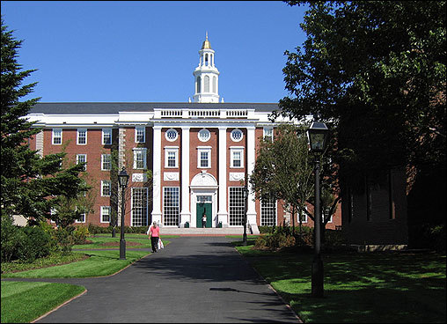
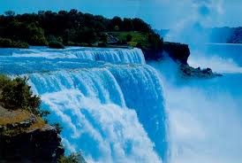
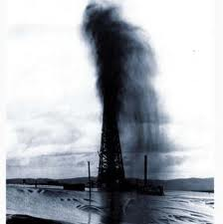
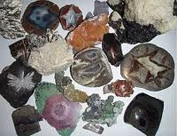
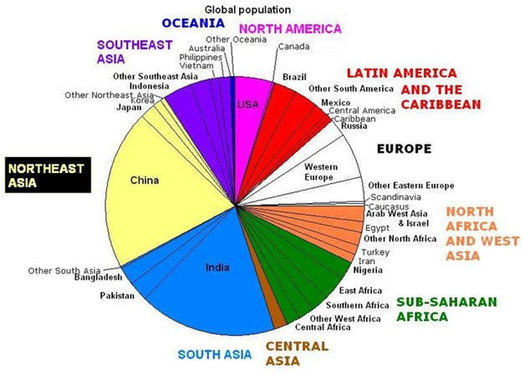


ABUNDANT RESOURCES

Slide 3
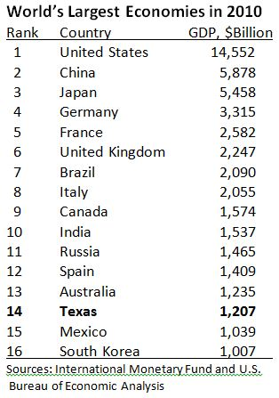
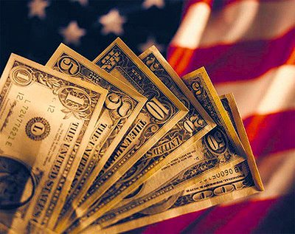
ECONOMIC SUPERPOWER

Slide 4
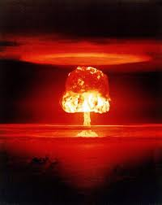
NUCLEAR SUPERPOWER

Slide 5
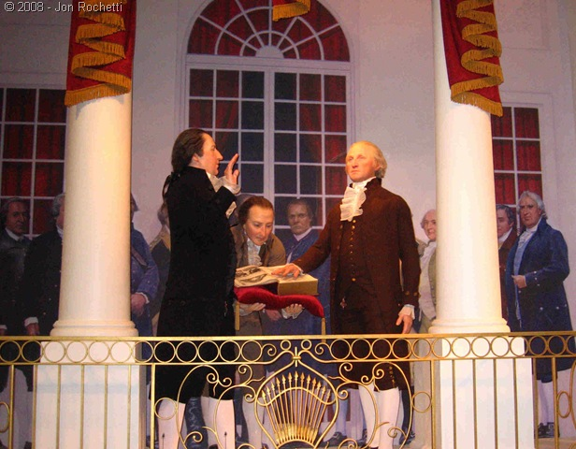
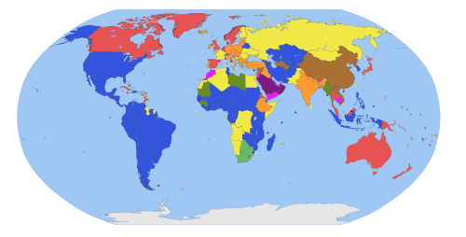
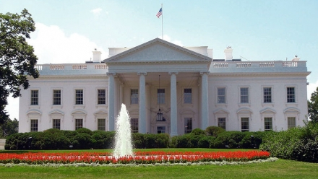
PRESIDENTIAL SYSTEM

Slide 6

SEPARATION OF POWERS &

Slide 7
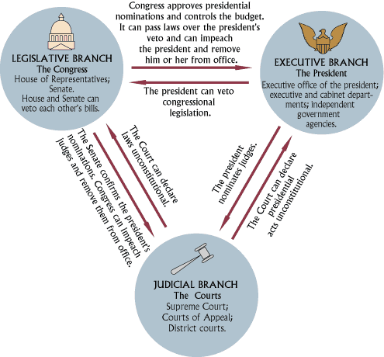
CHECKS AND BALANCES…

Slide 8
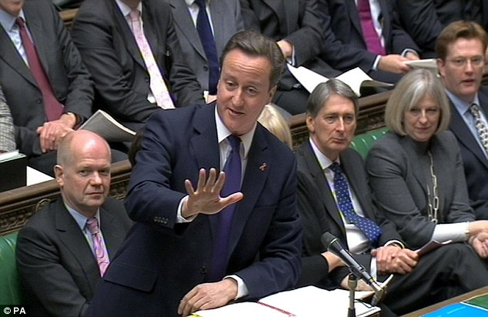
UNLIKE…
FUSION OF POWERS

Slide 9
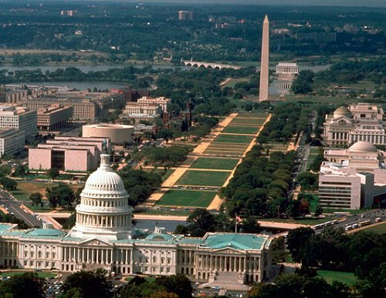
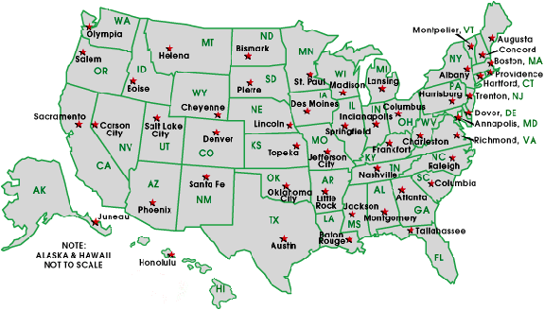
WEAK STATE
Government interventions as a Last Resort!
“That government is best which governs least.”
--Thomas Paine

Slide 10

RUGGED INDIVIDUALISM

Slide 11
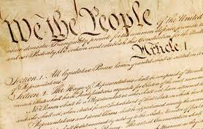
OLDEST ENDURING CONSTITUTION
1789
Mexico: 1917
Iran: 1979
China: 1982
Russia: 1993
Nigeria: 1999
U.K. loses on technicality: no single, codified constitution

Slide 12
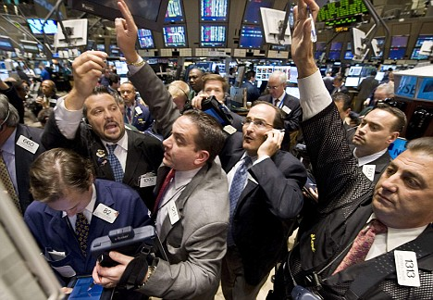
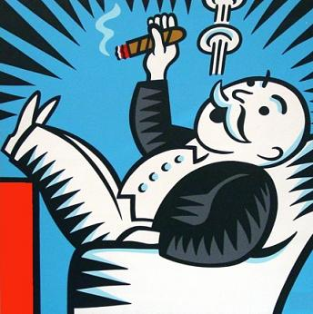
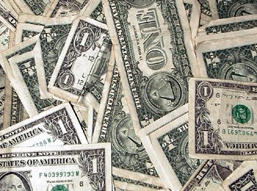
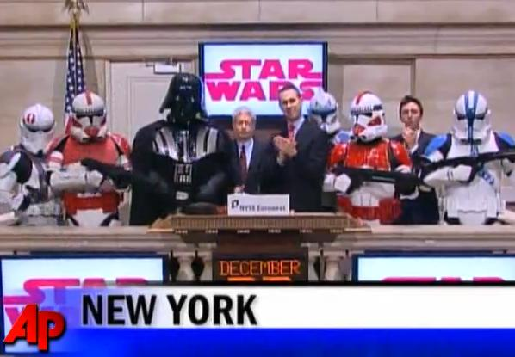
DEVOTION TO CAPITALISM

Slide 13
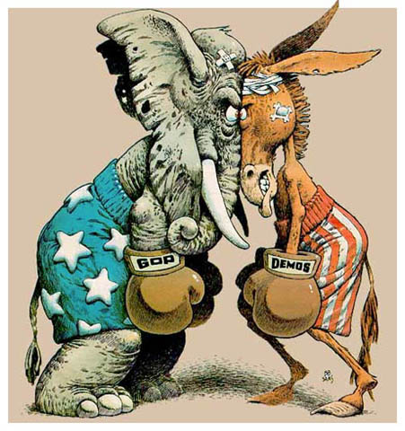
300+ million people in the United States and……only…
TWO PARTY SYSTEM

Slide 14
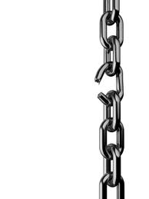

Weak Party Discipline…
…Weak Party Identification

Slide 15
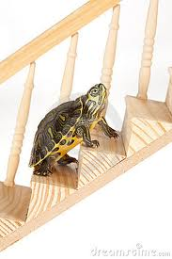
Slow, Incremental Change

Slide 16
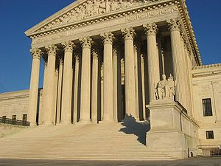
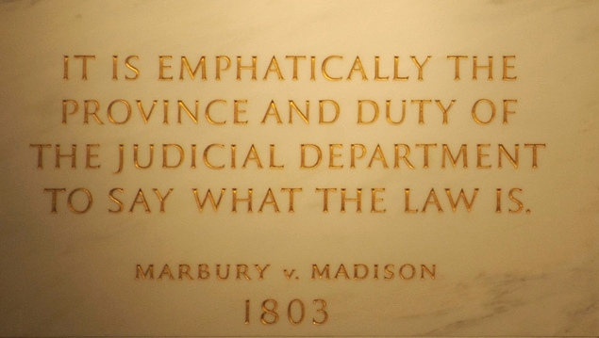
JUDICIAL
REVIEW

Slide 17


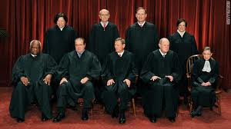

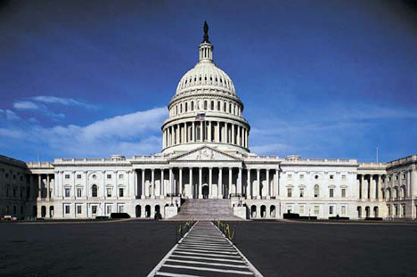
+
+

Slide 18
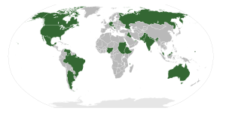
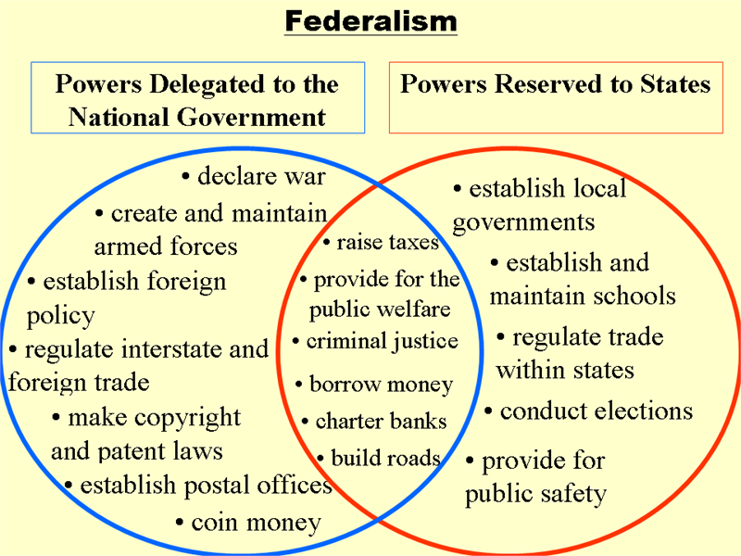
FEDERALISM

Slide 19

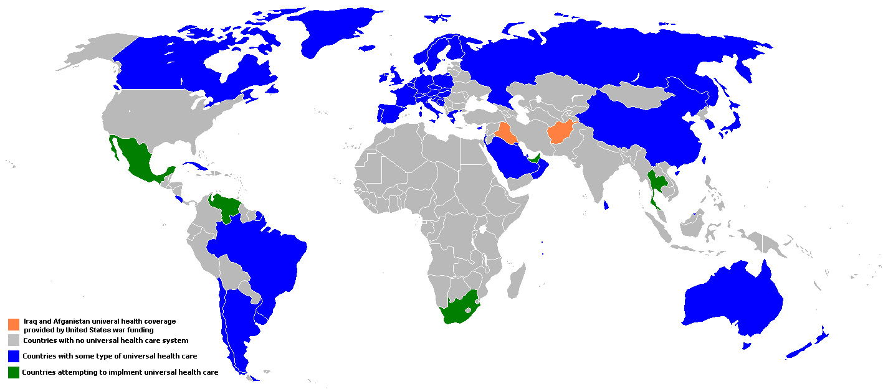
NO UNVERISAL HEALTH CARE
The only industrialized country without universal health care!

Slide 20
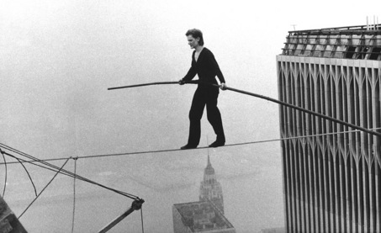
MINIMAL SOCIAL SAFETY NET
Working Without a Net: low levels of unemployment insurance, minimum wage, welfare, Social Security

Slide 21
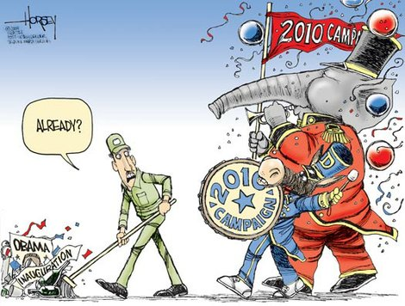


The Eternal Campaign
FREQUENT VOTING

Slide 22

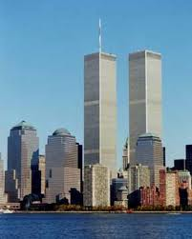
(RELATIVELY) TRANQUIL HISTORY

Slide 23
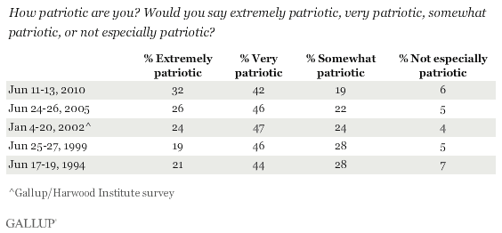

VERY PATRIOTIC

Slide 24

I am very proud to be ____
Success in life is determined by forces outside of our control
Children should be taught the value of hard work
It is necessary to believe in God to be moral
 | Pride | Outside Control | Teach Value of Hard Word | God and Morality
USA | 71% | 32% | 60% | 58%
Canada | 66 | 35 | 51 | 30
Britain | 45 | 48 | 38 | 25
France | 38 | 54 | 50 | 13
Germany | 21 | 68 | 22 | 33
Italy | 38 | 66 | na | 27
Notes:
Andrew Kohut, America Against the World (New York: Times Books, 2006. Survey done in 2000-2005 in Wilson and Dilulio

Slide 25
Table 4.2 Patriotism in America, France, and Germany
Statement | U.S. | France | Germany
I am very patriotic | 51% | 27% | 26%
I am proud to be (American, etc…) | 74% | 25% | 23%
We should be willing to fight for our country whether it is right or wrong | 22% | 17% | 5%
Source: Adapted from The Public Perspective (April/May 1999): 23

Slide 26
Commitment to Income Equity?
 | Political Party Leaders |  | Blue-Collar Union Leaders
 | Sweden (Social Democrats) | U.S. (Democrats) | Sweden | U.S.
Favor equality of results (%) | 21% | 9% | 14% | 4%
Favor equal pay (%) | 58% | 12 | 68 | 11%
Favor top limit on income (%) | 44% | 17 | 51 | 13%
Fair income ratio of executive to menial worker | 2:1 | 15:1 | 2:1 | 11:1
Notes:
Source: Equality in America: The View from the Top by Sidney Verba and Gary R. Orren, Cambridge: Harvard University Press, 1985.

Slide 27
Attitudes Toward Economic Equality in America and Europe
 | Percentage Agreeing
Statement | U.S. | Great Britain | Germany | Italy | France
It is government’s responsibility to take care of the very poor who can’t take care of themselves | 23% | 62% | 50% | 66% | 62%
Hard work guarantees success | 63 | 46 | 38 | 51 | 46
Government should not guarantee every citizen food and basic shelter | 34 | 9 | 13 | 14 | 10
Source: Adapted from The Public Perspective (November/December 1991): 5, 7

Slide 28
Religious Beliefs?
Statement | U.S. | Great Britain | Germany | Italy | France
I never doubt the existence of God. | 60% | 31% | 20% | 56% | 29%
Prayer is an important part of my daily life. | 77% | 37% | 44% | 69% | 32
There are clear guidelines about what it is good and evil. | 79% | 65% | 54% | 56% | 64%
Notes:
Source: Adapted from The Public Perspective (November/December 1991): 5, 8

Slide 29
Religion in America Today
Statement | Percentage of Adult Americans
Believe in God | 96%
Say they have a personal relationship with God | 80%
Never doubt God’s existence | 79%
Say they are seeking to grow in religious faith | 76%
Pray at least daily | 75%
Are a member of church, synagogue, mosque, or other organized religious group | 64%
Say religion can solve all or most of today’s problems | 61%
Attend worship services more than once a month | 54%
Source: Adapted from George Gallup, Jr. and Timothy Jones, The Next American Spirituality (Colorado Springs, CO: Cook 2000)

Slide 30
Religion in Industrial Nations,
1990-1993
 | US | Sweden | France | West Germany | Britain | Spain | Canada | Mexico
Would you say you are . . .
A religious person? | 82 | 29 | 48 | 54 | 55 | 64 | 69 | 72
Not a religious person? | 15 | 56 | 36 | 27 | 37 | 27 | 26 | 22
A convinced atheist? | 1 | 7 | 11 | 2 | 4 | 4 | 3 | 2
Not sure | 2 | 9 | 5 | 17 | 4 | 5 | 2 | 4
Source: Adapted from the Public Perspective, reporting data from surveys from 1990 to 1993 by the Inter-University Consortium for Political and Social Research (April/May 1995: 2.

Slide 31
Religion in the United States (The Economist: 8/16/08 p. 35)
92% believe in God
63% believe the Bible is the word of God
46% would vote for an atheist for president
56% would vote for a homosexual for president
93% would vote for a black for president

Slide 32
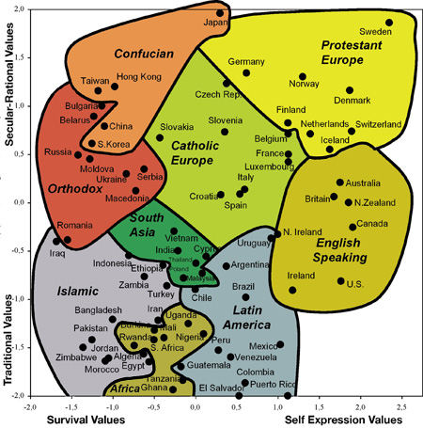

Slide 33
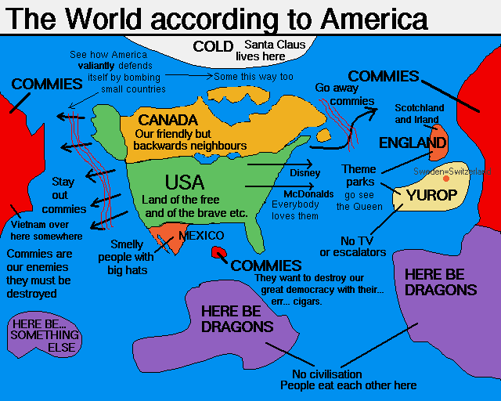

Slide 34
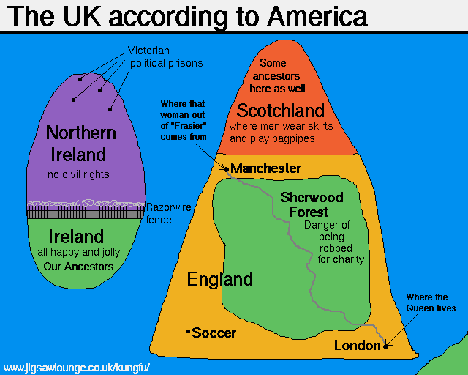

Slide 35
